Slide 1

Working With States to Achieve More College Degrees and Credentials
Presentation to the State of Arkansas
September 25, 2010

Slide 2
Our Current reality
Once first in the world, America now ranks 10th in the percentage of young adults with a college degree.
(Organisation for Economic Cooperation and Development, 2009)
For the first time in our nation’s history, the current generation of college-age Americans will be less educated than their parents’ generation.
(National Center for Higher Education Management Systems, 2008)

Slide 3
Impact on our States and Nation
By the end of this decade, more than 60% of jobs will require college education.
(Georgetown University Center on Education and the Workforce, 2009)
Nationwide, unemployment rates are twice as high for those with just a high school than for those with a college degree.
(Bureau of Labor Statistics, 2009)

Slide 4
The Completion Shortfall
Record enrollment each year: More than 70% start advanced training or education within two years of graduating from high school.
Yet just over half of students who start four-year, full-time bachelor’s degree programs finish in six years.
Fewer than three out of ten students who start at community colleges full-time graduate with an associate degree in three years.

Slide 5
Founded in 2009 with a single focus on working with states to:
Significantly increase the number of students successfully earning degrees and credentials of value in the labor market, and
Close attainment gaps for traditionally underrepresented populations, including minority and low-income young adults.

Slide 6
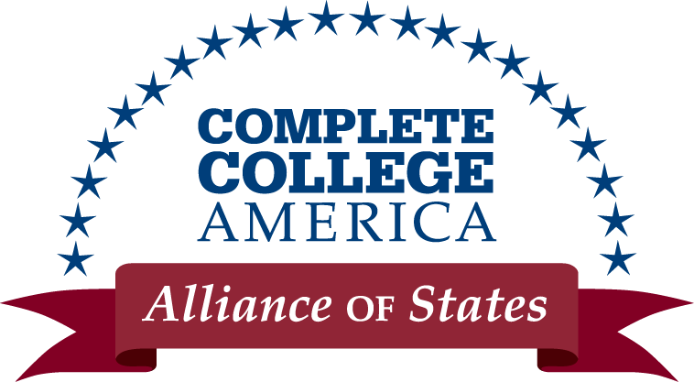
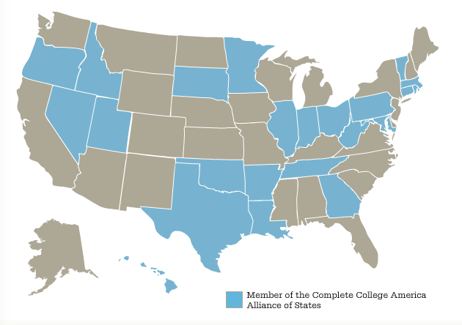
Arkansas
Connecticut
Georgia
Hawai’i
Idaho
Illinois
Indiana
Louisiana
Maryland
Massachusetts
Minnesota
Nevada
Ohio
Oklahoma
Oregon
Pennsylvania
Rhode Island
South Dakota
Tennessee
Texas
Utah
Vermont
West Virginia
23 Charter Members

Slide 7
Alliance Commitments
COMMITMENT TO A NATIONAL GOAL
Significantly increasing the number of students successfully completing college degrees and certificates of value
Closing the college attainment gap for underrepresented populations
COMMITMENT TO STATE AND CAMPUS GOALS
Commit to set state and campus numerical goals to increase completion and close attainment gaps by 2020
COMMITMENT TO MEASURING PROGRESS & SUCCESS
State and campus leaders will pledge to measure and publicly report annual progress on key progression and completion metrics
COMMITMENT TO BOLD ACTION
Ensure all students are ready to start and succeed in freshman credit courses
Redesign remediation strategies to substantially improve success
Reduce time to degree and increase the number of students completing on time
Provide financial incentives to students and colleges for progress
Develop new, shorter and faster pathways to degrees and certificates of value

Slide 8
State and Campus-Level Goals
A strong state goal:
Has broad support
Requires stretching
Preserves access
Has a firm deadline
Is a single, easily explained number
Serves as reference point for campus goals

Slide 9
Metrics that Inform Progress
Purpose of Common Metrics
Inform: To help policymakers and the public understand how students, colleges, and the state are doing on college completion
Analyze: To help policymakers and colleges identify specific challenges and opportunities for improvement
Show Progress: To establish a fair baseline and show progress over time
Hold Accountable: To hold students, colleges, and the state accountable to the public and to policymakers investing taxpayer dollars in higher education

Slide 10
Critical Limitations of Current Data (IPEDS)
No graduation rates for Part-Time Students:
  37% of all college students,
  61% of public two-year college students,
  41% of all black students, and
  48% of all Hispanic students.
No graduation rates for Transfer Students:
  37% of students who earned bachelor’s degrees attended more than one institution; 23% attended more than two
No graduation rates for Low-Income Students:
  Pell grant program represents an $18.4 billion public investment in 6.2 million students (2008-09)—and an additional $36 billion investment announced in recent legislation.
No graduation rates for Remedial Students:
  Around 40% of all students, and 61% of students who start in community colleges, enter needing remedial education.

Slide 11
Metrics that Inform Progress
Outcome Metrics
Indicators of successful outcomes
DEGREES AWARDED ANNUALLY
(# and change over time)
GRADUATION RATES
Progress Metrics
Measures of interim achievements strongly linked to student success
REMEDIATION:
ENTRY and SUCCESS
SUCCESS in FIRST-YEAR COLLEGE COURSES
(1st yr. math and English)
CREDIT ACCUMULATION
RETENTION RATES
TRANSFER RATES
COURSE COMPLETION
TIME and CREDITS to DEGREE

Slide 12
Core Themes in Strategies to
Increase College Completion:
Time
Choice
Structure

Slide 13
Transform Remediation
Adelman, C. (2004)

Slide 14
Transform Remediation
Many students who place into remedial education never enroll in those courses:
Bailey, T., et al (2008)

Slide 15
Ways to Transform Remediation
Tailored Approach:
For students near college-ready: Let them start!
For students one or two levels below college-level: Compress and accelerate remediation
For students significantly behind: Focus on career readiness integrated with basic skills

Slide 16
Accelerate Success
Accelerate success:
Require students to have graduation plans and declare majors early
Improve transfer policies
Develop common course-numbering system
Provide incentives for full-time attendance
Use summers
Use technology to reduce seat time
Expand early credit accumulation
Review programs that exceed 120 credit hours

Slide 17
Restructure Delivery
    Provide greater structure and clearer pathways to completion:
    Block schedules
    Cohort-based programs
    Remediation integrated into college courses
    Use a Core curriculum and fewer electives
    Accelerate: reduce time to degree

Slide 18
Assess and Count Certificates
One year technical certificates of economic value
Embed industry credentials and require third party validation
Publicly report increases in degrees AND certificates annually
Provide financial incentives to increase certificates
Include certificates in attainment goals
Link certificate programs with associate degrees

Slide 19
Shift to Performance Funding
Performance funding should incent outcomes:
Increases in the number of degrees/certificates
Increases in transfer rates
Increases in number of Pell graduates
Increases in courses completed
Meeting progression point benchmarks

Slide 20
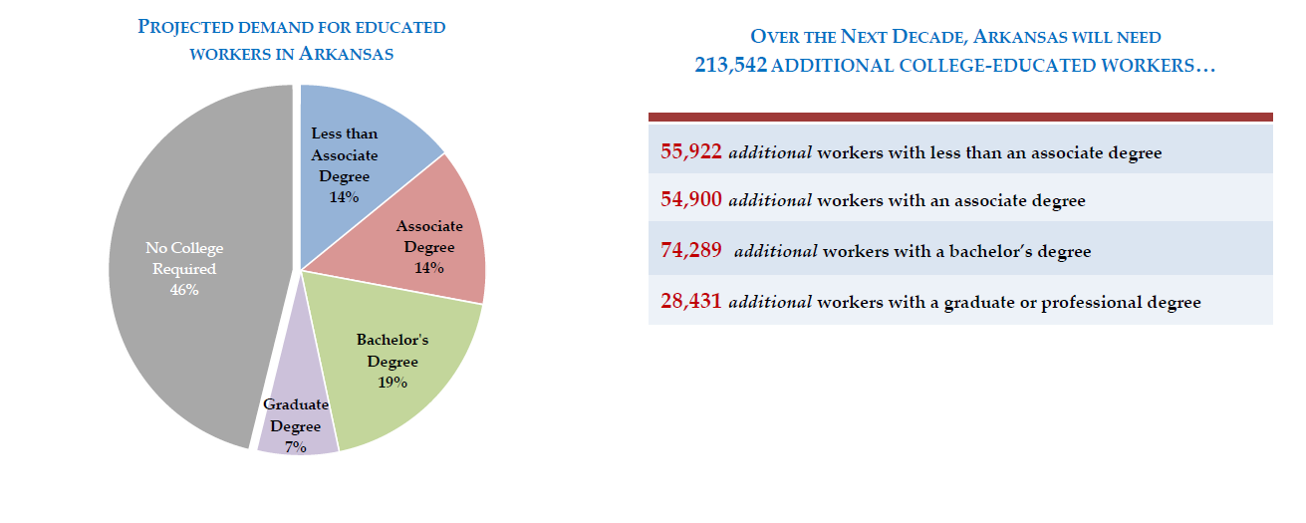
The Challenge in Arkansas
State Job Growth and Education Demands: Employment projections anticipate that 54% of Arkansas’s jobs will require college education by the end of the decade.

Slide 21
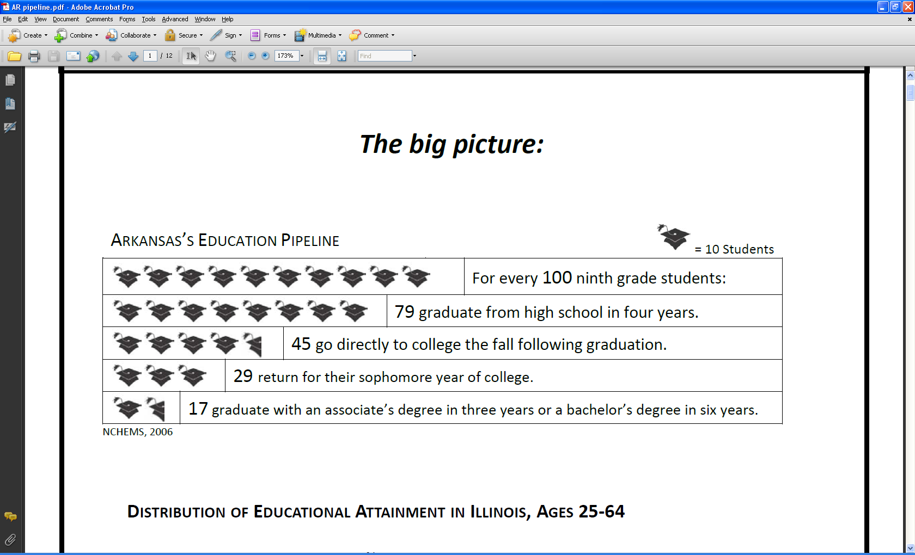
The Challenge in Arkansas
Losing students along the way: Currently, out of every 100 ninth grade students, only 10 graduate from high school, enter college the following fall, persist through college and graduate with a degree within 150% of the normal time (three years for students in community colleges and six years for students in four-year institutions).

Slide 22
The Challenge in Arkansas
Graduation Rates: Arkansas Public Two-Year Colleges
First-time full-time degree-seeking students graduating from four-year institutions within six years.
U.S. Department of Education, National Center for Education Statistics, Integrated Postsecondary Education Data System (IPEDS), 2007

Slide 23
The Challenge in Arkansas
.
Graduation Rates: Arkansas Public Four-Year Colleges
Reported by institutions to NCES Integrated Postsecondary Education Data System (IPEDS). Graduation rates are for first-time, full-time students completing a bachelor’s or equivalent degree within six years. Source: U.S. Department of Education, IPEDS 2007-08 Graduation Rate File; gr2008 Early Release Data File Downloaded 11-05-09; aggregated by NCHEMS

Slide 24
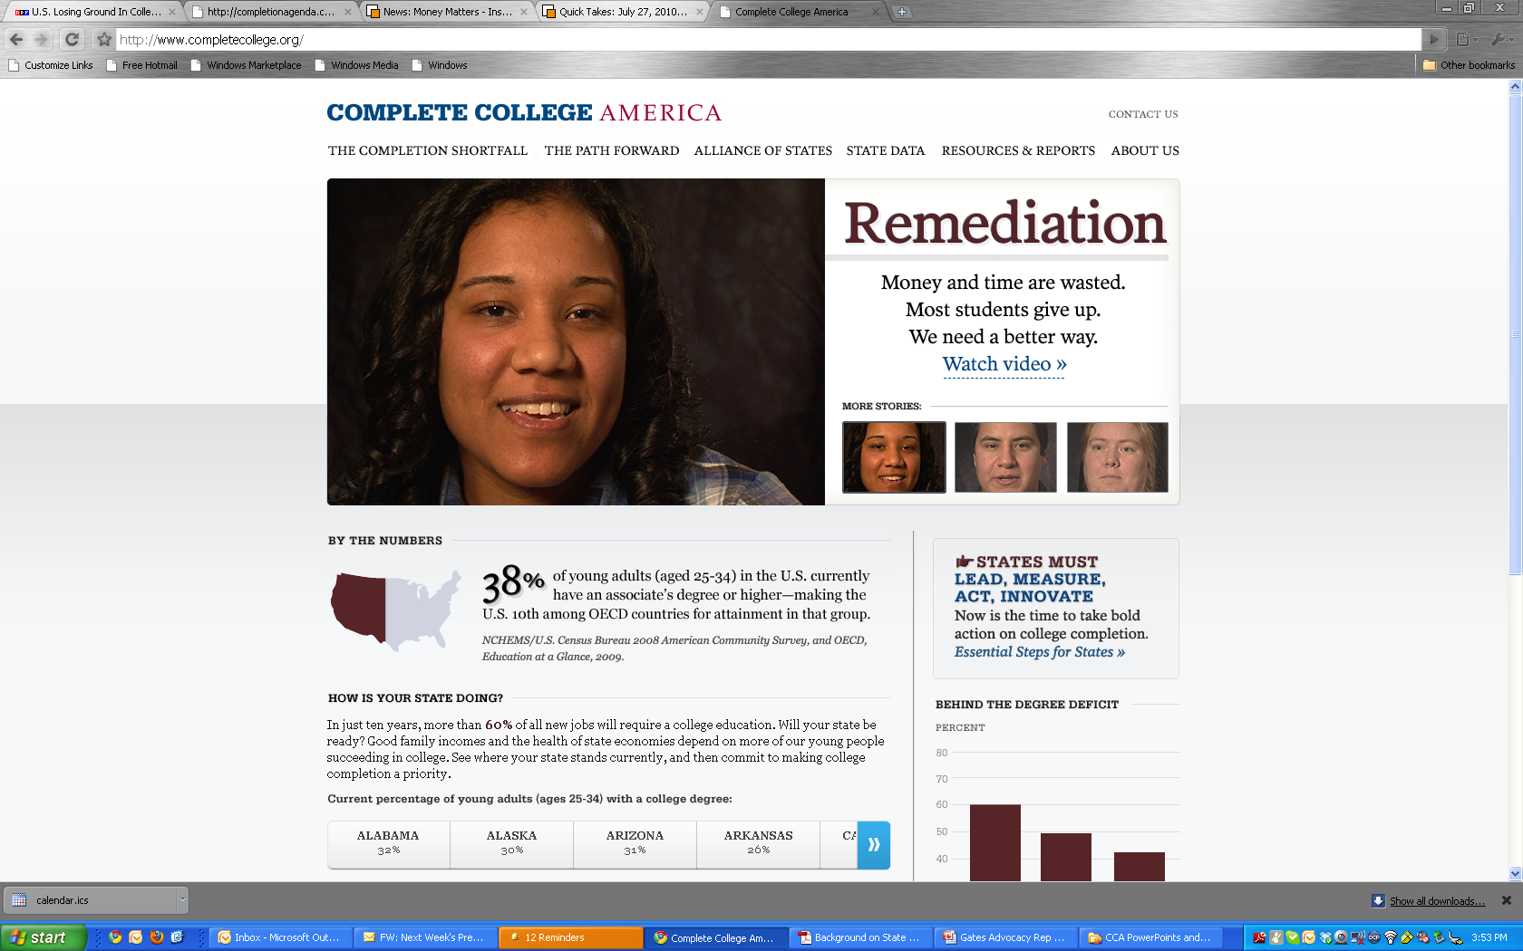
www.completecollege.org

