Slide 1

Arkansas GIS Board
EXHIBIT B
Annual Status Report of the Arkansas Spatial Data Infrastructure to the Joint Committee on Advanced Communications and Information Technology
15-21-503 (i)

Slide 2
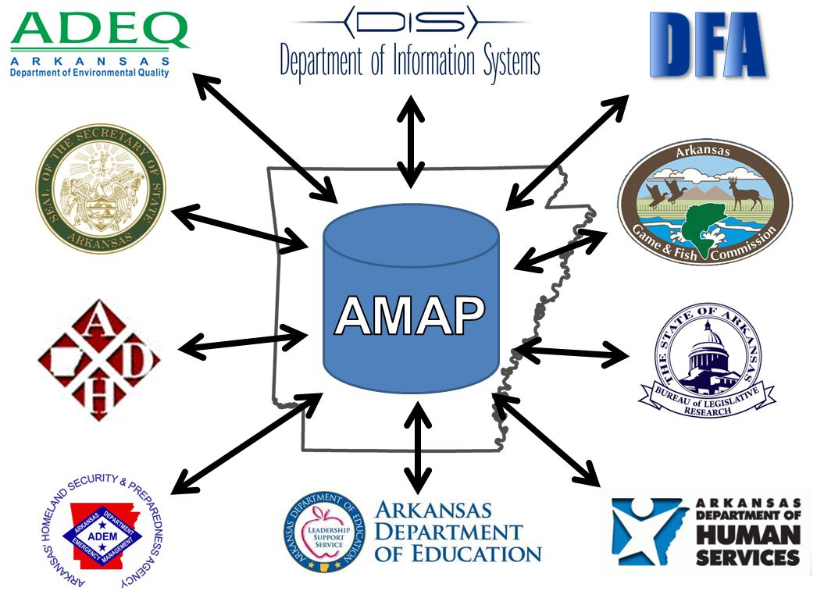
Arkansas Master Address Program (AMAP)
AMAP was started in 2009 as the next, and most important, step in the practical application of information technology that directly and universally affects government business. Simply stated, it is not just an address any more because we live in a digital society that expects government to be effective, efficient, and transparent.

Slide 3

An address is the most redundant piece of information stored by government. That statement leads to the question, how can such a common and inconspicuous piece of information (such as a mapped physical address) be so important to the way we manage government services related to people, places, and events?

Slide 4

Consider the following:
Local government- utilizes a common data model based on 9-1-1 information, postal service delivery addresses, and digital imagery to correct, correlate, and standardize physical address data across the state.
Education- mapping the location of students would allow for better school bus routing which will result in reduced fuel consumption and smarter decision making by state and district officials.
Health and Human Services- mapping the location of constituents would enable administrators to better manage staff and physical resources.
Public Safety- mapping the location of addresses dialed from a landline or mobile phone would enable quicker response times; a proven means of saving lives and property.
Broadband- mapping the location of addresses would allow for better decision making regarding where coverage is needed to insure that all Arkansans have equal access to the internet.
Economic Development- standardization, open access, and accuracy of information make site selection and demographic analysis much easier in Arkansas than in other areas of the country.
Location based services- the information will be ingested by online mapping companies to update base maps for navigation, routing, and advanced logistics.
A master address program will eliminate redundancy and errors, ultimately saving money.

Slide 5
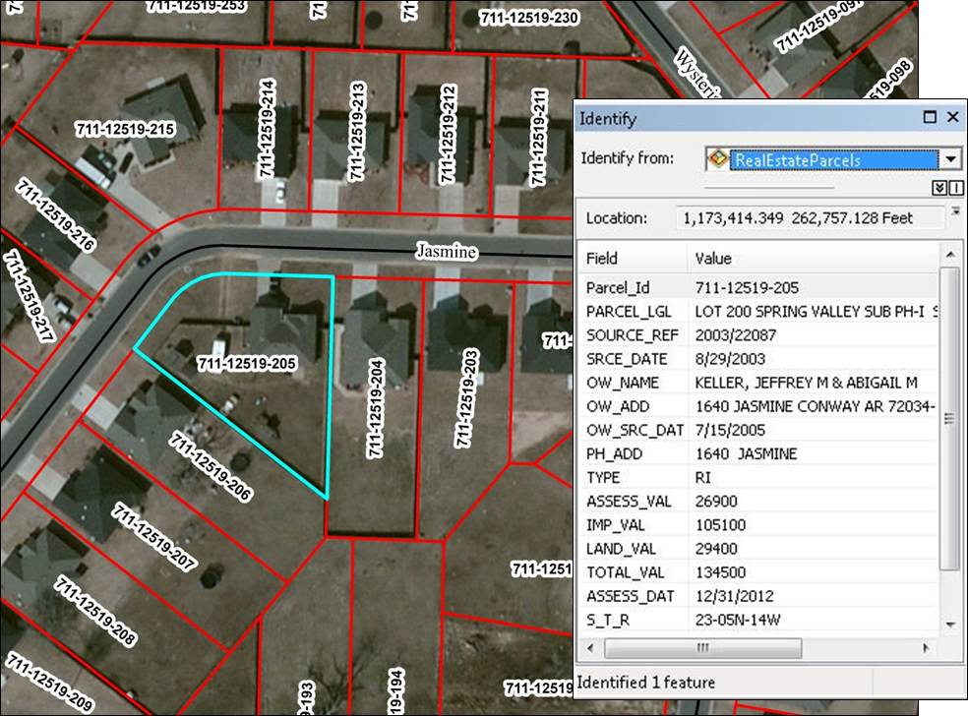
County Assessor Mapping Program
The County Assessor Mapping Program is a cooperative partnership between the Arkansas Assessment Coordination Department, The Arkansas Geographic Information Office (AGIO), and participating counties. Its primary mission focuses on the development of parcel maps in Arkansas.
Parcel mapping creates a digital polygon in a computer system that represents a piece of real estate. This piece of real estate is based on those parcels listed within the counties' tax roll system. Parcel mapping associates a graphic representation of that real estate with its record, from the tax rolls. The program provides training to assist in maintenance and quality control.
Parcels

Slide 6
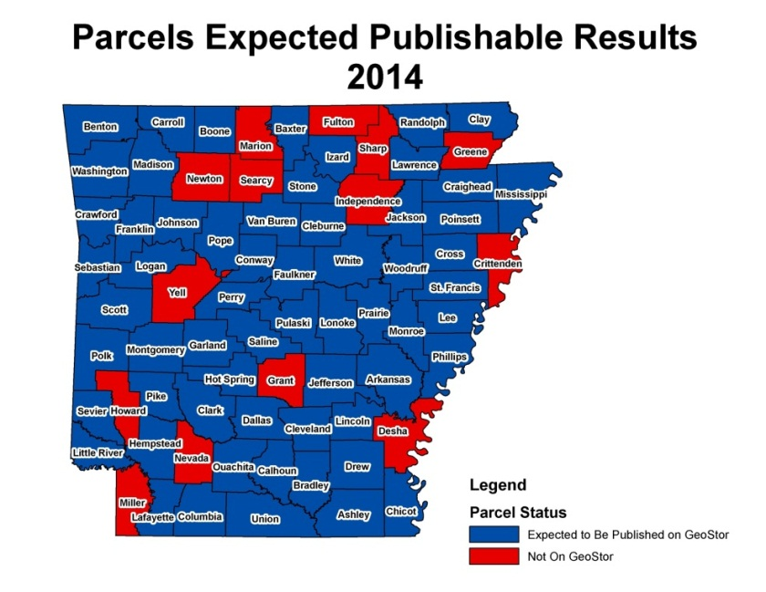
In 2010 the 88th General Assembly with the support of the Governor enacted Act 559 of 2011 that establishes a mechanism and program for parcel mapping in the state. As a result the state has provided partial funding, and received matching funding from 25 counties to assist with digital parcel mapping.
Currently there are 36 counties published on GeoStor.
That number is expected to top 50 counties by the end of the year.

Slide 7
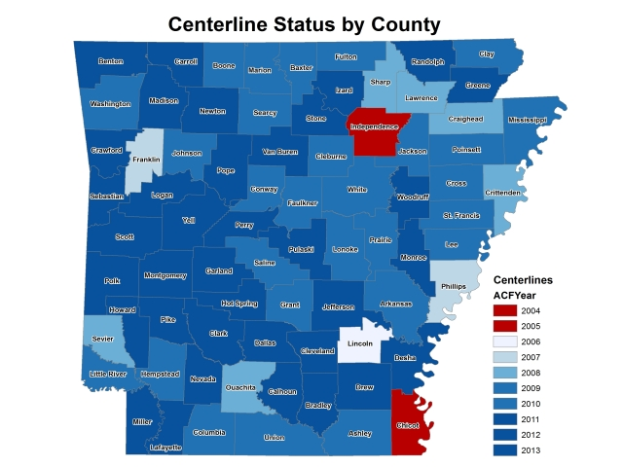
The creation of data for in the state was began in 2002 to provide a standardized road database that can be used by all levels of government, the private sector, and the public. This database contains lines representing roads and names, address range and postal code Maintenance of this database occurs primarily by county 9-1-1 offices. AGIO does not create or develop any of these data; rather, it integrates local sources into a common database. Our staff helps local government agencies with technical facets of maintaining their road databases. This statewide road database has been completed for all of Arkansas’ 75 counties and is available for download through GeoStor℠ at no fee. The road database serves as the backbone for several local government applications, not the least of which is E9-1-1 response.
Road Data

Slide 8
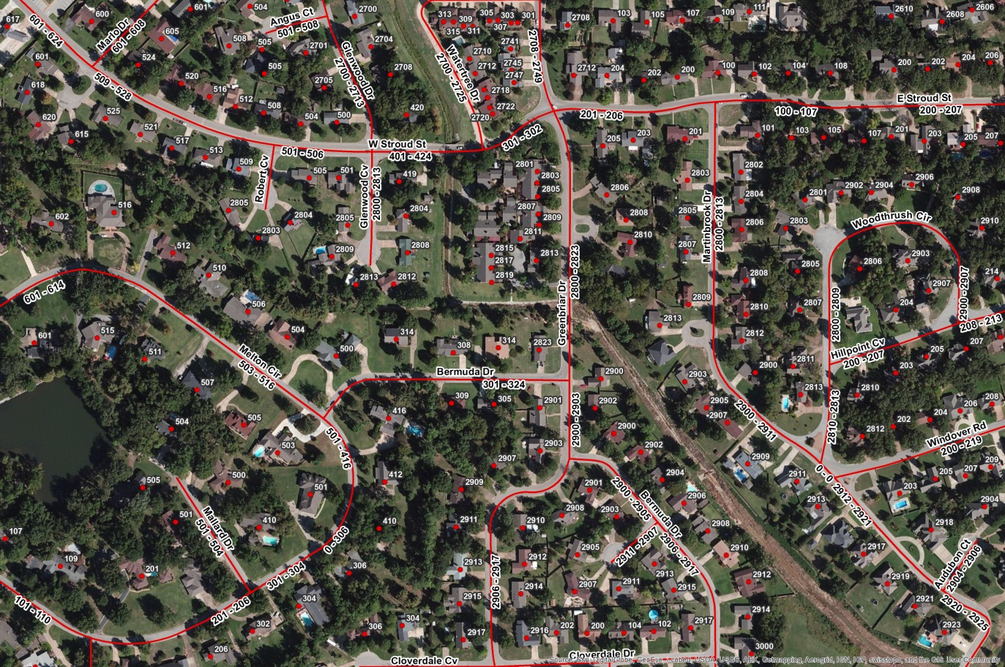
An example of the road database in Jonesboro

Slide 9
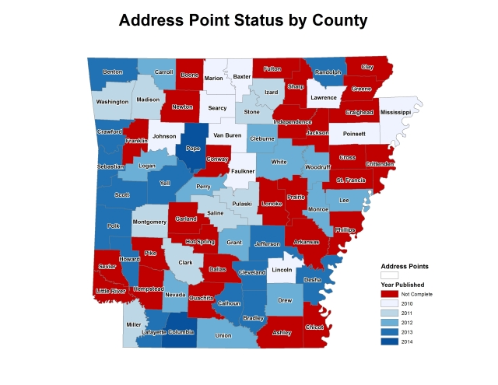
Since 2009, an activity complimentary to the road database has been the development of a physical address point database. This database represents physical address locations and, like the road data, is built by local government partners. Address point data improves emergency response, election administration, revenue generation through the Streamlined Sales and Use Tax initiative, and economic development. Our long range goal for the data is to:
The physical address point database currently has completed data for 48 of Arkansas’ 75 counties and is also available for download through GeoStor℠ at no fee to internet users.
Physical Address Data
Improve accuracy
Update the data on a more frequent basis
Support local maintenance
Moving counties toward digital records instead of paper

Slide 10
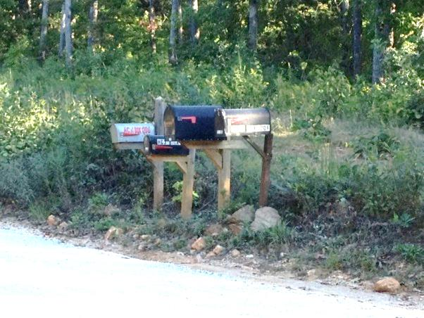

Accurate mapping helps solve problems like mailboxes in one precinct and the residence in the other.
Moving counties to converting paper records into digital records

Slide 11
Beginning in 2011, AGIO began work on the State Broadband Data and Development project with Connect Arkansas. When complete at the end of 2014, this project will have added physical address point data for 36 counties into a growing statewide database. Through the project, AGIO will be able to pass along over $300,000 in federally sourced grant funds to the participating counties.

Slide 12
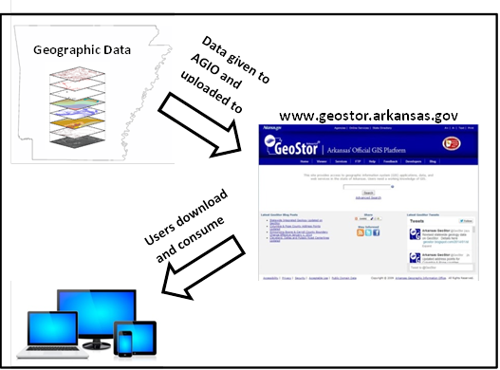
GeoStor
GeoStor is a database that stores geographic data about Arkansas. It was created in 1999 out of the need for a single statewide database to cut down on the duplication of data creation and dissemination. This data is gathered from entities across the state. AGIO gathers and uploads the data to GeoStor. Users can access GeoStor www.geostor.arkansas.gov Here, they are able to search for the data and download it to their own computer. All the data on GeoStor is accessible to the public at no fee. Common users of GeoStor include assessors, legislative offices, 9-1-1 coordinators, engineering firms, surveyors, lawyers, universities, K-12 schools, economic developers, and all levels of government. GeoStor also serves as a platform for geographic applications.

Slide 13
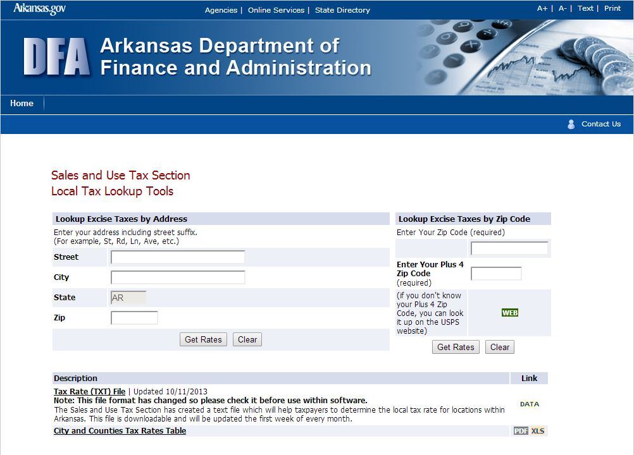
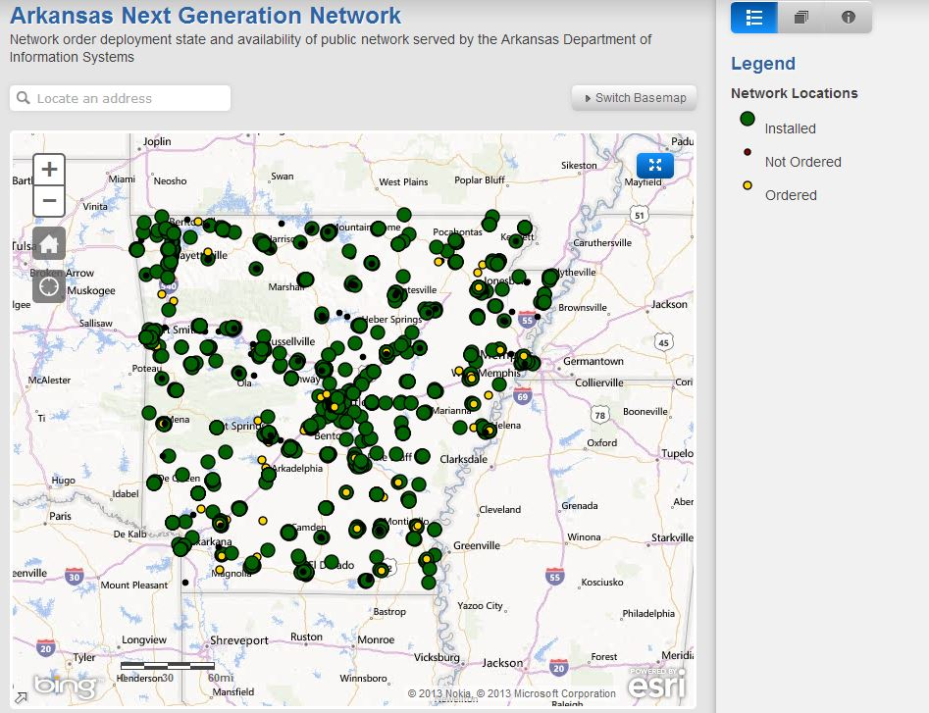
DFA Streamlined Sales and Use Tax Lookup
DIS Next Generation Broadband App

Slide 14























2,735 datasets downloaded in the last 6 months
GeoStor Usage
350 different datasets
43,972 visitors last year
Last year top ten by country and city:
21,020 were return visits

Slide 15
Totaling: $2,945,000 in funding needed for data and $200,000 for replacement of hardware
Strategic Goals
To provide recurring funding for continual investment and improvement of the Arkansas Spatial Data Infrastructure which would include:
Recurring, annual orthophotography (i.e. digital aerial imagery): $1,167,000 annually
Completion of statewide parcels: $1,503,000 annually for five years
Political and administrative boundary data improvement: $75,000 annually
Road and address data update and maintenance: $200,000 annually
Replacement of GeoStor hardware - $200,000 one-time cost

Slide 16
Arkansas Geographic Information Office (AGIO)
Big Mac Building
1 Capitol Mall
6th floor
Little Rock, AR 72201
Phone: (501) 682-2758
Fax: (501) 682-6077
Website: www.gis.state.ar.us
www.geostor.arkansas.gov
AGIO is on call to assist members with any GIS analysis.

