Slide 1
History of University Funding Formula
Universities wanted a need-based formula that would give every institution the same funding for the same course credit.
Previously, model calculations were based upon faculty salaries per SREB designation of the institutions.
For example, the funding for freshman English at UAF (SREB Level 1) would have been calculated differently than UAPB (SREB Level 6).

Slide 2
Developing the new funding formula
After 2001 ADHE began work on developing a formula that would be
Equitable, simple, and stable
Effective and efficient
Responsive to change
Sensitive to different missions
Replicable data
Supportive of State Goals, and
Sensitive to Special-purposes (medical, research, public service, agri., etc.

Slide 3
3 Formula-Driven Models
University Funding Model
Two Year College Funding Model
Technical Schools Funding Model

Slide 4
The University Funding Model
Was developed based upon empirical data derived from the study of the costs of each academic discipline in more than 450 universities over a 15 year period. The standards and classifications of costs in the formula are based on that study.
The formula is driven from data derived from
  Actual production of Student Semester Credit Hours and
  Square footage.

Slide 5
Component of the Model (4 Year)
SSCH/FTE-Based Functions:
Teaching Salaries Other Instructional Costs
Library Cost General Institutional Support
Research Public Service
Square Footage-Based: Facilities Maintenance and Operations
Special Missions: Traditional Minority Mission (HBCU) - Land Grant Mission
Diseconomy of Scale: Institutional Support & Other Instructional Costs for less than 3,500 FTE

Slide 6
Components based on SSCH
Teaching Salaries: Determine the number of faculty needed (SSCH by discipline and level)
Other Instructional Costs: 45% of teaching salaries
General Institutional Support: 54% of Teaching Salaries and Other Instructional Costs
Library: 11% of Teaching Salaries and other instructional costs
Research: 5% of undergraduate level teaching salaries generated; 25% of graduate level teaching salaries generated; 50% of doctoral level teaching salaries generated
Public Service: 3% of Teaching Salaries

Slide 7
Component Based on Square Footage
Maintenance and Operations
Calculation of Funding Needs:
Excess/Shortage Sq. Ft. = Total Sq. Ft. – Model Sq. Ft.
The needed square feet produced by the model will be funded at a set dollar amount per square foot.
Excess/shortage square feet will be funded at a lesser dollar amount per square foot.

Slide 8
Special Missions
Calculation:
Federal Land Grant Institution = 10% of Teaching Salaries
Traditional Minority Institution = 15% of FTE based Funding

Slide 9
Component Based on FTE
Diseconomy of Scale
An institution receives additional funding if its student FTE enrollment is less than 3,500.

Slide 10
Total Need
Teaching Salaries + Instructional Costs + Library Costs + General Institutional Costs + Research + Public Service + M&O + Special Purpose + Diseconomies of Scale
    = Total NEED

Slide 11
State Need
Total Need
less Tuition and fees
=State Need

Slide 12
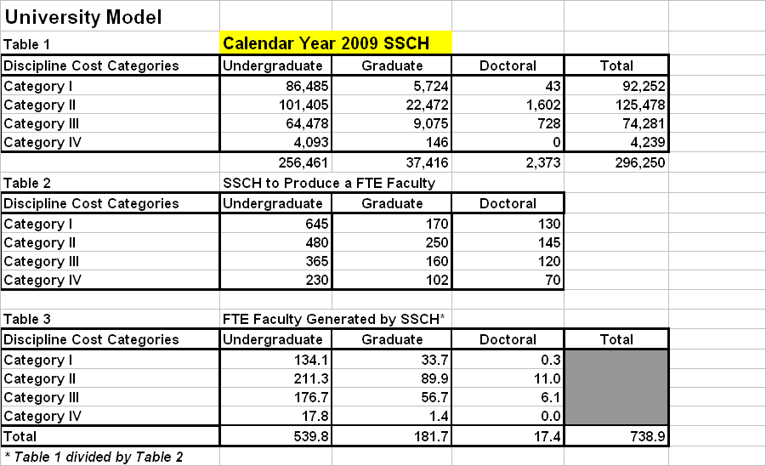
University Model (Faculty Calculation)

Slide 13
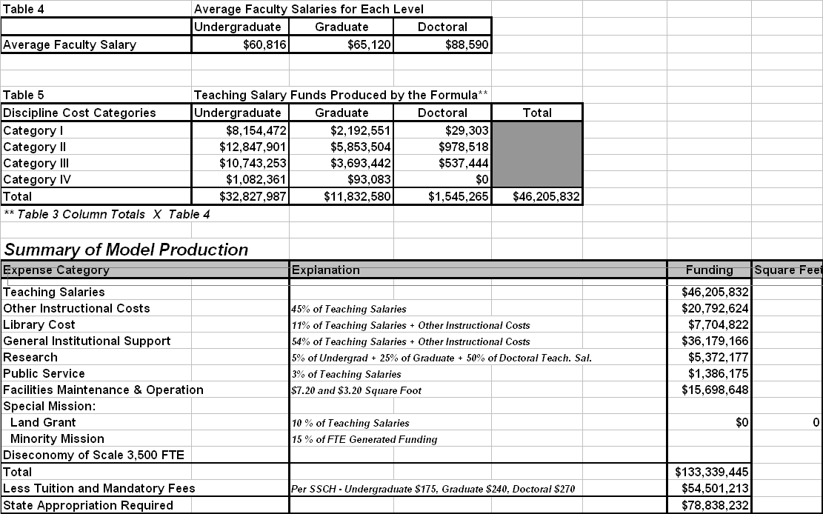
University Model

Slide 14
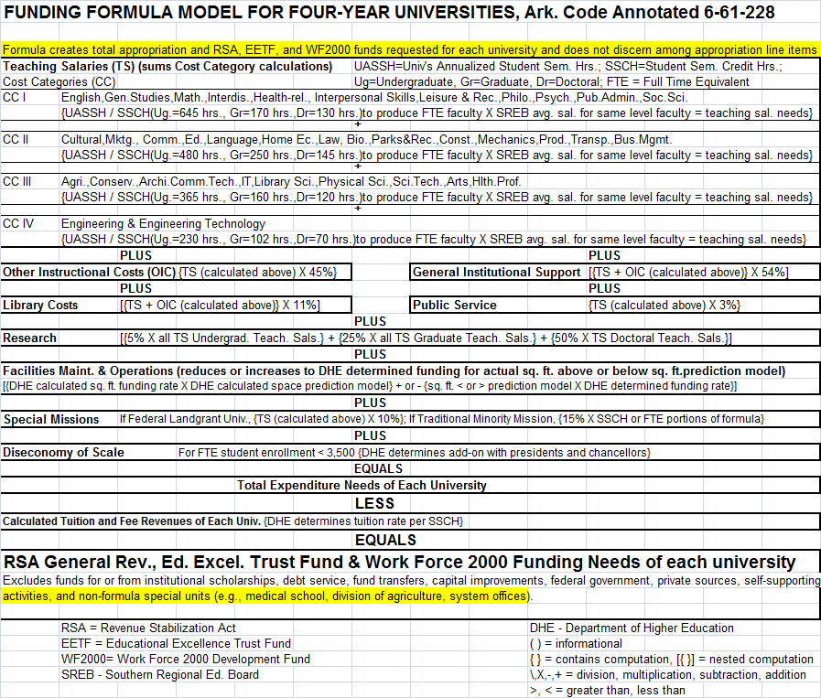
Funding Model (4 Year)
The University Funding Formula

Slide 15
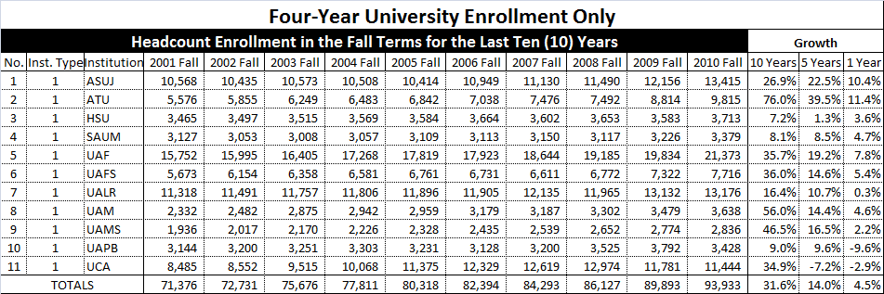
Four-Year University Enrollment

Slide 16
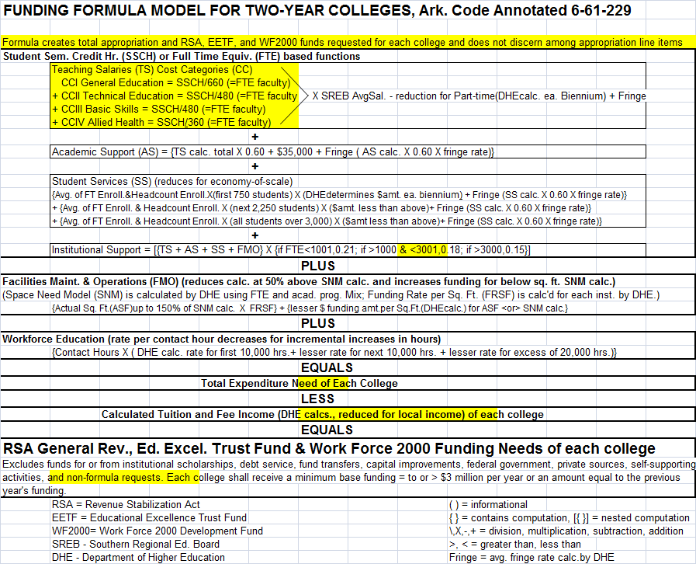
Funding Model (2 Year)

Slide 17
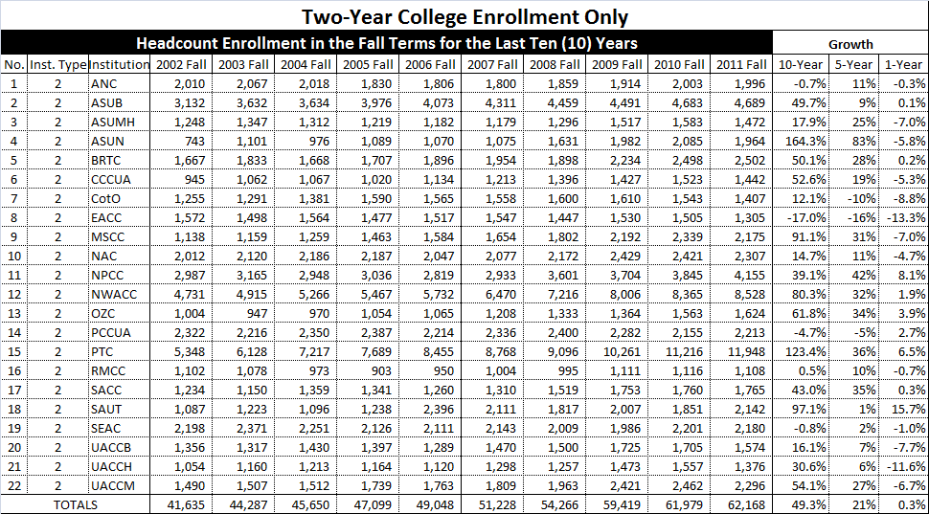
Two-Year College Enrollment

Slide 18
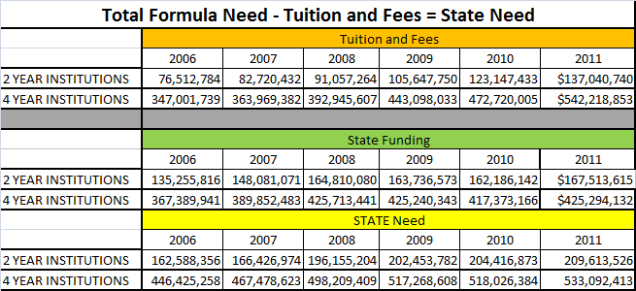
Tuition/State Need/State Funding

Slide 19
Four Year Graph

Slide 20
Two Year Graph

Slide 21
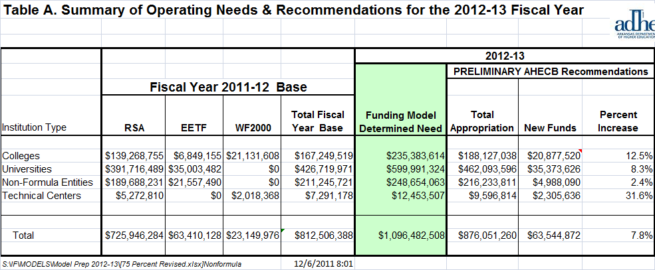
Operating Recommendation
2012-2013 (75% Need)

Slide 22
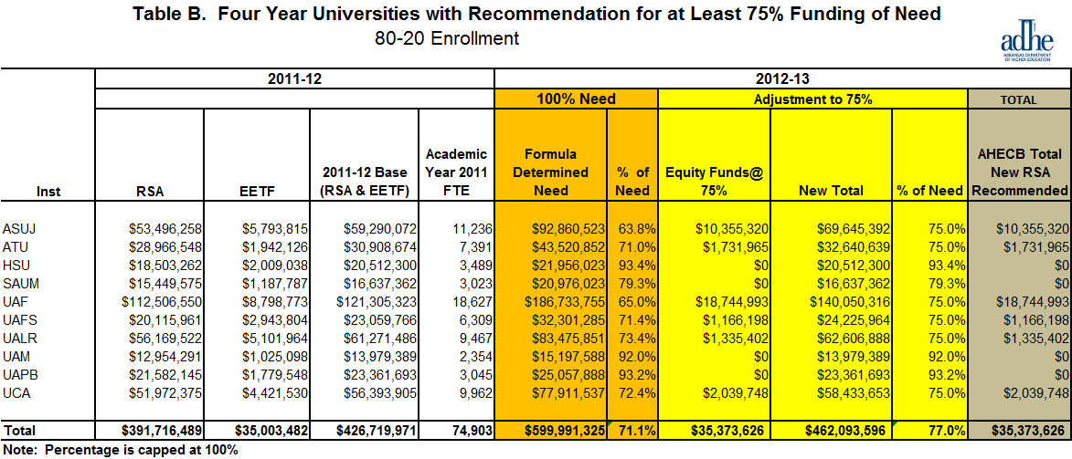
Operating Recommendation (4 Yr)
2012-2013 (75% Need)

Slide 23
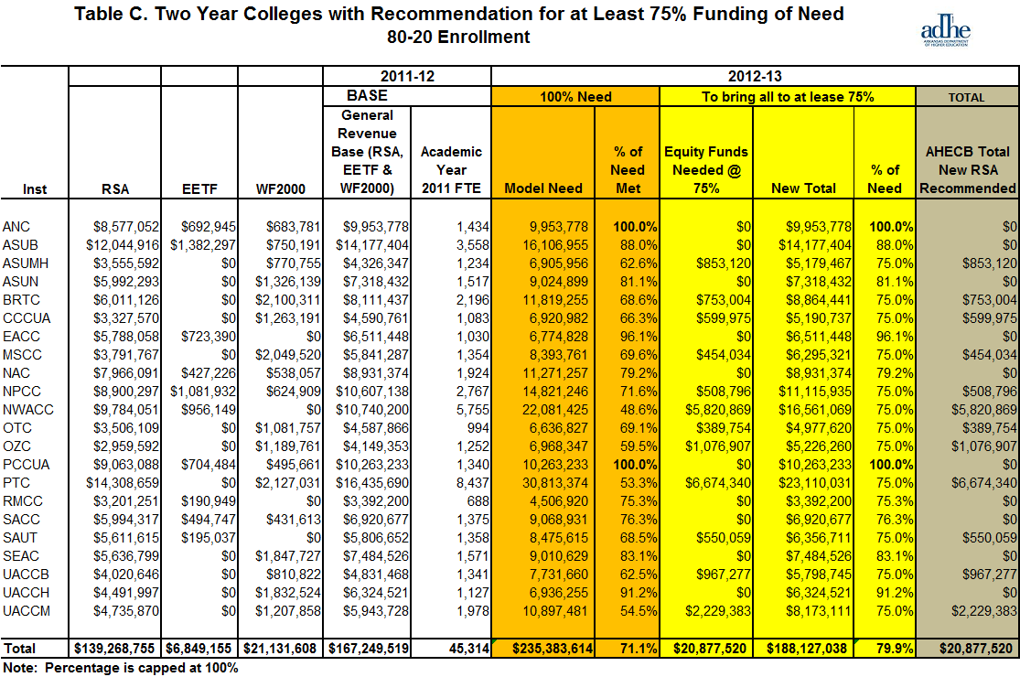
Operating Recommendation (2 Yr)
2012-2013 (75% Need)

Slide 24
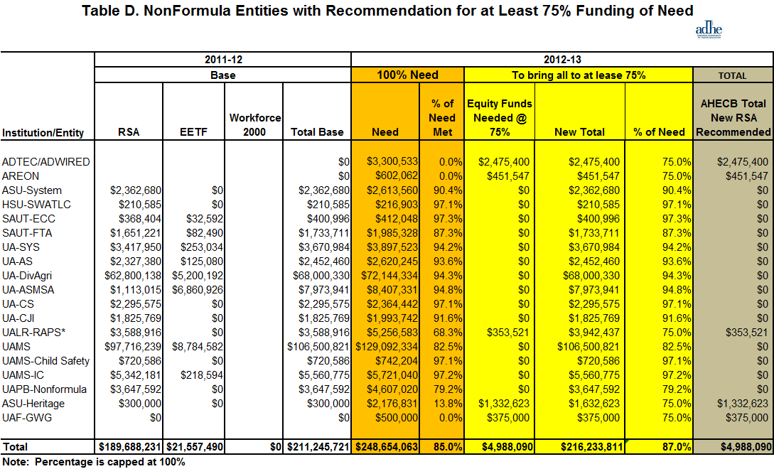
Operating Recommendation (Nonformula)
2012-2013 (75% Need)

Slide 25
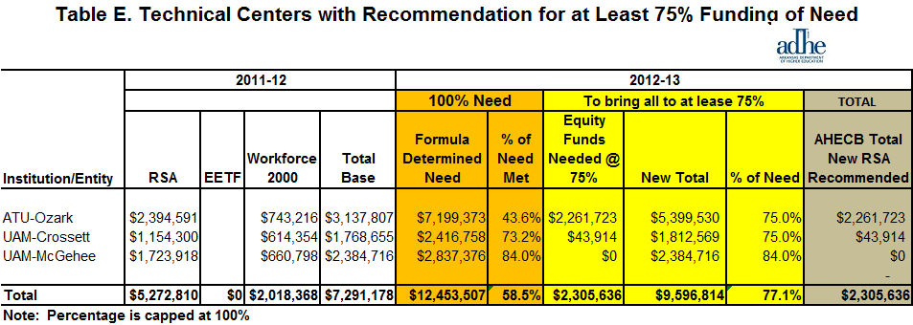
Operating Recommendation (Technical Ctr)
2012-2013 (75% Need)

Slide 26
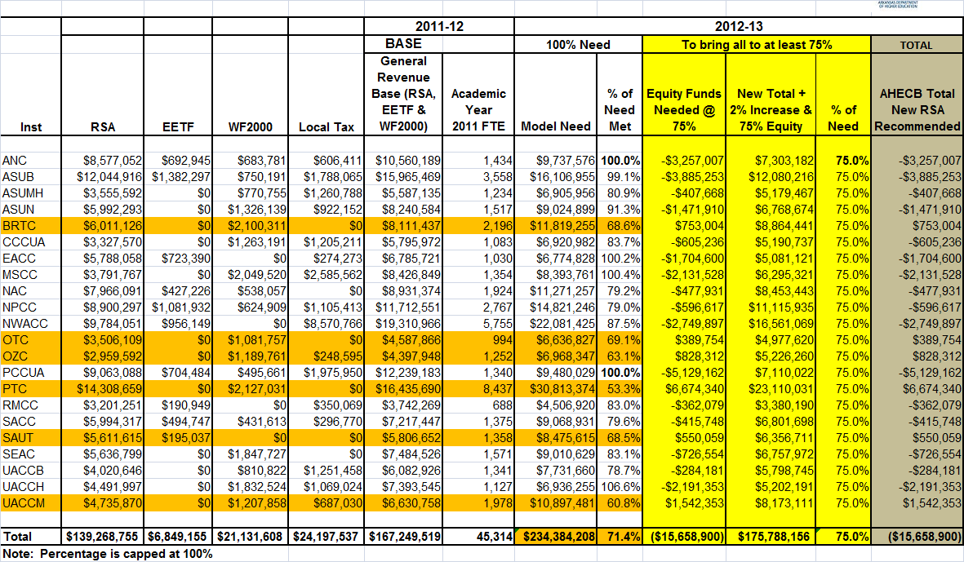
All Sources of Revenue (E&G)

Slide 27
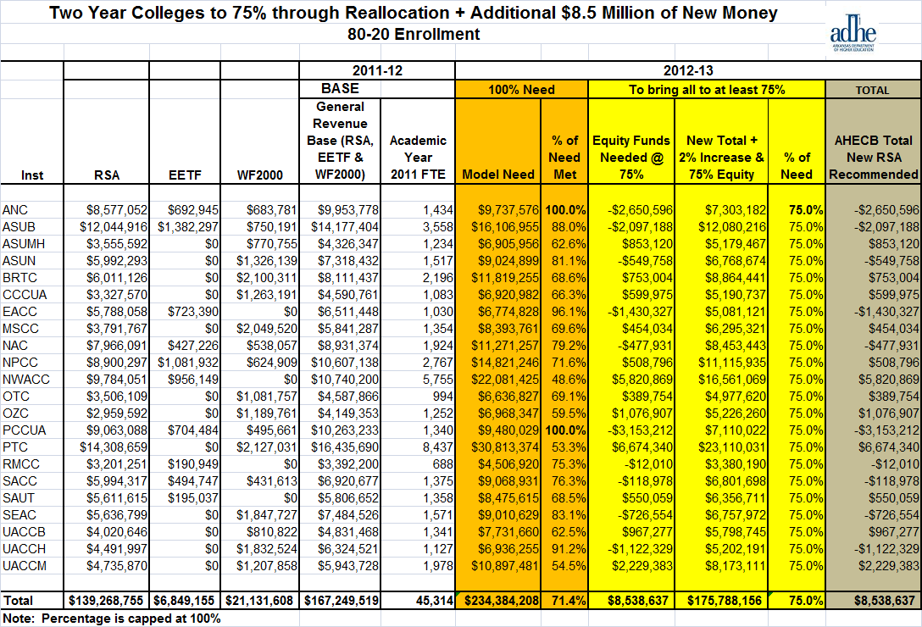
With 8.5 Million New Money and 75% Funding

Slide 28
Formula Definitions

