Slide 1

Autism Center of Excellence at
Arkansas Children’s Hospital

Slide 2
The Complexities of Autism

Slide 3

Autism
Genetics
Body
Chemistry
(Physiology)

Slide 4
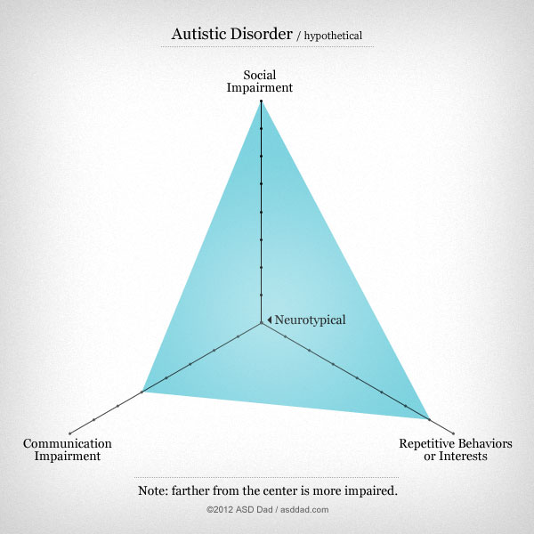

Slide 5
The Etiology of Autism: More than Genetic Disorders
Estimated Prevalence of Genetic Abnormalities
Cytogenetic Abnormalities 5%
Fragile X 5%
Rett Syndrome (Females only) 5% (~1% overall)
Chromosomal Microarray 10%
Total 21%
This leaves about 79%+ children with ASD without an identified genetic diagnosis.
Some resources suggest that once a genetic diagnosis is found, the investigation into other physiological abnormalities can stop. Rett syndrome will be used to demonstrate why this is a detrimental approach to take.
(Schaefer and Mendelson, Genetics in Medicine, 2013)

Slide 6
Common Themes Have Emerged in Autism Research
Multiple Physiological Systems Are Affected in Autism
Immune Dysregulation
Detoxification abnormalities
Sensitivity to Environmental exposures
Redox regulation/oxidative stress
Epigenetic Changes
Mitochondrial Dysfunction
How do they all fit together?

Slide 7
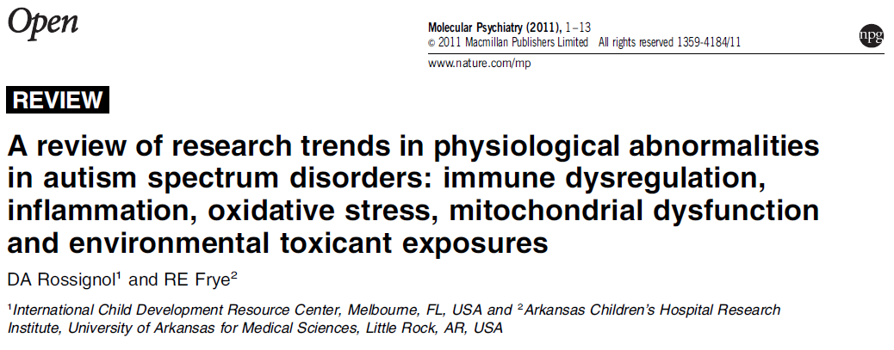
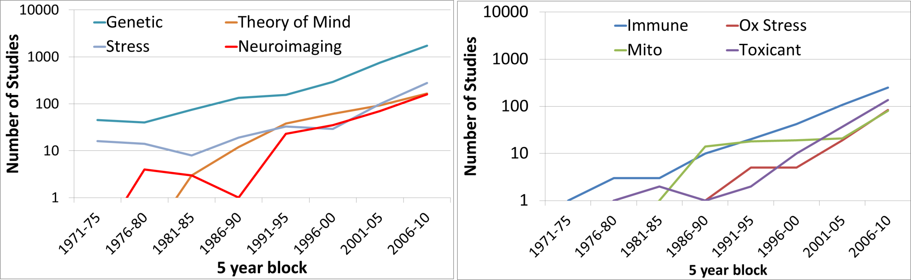

Slide 8
Clinical Programs

Slide 9
Outreach Programs
Clinical Programs
Translational Programs
Research Program
Education and Resource Center
Multidisciplinary
Clinic
Clinical Trials
Redox Regulation / Oxidative Stress
ATN/DDC
Community Outreach
Program
Autism
Model Development
Mitochondrial Function
Inpatient
Consults
Advocacy
Program
High-Risk
Pre and Post-natal
Clinic
Biomarker
Development
Immune Regulation / Inflammation
Medical
Educational
Programs
Professional
Medical
Training
Integrative
Autism
Seminars

Slide 10
Autism Multidisciplinary Clinic
Meets every Tuesday morning in the neurosciences clinic
Specialties Represented
  Neurology
  Genetic / Metabolism
  Gastrointestinal
  Nutrition
  Research
Patient stays in room and specialties rotate in/out of the room
Coordinating Clinical Conference Every Thursday morning 8am in Genetics Conference Room

Slide 11
Autism Multidisciplinary Clinic
Future Specialties
  Sleep Medicine
  Immunology
  Allergy
  Rheumatology
  Epilepsy
Future goal is for clinic to be integrated with the Autism Translational Research Center so children are familiar with space. Will be designed to be a low stimulating environment

Slide 12
Wait List
Reputation
We Have Become a National Referral Center for children with Autism
We regularly have International patients
Our Reputation helps the recognition of Arkansas and Arkansas Children's Hospital
New patients scheduled = 232
First available = 03/28/2017
Follow-up patients scheduled = 328
First available = 10/03/2017

Slide 13
High-Risk Clinic Overview
Identify High Risk Pregnancy
Prenatal Care in High Risk Clinic
Pediatric Care in High Risk Clinic
Future Clinic Integrated with High Risk Women’s Health Programs to monitor high risk Pregnancies.
Enrolls Women planning to become pregnant and currently pregnant
Follows women throughout pregnancy with psychiatric and biomarker collection (serum, saliva, urine)
Obtains samples biological assessments on dad (when available)
Obtains cord blood at birth and follows child’s development
Obtains psychiatric assessments of siblings

Slide 14
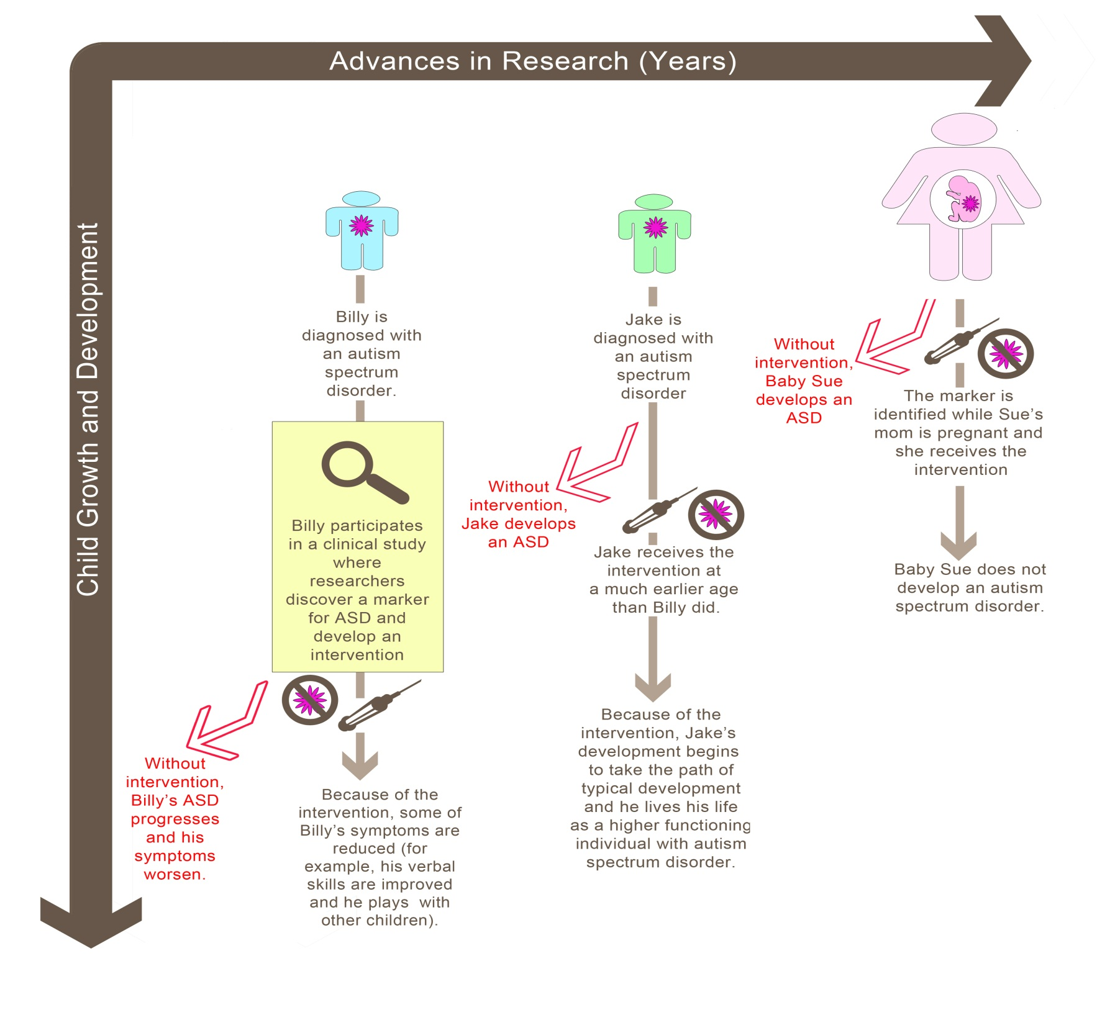

Slide 15
Pioneering Research
Leading to
Novel Treatments

Slide 16
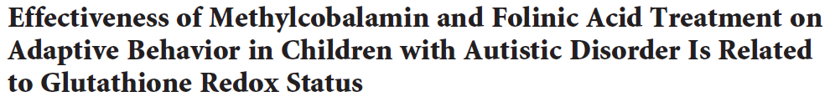


Vineland Subscale | Baseline Age Equivalent Months (mean ± SE) | Post-Intervention Age Equivalent Months (mean ± SE) | Change (months) (mean; 95% C I)
Receptive Language | 23.1 ± 1.8 | 31.4 ± 3.4 | 8.3 (2.9, 13.7)
Expressive Language | 20.6 ± 1.9 | 27.5 ± 2.9 | 6.0 (3.3,9.4)
Written Language | 40.5 ± 3.8 | 46.7 ± 4.0 | 6.2 (3.4, 9.0)
Personal Skills | 30.5 ± 2.3 | 40.5 ± 3.8 | 10.0 (3.8, 16.2)
Domestic Skills | 30.3 ± 4.1 | 39.3 ± 5.9 | 9.0 (-1.4, 19.4)
Community Skills | 32.9 ± 2.9 | 36.1 ± 3.8 | 2.0 (-3.0, 6.9)
Interpersonal Skills | 18.7 ± 2.7 | 24.1 ± 3.9 | 5.4 (0.0, 10.9)
Play/Leisure Skills | 22.0 ± 4.5 | 34.0 ± 4.1 | 12.0 (4.1, 19.6)
Coping Skills | 25.8 ± 2.5 | 34.3 ± 4.0 | 11.5 (4.9, 18.0)

Slide 17
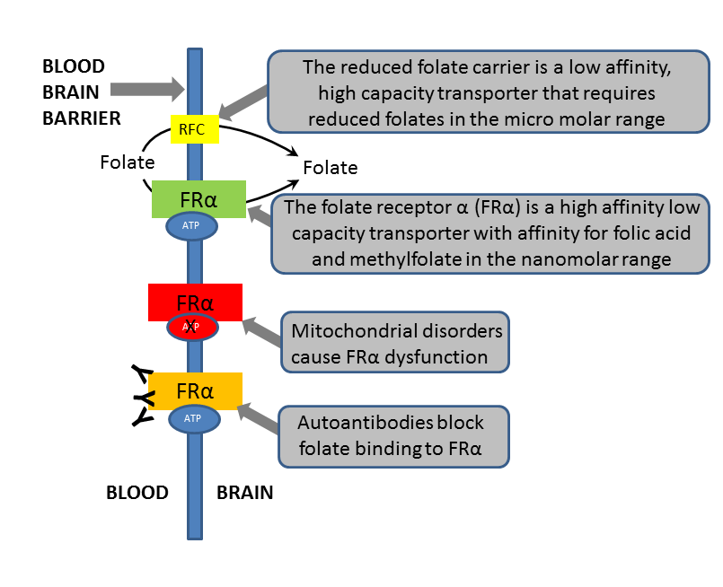

Slide 18
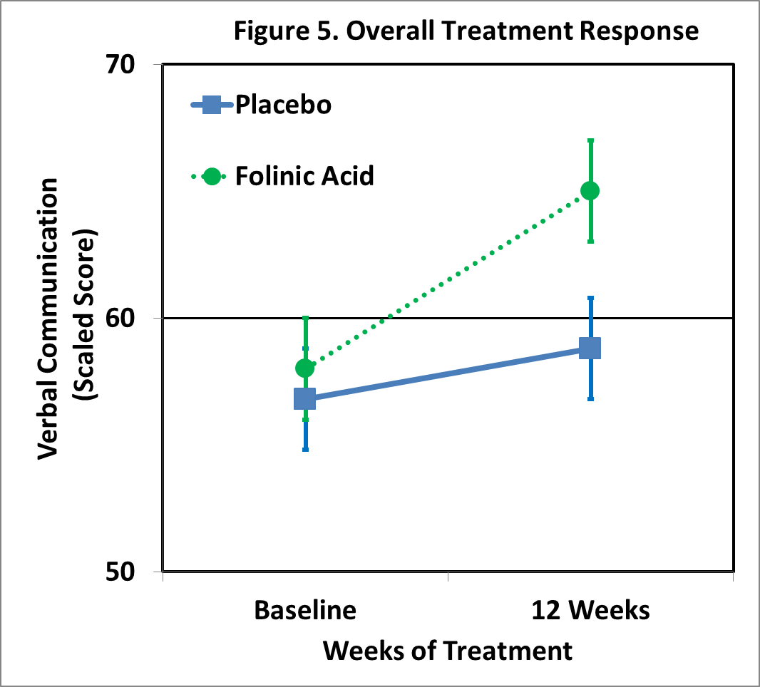

Slide 19
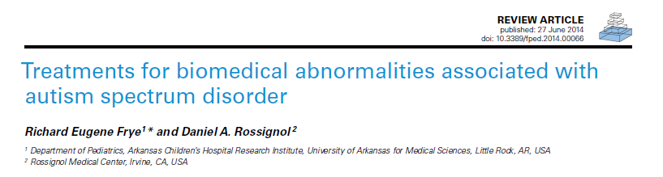
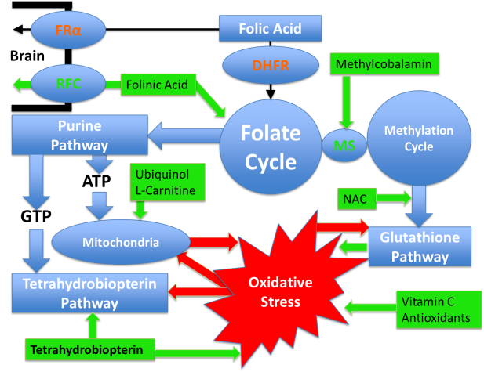

Slide 20
