Slide 1
SFY 2022-23 Biennium
Agency Overview

Slide 2


DHS
SFY 2021 Budgeted Position Breakdown
7,484
8,231 Authorized
SFY 2022-23 Biennium

Slide 3
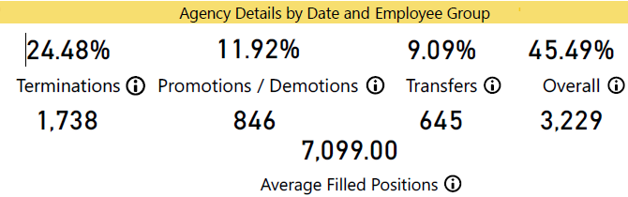
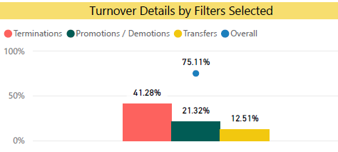
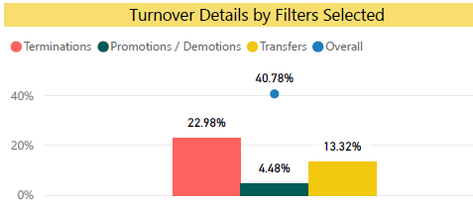
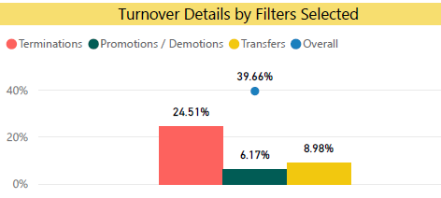
DHS
Personnel Turnover
Turnover – FY20
DDS – HDC’s
DAABH – AHC & ASH
DCFS – Field Staff
SFY 2022-23 Biennium

Slide 4
Activity Reflected in the Budget
  Launch of Arkansas Integrated Eligibility System (ARIES)
  Development of Comprehensive Child Welfare Information System (CCWIS)
  Residential Option for Adolescents in Recovery (ROAR)
    Intensive residential substance abuse treatment when a DYS commitment is not in the juvenile’s best interest
  Continued focus on DYS community-based services
    DYS shifted $1.75 million from residential services to community-based services in SFY21
  Human development center staff restructuring
    DDS will shift 1,244 positions to require CNA certification
    DDS will also increase the RN to LPN ratio
SFY 2022-23 Biennium

Slide 5
Activity Reflected in the Budget
  Addition of 700 Slots to CES Waiver (often referred to as the “DD Waitlist”)
  Physician Rate and Personal Care Rate increases
    Ambulance
    ADT / EIDT
    DME Reduction to Medicare Cost
    Pharmacy Administered Vaccines
  Additional Vaccine and Lab Cost for Covid-19
  Annual Rate Adjustments for Provider Groups
    Nursing Home
    Hospice
  Increases in Medicare Rates impacting supplemental costs and Medicaid cost sharing
  Renewal of Arkansas Works Waiver
SFY 2022-23 Biennium

Slide 6
Budget Risks
  Potential rise in the number of foster children in DHS custody
  Trend changes in the number of juveniles committed to DYS custody
  Economic conditions
  Litigation
    ACA decision in California v. Texas
  Continuation of the federal COVID-19 Public Health Emergency
    The state receives an enhanced FMAP during the PHE but is required to maintain Medicaid enrollment as well
  New biologics and other specialty drugs
  Arkansas Works Demonstration continuation
SFY 2022-23 Biennium

Slide 7
FMAP Assumptions
SFY 2022-23 Biennium

Slide 8
FMAP Assumptions With Enhanced FMAP During PHE
SFY 2022-23 Biennium

Slide 9

Enrollment Since Public Health Emergency Began
Children
25,274 Added
ARWorks
39,266 Added
Adults
16,606 Added
SFY 2022-23 Biennium

Slide 10


Medicaid Funding Flow Over Biennial
State Share to State Funds Comparison ($M)
SFY 2021
SFY 2022
SFY 2023
SFY 2022-23 Biennium

Slide 11






Find Us On . . .
@ArkDHS
@arkansasdhs
@ARHumanServices
ARHumanServices
humanservices.arkansas.gov

Slide 12


Title Line
We Care. We Act. We Change Lives.
humanservices.arkansas.gov

