Slide 1
Weiss Memo, Cost Containment and Tuition increases
Jim Purcell
ADHE

Slide 2
Weiss Memo
Does the Director of DFA have authority to tell Colleges and Universities when or when not to give raises to their employees?
  I am not a lawyer.
  The memo gives good advice in these tough economic times.
  I personally agree with the memo.
Campus leaders who called ADHE for our interpretation have been advised that they should have a conversation with Director Weiss and his staff if they have questions about any action that is contrary to the memo’s intent. . .
beforehand.

Slide 3
Weiss Memo
Institutional Questions:
Can we give raises to non classified employees?
Can we complete the pay plan implementation for classified?
What about lifetime service raises, etc?
Campus leaders should have a conversation with Director Weiss and his staff if they have questions about any action that is contrary to the memo’s intent.

Slide 4
Funding Available and Pay Plan Costs

Slide 5
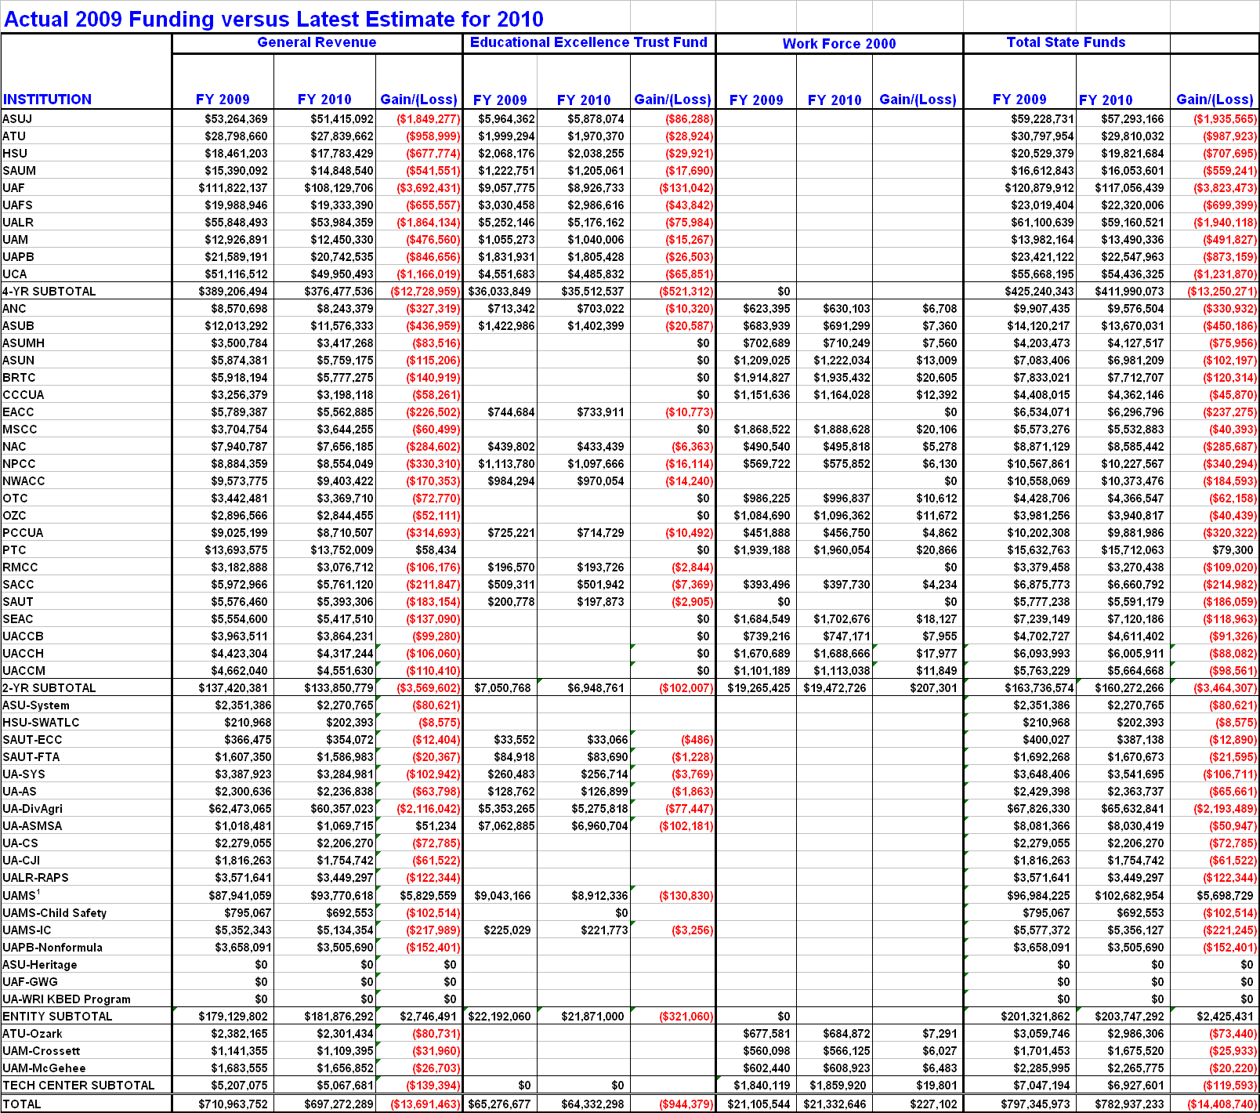
Includes $9,350,000 in Tobacco Tax Funds for Trauma Centers
Without Trauma Center Funds the loss would be (-$23,758,740)

Slide 6
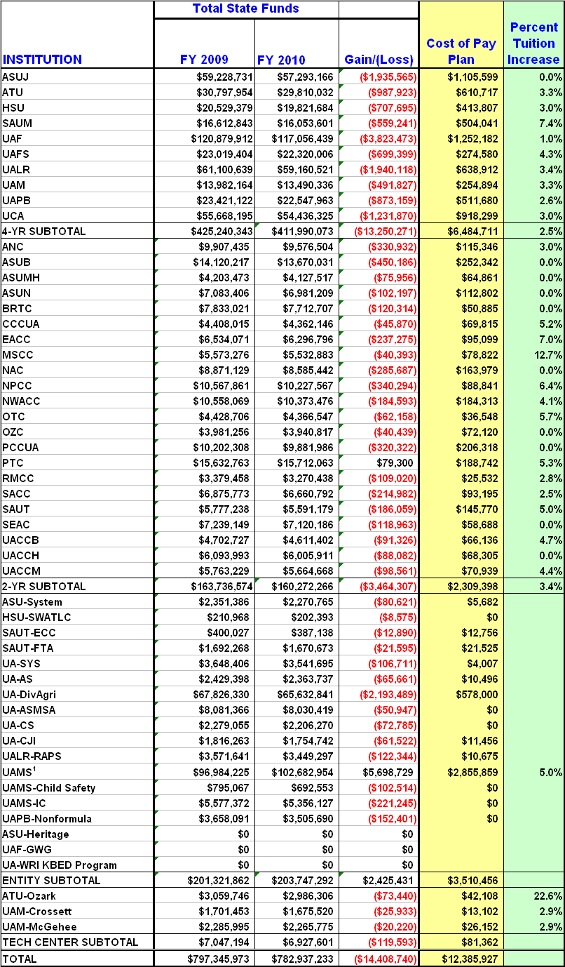
Minimal tuition increases for FY 2010

Slide 7
Pay Plan Implementation Cost did not take into consideration employees not paid through E&G. Did not include the auxiliary staff costs. Did not include Faculty and non- classified staff.

Slide 8
Classified Pay Plan Implementation
Institution | Fully Implemented | Partially Implemented | Remaining portion budgeted for:
ASUJ |  | Partially | FY11
ATU | Fully
HSU |  | Partially | FY11
SAUM |  | Partially | FY11
UAF |  | Partially | FY11
UAFS |  | Partially | FY11
UALR |  | Partially | FY11
UAM |  | Partially | FY11
UAPB |  | Partially | FY11
UCA |  | Partially | FY11
UAMS |  | Partially | FY11

Slide 9
Classified Pay Plan Implementation
Institution | Fully Implemented | Partially Implemented | Remaining portion budgeted for:
ANC | Fully
ASUB |  | Partially | FY11
ASUMH |  | Partially | FY11
ASUN |  | Partially | FY11
BRTC | Fully
CCCUA |  | Partially | FY11
EACC | Fully
MSCC | Fully
NAC | Fully
NPCC | Fully
NWACC | Fully
OTC | Fully
OZC | Fully
PCCUA |  | Partially | FY11
PTC | Fully
RMCC | Fully
SACC | Fully
SAUT | Fully
SEAC | Fully
UACCB | Fully
UACCH |  | Partially | FY11
UACCM | Fully

Slide 11
Cost Containment and Tuition

Slide 12
Cost Containment and Tuition
Putting all the higher education budget pieces together.
What has been done to keep cost down?
What factors compel institutions to increase tuition?
What has been the trend in tuition over time?
What can be done to keep tuition low?

Slide 13
Impact of Lottery Scholarships on Budgets of Colleges and Universities
Lottery Scholarship
Financing Higher Education
Students, Parents,
Scholarships,
Loans
College Tuition
State and other funding sources
70% in 1980’s
1. State funding covers less than half of the cost.
2. If state support is reduced, the student’s burden is increased.
3. Lottery revenues change who pays the cost of college– it will not impact higher education budgets.
4. Increased student enrollment without increases in state financial support stresses the ability of colleges to meet student demand.
Arkansas needs more graduates, but as with most good things it comes at a price.

Slide 14
$2,207
per student
34% decline in purchasing power
$1,290
$1,453
$1,322

Slide 15
The Dilemma of Higher Education Institutions

Slide 16
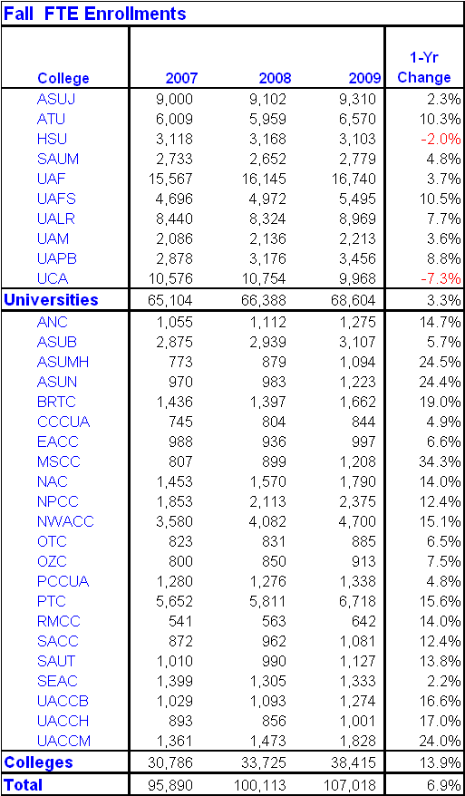
Significant Enrollment increases while . . .
State support declines
Students expect and demand greater amenities

Slide 17
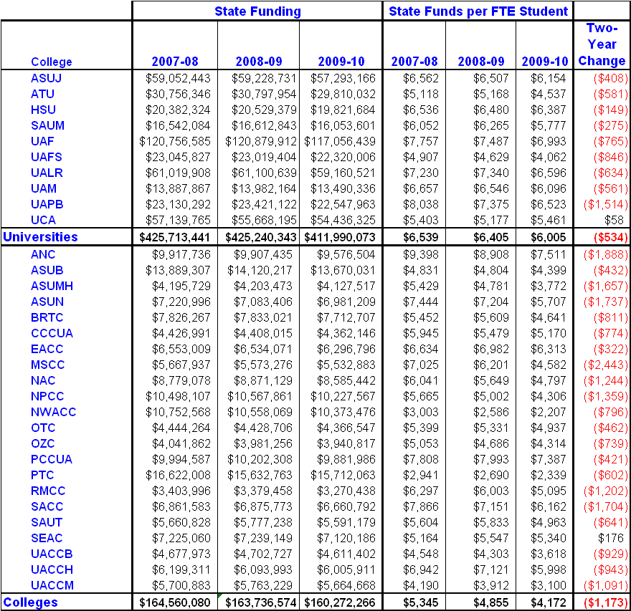
State Funds Per Student FTE decline

Slide 18
Tuition Costs in Arkansas In Comparison to SREB

Slide 20
Median annual tuition and required fees reached $5,000 in SREB states in 2008. This was 74 percent more than in 1998 after adjusting for inflation. In Arkansas, tuition and fees were 5,700 — an increase of 103 percent from 1998.
During same decade state support declined from 60% to 50%

Slide 21
Median annual tuition and required fees were about $2,100 for the SREB region in 2008. This was 45 percent more than in 1998 after adjusting for inflation. In Arkansas, tuition and fees were 2,000 — an increase of 62 percent from 1998.
During same decade state support declined from 60% to 50%

Slide 22
State Funds plus Tuition & Fee Income
US Average
Total Funds = State Funds + Tuition & Fees
Arkansas is one of the 10 lowest states in total funds per FTE
Source: Delta Cost project “the dreaded “P” word
Source: Delta Cost Project: “The dreaded “P” word” July 2009

Slide 23
Most
Arkansas is Among the Top 20 States in Productivity
Source: Delta Cost Project: “The dreaded “P” word” July 2009
Productivity
Least

Slide 24
Three Imperatives for Higher Education

Slide 25
Interim Legislative Study of Higher Education -Jeffress
Three “Musts”:
We must make sure state government continues to do its part in funding higher education
We must limit the start up of new programs
We must ensure a net reduction in costs for students

Slide 26

Strengthening the Arkansas Education Pipeline
Improving Preparation
Decreasing Remediation
Accessing Financial Aid
Increasing Retention and Graduation
Enhancing Funding and Governance
Addressing Data Needs
Supporting Economic Development
Issues for Further Study

Slide 27
Cost Containment Efforts

Slide 28
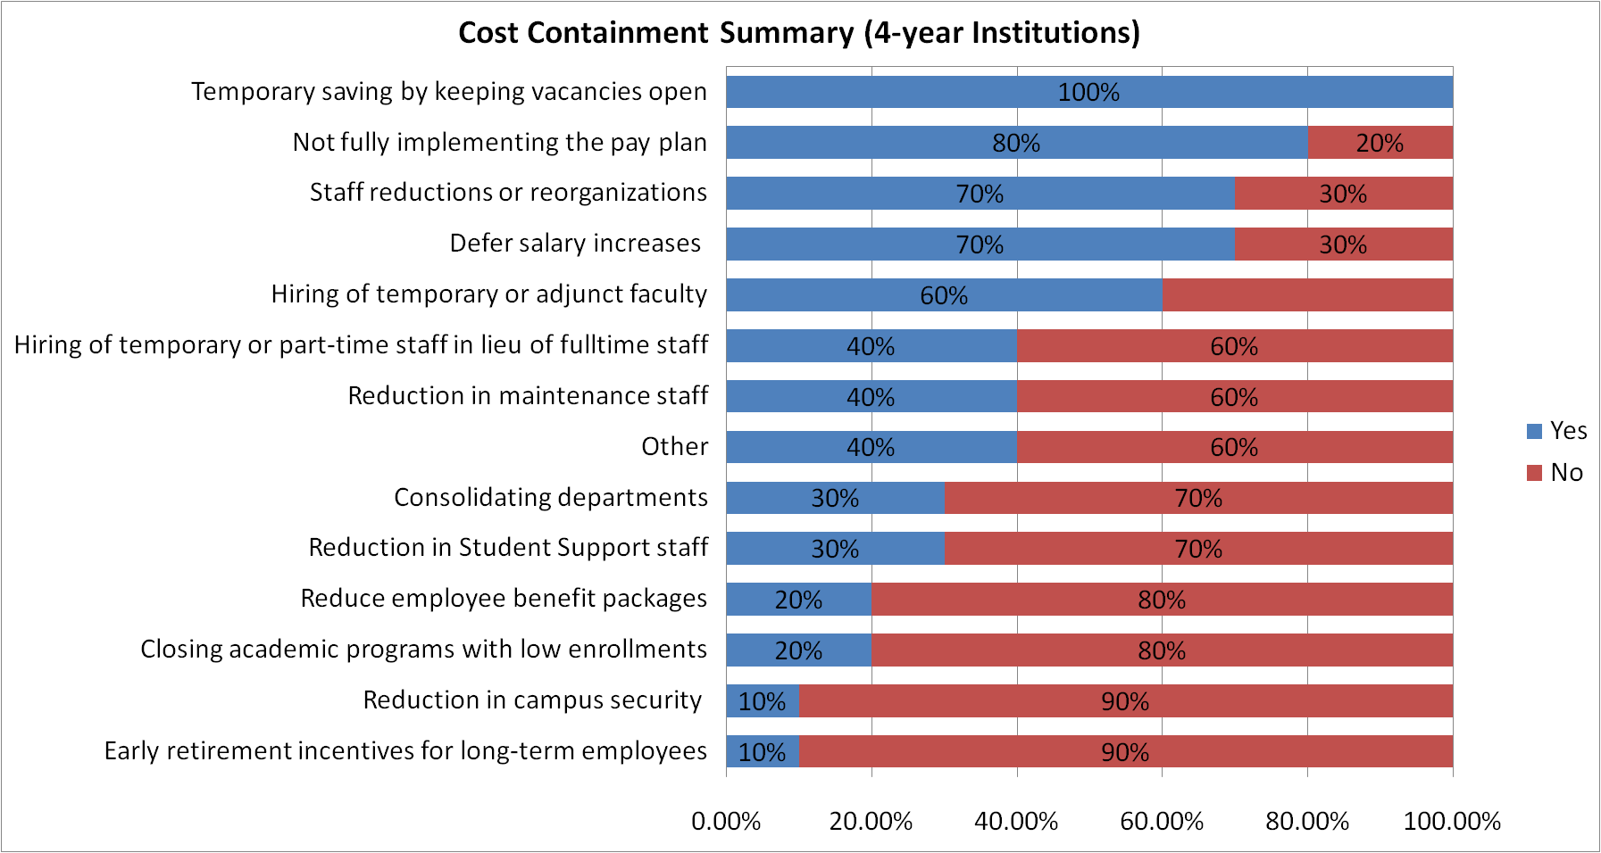
Four-Year Cost Savings
Personnel

Slide 29
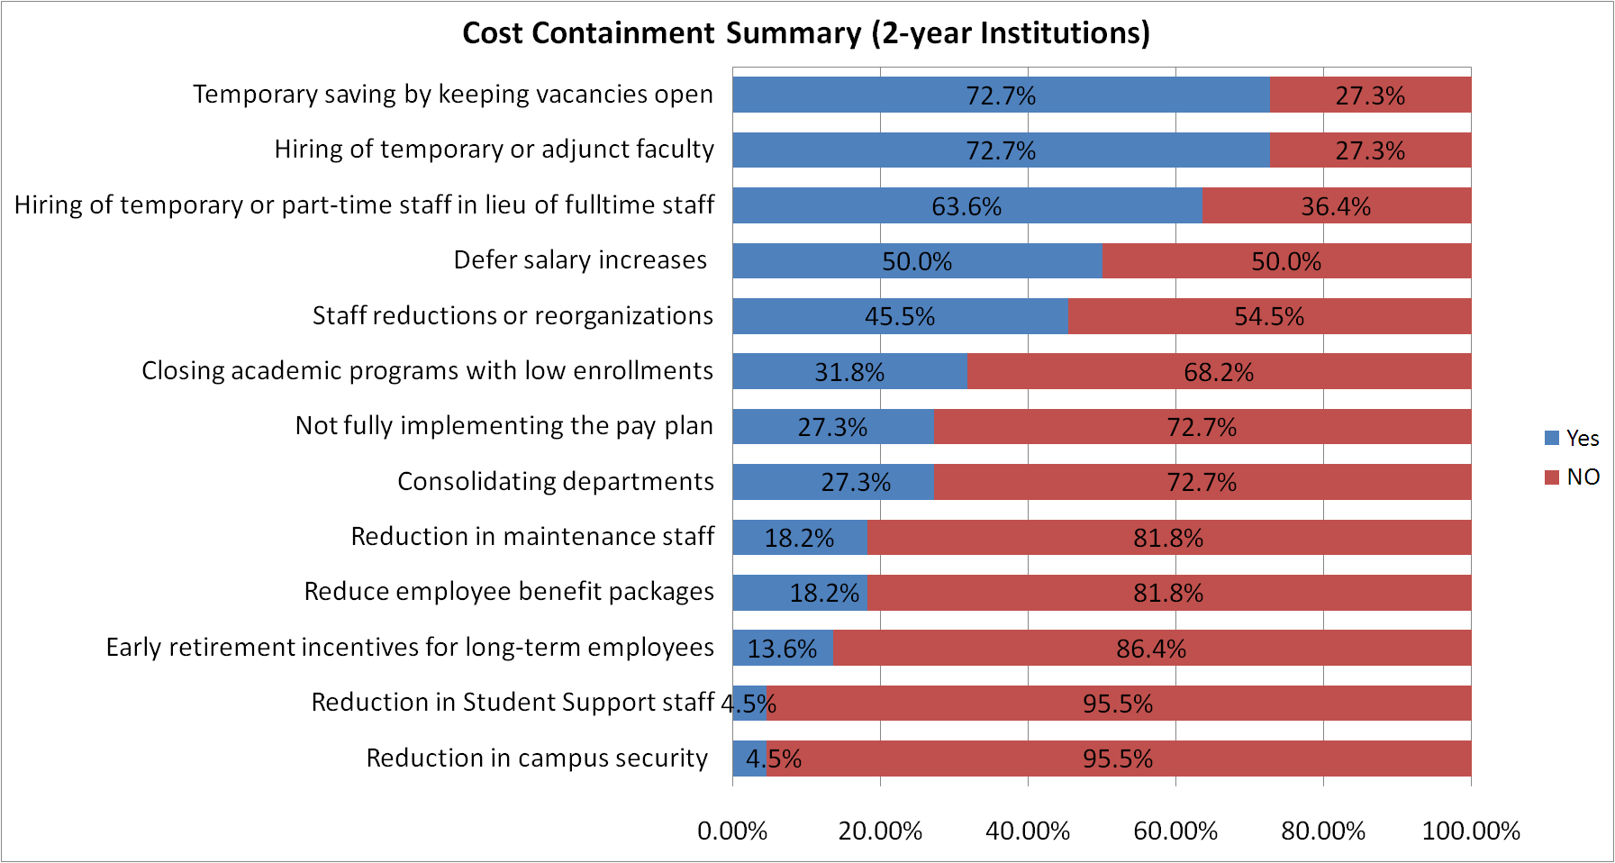
Two-Year Cost Savings
Personnel

Slide 30
Other Cost Saving Initiatives
Personnel
Changed Insurance Plans
Shared clerical services
Grant extension to provide salaries
Hiring at lower salaries
Conversion to paperless processing
Hiring Faculty Administrators from existing personnel

Slide 31
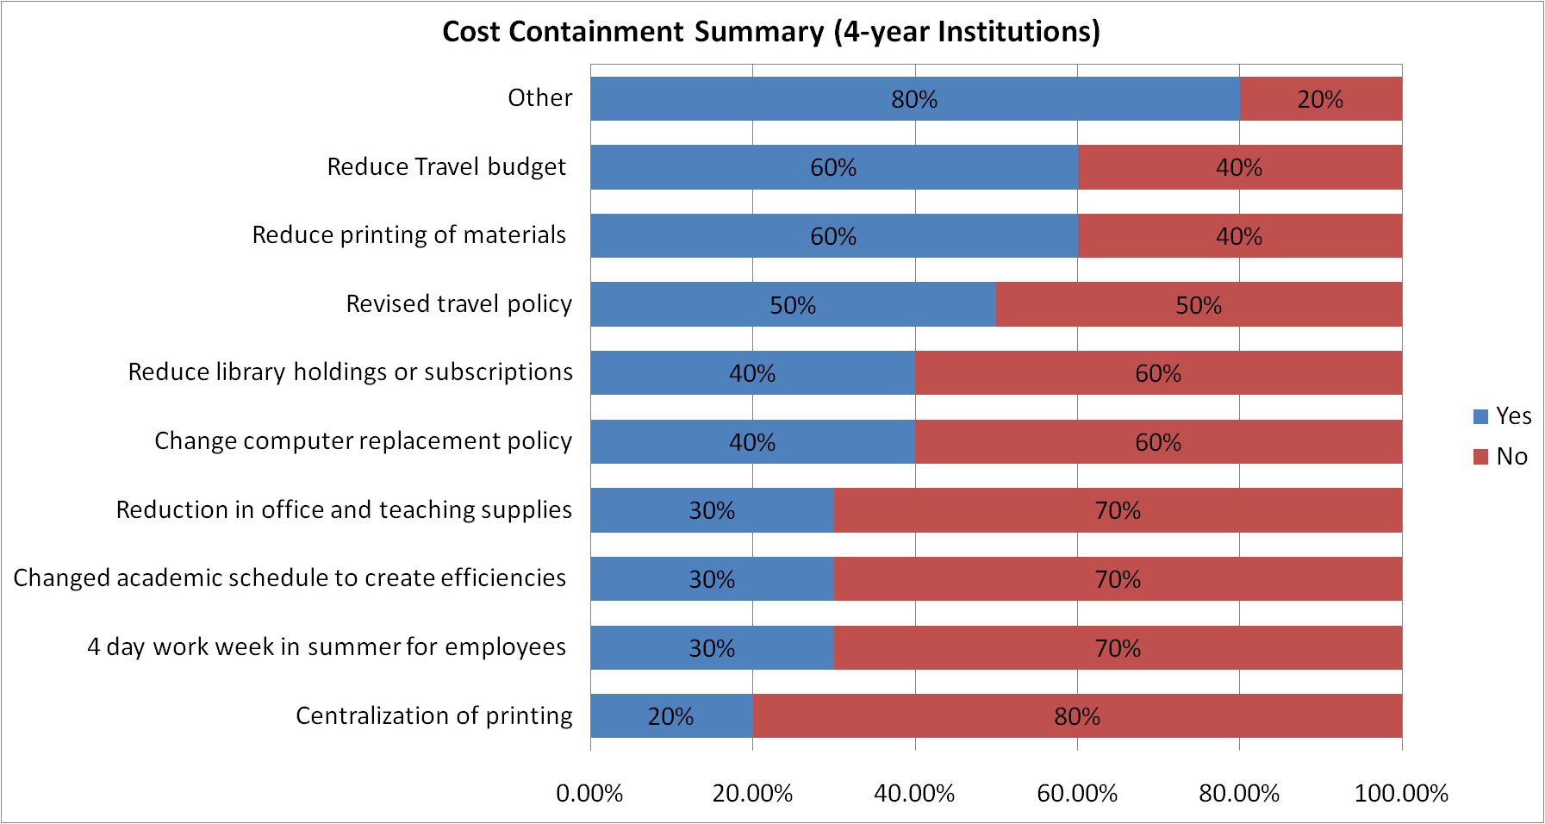
Four-Year Cost Savings
Operating

Slide 32
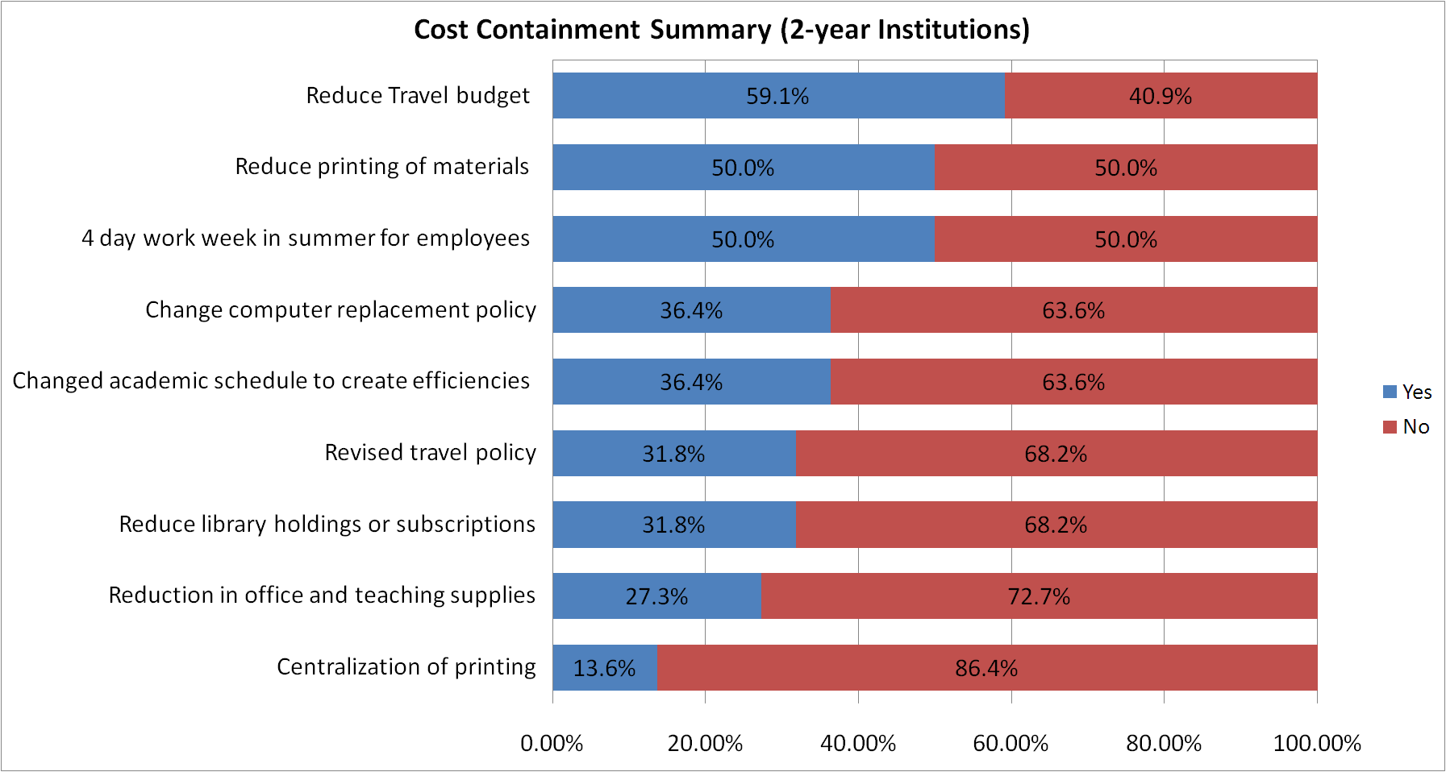
Two-Year Cost Savings
Operating

Slide 33
Other Cost Saving Initiatives
Operating
Partnerships with other institutions or local businesses
Used Institutional Personnel for Professional Development
Refunding Bond Issues
Consolidated purchasing, printing, and other services.

Slide 34
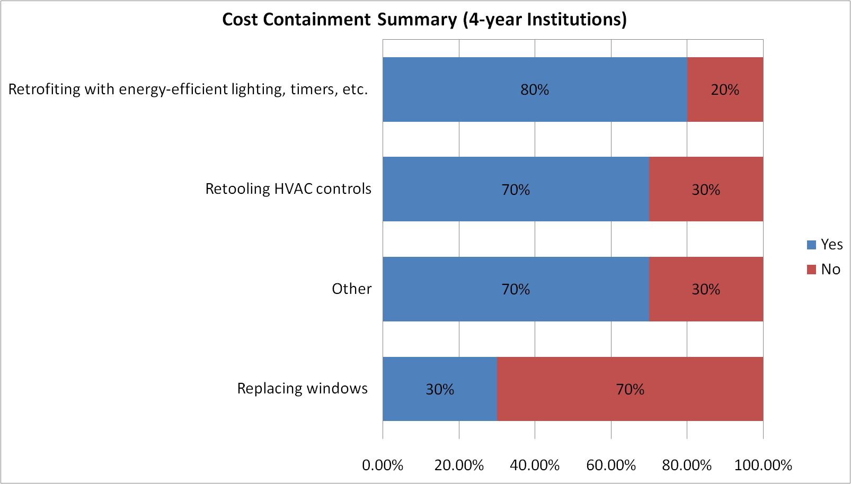
Four-Year Cost Savings
Utilities

Slide 35
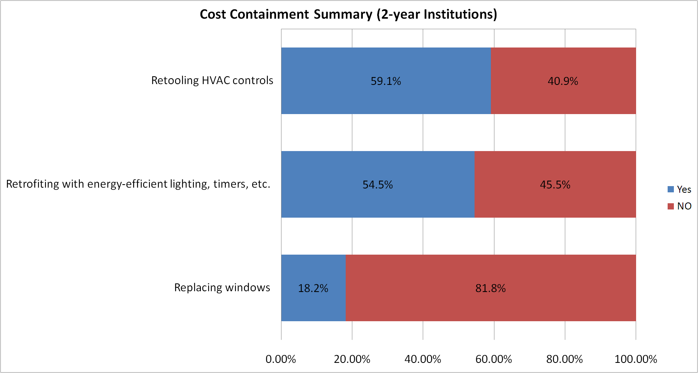
Two-Year Cost Savings
Utilities

Slide 36
Other Cost Saving Initiatives
Utilities
Installation of Entrance Vestibules
Automated Computer Lab Shutdown Software
Weekend power down
Programmable Thermostats
Replaced chillers
Replaced roofs with reflective materials and increased insulation
UAF – Capture the Kinetic Energy of students to help power a building

Slide 37
Tuition and Fee increases

Slide 38
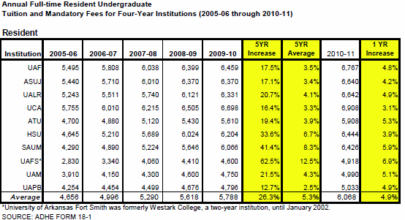
Four-Year Institutions
Resident Undergraduate
Fort Smith is an anamoly
Notes:
Slide 1 shows the resident undergraduate tuition and fees rates charged at the four year institutions.
The tuition amount is based on 30 semester credit hours and the fees include both E&G and Auxiliaries. Some fees are per credit hour and some are at a flat rate.
The first five columns reflect tuition and fees rates for the past 5 years. Over the 5-year period tuitions have increased on average 26.3%. This equates to a yearly average of 5.3%.
The last two columns reflect the increase in tuition and fee rates for FY2011 as compared to FY2010. The average 1-Year increase is 4.9%.

Slide 39
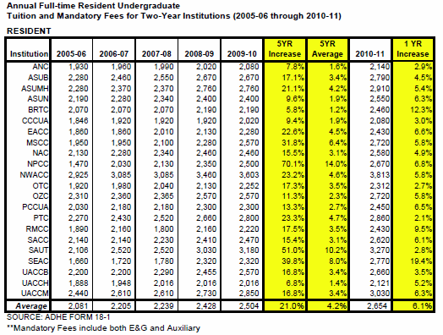
Two-Year Institutions
Resident Undergraduate
BRTC and SEAC =increase in fees
NPCC big in increase in 2006-7
Notes:
Slide 2 shows the resident undergraduate tuition and fees rates charged at the two year institutions.
The tuition amount is based on 30 semester credit hours and the fees include both E&G and Auxiliaries. Some fees are per credit hour and some are at a flat rate.
The first five columns reflect tuition and fees rates for the past 5 years. Over the 5-year period tuitions have increased on average 21.0%. This equates to a yearly average of 4.2%.
The last two columns reflect the increase in tuition and fee rates for FY2011 as compared to FY2010. The average 1-Year increase is 6.1%.

Slide 40
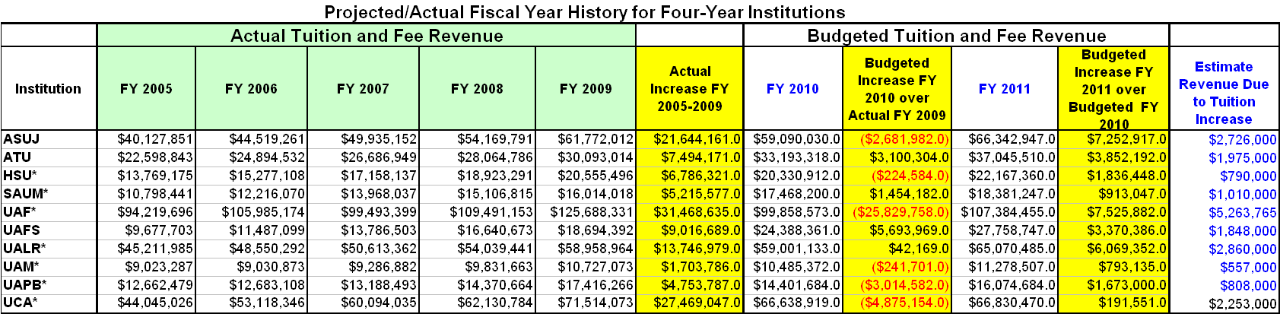

Slide 41
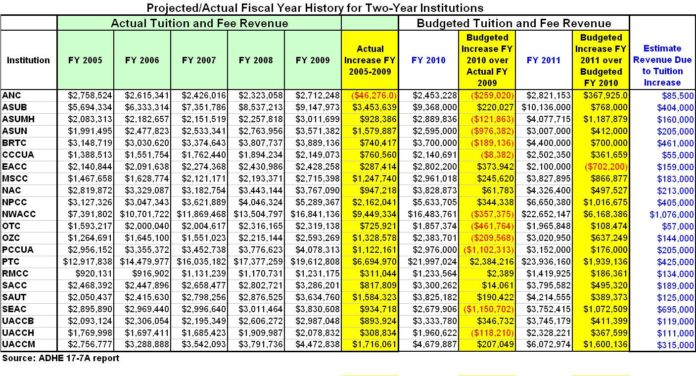

Slide 42
In your packet:
Non Resident undergraduate 2 and 4
Resident and Non Resident Graduate – Univ
Significant Points
Non Resident 2-yr: Increase 15.7% over 5 years
NR 4-yr: 22.4% over 5 years
  Non-resident tuition (GR and UG) is double the resident rate
  Graduate increased over 20% in 5 years.

Slide 43
Financial Aid

Slide 44

Universal Application Homepage

Slide 48
Financial Aid Funding Trend
Preliminary
GR peaked at 48m in 2008
Expense (Student Awards) has increased since 2005
Fund Balance peaked in 2009 at 53m

