Slide 1
Geography & Geographic Skills:
21st Century Skills Arkansas Students Must Know and Be Able to Do
Paul Gray:
2008 Arkansas Teacher of the Year
President: National Council for Geographic Education
Teacher: Russellville High School
Jeff Allender:
Chair, UCA Department of Geography
Karen Davis:
Teacher & Social Studies Dept. Chair,
St. Joseph High School, Conway
Ben Lykins:
UCA Senior & Future Arkansas Leader

Slide 2

CEO: Conway Development Corporation
Past Chair: Conway Chamber of Commerce
  Last year, Conway won the National Chamber of the Year by the American Chamber of Commerce Executives!
UCA Board of Trustees
Mr. Brad Lacy

Slide 3
“I cannot imagine a better undergraduate education for my work in economic development. Unfortunately most people still believe that geography is memorizing countries and capitals. The field of study is diverse and prepares students for careers in a variety of areas. For me, geography perfectly married the study of physically developing urban spaces with understanding demographic, human, and social characteristics of place. Geography is as much a part of my work as is finance, accounting, or economics.
Every student in Arkansas should have access to
a broad and rich geographic education. Everyone knows that our global economy shapes what happens on Main Street. Understanding cultures, economies, physical places, and populations is a key to thriving in our world today. Those who do not will be left behind. Geography is the only discipline where all of these things intersect.”
-Brad Lacy, 2013

Slide 4
Geography is NOT just knowing states and capitals. Geography is:
Economics and 21st Century jobs, especially with GIS
US National Security and Arkansas Economic Security
Water and Environmental management
Agriculture and Food Security
Natural Hazard and Emergency Preparedness
Urban Planning, business location and industry location dynamics
Global Cultural Understanding and connections
Attaining and mastering skills our students must have to compete against everyone in the world for jobs that haven’t even been invented yet.

Slide 5
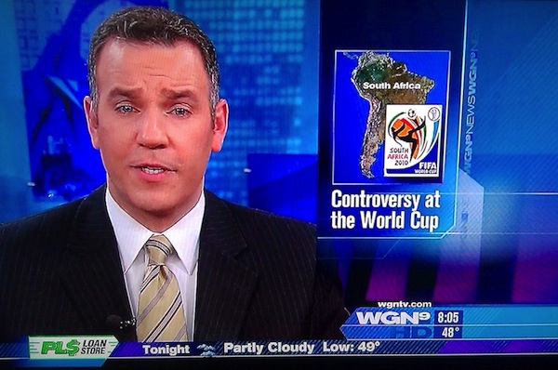
No states, capitals or rivers – but… place is still important…
Well, they got the “South” right!

Slide 6
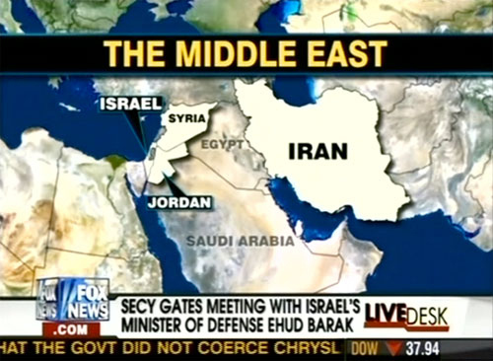
We lost 4,488 troops….. in Egypt!?! http://www.funnyordie.com/slideshows/7dffb13ac4/the-funniest-fox-news-fails#slide6

Slide 7
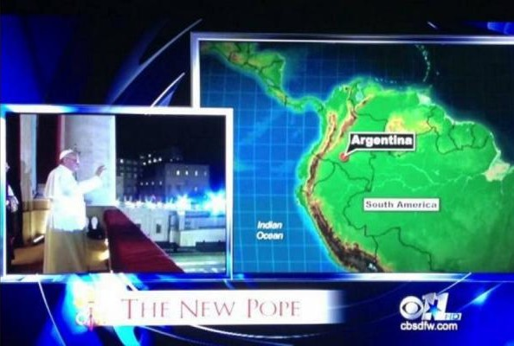
Dallas TV station relocates a country into the Columbian cocaine region and renames an ocean http://www.newscaststudio.com/2013/03/20/dallas-station-relocates-argentina-entire-ocean/

Slide 8

Wow! Who knew Hong Kong was a suburb of Rio de Janeiro?

Slide 9
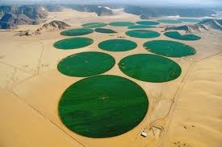
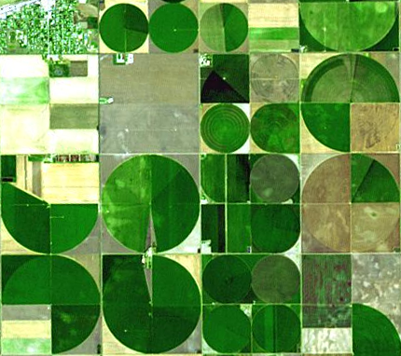
How many think of water usage as geography? Agricultural geography is a field of geography – how many Arkansas students need to learn about agriculture for the future?

Slide 10

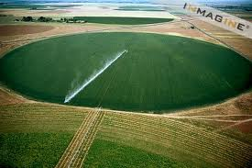
We know it’s Center Pivot Irrigation, shouldn’t all middle school students?

Slide 11
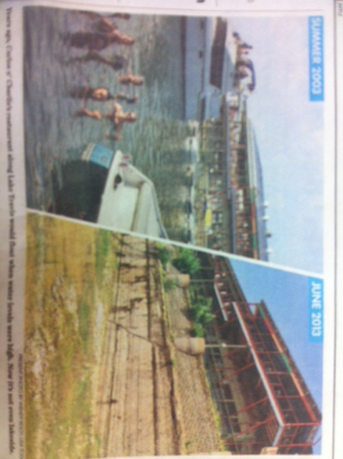
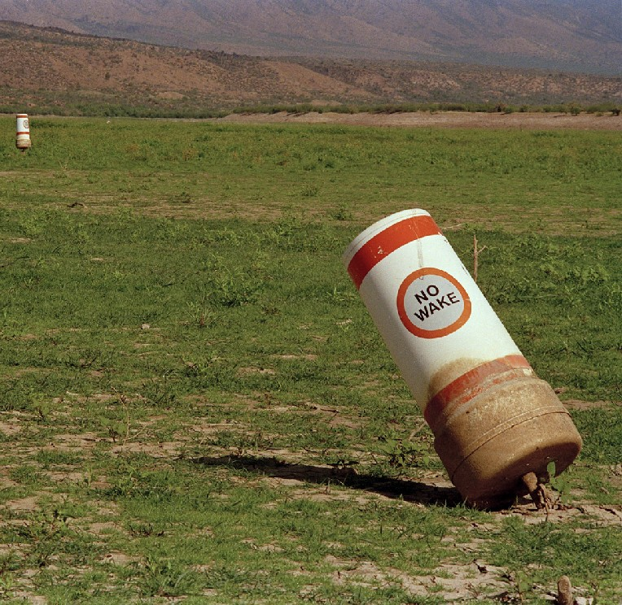
Environmental issues in Arizona & Texas
Geographically literate students in Arkansas should know not to let this happen here.

Slide 12

Knowing local geography:
Ever been around someone not from Russellville on Wednesday at noon?

Slide 13
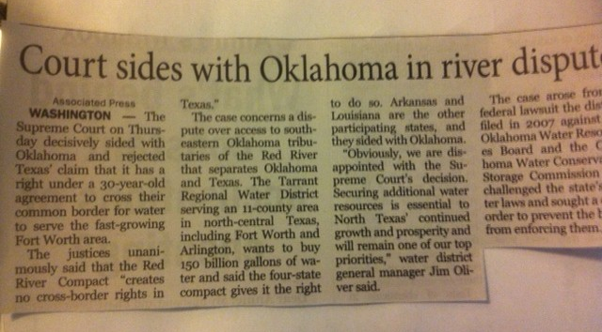
Border issues are common between US States – Understanding them is another geography skill.

Slide 14
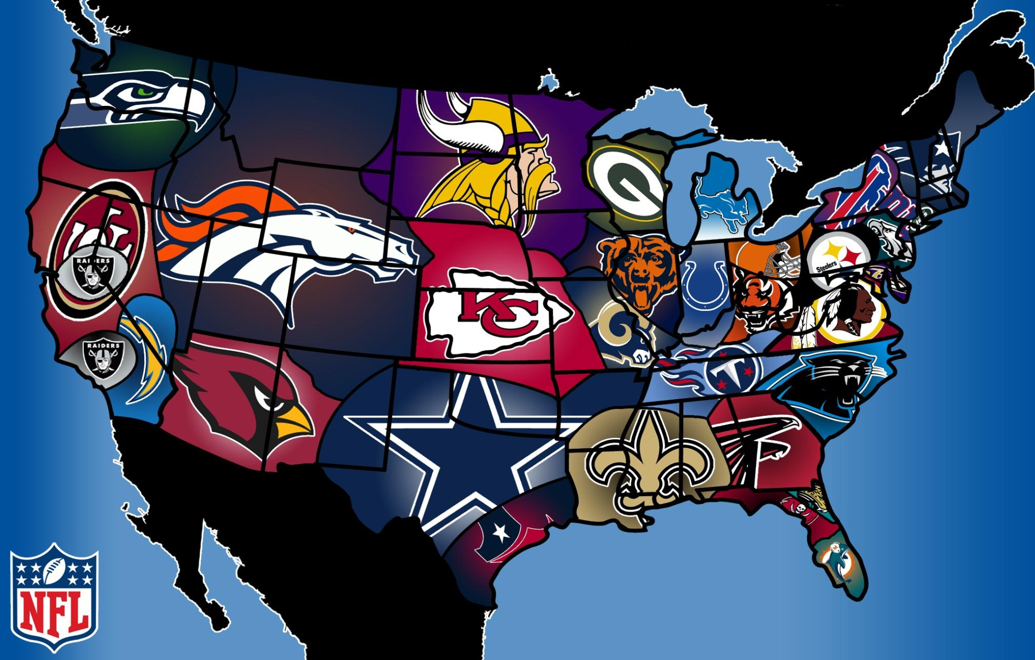
NFL – Just maps of where teams are? http://www.sportsgrid.com/nfl/u-s-map-redrawn-nfl-allegiances/
Just about football?

Slide 15
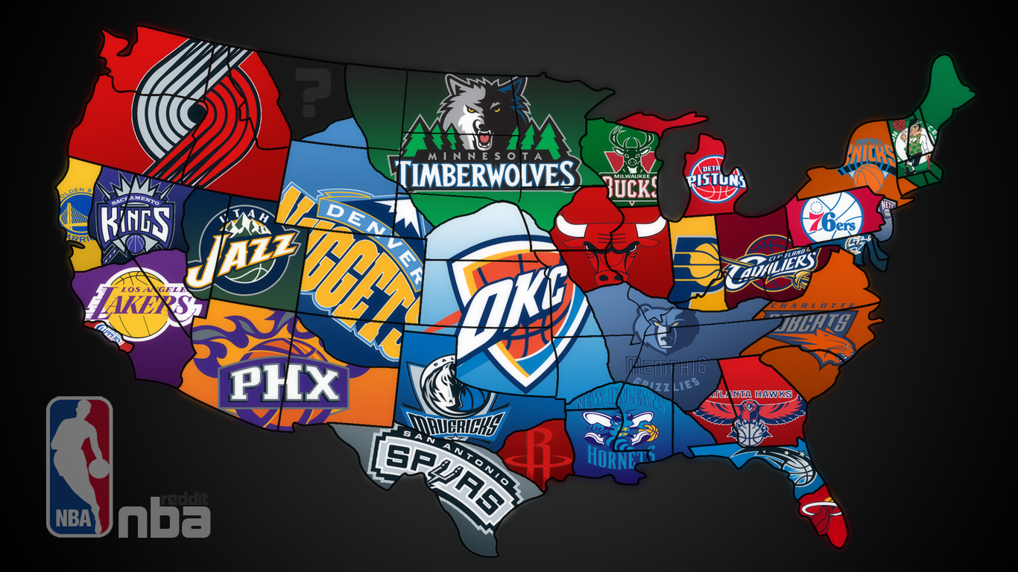
No – these are economic maps: who spends their money where for which team. http://www.basketballforum.com/nba-forum/451361-great-nba-team-map.html

Slide 16
These are also maps of economic reach and activity
These maps show economic ranges and thresholds
They show the potential customer base for professional sports teams and could be used for other higher order goods’ economic analyses
Economic Geographers developed most of these economic models years ago, but businesses rely on them today!

Slide 17
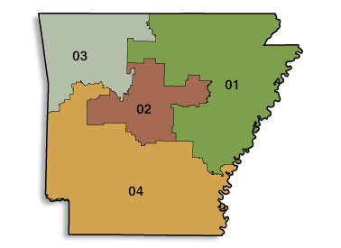
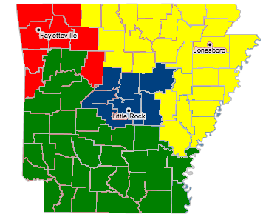
Political geography – No state is a stranger to redistricting.
Our students must understand this!
2010
http://www.iolp.gsa.gov/iolp/images/AR.gif
2012
http://www.rogerslowellchamber.blogspot.com/

Slide 18
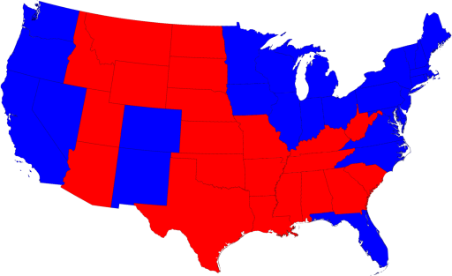
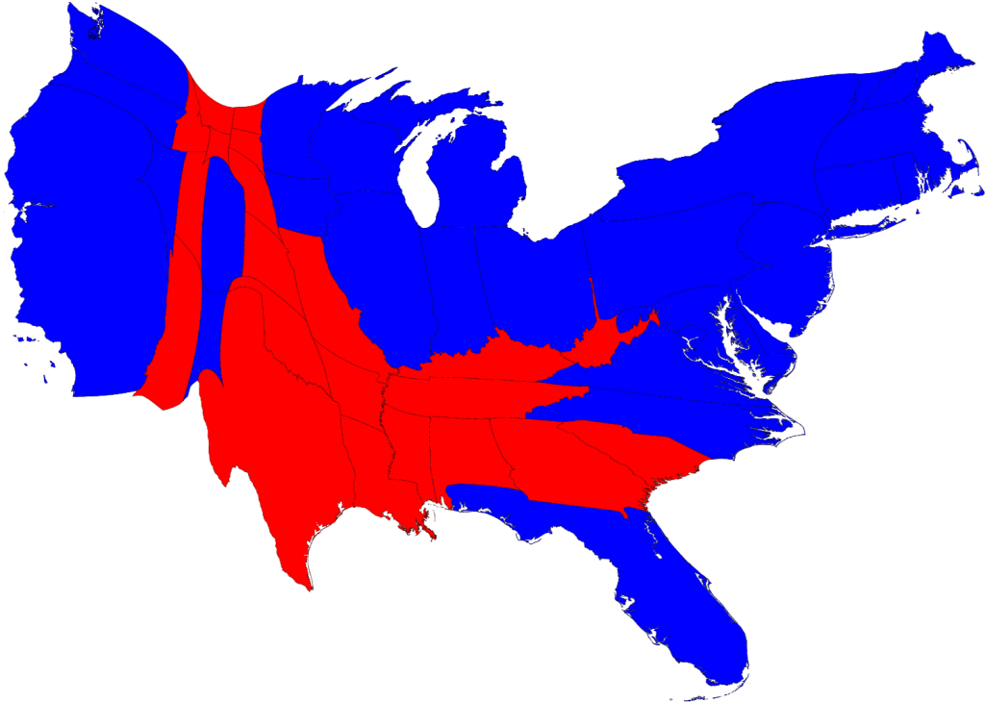
Want to win elections? You need geographic skills. The last two presidential elections are proof. One side understood the geography of demographics…

Slide 19
During the beginning of a great period of US innovative growth and expansion, what skills did we consider essential to be an educated, productive Arkansan?
“A subscription school will be taught by J. Brown commencing on Monday, March 10. He will teach reading, writing, arithmetic, English, grammar, and GEOGRAPHY.”*
*William Woodruff, owner and editor, Arkansas Gazette, March 4, 1823, one of Arkansas first schools.

Slide 20
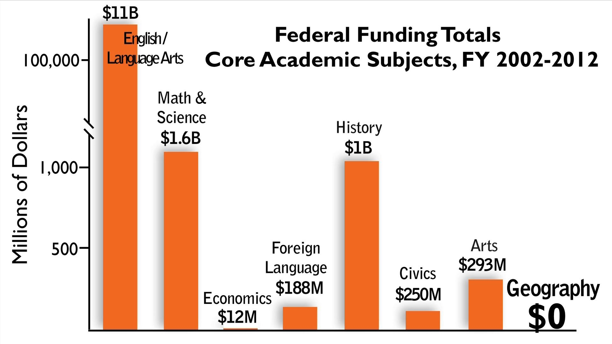
How do we show the importance of Geography?

Slide 21

“Today, geography has ceased to exist as a "stand alone" course, and public school educators are seeing the impact of the decision to "embed" it in the larger curriculum. "Embed" has unfortunately become a euphemism for..."so far under the bed it is lost".
The impact of that decision is now an appalling lack of fundamental geographic knowledge for Arkansas students who expect to be able to compete and meet the economic, cultural, and political challenges and demands of an age of globalization on “warp drive”.”
Sherry Tipps-Holder
History Dept. Chair
-Conway Jr. High School
Arkansas Teacher of the Year-1999

Slide 22

“Geographic education encompasses an organized sequence of developmentally appropriate knowledge and skills. In today's interconnected economy, geographic education offers the best opportunities for our P-12 students to become fully prepared for college, careers, and citizenry in Arkansas.”
Dr. Nancy P. Gallavan
Professor of Teacher Education
UCA Dept. of Teaching and Learning

