Slide 1
Arkansas Better Chance
Update
Early Childhood Permanent Subcommittee
November 26, 2012
Division of Child Care and Early Childhood Education
www.arkansas.gov/childcare/

Slide 2
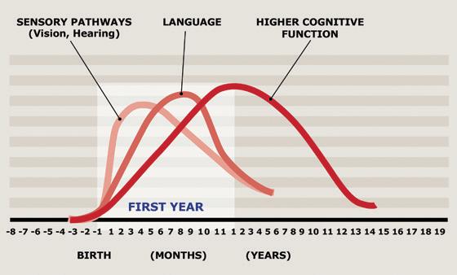
Brain Development

Slide 3
History
Act 212 of 1991 created Arkansas Better Chance (ABC) with funding of $10 million.
Purpose was to provide quality early education opportunities to children birth through 5 years with variety of developmental and economic risk factors.

Slide 4
History
In 2002, the following program quality model was adopted based on early childhood research.
Core components include:
  staff qualifications and compensation
  low student to teacher ratio (1:10)
  health and development screenings
  meaningful parent and community engagement activities
  proven curricula
  Arkansas requires the Environmental Rating Scales for state pre-k programs

Slide 5
History
Act 49 of 2003 expanded ABC creating the state funded pre-K program--ABC for School Success targeting 3 and 4 year olds below 200% federal poverty
At that time, the Legislature made a commitment to fund up to $100 million new dollars-$103.5 Million State funding/$7.5 Million Federal
The funding targeted approximately 70% of 3 and 4 year olds below 200% federal poverty

Slide 6
Funding

Slide 7
Children Served

Slide 8
ABC Delivery Model
Diverse delivery model
  School Districts
  Educational Cooperatives
  State Universities
  For Profit and Non-profit Community Based early childhood programs
  Program model
    Center based
    Home based

Slide 9
Program Information
Total Agencies: 275
School districts/educational cooperatives make up more than half.
  Center Based 86%
    Total Sites: 560
    Total Classrooms: 1,250
    Full Day: 178 days, 7 hours
    Per Child Funding: State-$4,860 (60%), 40% Local Match
  Home Based 14%
    Per Child Funding: State-$1,750 (60%), 40% Local Match
Notes:
+3,240.00
1,166.67

Slide 10
Teacher Qualifications
Doctorate 1%
Master’s 15%
Bachelor’s 73%
Associate’s 9%
Child Development Associate Credential 2%
Notes:
89% with Bachelor’s degree or higher
98% with degrees

Slide 11
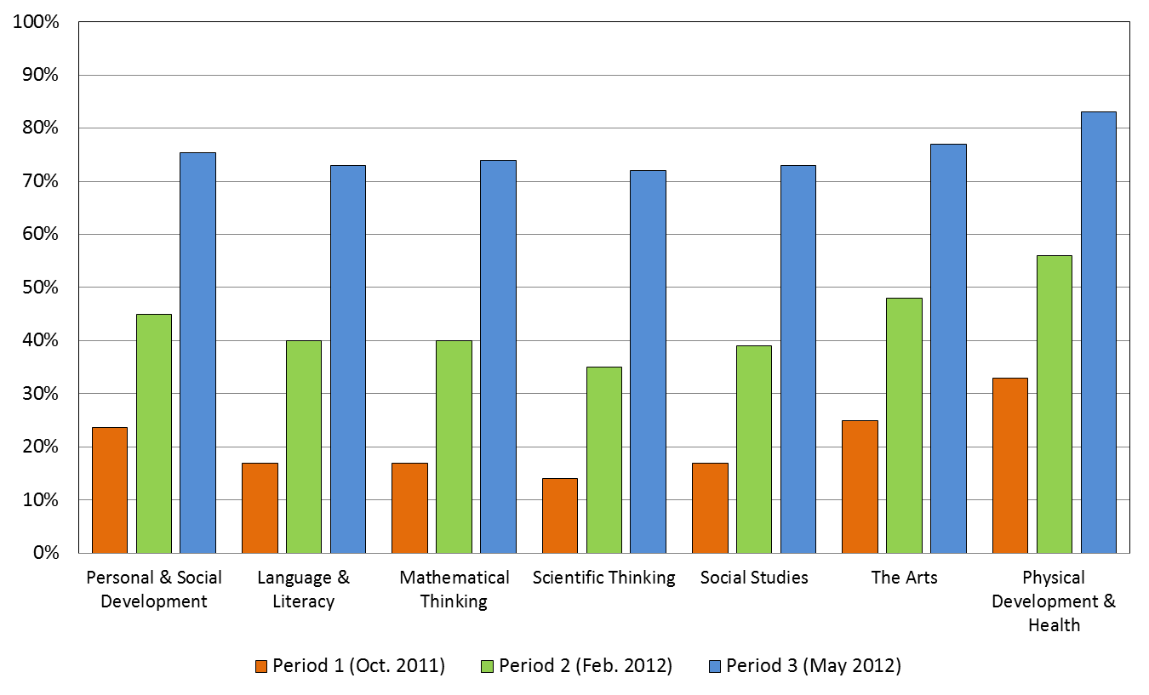
Child Assessment
Notes:
Not yet
In process
Proficient

Slide 12
National Perspective
Arkansas has been recognized by the National Institute for Early Education Research since 2004 for quality standards in state funded pre-k receiving either a 10/10 or 9/10.
The National Institute of Early Education Research has ranked Arkansas in The State of Pre-K 2011 Yearbook:
· 4th in the nation for access to 3-year-olds
· 10th in the nation for access to 4-year-olds
· 9 out of 10 quality standards
www.nieer.org

