Slide 1
Higher Education Subcommittee
October 14, 2010

Slide 2
B National Center for Higher Education Management Systems’ (NCHEMS) Analysis and Recommendations on Improving the State’s Educational Attainment, due December 1, 2010.
C. Statewide and Institutions’ College Default Rate, Possible Federal Consequences of Default Increases, and Total Loans by Institution
D The Worth of Degree Programs Across the State
E. Credit Hours Required for Degree Programs Across the State
F. Cost of Courses Dropped Across the State
G. ACT/SAT Cut Scores for Other States

Slide 3
National Center for Higher Education Management Systems’ (NCHEMS) Analysis and Recommendations on Improving the State’s Educational Attainment, due December 1, 2010.

Slide 4

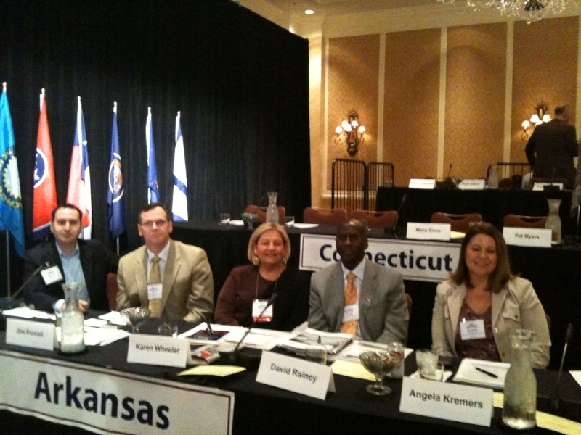
Overview
An initiative aimed at increasing college completion.
CCA’s goal is to double the number of college graduates by 2020 and have asked multiple states to collaborate with each other in doing so.
The following Arkansas representatives attended the May 4, 2010 Alliance of States meeting:
  Rep. David Rainey (Arkansas General Assembly)
  Angela Kremers (Winthrop Rockefeller Foundation)
  Jim Purcell (ADHE)
  Karen Wheeler (ADHE)
  Brooks Harrington (ADHE)

Slide 5

“I realize that, without improvement in higher education, our economic development efforts will face enormous barriers.”
-Gov. Mike Beebe

Slide 6
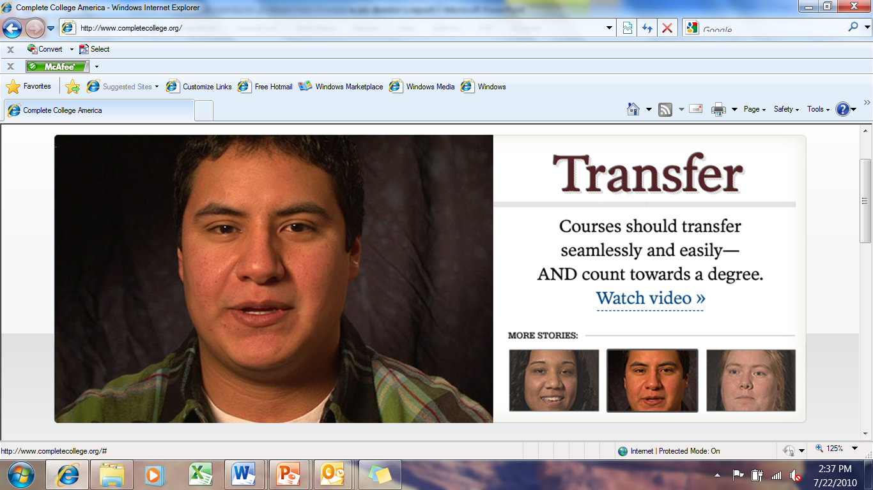
Complete College America is an initiative aimed at increasing college completion.
CCA’s goal is to double the number of college graduates by 2020 and have asked multiple states to collaborate with each other in doing so.

Slide 7
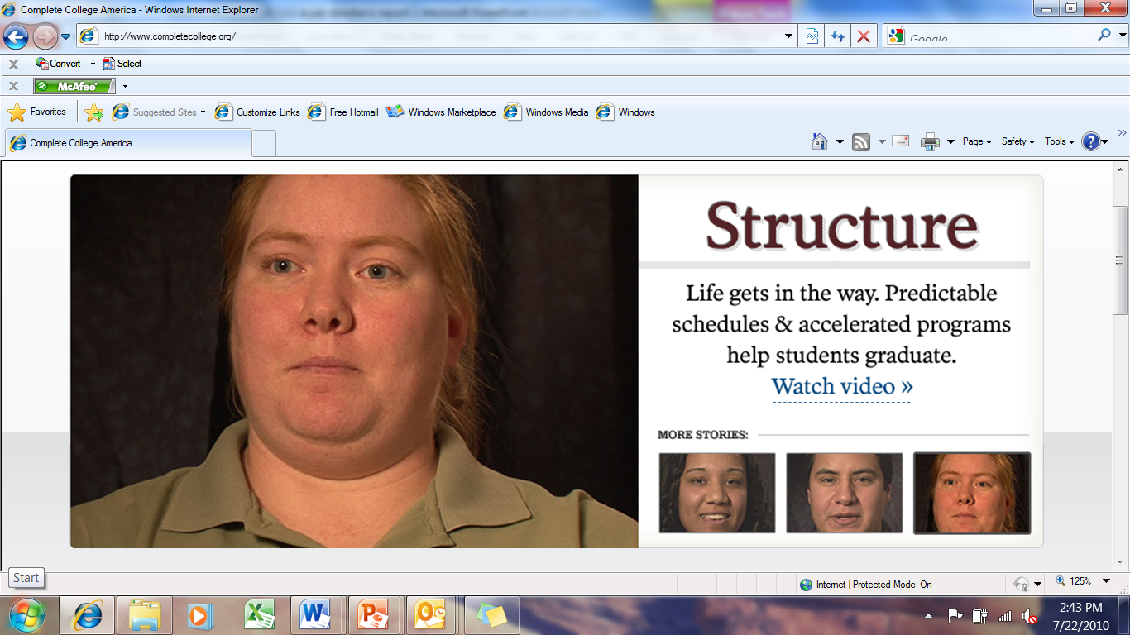

Slide 8
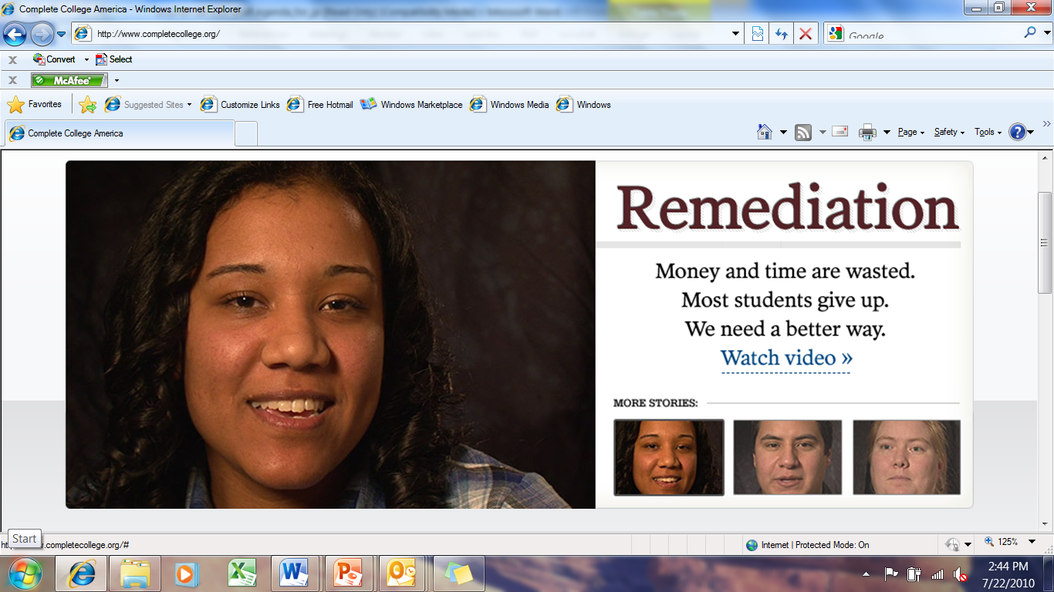

Slide 9
CCA Plan Template
Essential Steps for States
LEAD | MEASURE
ACT | INNOVATE
Set State and Campus Completion Goals
Uniformly Measure Progress and Success
Shift to Performance Funding
Reduce Time to Degree and Accelerate Success
Transform Remediation
Restructure Delivery for Today’s Students
Notes:
In just 10 years, 6 of 10 new jobs will require a college education, but currently, only half of all students who enter college graduate.
Complete College America has set a goal that by 2020, six out of 10 young adults in our country will have a college degree or certificate of value.
40% now; 60% by 2020. We will not close this gap by standing still or tinkering around the edges. Complete College America’s Essential Steps explain how states can implement systemic reforms and innovative policies to significantly increase college completion.

Slide 10
Proposed Arkansas
Higher Education Strategic Plan
Six Goals
Degree Production
  Redesign programs to meet the criteria of “Speed to Market—Close to Customer” in a modern global society including accelerated degree programs, modular program designs, and effective use of instructional technology.
  Increase college-going rates in counties below the state average.
  Close the college achievement gap of minority students.
  Increase number of adults attending/returning to college
  Encourage the redesign of developmental education statewide and provide state support for innovative programs.
Program Quality and Viability
Two-Year Colleges and Workforce Training
Research
Teacher and School Administrator Effectiveness
Stewardship of Resources and Public Trust

Slide 11
Possible Institutional Goals
(Example @ 6%)
 | 2009 | 2010 | 2011 | 2012 | 2013 | 2014 | 2015 | 2016 | 2017 | 2018 | 2019 | 2020
ASUJ | 1414 | 1499 | 1589 | 1684 | 1785 | 1892 | 2006 | 2126 | 2254 | 2389 | 2532 | 2684
ATU | 973 | 1031 | 1093 | 1159 | 1228 | 1302 | 1380 | 1463 | 1551 | 1644 | 1742 | 1847
HSU | 463 | 491 | 520 | 551 | 585 | 620 | 657 | 696 | 738 | 782 | 829 | 879
SAUM | 370 | 392 | 416 | 441 | 467 | 495 | 525 | 556 | 590 | 625 | 663 | 702
UAF | 2494 | 2644 | 2802 | 2970 | 3149 | 3338 | 3538 | 3750 | 3975 | 4214 | 4466 | 4734
UAFS | 396 | 420 | 445 | 472 | 500 | 530 | 562 | 595 | 631 | 669 | 709 | 752
UALR | 1084 | 1149 | 1218 | 1291 | 1369 | 1451 | 1538 | 1630 | 1728 | 1831 | 1941 | 2058
UAM | 265 | 281 | 298 | 316 | 335 | 355 | 376 | 398 | 422 | 448 | 475 | 503
UAMS | 290 | 307 | 326 | 345 | 366 | 388 | 411 | 436 | 462 | 490 | 519 | 551
UAPB | 401 | 425 | 451 | 478 | 506 | 537 | 569 | 603 | 639 | 677 | 718 | 761
UCA | 1532 | 1624 | 1721 | 1825 | 1934 | 2050 | 2173 | 2304 | 2442 | 2588 | 2744 | 2908
Private | 2228 | 2362 | 2503 | 2654 | 2813 | 2982 | 3160 | 3350 | 3551 | 3764 | 3990 | 4229
TOTAL | 11910 | 12625 | 13382 | 14185 | 15036 | 15938 | 16895 | 17908 | 18983 | 20122 | 21329 | 22609

Slide 12
Additional Graduates Needed Each Year (Example @ 6%)
 | 2010 | 2011 | 2012 | 2013 | 2014 | 2015 | 2016 | 2017 | 2018 | 2019 | 2020
ASUJ | 85 | 90 | 95 | 101 | 107 | 114 | 120 | 128 | 135 | 143 | 152
ATU | 58 | 62 | 66 | 70 | 74 | 78 | 83 | 88 | 93 | 99 | 105
HSU | 28 | 29 | 31 | 33 | 35 | 37 | 39 | 42 | 44 | 47 | 50
SAUM | 22 | 24 | 25 | 26 | 28 | 30 | 31 | 33 | 35 | 38 | 40
UAF | 150 | 159 | 168 | 178 | 189 | 200 | 212 | 225 | 239 | 253 | 268
UAFS | 24 | 25 | 27 | 28 | 30 | 32 | 34 | 36 | 38 | 40 | 43
UALR | 65 | 69 | 73 | 77 | 82 | 87 | 92 | 98 | 104 | 110 | 116
UAM | 16 | 17 | 18 | 19 | 20 | 21 | 23 | 24 | 25 | 27 | 28
UAMS | 17 | 18 | 20 | 21 | 22 | 23 | 25 | 26 | 28 | 29 | 31
UAPB | 24 | 26 | 27 | 29 | 30 | 32 | 34 | 36 | 38 | 41 | 43
UCA | 92 | 97 | 103 | 109 | 116 | 123 | 130 | 138 | 147 | 155 | 165
Private | 134 | 142 | 150 | 159 | 169 | 179 | 190 | 201 | 213 | 226 | 239
TOTAL | 715 | 757 | 803 | 851 | 902 | 956 | 1014 | 1074 | 1139 | 1207 | 1280

Slide 13
Possible Institutional Goals (Example @ 6%)
 | 2009 | 2010 | 2011 | 2012 | 2013 | 2014 | 2015 | 2016 | 2017 | 2018 | 2019 | 2020
ANC | 268 | 284 | 301 | 319 | 338 | 359 | 380 | 403 | 427 | 453 | 480 | 509
ASUB | 831 | 881 | 934 | 990 | 1049 | 1112 | 1179 | 1250 | 1324 | 1404 | 1488 | 1577
ASUMH | 208 | 220 | 234 | 248 | 263 | 278 | 295 | 313 | 332 | 351 | 372 | 395
ASUN | 275 | 292 | 309 | 328 | 347 | 368 | 390 | 413 | 438 | 465 | 492 | 522
BRTC | 406 | 430 | 456 | 484 | 513 | 543 | 576 | 610 | 647 | 686 | 727 | 771
CCCUA | 133 | 141 | 149 | 158 | 168 | 178 | 189 | 200 | 212 | 225 | 238 | 252
EACC | 294 | 312 | 330 | 350 | 371 | 393 | 417 | 442 | 469 | 497 | 527 | 558
MSCC | 76 | 81 | 85 | 91 | 96 | 102 | 108 | 114 | 121 | 128 | 136 | 144
NAC | 319 | 338 | 358 | 380 | 403 | 427 | 453 | 480 | 508 | 539 | 571 | 606
NPCC | 537 | 569 | 603 | 640 | 678 | 719 | 762 | 807 | 856 | 907 | 962 | 1019
NWACC | 549 | 582 | 617 | 654 | 693 | 735 | 779 | 825 | 875 | 928 | 983 | 1042
Note: Calculations from ADHE SIS – Technical Certificates and Associate degrees awarded in 2009 (does not include Certificate of Proficiency)

Slide 14
Possible Institutional Goals (Example @ 6%)
 | 2009 | 2010 | 2011 | 2012 | 2013 | 2014 | 2015 | 2016 | 2017 | 2018 | 2019 | 2020
OTC | 252 | 267 | 283 | 300 | 318 | 337 | 357 | 379 | 402 | 426 | 451 | 478
OZC | 192 | 204 | 216 | 229 | 242 | 257 | 272 | 289 | 306 | 324 | 344 | 364
PCCUA | 199 | 211 | 224 | 237 | 251 | 266 | 282 | 299 | 317 | 336 | 356 | 378
PTC | 1328 | 1408 | 1492 | 1582 | 1677 | 1777 | 1884 | 1997 | 2117 | 2244 | 2378 | 2521
RMCC | 95 | 101 | 107 | 113 | 120 | 127 | 135 | 143 | 151 | 161 | 170 | 180
SACC | 218 | 231 | 245 | 260 | 275 | 292 | 309 | 328 | 347 | 368 | 390 | 414
SAUT | 451 | 478 | 507 | 537 | 569 | 604 | 640 | 678 | 719 | 762 | 808 | 856
SEAC | 441 | 467 | 496 | 525 | 557 | 590 | 626 | 663 | 703 | 745 | 790 | 837
UACCB | 226 | 240 | 254 | 269 | 285 | 302 | 321 | 340 | 360 | 382 | 405 | 429
UACCH | 308 | 326 | 346 | 367 | 389 | 412 | 437 | 463 | 491 | 520 | 552 | 585
UACCM | 379 | 402 | 426 | 451 | 478 | 507 | 538 | 570 | 604 | 640 | 679 | 719
TOTAL | 7985 | 8464 | 8972 | 9510 | 10081 | 10686 | 11327 | 12006 | 12727 | 13490 | 14300 | 15158
Note: Calculations from ADHE SIS – Technical Certificates and Associate degrees awarded in 2009 (does not include Certificate of Proficiency)

Slide 15
Funding of the review of Higher Education
Complete College America $20,000
External funds $15,000
College Access Challenge Grant $7,500
Non Traditional No More $ 7,500
$50,000
Visiting throughout the state: universities, community colleges, system offices, AATYC, legislators, governor’s office, agency heads, foundations, and the state chamber

Slide 16
Arkansas Higher Education is Changing
41 percent increase in enrollment

Slide 17
Credit Hours Taken Are Increasing
47 percent increase in credit hours

Slide 18
Credentials Awarded are Increasing
79 % Increase in Credentials
234 % Certificate of Proficiency
192 % Technical Certificates
120 % Associates Degrees
31 % BA/BS Degrees
49 % Masters Degrees
93 % Doctoral Degrees

Slide 19
Science and engineering degrees as a percentage of bachelor’s degree (2009)
47.8% (DC 1st)
28.0%
(45th)
26.2%
(51st)
Source: U.S. Census Bureau, 2010 American Community Survey, 2009 Table B15010. Note: Population 25 years and over.

Slide 20
Arts, humanities and other degrees as a percentage of bachelor’s degree (2009)
17.5%
(51st)
31.0% (DC 1st)
18.9%
(48th)
Source: U.S. Census Bureau, 2010 American Community Survey, 2009 Table B15010. Note: Population 25 years and over.

Slide 21
Business degrees as a percentage of bachelor’s degree (2009)
11.0% (DC 51st)
21.3%
(15th)
24.6%
(1st)
Source: U.S. Census Bureau, 2010 American Community Survey, 2009 Table B15010. Note: Population 25 years and over.

Slide 22
Education degrees as a percentage of bachelor’s degree (2009)
22.8%
(1st)
6.0% (DC 51st)
21.1%
(6th)
Source: U.S. Census Bureau, 2010 American Community Survey, 2009 Table B15010. Note: Population 25 years and over.

Slide 23
Percent of population with bachelor’s degree or higher (2009)
17.3%
(51st)
48.5% (DC 1st)
18.9%
(50th)
Source: U.S. Census Bureau, 2010 American Community Survey, 2009 Table B15001. Note: Population 25 years and over.

Slide 24
Postsecondary Certificates & Degrees
Six-Year Graduation Rates in 2008
for First-Time, Full-Time Freshmen Who Entered
Public Four-Year Colleges and Universities
in Fall 2002
Source: SREB-State Data Exchange
Notes:
Reference

Slide 25
By the end of this decade, more than 60% of jobs will require college education¹
Today, 26% of Arkansas’s young adults aged 25-34 have a college degree.²
26%
Is 26% enough?
¹ Carnevale, T., Georgetown University Center on Education and the Workforce, 2009. High-growth fields based on national projections of total new and replacement jobs. http://cew.georgetown.edu/research/jobs/79012.html
² “College degree” means an associate degree, bachelor’s degree, or higher. National Center for Higher Education Management Systems (NCHEMS), 2008 (from U.S. Census Bureau, 2008 American Community Survey Public Use Microdata Sample File.) http://www.higheredinfo.org

Slide 26
Current percentage of young adults (25-34) with a college degree³
³ “College degree” means an associate degree, bachelor’s degree, or higher. National Center for Higher Education Management Systems (NCHEMS), 2008 (from U.S. Census Bureau, 2008 American Community Survey Public Use Microdata Sample File.) http://www.higheredinfo.org

Slide 27
Current percentage of young adults (25-34) with a college degree³
³ “College degree” means an associate degree, bachelor’s degree, or higher. National Center for Higher Education Management Systems (NCHEMS), 2008 (from U.S. Census Bureau, 2008 American Community Survey Public Use Microdata Sample File.) http://www.higheredinfo.org

Slide 28

http://cew.georgetown.edu/jobs2018/states/

Slide 29
Arkansas’s rank in jobs forecasted for 2018 by education level unless there is a change in the education our of workforce
Education Level | 2018 Jobs | Rank
High school dropouts | 178,000 | 9
High school graduates | 519,000 | 2
Some college | 108,000 | 47
Associate’s | 334,000 | 17
Bachelor’s | 217,000 | 47
Graduate | 92,000 | 51

Slide 30
Percentage of jobs in 2018 that will require a postsecondary education, by state
National Average
63% of all jobs will require postsecondary education by 2010

Slide 31
Addressing the need for an educated Workforce
Educating those closest to degree
Fine tuning our curricular delivery mechanisms
Sharing of information and students
Greater transferability
Graduating students

Slide 32
Percent of County Population
that hold Bachelors & Higher 2000
Pulaski county is the only county at the national percentage of college graduates 28.1%
Arkansas ranked 51st (16.7%) Nation-wide in 2000 for Bachelors & Higher
U.S. Census Bureau
Data Set: Census 2000 Summary File 3 (SF 3)
Notes:
AR was 49th (19.3%) in 2007 nation-wide among degree holders (bechelors degree & higher)

Slide 33
Percent of County Population
(Associate Degree Holder) 2000
Arkansas ranked 50th (4%) Nation-wide in 2000 for Associate Degree Holders
U.S. Census Bureau
Data Set: Census 2000 Summary File 3 (SF 3)
Notes:
AR was 48th (5.88%) in 2007 nation-wide among degree holders (associate degrees)

Slide 34
Statewide and Institutions’ College Default Rate, Possible Federal Consequences of Default Increases, and Total Loans by Institution

Slide 35
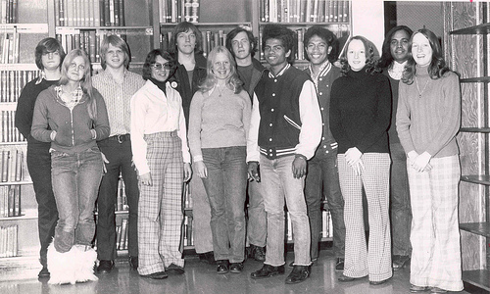
How college is paid for has changed
In 1970’s: 80% of the cost of attendance could be covered by a Pell grant
Today, less than 40%

Slide 36
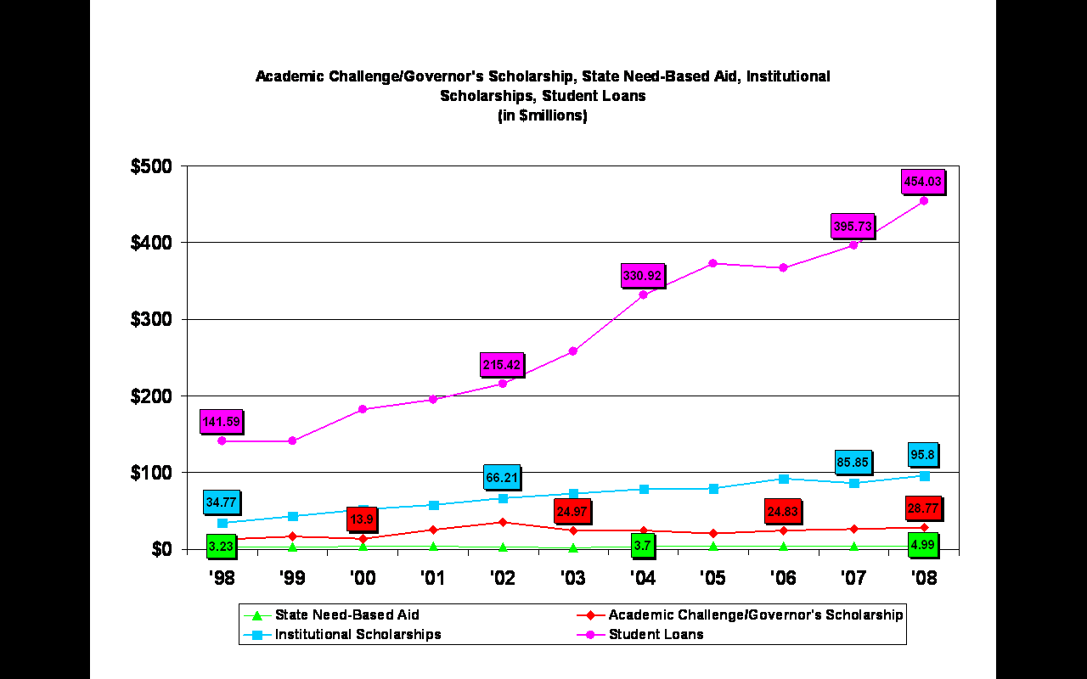

Slide 37
2005 Loan Default Rates
2.6%
2.3% (VT)
7.2%
6.9%
2.2% (DC)
7.1%
6.8%
(5th)
6.9%
2.0%
Source: U.S. Department of Education

Slide 38
2006 Loan Default Rates
2.4%
2.4%
2.3%
2.4% (VT)
7.4%
8.8%
9.7%
9.3%
7.6%
(4th)
Source: U.S. Department of Education

Slide 39
2007 Loan Default Rates
2.3%
3.1%
2.8%
9.3%
9.9%
9.0%
(4th)
8.8%
9.3%
Source: U.S. Department of Education

Slide 40
2008 Loan Default Rates
1.8%
2.9%
3.4%
9.9%
9.23%
9.6%
10.9%
10.15%
(2nd)
Source: U.S. Department of Education

Slide 41
U.S. Department of Education Official Student Loan Default Rates
 | Default Rate |  |  |  | Number of Loans In Repay |  |  |  | Number of Loans in Default
 | Fiscal year |  |  |  | Fiscal year |  |  |  | Fiscal year
 | 2006 | 2007 | 2008 |  | 2006 | 2007 | 2008 |  | 2006 | 2007 | 2008
ASUJ* | 7.7% | 8.2% | 10.1% |  | 4,371 | 3,862 | 3,787 |  | 338 | 317 | 408
ATU | 8.9% | 9.3% | 9.8% |  | 1,662 | 1,491 | 1,560 |  | 149 | 139 | 154
HSU | 6.2% | 6.8% | 9.8% |  | 1,065 | 961 | 857 |  | 67 | 66 | 84
SAUM | 10.4% | 11.5% | 11.6% |  | 749 | 691 | 723 |  | 78 | 80 | 84
UAF | 2.3% | 3.4% | 4.3% |  | 3,606 | 2,570 | 2,459 |  | 85 | 87 | 106
UAFS | 9.6% | 11.2% | 10.8% |  | 1,126 | 1,091 | 1,083 |  | 109 | 123 | 118
UALR | 6.9% | 8.9% | 9.1% |  | 3,649 | 3,032 | 2,967 |  | 255 | 270 | 272
UAM | 11.5% | 13.4% | 14.7% |  | 987 | 872 | 825 |  | 114 | 117 | 122
UAMS | 0.2% | 1.2% | 1.6% |  | 922 | 543 | 594 |  | 2 | 7 | 10
UAPB | 15.4% | 15.9% | 17.3% |  | 1,115 | 1,057 | 915 |  | 172 | 169 | 159
UCA | 6.9% | 6.4% | 9.4% |  | 2,650 | 2,455 | 2,483 |  | 184 | 162 | 234
Total | 7.1% | 8.3% | 9.6% |  | 21,902 | 18,625 | 18,253 |  | 1,553 | 1,537 | 1,751
US Average = 7.0%
*Includes ASUN, ASUMH.

Slide 43
Schools subject to loss of FFEL/FDSLP/Pell eligibility, 3 years of rates >=25.0%
A school subject to loss of eligibility to participate in the Federal Family Education Loan (FFEL) Program, William D. Ford Federal Direct Loan (Direct Loan) Program, and/or Federal Pell Grant Program has FY 2008, FY 2007, and FY 2006 official cohort ` rates that are 25.0% or greater. If a school fails to successfully appeal this sanction, it will lose eligibility to participate in the FFEL, Direct Loan, and/or Federal Pell Grant Program until September 30, 2012. For more information on this sanction and specific exceptions, please refer to the Cohort Default Rate Guide.

Slide 44
Cost of Courses Dropped Across the State

Slide 45
Cost of Courses Dropped Across the State
Interesting question
  Ws occur after all expenses of the course are encumbered. (faculty, facility assignment)
W’s scattered among classes
ADHE formula currently calculated on 80% of census date and 20% end-of-term (No ‘W’s or ‘I’s)
Current state funding of budget need is 77%

Slide 46
Interpolation
A rough calculation of student cost
 |  | Student Semester Credit Hours (SSCH)
 |  | Universities | Two-Year Colleges | All
Census Date |  | 2,138,637 | 1,221,291 | 3,359,928
End-of-Term |  | 1,876,907 | 1,032,902 | 2,909,809
Percent of Courses with I or W |  | 12.2% | 15.4% | 13.4%
Cost to Students In Tuition and Fees* |  | $55,169,310 | $16,113,854 | $71,283,163

Slide 47
ACT/SAT Cut Scores for Other States
Remediation cut scores of other states
2 Handouts

Slide 48
2010 Average ACT Scores by State
State | Percent of Graduates Tested | Average Composite Score | Average English Score | Average Math Score | Average Reading Score | Average Science Score
National | 47 | 21.0 | 20.5 | 21.0 | 21.3 | 20.9
Texas | 33 | 20.8 | 19.7 | 21.4 | 20.8 | 20.9
Georgia | 44 | 20.7 | 20.1 | 20.7 | 20.9 | 20.5
Illinois | 100 | 20.7 | 20.3 | 20.7 | 20.8 | 20.5
Oklahoma | 73 | 20.7 | 20.4 | 19.9 | 21.2 | 20.6
West Virginia | 64 | 20.7 | 20.7 | 19.6 | 21.3 | 20.6
Colorado | 100 | 20.6 | 19.9 | 20.4 | 21.1 | 20.7
Alabama | 78 | 20.3 | 20.4 | 19.5 | 20.7 | 20.2
Arkansas | 81 | 20.3 | 20.1 | 19.9 | 20.6 | 20.2 | 40th
Louisiana | 98 | 20.1 | 20.1 | 19.6 | 20.2 | 20.2
New Mexico | 66 | 20.1 | 19.3 | 19.7 | 20.5 | 20.2
Arizona | 28 | 20.0 | 18.9 | 20.4 | 20.2 | 19.9
South Carolina | 52 | 20.0 | 19.2 | 20.1 | 20.0 | 20.0
Wyoming | 100 | 20.0 | 19.0 | 19.8 | 20.4 | 20.1
District of Columbia | 29 | 19.8 | 19.5 | 19.9 | 20.2 | 19.2
Michigan | 100 | 19.7 | 18.9 | 19.7 | 19.7 | 19.9
Tennessee | 100 | 19.6 | 19.4 | 19.0 | 19.9 | 19.6
Florida | 65 | 19.5 | 18.6 | 19.7 | 20.1 | 19.1
Kentucky | 100 | 19.4 | 18.9 | 19.1 | 19.7 | 19.5
Mississippi | 96 | 18.8 | 18.6 | 18.3 | 18.8 | 18.8

Slide 49
Jim Purcell
Jim.purcell@adhe.edu
501-371-2030

