Slide 1

The Role of Early Remediation
in Preparing College-Ready Arkansas Students
Partnering for Progress Conference
November 20, 2013

Slide 2

Arkansas’ economy depends on improving college completion rates
28% of adults (25-64) in Arkansas currently hold postsecondary credentials
By 2018, 52% of all Arkansas jobs will require postsecondary education (Center on Education and Workforce at Georgetown University)
Arkansas’ high school graduation rate is 75% (2009-10)
60% of Arkansas public K-12 students are low income

Slide 3
Arkansas must grow its talent – and economy - from within
In the majority of counties in Arkansas, 30% or more high school graduates attend the same college

Slide 4
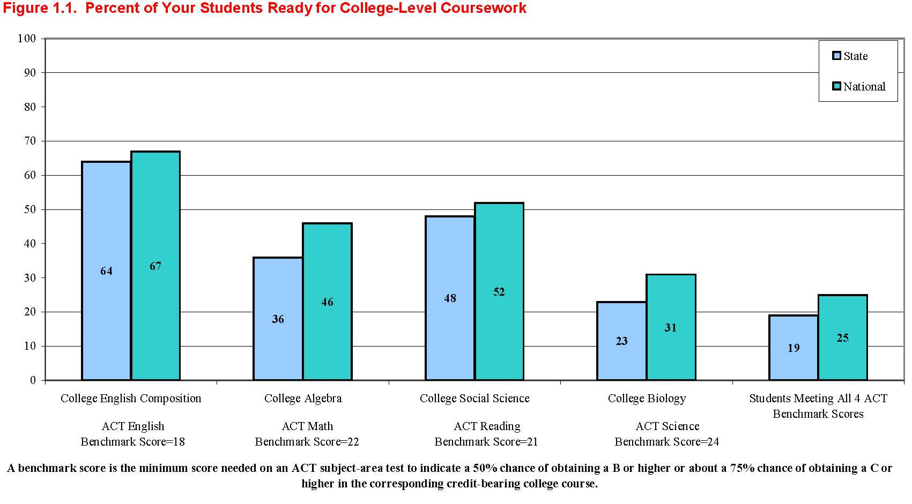
College assessments show not enough Arkansas students are prepared
19% of Arkansas students taking the ACT meet all 4 benchmarks (ACT, Fall 2011)

Slide 5
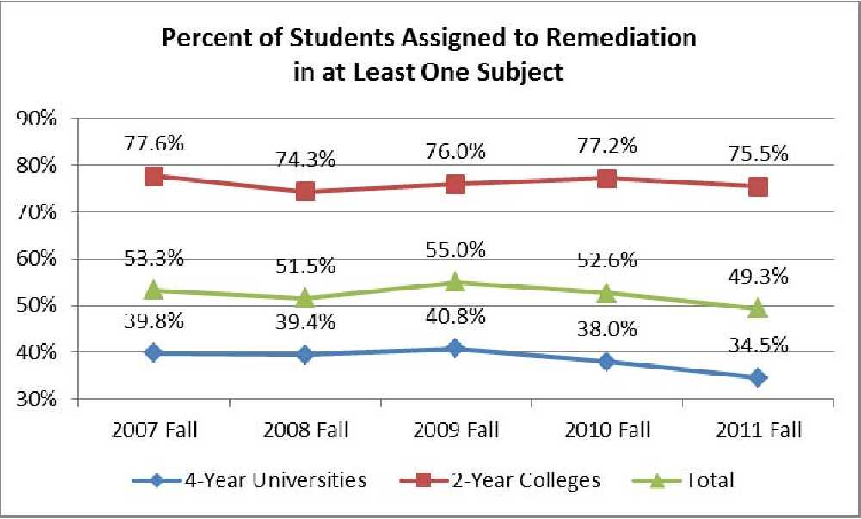
Entering college underprepared lowers a student’s chance of success
Almost half (49.3%) of all Arkansas students in 2- and 4-year colleges are placed in at least one remedial course

Slide 6
Arkansas is taking steps in the right direction
An early task force on poverty identifies education as a key pathway for upward mobility
State’s adoption of new K-12 standards (Common Core) helps with the alignment of expectations to postsecondary education
New Joint Task Force on Higher Education Remediation, Retention, and Graduation Rates sets stage for action

Slide 7
Moving forward
Assess the current ‘assessments’ – use reliable diagnostics
Improve data capacity and analysis
Analyze current developmental education programs to determine if they are working
Align K-12 and higher education standards – clearly define ‘college readiness’

Slide 8


