Slide 1

Arkansas Health Care Reform
Task Force: TSG Update
March 29, 2016

Slide 2
Agenda
Medicaid Spending by Category
Private Option Household Demographics
Status of Individuals with Zero Income
EEF Backlog
TSG Update on Monitoring of EEF Project
Consumer Satisfaction with Medicaid Managed Care
Experience Rebate Discussion
Modification and Nullification of Consent Decrees

Slide 3
Medicaid Spending by Category

Slide 4
Private Option Household Demographics Findings
251,670 Private Option beneficiaries as of the final quarter in 2015. (Note: TSG noted in 273,346 unique Private Option recipients as of February 2016)
44% of Private Option members are single and have income less than 50% of FPL
83% of Private Option members are at less than 100% of FPL
35% of Private Option members also receive SNAP benefits
2,441 Private Option members have higher education
4,616 Private Option members receive Unemployment Insurance
Less than ½% of Private Option members receive TANF benefits

Slide 5
0 - 40% FPL
123,759 (49%) were within the 0 to 40% of FPL category
1078 reported to be attending higher education
1819 reported that they were receiving UI benefits
50,460 reported they were receiving SNAP benefits
475 were receiving TANF benefits
91,667 (74%) reported they were living in a household size of one
14,068 (11%) reported they were living in a household size of 2
7,546 (6%) reported to live in a household size of 3
10478 (8%) reported to live in households with four or more

Slide 6
50 - 100% FPL
39,517 or 16% had incomes within the 100 to 138% FPL
452 reported to be attending higher education
920 reported that they were receiving UI benefits
7822 reported they were receiving SNAP benefits
93 were receiving TANF benefits
15,726 (40%) reported they were living in a household size of one
10,282 (26%) were living in a household size of 2
5935 (15%) reported to live in a household size of 3
7904 (20%) reported to live in households with 4 or more

Slide 7
100 - 138% FPL
39,517 or 16% had incomes within the 100 to 138% FPL
452 reported to be attending higher education
920 reported that they were receiving UI benefits
7822 reported they were receiving SNAP benefits
93 were receiving TANF benefits
15,726 (40%) reported they were living in a household size of one
10,282 (26%) were living in a household size of 2
5935 (15%) reported to live in a household size of 3
7904 (20%) reported to live in households with 4 or more

Slide 8
Nearly 60% of Private Option Members Fall Below 50% of FPL

Slide 9
35% of Private Option Members also Receive SNAP Benefits

Slide 10
Single-person Households at 0-50% of FPL Account for 44% of all PO

Slide 11
Members at 0-50% FPL are in Single Person Households
Households in the 50-100% FPL range are Much Larger

Slide 12
43,000 Households are at 100-138% of FLP
60% Live in Households of 1 or 2 people
5% more get SNAP benefits compared to the 13*+ group

Slide 13
61,000 PO Members are in the 50-100% FPL Group
52% Live in Households of 1 or 2 people 30% get SNAP benefits compared to 18% for the 100-138 group

Slide 14
155,000 PO Members are at less than 50% of FPL
81% are in households of 1 or 2 people
37% receive SNAP benefits

Slide 15
Status of Individuals on Private Option Reporting Zero Income
PO enrollees reporting zero income | 103,617
Also receiving SNAP | 41,826
Also receiving UI benefits | 1388
Also receiving Higher Ed Assistance | 759
Also receiving TANF | 397
Also receiving SNAP and TANF | 280

Slide 16
EEF Backlog: Pending Private Option Applications
Month | # Pending Applications
November 2015 | 70,776
December 2015 | 55,495
January 2016 | 56,969
February 2016 | 55,996
March 2016 as of March 21st | 48,091

Slide 17
TSG Monitoring of the EEF Project
TSG met with DHS and Gartner to monitor the progress of EEF Project #6 – Competitive Procurement System Integrator Services and #2 Define/Ratify Vision. Findings to date:
  Work on requirements for the RFP proceeding. Release of RFP to CMS will be slightly delayed by 2-3 weeks but overall procurement remains on track for 12/31/16 completion. RFP posting previously scheduled for mid-June will now be week first or second week of July
  Enterprise Visioning meetings continue and will culminate in a Governor’s report to be released in April timeframe.

Slide 18
TSG Monitoring of the EEF Project: Current Operations
All new applications and new renewals for recipients are being processed through Curam and the application/renewal processing through the Curam system is improving as additional fixes continue to be put into place
The backlog of renewals that occurred between November 2013 and June 2015 are being worked and slowly resolved over time
The number of DHS “Pending Applications” is trending lower, month by month

Slide 19
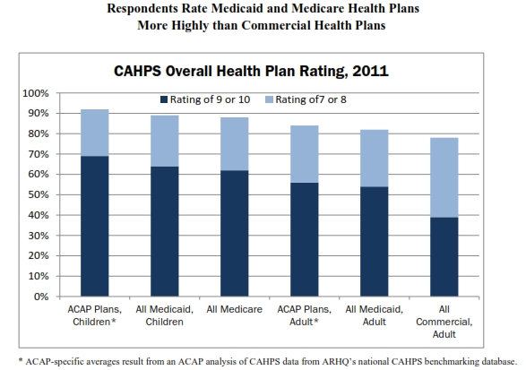
Enrollee Satisfaction with Medicaid Managed Care
Study by Association for Community Affiliated Plans
http://www.communityplans.net/Portals/0/Fact%20Sheets/ACAP%20-%20CAHPS%20Comparison%20of%20Managed%20Care%20Plans.pdf

Slide 20
Enrollee Satisfaction with Medicaid Managed Care
Other Findings
Florida, 2014 – Consumer satisfaction w/ Medicaid managed care is high. More than 70% overall satisfied.
  https://ahca.myflorida.com/medicaid/statewide_mc/pdf/SMMC_Quality_and_Performance_Snapshot.pdf
Texas, 2015 – High member satisfaction with Medicaid managed care
  http://tahp.org/images/reports/Sellers_Dorsey_Medicaid_Managed_Care_TX.pdf
California, 2011 – Seniors and disabled on Medicaid managed care more likely to report being ‘very satisfied’ than those in fee-for-service.
  http://www.ncbi.nlm.nih.gov/pubmed/22080719

Slide 21
Experience Rebate Description
Pre-tax Income as a % of Revenues | MCO Share | State Share
≤ 3% | 100% | 0%
> 3% and ≤ 5% | 80% | 20%
> 5% and ≤ 7% | 60% | 40%
> 7% and ≤ 9% | 40% | 60%
> 9% and ≤ 12% | 20% | 80%
> 12% | 0% | 100%

Slide 22
Modification or Nullification of Consent Decree
Mistake, inadvertence, surprise, or excusable neglect;
Newly discovered evidence that, with reasonable diligence, could not have been discovered in time to move for a new trial under Rule 59(b);
Fraud (whether previously called intrinsic or extrinsic), misrepresentation, or Misconduct by an opposing party;
The judgment is void;
The judgment has been satisfied, released or discharged; it is based on an earlier judgment that has been reversed or vacated; or applying it prospectively is no longer equitable; or
Any other reason that justifies relief.

