Slide 1
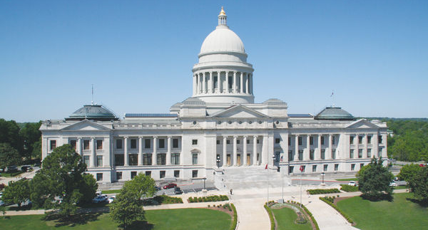

Senate Committee on Transportation, Technology and Legislative Affairs
House Committee on Public Transportation
Thursday, July 18, 2013

Slide 2
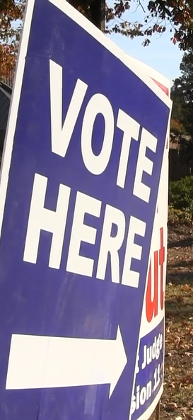
Recent Voter Approved Programs
November 2011
Interstate Rehabilitation Program
November 2012
Connecting Arkansas Program
Notes:
The road to improvement actually began in November of 2011. Voters passed the Interstate Rehabilitation Program. There are somewhere between 75 and 80 individual projects included. 81%
Approximately 60% of the work will be underway in the first three years (2013-2015); remainder spread out over the following 12 years (through 2027).
Then, as I said.. In November of last year, they overwhelmingly approved the Connecting Arkansas Program or CAP. 58%

Slide 3
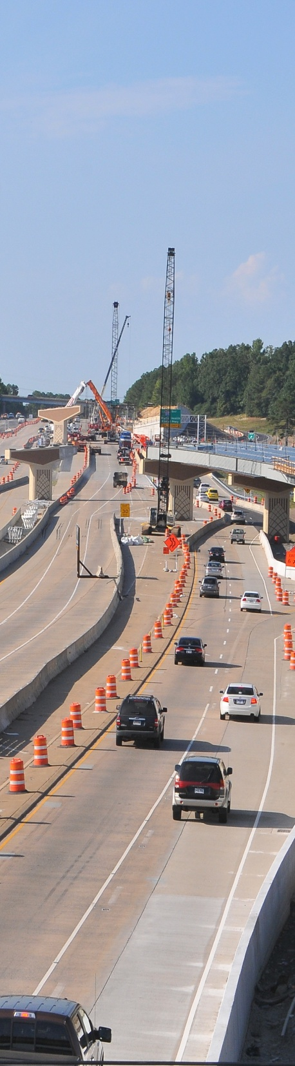
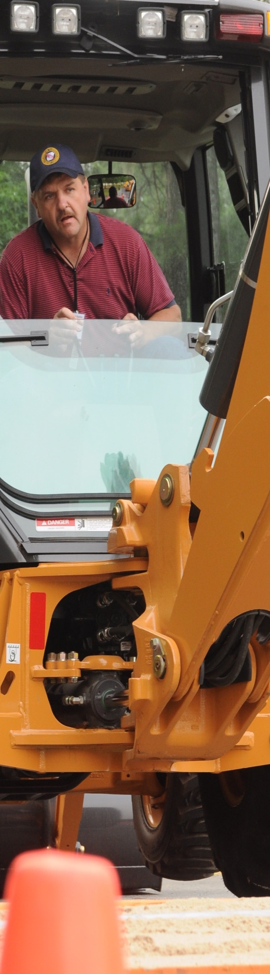
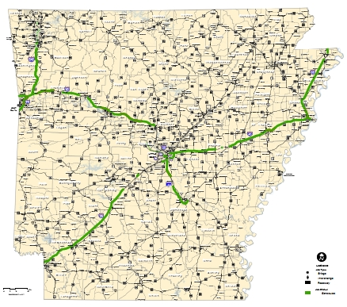
Interstate Rehabilitation Program
Planned
Projects
Notes:
This map shows the sections of the Interstate system that will be improved as part of the 2011 program.
There will be somewhere between 75 and 80 individual projects included.
Approximately 60% of the work will be underway in the first three years (2013-2015); remainder spread out over the following 12 years (through 2027).
3

Slide 4
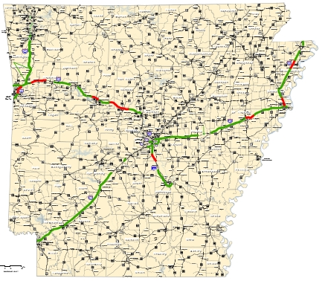
Interstate Rehabilitation Program
Construction
Planned
Projects
Planned
Projects
Notes:
On this map… the areas of red are projects currently let to contract. So we still have plenty to do.
4

Slide 5

Connects Arkansas
Increases Capacity
10-Year Revenue Cap
Notes:
The money used in the half cent tax funded the “Connecting Arkansas” Program. It’s a perfect name because that’s exactly what to does.. Connect the people of Arkansas. Cap is also short of “capacity” which is exactly what the program does. It greatly increases capacity and improves connectivity. The term CAP also relates to the deadline to have it all complete. We have a ten year revenue CAP on the entire project.

Slide 6

MAP GOES HERE
4+ Lane Highways (Existing, Under Construction, Scheduled , and Proposed)
Planned
Notes:
The areas in blue are the areas being improved. Believe it or not, this totals 1.8 billion dollars. When you look at it on a statewide map, it doesn’t look like much at all.
Here is what the CAP alone is doing here in Arkansas..
--$700 million in additional revenue to cities & counties
--An additional $20 million annually for State Aid City Street Program
--10-Year Program
Remember—this work is all in addition to our Interstate Rehabilitation Program already underway…

Slide 7
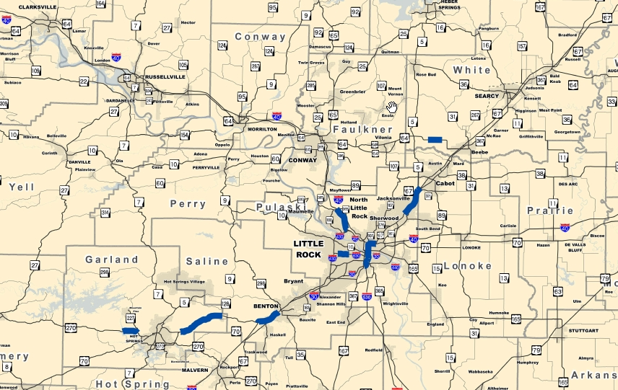
Highway 64
Turner Rd – Hwy 5
Interstate 40
Hwy 365 – I-430
Highway 70
Hot Springs - Hwy 128
Interstate 630
Bapt Hosp – Fair Park
Highway 67
Vandenberg – Hwy 5
Highway 67
Main St. - Vandenberg
Highway 270
Hwy 227 – Ouachita River
Interstate 30
I-530 – Hwy 67
Interstate 30
Hwy 70 – Sevier St.
Regional View
Central Arkansas
Notes:
Highway 70 (Widening) Interstate 30 & 40
Hot Springs to Highway 128 I-530 to Hwy 67
$40 million $300 million
Interstate 630 in Little Rock (Widening) Interstate 30
Baptist Hospital to Fair Park Blvd. Highway 70 to Sevier St
$50 million $75 million
Interstate 40 (Widening) Highway 270
Highway 365-I-430 Highway 227 to Ouachita River
$20 million $13 million
Highway 64 (Widening)
Turner Road to County Road 5
$30 million
Highway 67 (Widening)
Vandenberg (Air Base Exit) to Highway 5
$40 million
Highway 67 (Widening)
Main St. in Jacksonville to the Air Force Base
$25 million

Slide 8
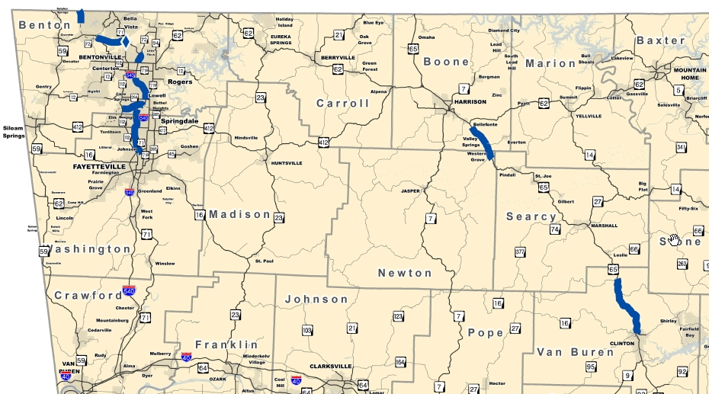
Bella Visa Bypass
Hwy 71
Interstate 540
Fayetteville - Bentonville
Springdale Bypass
Hwy 112 – I-540
Highway 65
Hwy 412 – Western Grove
Highway 65
Clinton - Dennard
Regional View
Northwest Arkansas
Notes:
In northwest Arkansas…
Bella Visa Bypass
Highway 71
$100 million
Interstate 540
Fayetteville to Bentonville
$125 million
Springdale Bypass
Highway 112 to Interstate 540
$150 million
Highway 65
Highway 412 to Western Grove
$45 million
Highway 65
Clinton – Dennard
$60 million

Slide 9
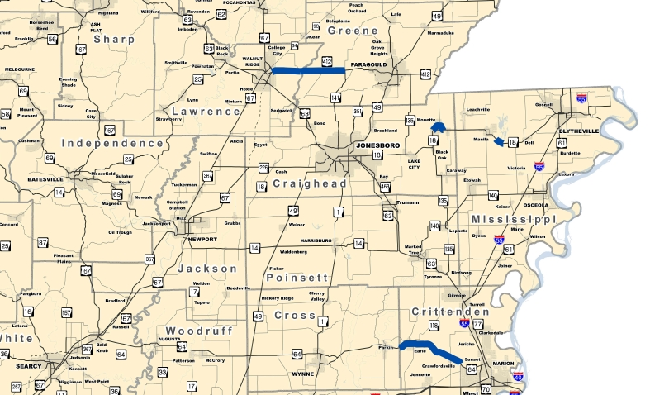
Highway 18
Manila - East
Highway 412
Hwy 67– Hwy 141
Highway 18
Monette Bypass
Highway 64
Cross Co – Hwy 147
Regional View
Northeast Arkansas
Notes:
Northeast Arkansas…
Highway 412
Highway 67 to Highway 41
$70 million
Highway 18 Manila - East
$24 million to widen to five lanes 2.4 miles on existing location
Highway 18/ Monette Bypass
Two projects scheduled to construct a 3.6 mile bypass to the north of Monette for $38 million. Grading and structures work is scheduled for late 2014. Base and Surface work will follow.
Highway 64
Cross Co. Line to Highway 147
$50 million

Slide 10
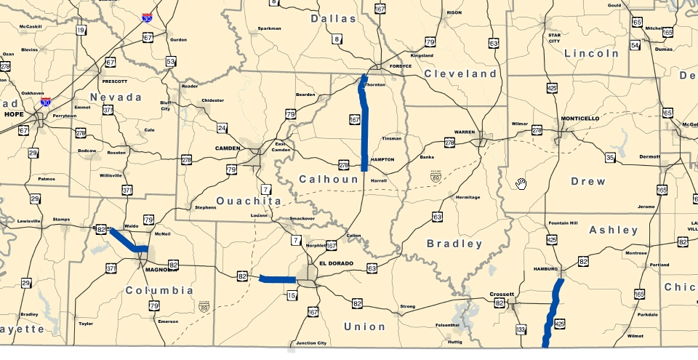
Highway 167
Hwy 79 – South
Highway 167
Hwy 274 - North
Highway 167
Hampton
Highway 167
Hampton – Hwy 274
Highway 82
Hwy 98 – Hwy 79
Highway 82
Hwy 83B- West
Highway 425
Hamburg – Hwy 82
Highway 425
Hwy 82 - State Line
Regional View
Southern Arkansas
Notes:
Southern Arkansas…
Highway 167 (Widening) Highway 425
Highway 79 – South Hamburg to Highway 82
$30 million $25 million
Widening Highway 82 to Louisiana State Line
Highway 274 – North $45 million
$45 million
Widening Highway 82 (Widening)
Hampton – Highway 274 Hwy 82B - West
$35 million $25 million
Improvements in Hampton Highway 98 to Hwy 79
$10 million $25 million

Slide 11
MAP GOES HERE
4+ Lane Highways (Existing, Under Construction, Scheduled , and Proposed)
Planned
Notes:
The areas in blue are the areas being improved. Believe it or not, this totals 1.8 billion dollars. When you look at it on a statewide map, it doesn’t look like much at all.
Here is what the CAP alone is doing here in Arkansas..
--$700 million in additional revenue to cities & counties
--An additional $20 million annually for State Aid City Street Program
--10-Year Program
Remember—this work is all in addition to our Interstate Rehabilitation Program already underway…

Slide 12
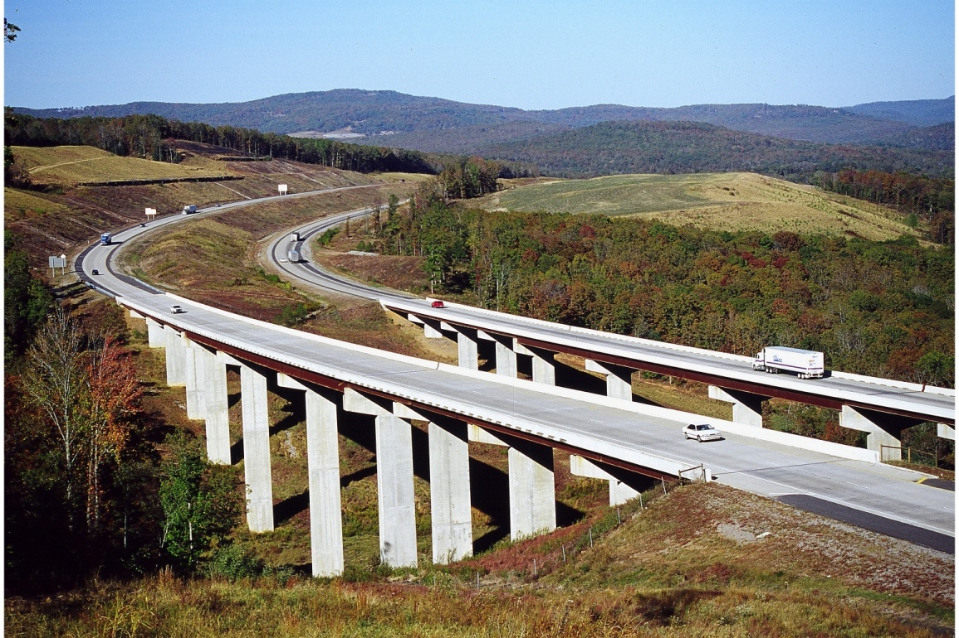
“It was the best of times,
it was the worst of times, . . .”
A Tale of Two Cities
Charles Dickens
Notes:
Projected revenue transferred over 10-year period to AHTD = $1.45 Billion
Projected revenue transferred over 10-year period to cities = $313 Million
Projected revenue transferred over 10-year period to counties = $313 Million
12

Slide 13
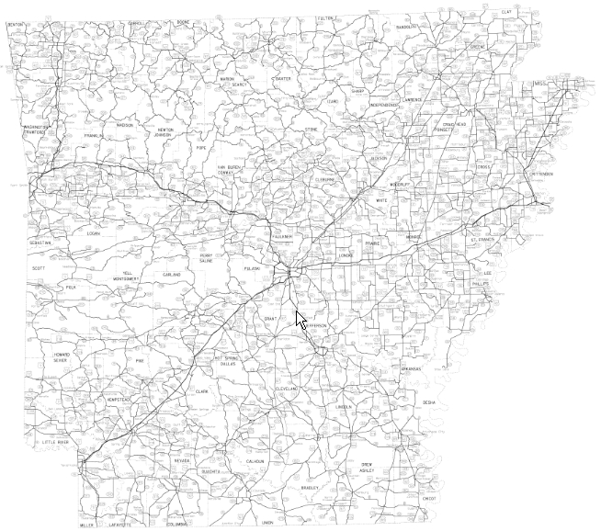
Needs vs. Revenue
Arkansas Highway System
16,400 miles
Notes:
There are 16,400 miles of Arkansas Highways.

Slide 14


Needs vs. Revenue
= 200 miles
= 450 miles
Notes:
Cap=about 200 miles of highway
IRP=450 miles of highway
16,400 mile system

Slide 15

Needs vs. Revenue
+
Total = 650 miles
3.9%
Notes:
Those two programs cover just 650 miles of the 16,400 mile system. That translates to just 3.9 percent.

Slide 16
    An additional $200 million annually is needed over the next 10 years
    for highway congestion, pavement and bridge conditions, maintenance, administration and operations to remain at current levels.
Notes:
Projected revenue transferred over 10-year period to AHTD = $1.45 Billion
Projected revenue transferred over 10-year period to cities = $313 Million
Projected revenue transferred over 10-year period to counties = $313 Million
16

Slide 17
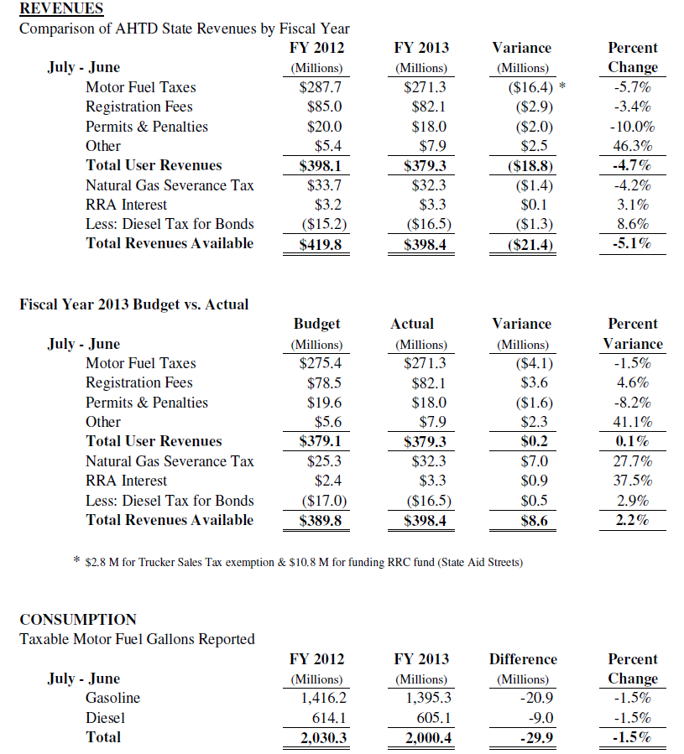
Revenues and Consumption
June 2013
Notes:
UP TO DATE FOR JUNE MEETING

Slide 18
HIGHWAY TRUST FUND
ESTIMATED FEDERAL HIGHWAY AND TRANSIT PROGRAM FUNDING LEVELS
WITH NO NET NEW REVENUES

Slide 19
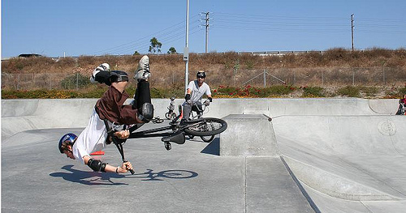
Status of Federal Highway Trust Fund
No Action = Crash!!

Slide 20
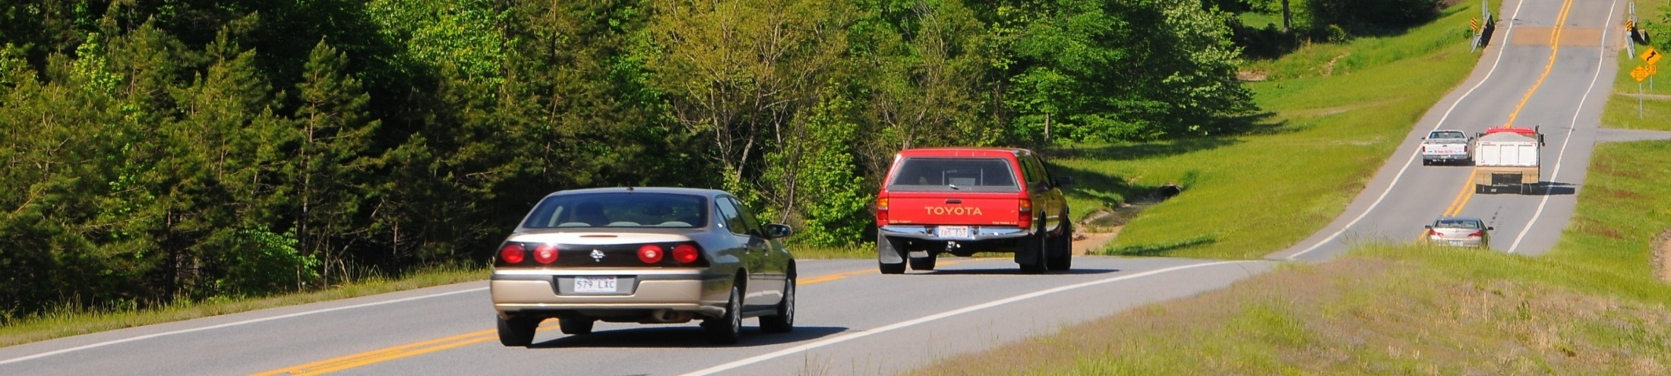
National Survey:
Americans Value Good Roads
78 %
Driving a motor vehicle is “Very” or “Extremely” important to conducting daily lives
Notes:
78 % Driving a motor vehicle is “Very” or “Extremely” important to conducting daily lives.

Slide 21
National Survey:
Americans Value Good Roads
88 %
Transportation infrastructure is important to maintaining a strong economy
Notes:
88 % Transportation infrastructure is important to maintaining a strong economy.

Slide 22
National Survey:
Americans Value Good Roads
83 %
Transportation network is important to ensuring national defense and emergency response
Notes:
83 % Transportation network is important to ensuring national defense and emergency response.

Slide 23
Average Monthly Household
Expenditures
Notes:
So if we value out highways so much.. And want them to improve.. Why do we spend so little on them?
As a state and a nation, we are under investing in our infrastructure. Even with the half cent sales tax passed back in November.
Most Americans have no idea how much money they pay every month to maintain roads, bridges and public transportation.
Compared to the average monthly American household expenditure on state and federal gas taxes used to fund surface transportation improvements necessary for mobility, data from the U.S. Department of Commerce and the Federal Highway Administration show the average household spends:
Nearly 3.5 times more monthly ($159) for electricity and natural gas
Nearly 3.5 times more ($161) for telephone service; and
More than 2.5 times more ($124) for cable and satellite television, radio and internet service.
19 percent more on internet service than on highways.

Slide 24
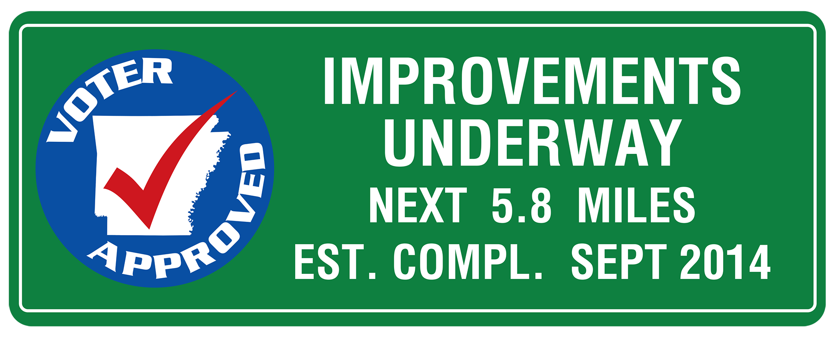

Slide 25

Coming Soon!!

Slide 26
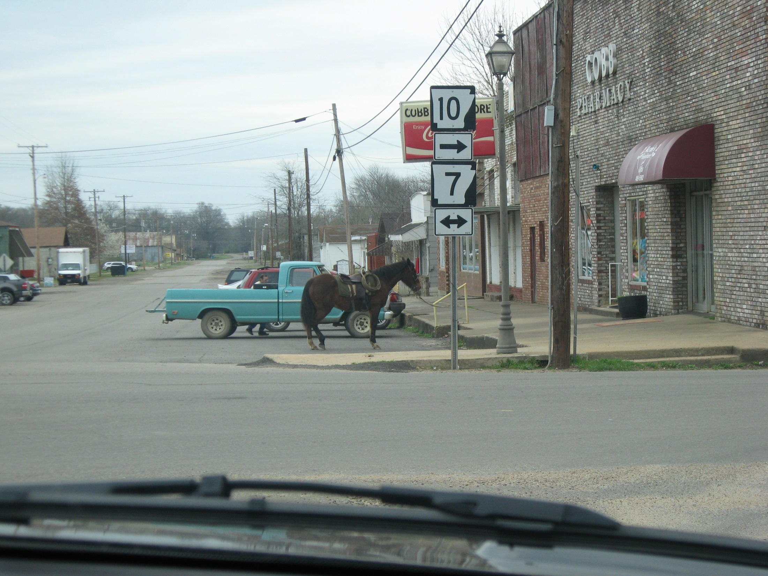

Slide 27
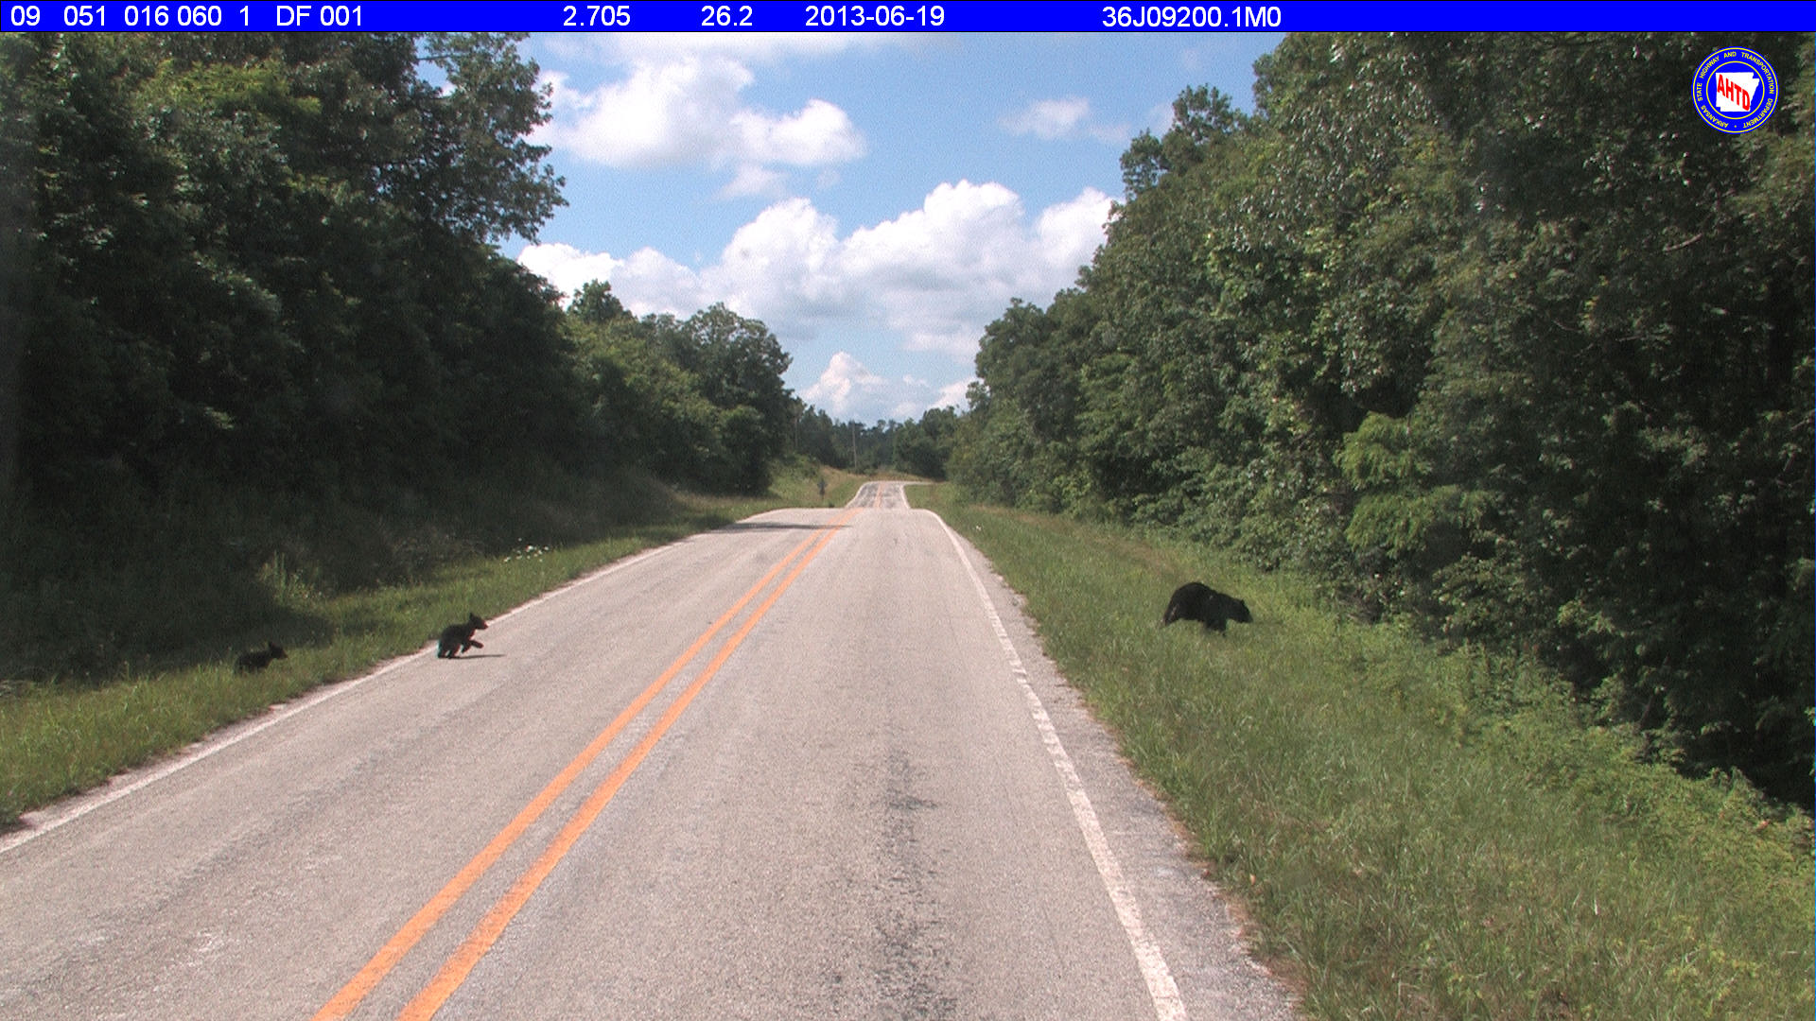

Slide 28
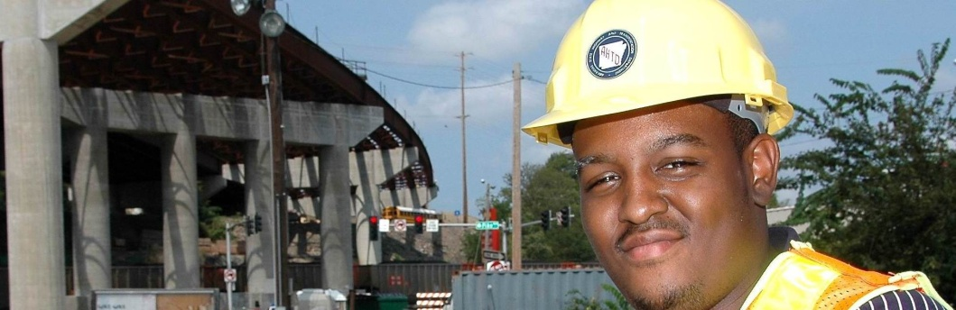

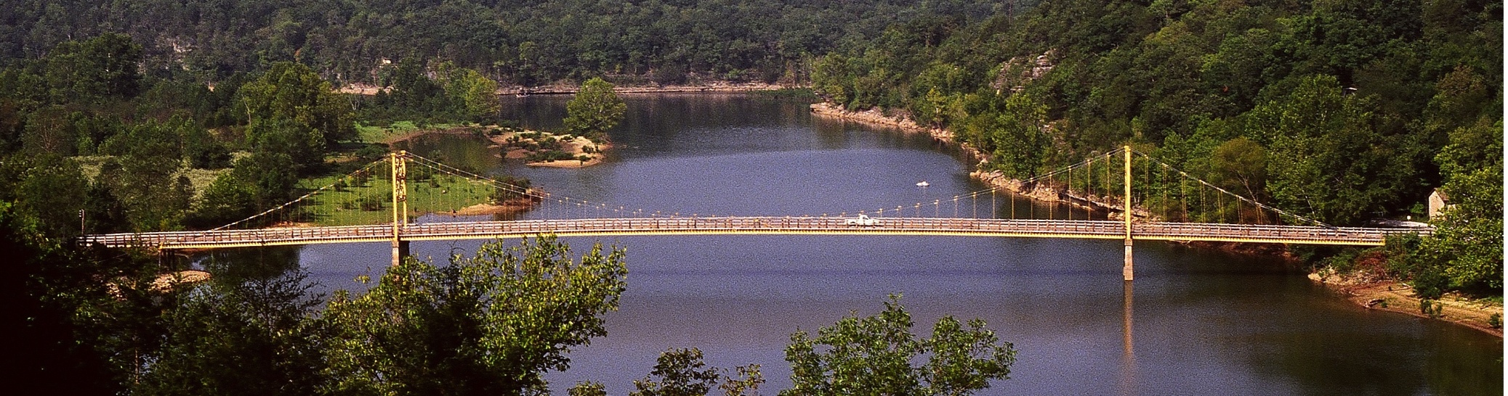
ArkansasHighways.com
Litter Hotline 866-811-1222
@AHTD
Notes:
A REMINDER:
You can get all your Arkansas travel information at ArkansasHighways.com.
Also, follow us on Twitter at AHTD.

Slide 29
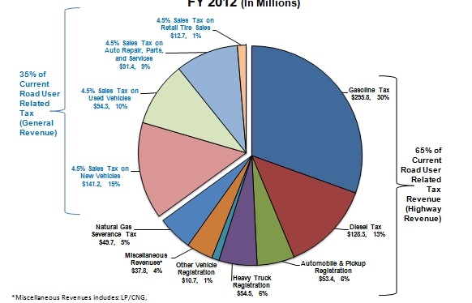
Road User State Tax Revenue
4.5% Sales Tax on
Retail Tire Sales
$12.7, 1%
>>>>>>>>>>
4.5% Sales Tax on
Auto Repair, Parts,
and Services
$91.4, 9%
35% of
Current
Road User
Related
Gas Tax
$295.8,
30%
4.5% Sales
Tax on Used Vehicles
$94.3, 10%
Tax
(Gen Rev)
65% of
Current
Road User
Related
4.5 % Sales
Tax on New
Vehicles
$141.2, 15%
Tax
Revenue
(Highway
Revenue
Natural Gas
Severance Tax
$49.7, 5%
Diesel Tax
$128.3, 13%
Miscellaneous
37.8, 4%
Other Vehicle
Registration
$10.7, 1%
Automobile & Pickup
Registration
$53.4, 6%
Heavy Truck
Registration
$54.5, 6%
…………………………………………..
Notes:
During the previous legislative session, we tried to increase revenue by transferring road user revenue to highways. It failed. The argument was.. You can’t use general revenue for highways. Our argument is that you have been using highway revenue for general fund revenue for years. Looking at this chart, we actually don’t quite get 65 percent of road user revenue to spend on highways, roads and streets. 35 percent goes for other purposes. We don’t think this is dipping into the general revenue fund. We think this is bringing it back where it belongs.
Miscellaneous Revenue:
LP/CNG, Oversize/Overweight Permits, Title Transfer Fees, Driver Search Fees, Interest and other fees.

