Slide 1

Arkansas Public School Choice Data Tracking System
Jim Boardman, Assistant Commissioner-Research & Technology
Cody Decker, Director-Information Systems
Arkansas Department of Education
{jim.boardman|cody.decker} @ arkansas.gov

Slide 2
Background
Ark. Code Ann. § 6-18-1907(c), created by Act 1227 of 2013, requires the Arkansas Department of Education to collect data from school districts on the number of school choice transfers and to report its findings to the House and Senate Education Committees by October 1 of each year.
ADE has developed a new system in the form of Public School Choice Data Tracking System (PSCS). The system is located on ADE Data Center at https://adedata.arkansas.gov/pscs and can be accessed by any district-level user with a valid Triand Username and password. The system is designed in a way to collect data on school choice transfers of students both into and out of each district. District Administrators were asked to complete the data entry for their districts by September 30, 2013.
System Launched September 18, 2013 under ADE Commissioners Memo COM-14-020.

Slide 3
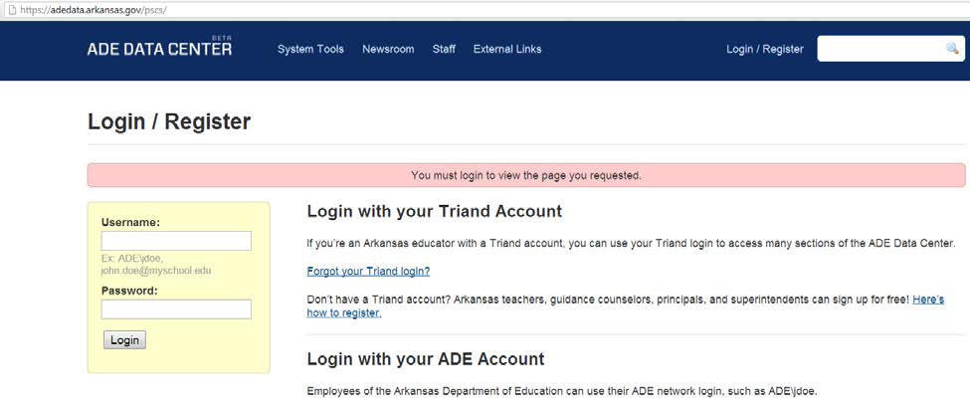
System Data Entry
Step 1: Login with valid username and password

Slide 4
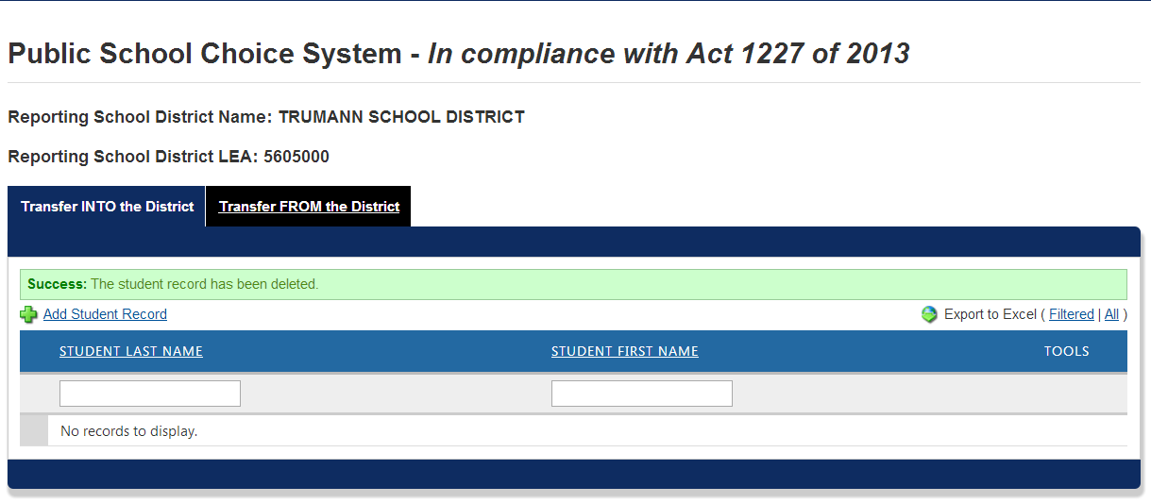
System Data Entry
Step 2: Verify Correct District Name and LEA Address

Slide 5
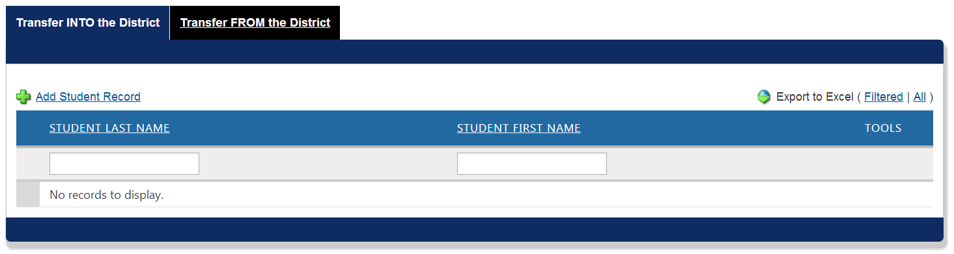
System Data Entry
Step 3: Select Transfer INTO of FROM tab to start adding student records.

Slide 6
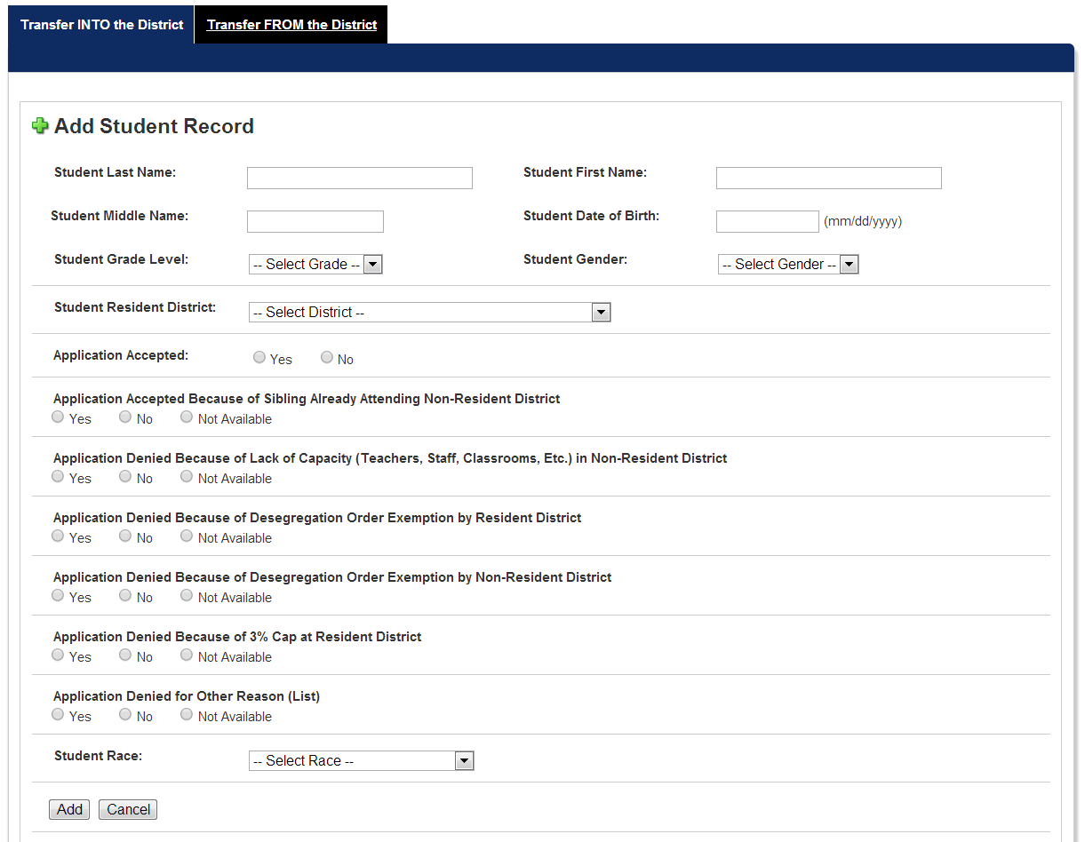
System Data Entry
Step 4: Input Student Records

Slide 7
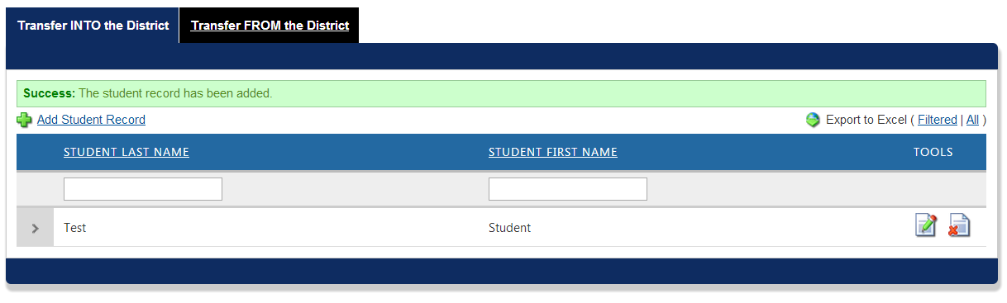
System Data Entry
Step 5: Verify Student Record. Confirm “Success” indicator message is displayed.

Slide 8
Data Review
Step 6: Review records through the website or by exporting to Microsoft Excel.

Slide 9
Legal & Technical Assistance
Tutorial URL
Act 1227 of 2013
Website Assistance:
ADE Research and Technology by e-mail at ade.rtweb@arkansas.gov or by phone at 501-683-5658.
Legal Assistance:
ADE Legal Services at 501-682-4227

Slide 10
Survey Results
Public School Choice Net Gain and Loss Report
Public School Choice Net Gain and Loss Report

Slide 11
Survey Results
Top (20) Districts with Most Net Gain in Students

Slide 12
Survey Results
Top (20) Districts with Most Net Loss in Students

Slide 13
Next Steps
Continue assisting districts and improving data quality. Supports will be available in the form of web, email and phone assistance in addition to web-based tutorials.
Analyze survey results with data submitted and certified through Arkansas Public School Computer Network
Explore technologies to pre-populate survey with student data from APSCN to improve and validate data

