Slide 1
VISION 2025 COMMISSION
November 8, 2013

Slide 2
Arkansas Higher Education Initiatives
Overview of the Blue Ribbon Committee on Higher Education
Review the Process of the Legislative Taskforce on Higher Education Remediation, Retention and Graduation Rates

Slide 3
There was the blue ribbon committee on Higher Education 2003-04
Before there was the Vision 2025
Commission (2013-16)
Before there was the Legislative Taskforce on Higher Education Remediation, Retention and Graduation Rates (2007-08)

Slide 4
Even further back
The Carnegie Foundation for the Advancement of Teaching’s report “Rise to excellence” 1988 Commissioned by the Arkansas Business Council (Good suit club) for $100,000. also in 1988 The committee on higher education conducted a similar study.
The Quality Higher Education Study Committee (QHESC) - Act 8 of 1983

Slide 5


Slide 6
The Good Suits Club Report
Arkansas Business Council: included Sam Walton, Charles Murphy, and Don Tyson
They issued a report in 1988 that endorsed most of the Carnegie study recommendations and added one on faculty tenure.
Stated their support for higher taxes in exchange for reforms and greater accountability. (Source: Southern Arkansas University , The Mulerider School’s Centennial History, 1909-2009. James F. Willis.)

Slide 7


Slide 8

The Committee on Higher Education
15 Member Body—6 legislators & 9 business and education leaders.
Many of same recommendations as the Good Suit Club.

Slide 9


Slide 10
The Blue Ribbon Committee on Higher Education
The study lasted six months—seven meetings.
Research provided by the ADHE, SREB, ACT, AEDC, SHEEO, and K-12 reports.
15 Members—all appointed by Governor Huckabee in 2004.
Senator Jim Hendren was a member [not in office at that time]. Almost all were business members.

Slide 11
The Blue Ribbon Committee on Higher Education
The report questioned the efficiency of the state’s system of higher education and asserted:
…we recognize that for Arkansas’ two- and four-year higher education institutions to perform at a level comparable to their peers and worthy of the investment made by Arkansas’ taxpayers, major structural reform of the existing system is necessary. Incremental change will not create meaningful improvement to the current situation.
We believe the recurring and explicit lack of any meaningful centralized governance is at the heart of our higher education performance issues.

Slide 12

ACCESS TO SUCCESS
The report from the Legislative Task Force on Higher Education Remediation, Retention and Graduation Rates
August 2008
INCREASING ARKANSAS'S
COLLEGE GRADUATES PROMOTES
ECONOMIC DEVELOPMENT

Slide 13
Higher Education Initiatives
Understand the Setting or Current Reality
Define the Problem-Challenges (Limits to Scope)
Establish a Goal(s)
Identify Resources-Strengths
Propose Solutions (Recommendations) – Set Benchmarks
Be Guided by the Legislation - Act 1082 of 2013

Slide 14
Challenges
An outline of challenges provided a framework for the research and recommendations.
Strengthening the Arkansas Education Pipeline
Improving Preparation
Decreasing Remediation
Accessing Financial Aid
Increasing Retention and Graduation
Enhancing funding and Governance
Addressing Data Needs
Supporting Economic Development

Slide 15
TASKFORCE MEMBERS
15 appointed positions
  Limited to 4 Legislators
  Agency Representatives
    Higher Education
    Education (K-12)
  Practitioners
    Deans, Faculty
    Administrative Personnel
    Four-Year and Two-Year Institutions

Slide 16
Task Force Meetings
Started meeting in September 2007
Met 16 times
Utilized three work groups
  K-12
  Two-Year Institution
  Four-Year Institution
These groups met numerous times to consider research and recommendations central to their particular concerns.

Slide 17
Research Based - Speakers
Fall Two Day Workshop
Dr. Dave Spence, President, SREB
Dr. John Ahlen, President, ASTA
Dr. Julie Bell, Ed. Program Director, NCSL
Dr. Dennis Jones, President, NCHEMS
Dr. Joe Marks, Director, SREB
Mr. Richard Kazis, Senior VP, Jobs for the Future
Spring Workshop
Governor Beebe
Kati Haycock, President, Education Trust

Slide 18
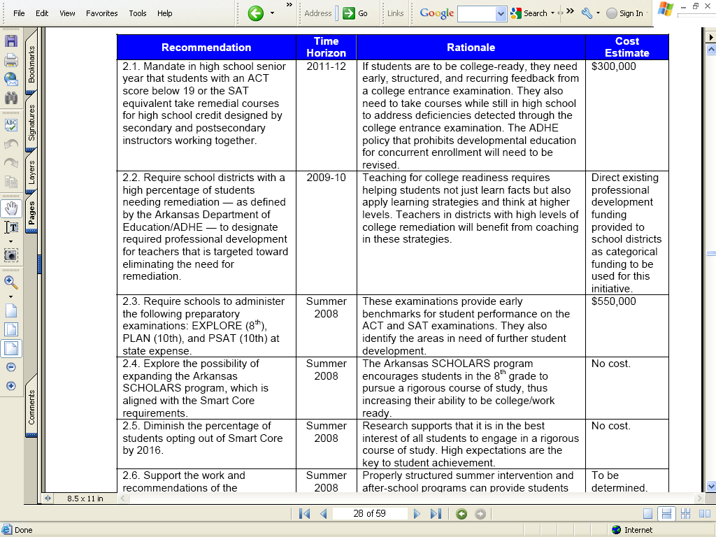
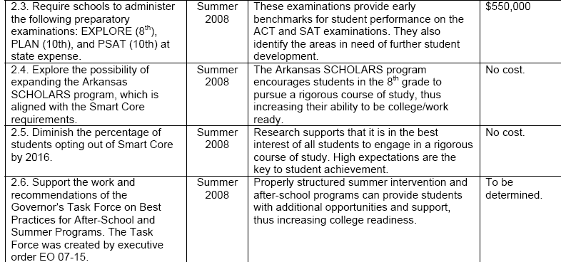
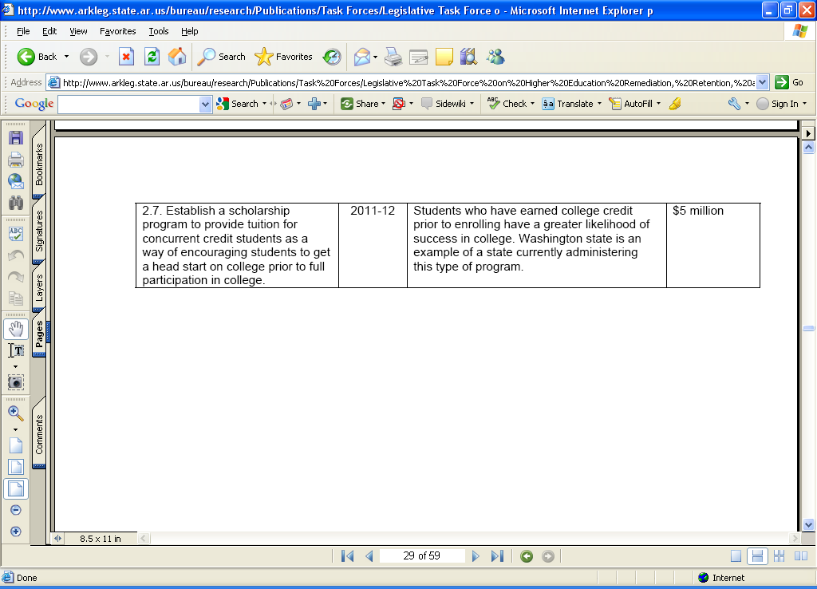
Task Force Initial Recommendations

Slide 19
Tracking Progress on Recommendations
Recommendation | Report Page No. | Time Horizon | Bill Number | Bills and Other Actions | Sponsor | Bill Status
1.6. Require each college and university to develop a transfer plan to increase the number of students who transfer between institutions to earn bachelor’s degrees. The plan should include a mechanism for coordinating financial aid between institutions and innovative approaches for a seamless transfer. Colleges and universities will work with ADHE to continue developing the Arkansas Course Transfer System, which should have a common course numbering system as a component. | 26 | 2011-12 | HB1357 of 2009 | An act to create a system for fully transferable credit hours from degrees in associate of arts, associate of science, and associate of arts in teaching among public institutions of higher education | M. Burris | Signed as Act 182 of 2009
 |  |  | HB1772 of 2011 | An act to enhance the opportunity for successful degree completion by strengthening the transfer of courses between institutions of higher education; to expand the Roger Phillips transfer policy; to clarify which courses are prerequisite courses; to establish a statewide common course numbering system for postsecondary courses | Roebuck | Signed as Act 747 of 2011
1.7. Encourage students who have transferred to a four-year university without earning a degree to transfer back (reverse transfer) credit hours that are needed to award an associate’s degree or certificate. | 26 | 2010-11
1.8. Recommend colleges and universities increase adult participation in higher education through programs such as the Beck PRIDE Center at Arkansas State University for veterans and inmate or parolee education programs. | 26 | 2011-12 | HB1894 of 2009 | An act to authorize the Department of Correction to expand the skills training program and educational opportunities for inmates in the Department of Correction | Blount | Signed as Act 788 of 2009
OTHER MEASURES AIMED AT STRENGTHENING THE EDUCATION PIPELINE |  |  | HB1956 of 2009 | An act to create the Arkansas Project Graduation Commission | Word | Signed as Act 1306 of 2009

Slide 20
Summary: How to Get it Done
Build Support
Identify Action Needed and Actors to Complete the Action
Track Progress

