Slide 1
Workforce Education
At Springdale High School

Slide 2
Springdale High School
Over 2250 students
Grades 10-12
52% Hispanic, 37% Caucasian, 8% Marshallese, 3% African American
66% Free & Reduced Lunch Status
5 Pocket Academies
19 Advanced Placement classes offered
International Baccalaureate School
Comprehensive High School
22 Career Technical Teachers (15% of faculty)

Slide 3
Over 70 CTE Course offerings
  Computer Applications
  Business Law
  Computerized Accounting
  Advanced Placement Computer Science
  Advertising and Design
  Marketing Management
  Civil Engineering and Architecture
  Robotics and 3D Modeling
  TV Broadcasting
  Greenhouse Management
  Agriculture Food Science
  Beef and Poultry Science
  Childcare Management
  Culinary Arts
  Medical Procedures
  Medical Terminology

Slide 4

Pocket Academies at SHS
5 Pocket Career Academies
  Medical Professions
  Engineering and Architecture
  Law and Public Safety
  Informational Technology
  Agriculture and Food Science

Slide 5
1991 SHS Joins HSTW
High Schools That Work (HSTW) was established in 1987 by the SREB State Vocational Education Consortium, a partnership of SREB, its member states, their school systems and school sites.

Slide 6
HSTW uses research-proven strategies to help states transform their public high schools into places where all students learn at high levels.
The program is based on the belief that most students can master complex academic and technical concepts if schools create an environment that encourages students to make the effort to succeed. Member schools implement 10 Key Practices for changing what is expected of students, what they are taught and how they are taught.

Slide 7
30 States Involved
HSTW has grown from 28 pilot sites in 13 states to its current size of more than 1,200 sites in 30 states and the District of Columbia, including: Alabama, Arkansas, Delaware, Florida, Georgia, Hawaii, Idaho, Illinois, Indiana, Kansas, Kentucky, Louisiana, Maryland, Massachusetts, Mississippi, Missouri, Nebraska, New Jersey, New Mexico, New York, North Carolina, Ohio, Oklahoma, Pennsylvania, South Carolina, South Dakota, Tennessee, Texas, Virginia and West Virginia.

Slide 8
Southern Regional Education Board
SREB (Southern Region Education Board) is a nonprofit, nonpartisan organization headquartered in Atlanta.
Member states are Alabama, Arkansas, Delaware, Florida, Georgia, Kentucky, Louisiana, Maryland, Mississippi, North Carolina, Oklahoma, South Carolina, Tennessee, Texas, Virginia and West Virginia.

Slide 9
Southern Regional Education Board
SREB was created in 1948 by Southern governors and legislators who recognized the link between education and economic vitality. To this day, the organization maintains its focus on critical issues that hold the promise of improving quality of life by advancing public education. The region’s track record shows that setting goals and maintaining the commitment to work toward them can make a difference.

Slide 10
Standards
SREB is working intensively in member states to help them implement SREB’s College- and Career-Readiness Action Agenda, consisting of these essential statewide components:
1. Adopt statewide readiness standards for literacy and mathematics
skills students need to succeed in postsecondary study.
2. Assess high school juniors to determine their progress in achieving the
readiness standards.
3. Hold schools accountable to increase postsecondary readiness as an
important criterion in school accountability systems.

Slide 11
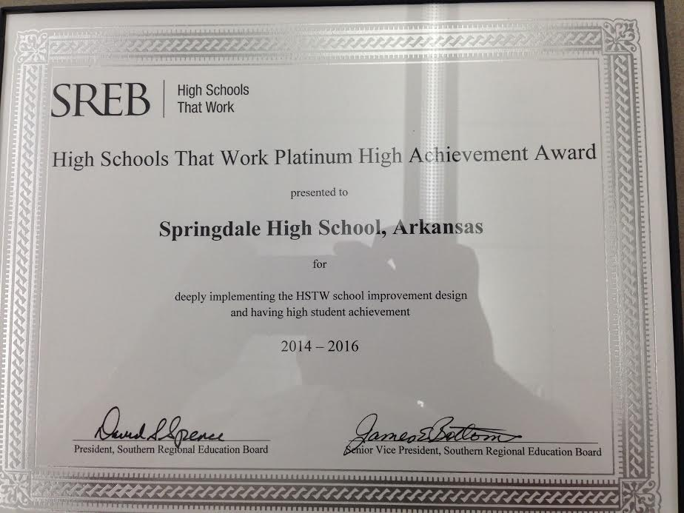

Slide 12
Criteria for Award
At least 85% of SHS seniors met one of more career readiness goals.
At least 85% of SHS seniors completed one or more parts of the HSTW recommended curriculum, for graduation, which includes:
  4 English classes.
  4 math classes.
  3 science classes.
  3 social studies classes.
  A career or academic concentration.
At least 85% of seniors completed at least one recommended academic or career concentration.

Slide 13
Criteria for Award
At least 50 seniors completed the 2014 HSTW Assessment (or at least 75% of the senior class if it is fewer than 60 seniors).
Met state AYP or had a graduation rate of at least 85% (stated-reported data).

Slide 14
What’s Next?
Getting better and getting better!

