Slide 1
Foreign Language is an essential for college-bound students
Jennifer Deacon
American Association of Teachers of French, Arkansas Chapter
2011 Arkansas Foreign Language Teacher of the Year

Slide 2
Foreign Language Initiatives

Slide 3

Partnership for 21st Century Skills

Slide 4

Partnership for 21st Century Skills
http://www.p21.org/index.php

Slide 5

P21 Founders

Slide 6

Mission of P21

Slide 7

Core Subjects and Themes of P21

Slide 8

Critical Themes of P21
These themes are covered in the Arkansas Foreign Language Teaching Frameworks.
http://arkansased.org/educators/curriculum/fl_frameworks.html

Slide 9


























Today’s Strategic Council Members

Slide 10

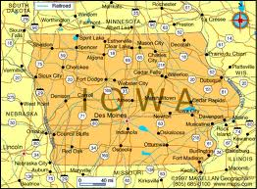
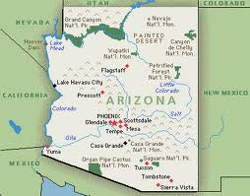
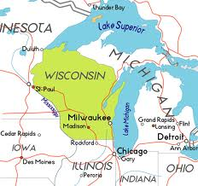
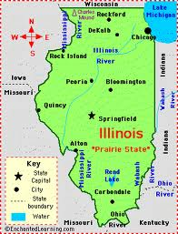
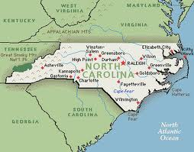

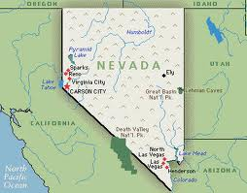
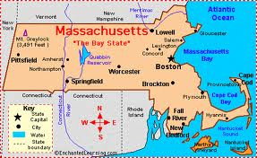
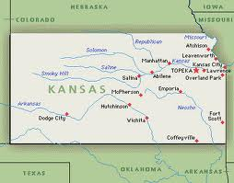
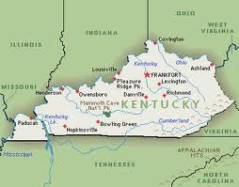
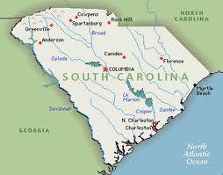

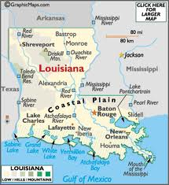
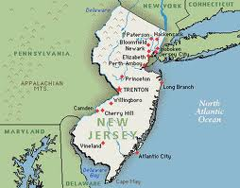
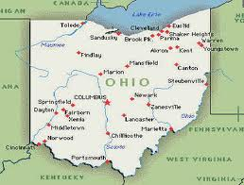
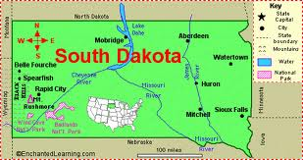
State Initiatives
Arizona
Illinois
Iowa
Kansas
Kentucky
Louisiana
Maine
Massachusetts
Nevada
New Jersey
North Carolina
Ohio
South Dakota
South Carolina
West Virginia
Wisconsin

Slide 11

http://route21.p21.org/index.php?option=com_content&view=article&id=41&Itemid=35

Slide 12
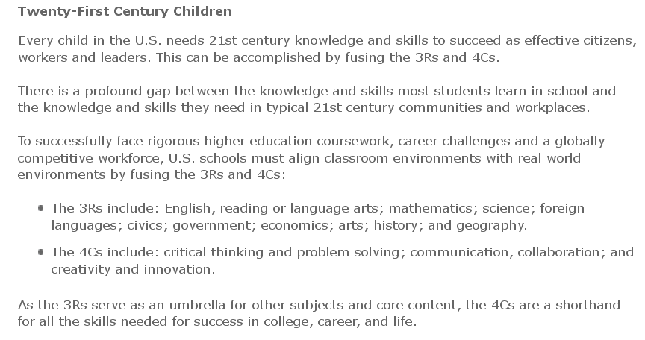
21st Century Children

Slide 13
Higher Academic Performance

Slide 14
Higher SAT Scores
Comparison of verbal (SAT) and California Achievement Test (CAT) supported the conclusion that length of foreign language study was positively related to high SAT verbal scores.
Regardless of economic background, students who study a foreign language perform better on the verbal section of the SAT than those who don’t; and the longer they study, the better they perform.
Comparisons of eleventh grade Maryland students found that, students who study foreign language for longer periods of time will do better on various SAT sub-tests and on the SAT-Verbal as a whole.
Cooper, T. C. (1987). Foreign language study and SAT-verbal scores. Modern Language Journal, 71(4), 381-387.
Eddy, P. A. (1981). The effect of foreign language study in high school on verbal ability as measured by the scholastic aptitude test-verbal. Final report. U.S.; District of Columbia.

Slide 15
National SAT Scores 2010
http://professionals.collegeboard.com/profdownload/cbs2011_total_group_report.pdf

Slide 16
Arkansas SAT scores 2010
http://professionals.collegeboard.com/profdownload/AR_11_03_03_01.pdf

Slide 17
National SAT Scores 2010
http://professionals.collegeboard.com/profdownload/cbs2011_total_group_report.pdf

Slide 18
Arkansas SAT scores 2010
http://professionals.collegeboard.com/profdownload/AR_11_03_03_01.pdf

Slide 19
Foreign Language Student Breakdown
http://professionals.collegeboard.com/profdownload/cbs2011_total_group_report.pdf

Slide 20
Foreign Language Student Breakdown
http://professionals.collegeboard.com/profdownload/AR_11_03_03_01.pdf

Slide 21
Higher ACT Scores
Analysis of the ACT scores of 17,451 students applying for college admission found that students who studied a foreign language in high school consistently scored higher on ACT English and mathematics components than did students who did not.
The result of a test at Southern Illinois University at Carbondale found that for each group, “gifted” and “non”, years of study led to improved composite ACT scores, with the highest effect on scores in the English subsection of the test.
Olsen, S.A., Brown, L.K. (1992). The relation between high school study of foreign languages and ACT English and mathematics performance. ADFL Bulletin, 23(3).
Timpe, E. (1979). The effect of foreign language study on ACT scores. ADFL Bulletin, 11(2), 10-11.

Slide 22
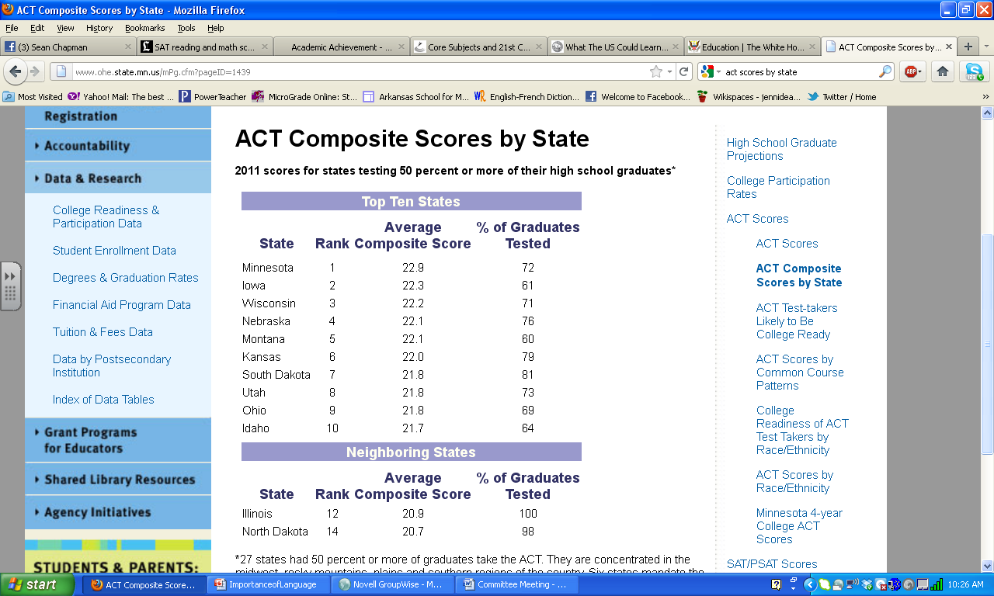
ACT Score Rankings by State
http://www.act.org/newsroom/data/2011/states.html#begincontent
http://www.ohe.state.mn.us/mPg.cfm?pageID=1439

Slide 23
State WL Requirements
Minnesota-local decision
Iowa-P21 State
Wisconsin-P21 State
Kansas-P21 State, schools must offer WL, Students wishing to qualify as Regents Scholar and for Qualified Admissions require two (2) years.
South Dakota-P21 State
Utah-Required for upper College Ready Diploma. Also required for the state Regents scholarship.
Ohio-P21 State, requirement for an Honors Diploma
http://www.ncssfl.org/docs/States%20with%20Foreign%20Language%20Graduation%20Requirements%20-%20%20Revised%202010.pdf

Slide 24
Courses Count

Slide 25
College Readiness
“Taking specific course sequences in high school has a direct effect on students’ ACT scores, and thus on their preparedness for college-level course work. In particular, taking a foreign language and upper-level mathematics and science courses is associated with significant increases in ACT English, Mathematics and Science scores. This is true regardless of students’ prior achievement and grade level at the time of testing.”
Issues of College Readiness by ACT, 2004
http://www.act.org/research/policymakers/pdf/2004-3.pdf

Slide 26
Courses Count
Cross-disciplinary benefits of specific courses
Taking at least one foreign language increased both achievement and the chances of being successful in college English Composition beyond the English sequence alone.”
Taking one or more foreign languages over and above English 9–11 increased students’ ACT English score by 1.1 points.
Foreign languages was typically associated with a 9% increase in students’ chances of meeting or exceeding the benchmark (to 87 percent).
Courses Count: Preparing Students for Post-Secondary Succss: ACT Policy Report 2005

Slide 27
College Success
“Students who take higher-level English courses and a foreign language in high school are less likely to need remediation in English than those who do not take these courses (by up to 31 percentage points), regardless of gender, race/ethnicity, or family income.”
There is a correlation between high school foreign language study and higher academic performance at the college level stating that students who studied foreign language perform better academically in college than students of equal academic ability who do not take a foreign language.
Wiley, P. D. (1985). High school foreign language study and college academic performance. Classical Outlook, 62(2), 33-36.
What We Know about College Success: Using ACT Data to Inform Educational Issues, ACT Policy, 2008
http://www.act.org/research/policymakers/pdf/what_we_know.pdf

Slide 28
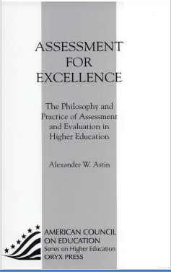
Higher College Retention
Astin, Alexander W. “Assessment for Excellence: The Philosophy and Practice of Assessment and Evaluation in Higher Education.” (1991)

Slide 29
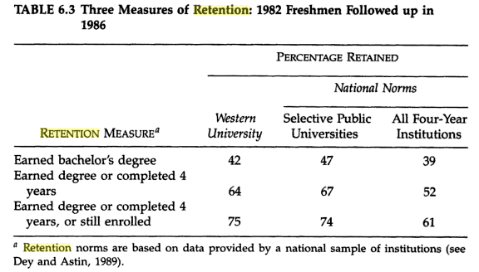
Concluded that Foreign Language was a factor in the higher retention rate.

Slide 30
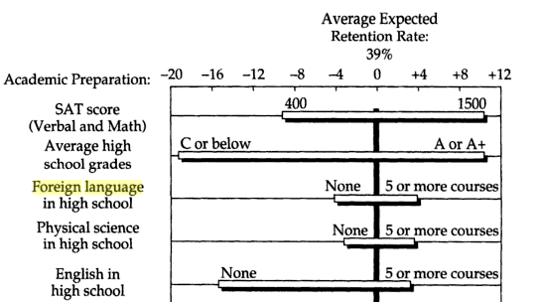
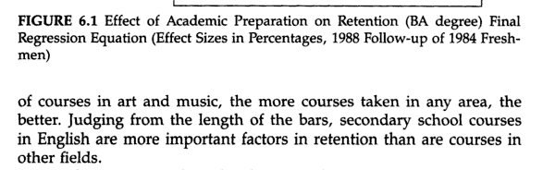
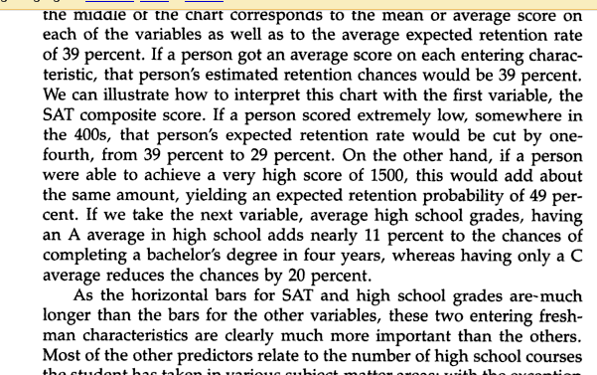

Slide 31
Reading Comprehension
In the area of language arts, students of second languages are thought to improve their reading comprehension in the native language and also score higher in reading achievement, including vocabulary, cognitive learning, and total reading ability.
Masciantonio, R. (1977). "Tangible Benefits of the Study of Latin: A Review of Research." Foreign Language Annals, Vol. 10, #4.
Listening Skills
Foreign language study has been shown to enhance listening skills and memory and the development of second language skills can contribute a significant additional dimension to the concept of communication.
Rattle, E. H. (1968). "Foreign Language in the Elementary School Language Arts Program." The French Review, Vol. 42.

Slide 32
Basic Skills
The results of this study indicate that regardless of their race, sex, or academic level, students in foreign language classes outperformed those who were not taking foreign language on the Louisiana's Basic Skills Tests despite gender or race.
Rafferty, E. A. (1986). Second Language Study and Basic Skills in Louisiana. Baton Rouge: Louisiana Department of Education.
Cognitive Ability
Children who have studied a foreign language show greater cognitive development in such areas as mental flexibility, creativity, divergent thinking and higher order thinking skills.
Foster, K. and C. Reeves (1989). "FLES Improves Cognitive Skills.“ FLES News 2 (3), 4-5.

