Slide 1

Arkansas State Parks
State Agencies and Governmental Affairs Committee June 19, 2012

Slide 2
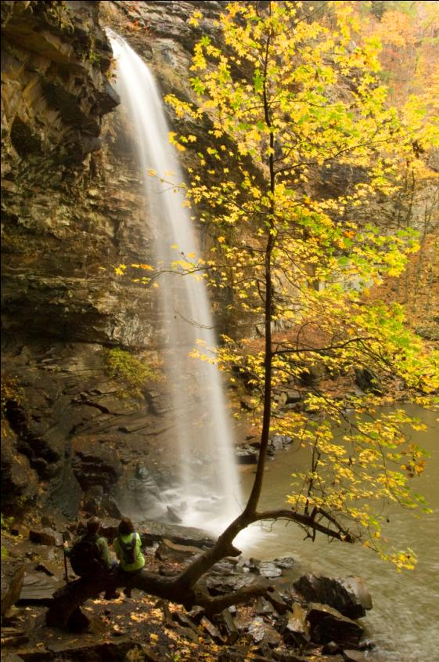
Arkansas State Parks
The state parks are natural
and historic treasures that
belong to each and every
Arkansan...
native and newcomer,
those of us who regularly
visit the parks, and those
who have never stepped
foot in one.
Simply put, Arkansas’s
state parks are
“your” state parks.
Cedar Falls,
Petit Jean State Park

Slide 3
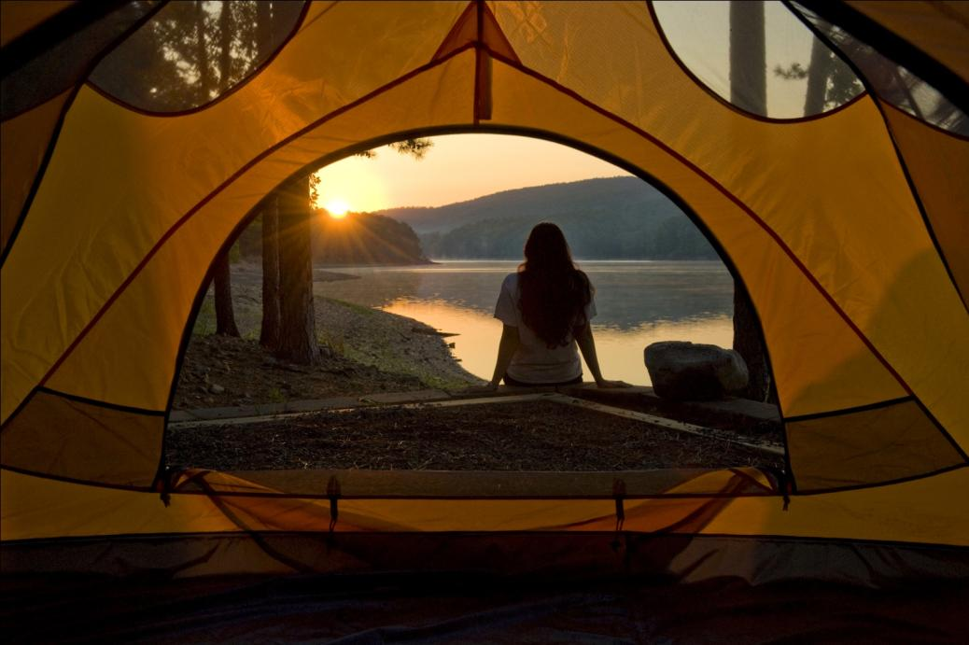
Arkansas State Parks
The parks are
an integral part of the quality of life we enjoy here in Arkansas—
The Natural State.
Lake Ouachita State Park

Slide 4
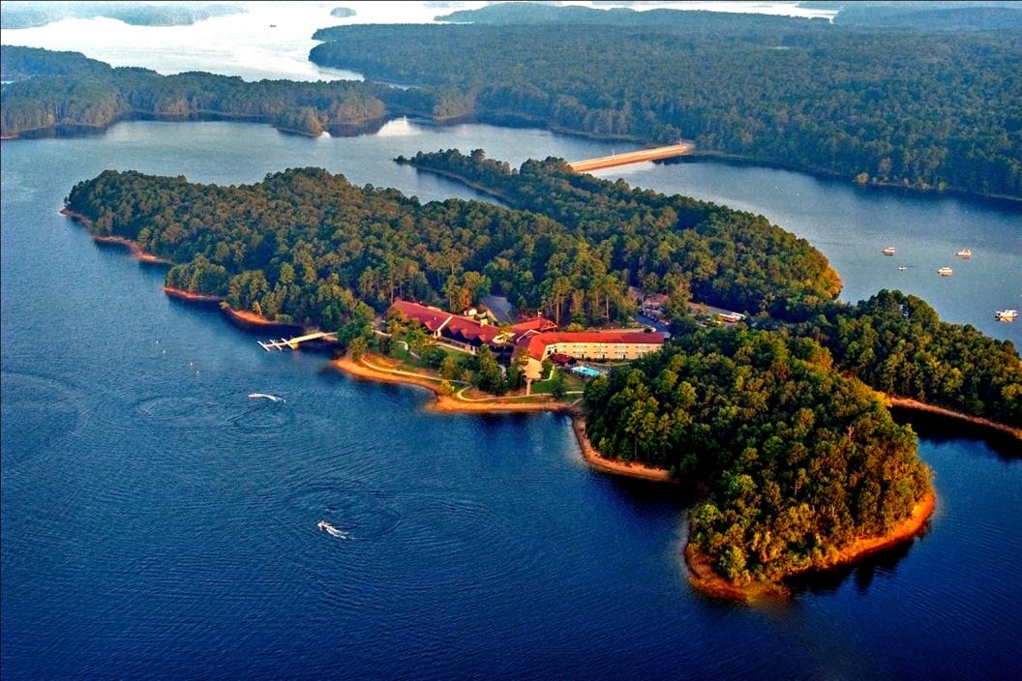
Arkansas State Parks
The economic impact of the state parks is felt throughout the state.
DeGray Lake Resort State Park

Slide 5
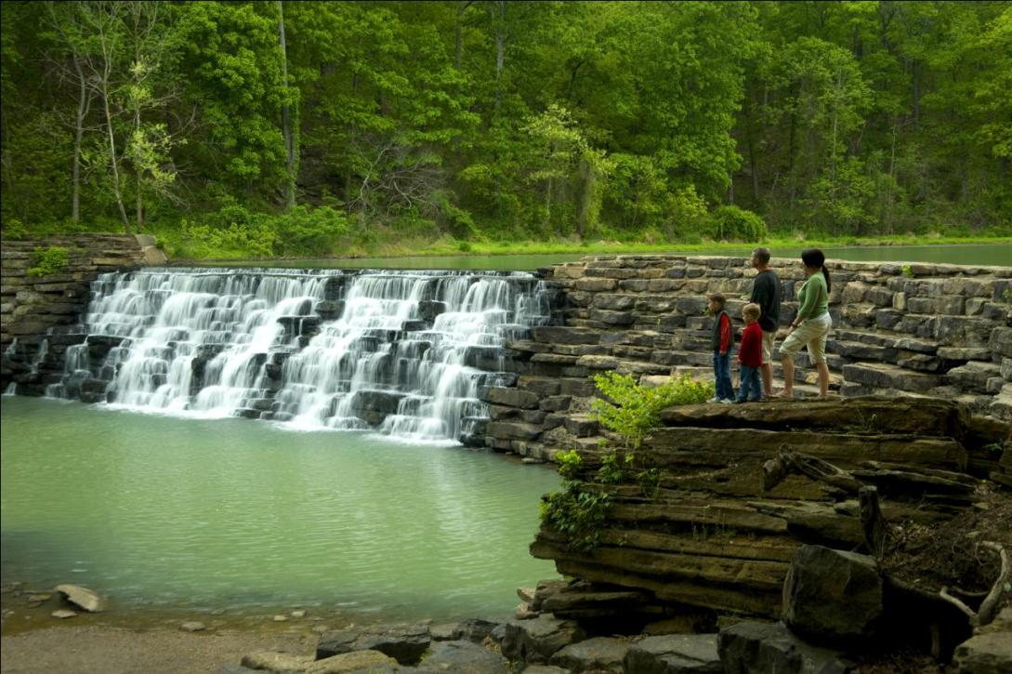
Arkansas State Parks
In perpetuity…
The parks are
in the “forever” business of helping to protect Arkansas’s natural and cultural heritage.
Devil’s Den State Park

Slide 6
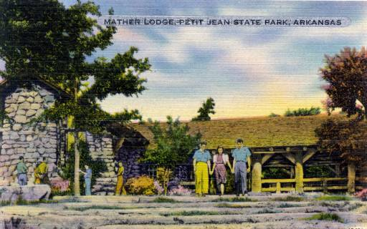
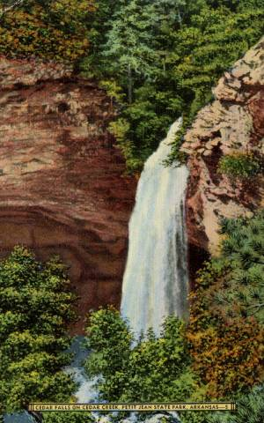
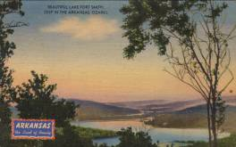
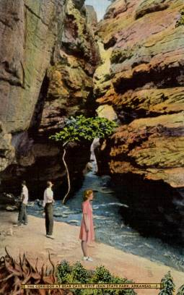
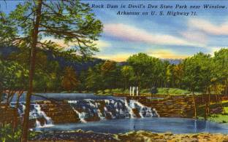
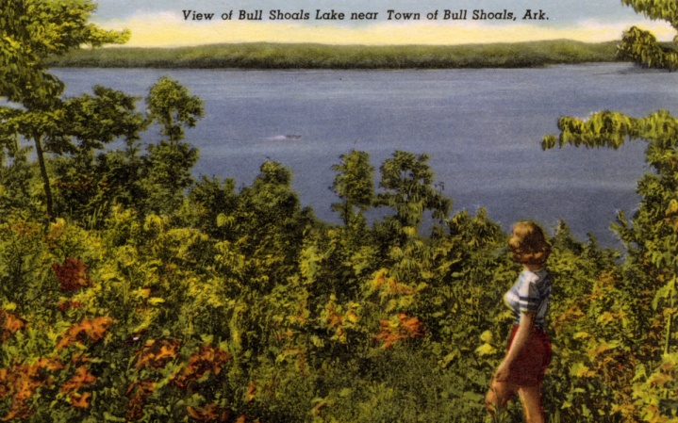
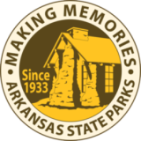
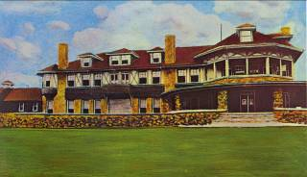

Slide 7

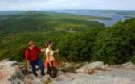

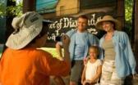
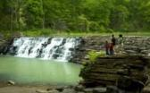
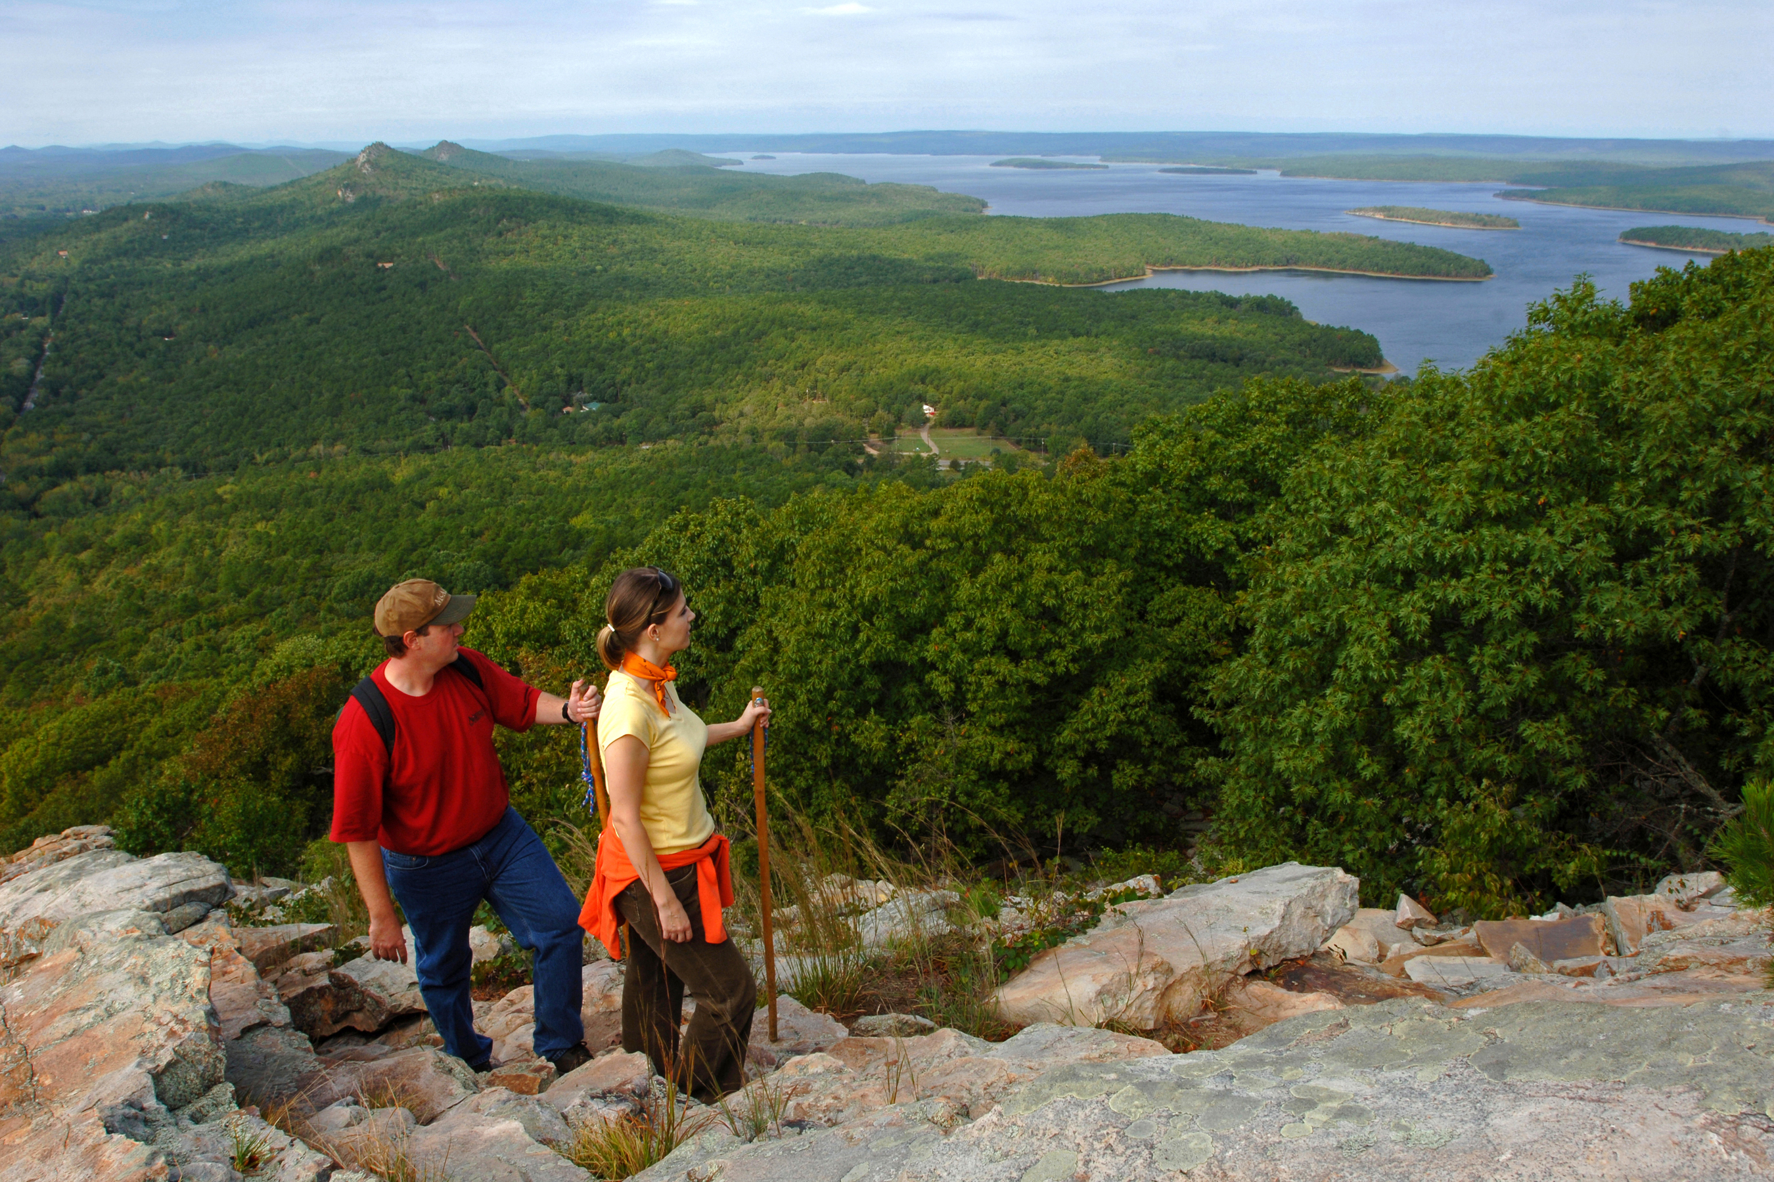
Arkansas State Parks Mission
preserve
natural, historical,
and cultural resources
provide
quality recreation and education opportunities
enhance
the economy
of Arkansas
lead
in resource conservation

Slide 8
Arkansas State Parks
52 state parks

Slide 9
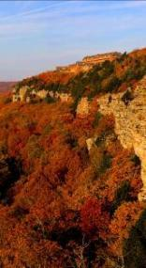
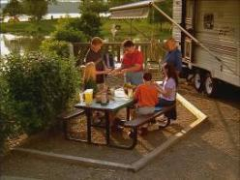
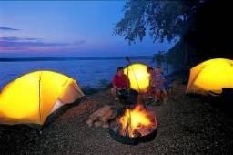
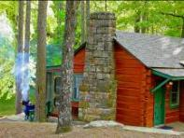
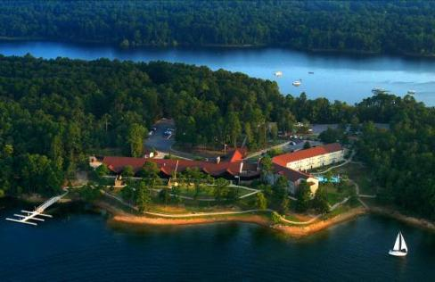

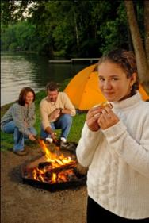
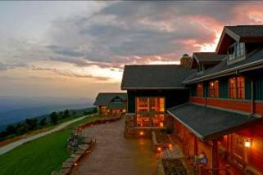
Facilities to experience

Slide 10
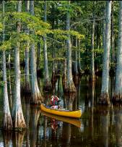
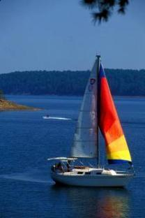
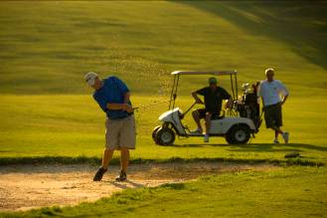
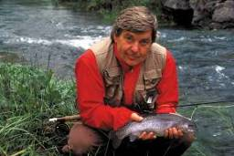
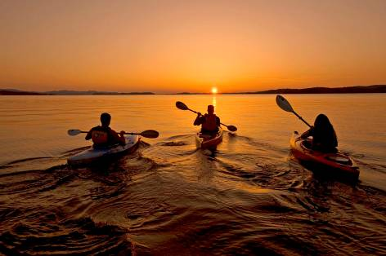
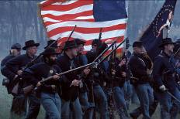
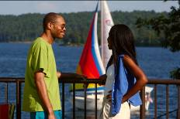
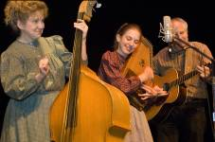

Activities to enjoy

Slide 11
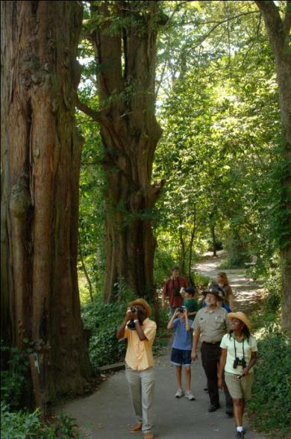
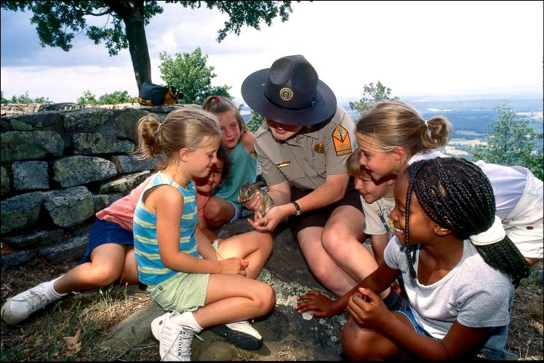
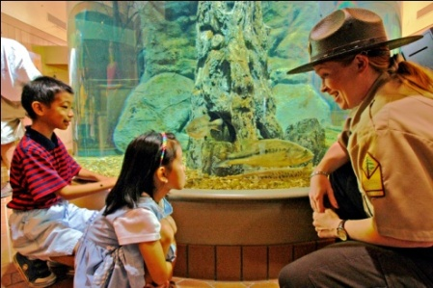
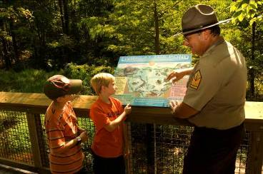
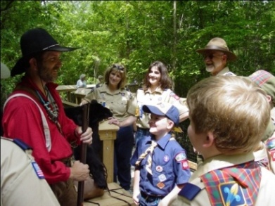
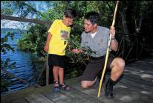
Programs to enrich

Slide 12
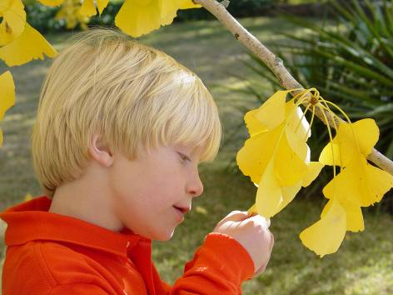
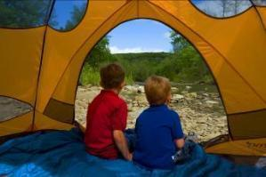
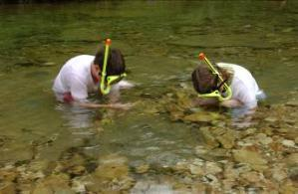
Children who have experiences in nature are better students and make better citizens.

Slide 13

The natural world
is a world of wonder.
And, we manage
over 54,000 acres.

Slide 14
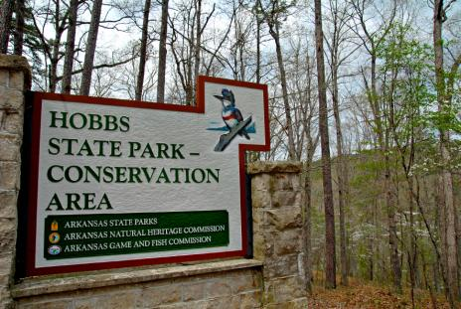
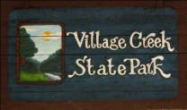
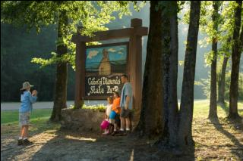
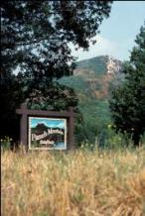
A state park’s operation can be compared
to the operation of city.
Infrastructure (buildings and roads)
Planning and Design
Water Treatment
Wastewater Management
Hotel and Restaurant Management
Retail Sales
Swimming Pool Operations
Golf Course Management
Marina Management
Maintenance
Law Enforcement
Emergency Services
Education Programs
Historic Preservation
Management
Fiscal operations
Human Resources

Slide 15
What Makes Up the Arkansas State Park System?
52 parks with over 54,358 acres
877 buildings insured at over $325 million; 183 are historic structures
16 sites are listed on the National Register of Historic Places
Six sites have been designated as National Historic Landmarks and one site is a National Natural Landmark
44 camping areas with 1,786 campsites, 963 picnic sites at 37 park locations, and 199 cabins at 11 park locations
216 guest rooms at four park lodges, eight restaurants and 10 marinas
139 trails covering over 373 miles
Notes:
52 parks with over 54,146 acres
877 buildings insured at over $308 million; 183 are historic structures
16 sites are listed on the National Register of Historic Places
6 sites have been designated as National Historic Landmarks and one site is a National Natural Landmark
41 camping areas with 1,799 campsites, 963 picnic sites at 37 park locations and 191 cabins at 11 park locations
218 guest rooms at 4 park lodges, 8 restaurants and 9 marinas
121 trails covering over 341 miles

Slide 16
and…
over 120 miles of roads
over 55 miles of underground wastewater distribution lines and
more than 673,879 square yards of parking lot surface
over eight million visitors in FY 11 who impacted Arkansas’s economy by over $225 million
11,420 volunteers in CY 11 who contributed 134,892 hours valued
at $3,013,487
over 70,000 education programs, activities and special events
Notes:
Over 120 miles of roads
Over 55 miles of underground wastewater distribution lines and more than 673,879 square yards of parking lot surface
Over 8 million visitors in FY 09 who impacted Arkansas’s economy by over $225 million
Over 9,989 volunteers in CY 09 contributed over 138,398 hours valued at $2,834,376
Over 45,588 education programs, activities and special events were enjoyed by 701,519 visitors in CY 09

Slide 17
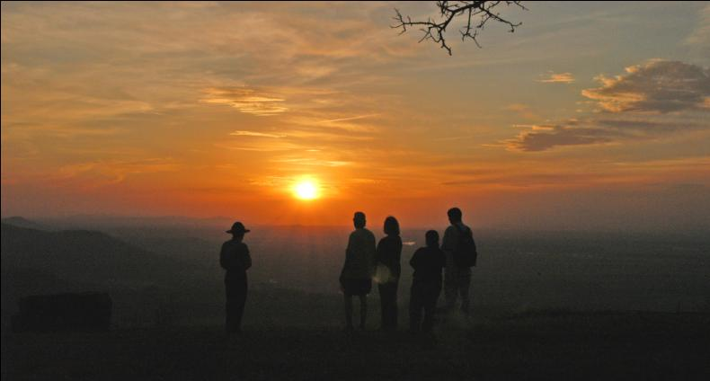
Today, Arkansas State Parks is among the finest systems
of parks and museums in the nation. To understand the
evolution of our state parks’ legacy, where we are today,
and we are headed, we need to look back in our history.

Slide 18
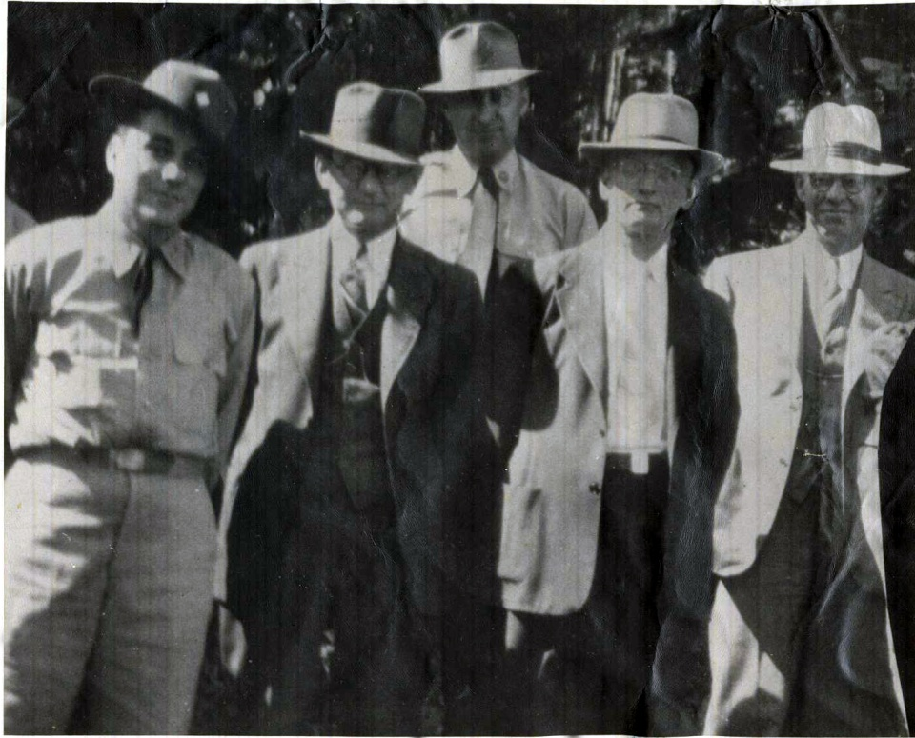
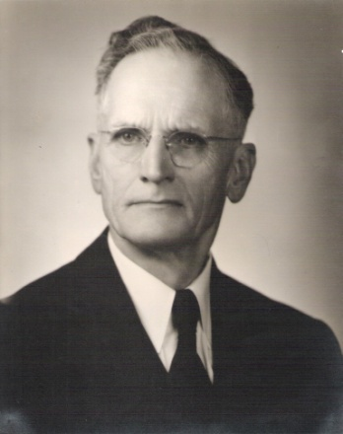
A look back at history
Dr. T. W. Hardison

Slide 19
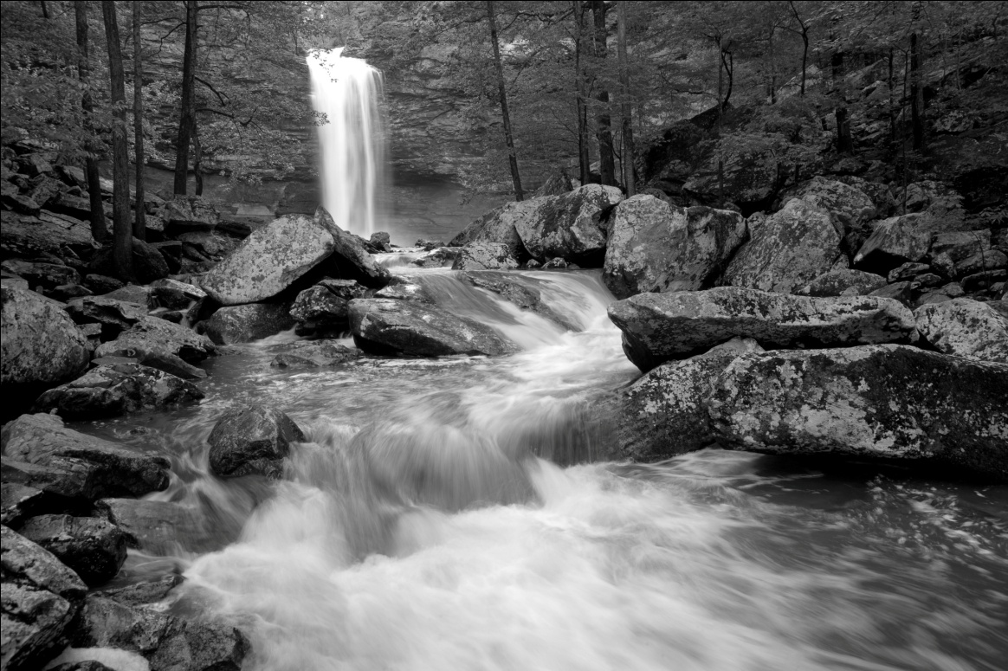
A look back at history
1923 -
Act 276 of 1923 authorizes the commissioner of State Lands to accept land donations for state parks and reservations. The area around Cedar Falls is acquired, and the
park system is born.

Slide 20
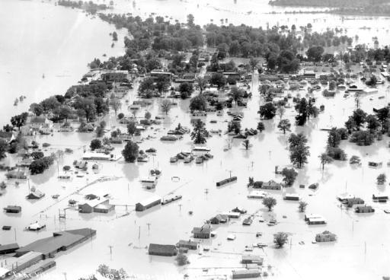
A look back at history
1927 -
The Flood of ’27,
the disastrous lower Mississippi Valley flood, sets a new benchmark to which all later floods will
be compared.

Slide 21
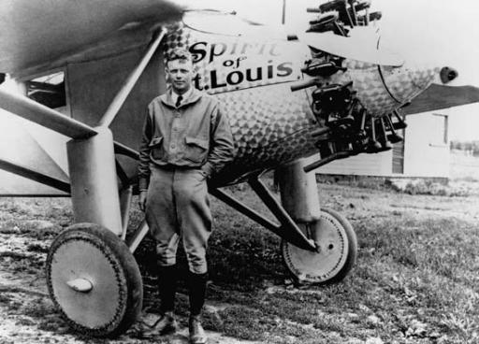
1927 -
Charles Lindbergh completes his first solo, non-stop flight across the Atlantic.

Slide 22

1927 -
Babe Ruth hit his 60th homerun of
the season off
Tom Zachary in Yankee Stadium,
breaking his own Major League Baseball record.

Slide 23

1927 -
Act 172 of 1927

Slide 24
Act 172 of 1927 -
… to protect and preserve in its original habitat and native beauty the flora, fauna, and wildlife therein and preserve the same for all future generations, thereby promoting health and pleasure through recreational places, resorts and scenic playgrounds for the people of the State and to attract visitors, homeseekers and tourists to the State and to provide places of recreation and pleasure for them, and to increase the wealth and revenue of our State by means of such parks.

Slide 25
Then…Act 57 of 1929 -
The purpose of this Act is hereby declared to be, by reason of the historical interest in
Arkansas Post, the preservation of things historical, to protect, build, and rebuild, maintain, and beautify this famous historic spot for future generations, thereby promotion health and pleasure providing a recreation place, resort, and playground for the people of the State and to attract visitors and tourists to the State.

Slide 26

1933 -
Construction of the Golden Gate Bridge begins.

Slide 27

1933 -
Repeal of the
18th Amendment
ends Prohibition.

Slide 28

1933 -
FDR creates the Civilian Conservation Corps (CCC) as part
of the New Deal.

Slide 29


The first state park development began in 1933 through the craftsmanship and conservation achievements of the Civilian Conservation Corps (CCC).
Petit Jean State Park
Petit Jean State Park
Crowley’s Ridge State Park

Slide 30






Arkansas’s First Six State Parks
Petit Jean
Mount Nebo
Crowley’s Ridge
Devil’s Den
Lake Catherine
Buffalo River

Slide 31
Then came…Act 170 of 1937 -
Section 10: The term “park,” as used in this Act, shall be construed to signify and embrace any area within the State which, by reason of location, natural features, scenic beauty or historical interest, possesses distinctive physical, aesthetic, intellectual, creative, and social values.

Slide 32
…and more parks -
Twenty parks were added to the state park system during the ‘50s and ’60s
Daisy, Bull Shoals-White River, Lake Ouachita,
Queen Wilhelmina, Lake Chicot, Hampson Archeological Museum, Herman Davis, Davidsonville Historic,
Poison Springs Battleground, Withrow Springs,
Marks’ Mills Battleground, Lake Poinsett, Lake Charles,
Jenkins Ferry Battleground, Jacksonport, White Oak Lake, Mammoth Spring, Lake Dardanelle, Lake Fort Smith,
and the Ozark Folk Center

Slide 33

1971 -
Governor Dale Bumpers
takes office. And, the
park system embarks on the greatest expansion
program in its history.

Slide 34
During the ’70s, more parks joined the system
Seventeen parks were added to the state park system from 1971 through 1979
Moro Bay, Prairie Grove Battlefield, DeGray Lake Resort,
Village Creek, Crater of Diamonds, Historic Washington,
Woolly Hollow, Pinnacle Mountain, Powhatan Historic,
Toltec Mounds Archeological, Logoly, Lake Frierson,
Millwood, Louisiana Purchase, Cane Creek, Hobbs,
and Mississippi River

Slide 35

1980s & 1990s -
Funding issues

Slide 36
1980s & 90s -
Funding needs

Slide 37

1996 -
Amendment 75

Slide 38
How Arkansas State Parks is Funded
Arkansas State Parks funding sources*
* FY2011

Slide 39
How is Amendment 75 money spent?
Amendment 75
Spending
* FY2011

Slide 40
Where is Amendment 75 spent?
System-wide utility systems replacements, road and parking improvements
Swimming pool replacements/additions: Crater of Diamonds, Devil’s Den,
Lake Chicot, Mount Nebo, Petit Jean
Campground renovations/additions: Bull Shoals-White River,
Cossatot River, Daisy, Delta Heritage Trail, Devil’s Den, Jacksonport,
Lake Catherine, Lake Charles, Lake Chicot, Lake Dardanelle, Lake Ouachita,
Lake Poinsett, Millwood, Mississippi River, Moro Bay, Petit Jean,
Village Creek, White Oak Lake, Withrow Springs, Woolly Hollow
Lodge renovations: DeGray, Petit Jean, Queen Wilhelmina
Cabin renovations/additions: Devil’s Den, Lake Catherine, Lake Chicot,
Lake Fort Smith, Lake Ouachita, Moro Bay, Mount Nebo,
Ozark Folk Center, Petit Jean, Village Creek
Notes:
Natural Parks are established primarily as a consequence of natural features and are intended to promote experiences closely associated with natural environments. They include land areas of 2,500 or more acres, with unique or scenic resources, and more than 60% of the total land area in an undeveloped natural condition.

Slide 41
Historic structure renovations: Crowley’s Ridge, Devil’s Den,
Historic Washington, Jacksonport, Mount Nebo, Petit Jean, Powhatan
Golf course renovation: DeGray
Marina improvements: Bull Shoals-White River, DeGray, Lake Catherine,
Lake Chicot, Lake Ouachita, Moro Bay
Relocation of Lake Fort Smith State Park
Day-use area renovations: Bull Shoals-White River, Cossatot River,
Crater of Diamonds, Davidsonville, DeGray, Delta Heritage Trail,
Daisy, Lake Catherine, Lake Charles, Lake Chicot, Lake Frierson,
Lake Ouachita, Mammoth Spring, Millwood, Moro Bay, Parkin,
Pinnacle Mountain, Poison Springs, Prairie Grove, Queen Wilhelmina,
White Oak Lake
Notes:
Natural Parks are established primarily as a consequence of natural features and are intended to promote experiences closely associated with natural environments. They include land areas of 2,500 or more acres, with unique or scenic resources, and more than 60% of the total land area in an undeveloped natural condition.

Slide 42
Shoreline stabilization: Bull-Shoals-White River, Jacksonport,
Lake Chicot, Millwood, Moro Bay
Barrier-free and multi-use trails: Bull Shoals-White River,
Crater of Diamonds, Delta Heritage Trail, Hobbs, Petit Jean, Village Creek
Visitor Centers: Bull Shoals-White River, Cossatot River, Hobbs,
Lake Dardanelle, Lake Fort Smith, Mississippi River
Interpretive exhibits/galleries: Arkansas Museum of Natural Resources, Bull Shoals-White River, Crater of Diamonds,
Cossatot River, Crowley’s Ridge, Hobbs, Lake Dardanelle,
Lake Frierson, Lower White River Museum,
Plantation Agriculture Museum
Notes:
Natural Parks are established primarily as a consequence of natural features and are intended to promote experiences closely associated with natural environments. They include land areas of 2,500 or more acres, with unique or scenic resources, and more than 60% of the total land area in an undeveloped natural condition.

Slide 43


What types of parks do we have?
Pinnacle Mountain State Park
Notes:
Natural Parks are established primarily as a consequence of natural features and are intended to promote experiences closely associated with natural environments. They include land areas of 2,500 or more acres, with unique or scenic resources, and more than 60% of the total land area in an undeveloped natural condition.

Slide 44


What types of parks do we have?
Jacksonport State Park
Notes:
Historic / Cultural Sites are established to preserve and protect unique historic and archeological resources and are intended to provide a direct link for the park visitor with Arkansas’s past. They are of statewide significance and commemorate an event, era or person; they may include historic structures, arts, artifacts, etc.

Slide 45


What types of parks do we have?
Lake Poinsett State Park
Notes:
Recreation Parks are established primarily as a consequence of an area’s suitability and regional need for outdoor recreation development with land areas of more than 500 acres and typically less than 1,500 acres. They are highly suited to the development of facilities oriented to providing outdoor recreation experiences; and less than 60% of the total land area in an undeveloped natural condition.

Slide 46


What types of parks do we have?
Arkansas Museum of
Natural Resources
Notes:
Museums are established to preserve and protect a collection of objects and are intended to provide an opportunity for the visitor to observe and study the collection. They reflect a collection of objects of statewide significance which may be geological, biological, archeological, historical, and/or cultural materials.

Slide 47

What types of parks do we have?
Arboretum
South Arkansas Arboretum
Notes:
Arboretums are designated locations where trees and woody plants are grown for exhibition and study.

Slide 48


Just a few of the projects completed with Amendment 75
Natural Resource Parks
$4,500,000 visitor center
Hobbs State Park-Conservation Area

Slide 49

Natural Resource Parks
$2,951,727 visitor center
Cossatot River State Park-Natural Area

Slide 50

Recreation Parks
$910,996
new swimming pool facility – Lake Chicot State Park

Slide 51

Museum Parks
$542,078 conservation of gin equipment & exhibits for the
reconstructed Dortch Cotton Gin – Plantation Agriculture Museum

Slide 52

Historic & Cultural Parks
$1,805,348 renovation of 1940 WPA Gym & 1874 Courthouse – Historic Washington State Park

Slide 53




Recreational Opportunities
Petit Jean State Park
Lake Ouachita State Park
Cane Creek State Park
Lake Catherine State Park

Slide 54




Educational Opportunities
Hampson Museum State Park
Hobbs State Park – Conservation Area
Ozark Folk Center State Park
Lake Dardanelle State Park

Slide 55




To safeguard the natural, historical and cultural resources
Devil’s Den State Park
Petit Jean State Park
Parkin Archeological State Park
Ozark Folk Center State Park

Slide 56




To safeguard the natural, historical and cultural resources
Protect People from Resources
Protect Resources from People
Resources
People
People
Protect People from People

Slide 57




To enhance the economy of the state
DeGray Lake Resort State Park
Ozark Folk Center State Park
Pinnacle Mountain State Park
Mount Magazine State Park

Slide 58




To provide leadership in the conservation of valuable state resources

Slide 59
The Economic Impact of Arkansas State Parks
$225,000,000
Throughout Arkansas from visitors to Arkansas’s state parks

Slide 60
The majority of overnight stays come from out-of-state visitors
CY 2011 - Lodges, Cabins & Camping
Notes:
In Calendar Year 2009 we had overnight guests from all 50 states and all but one Canadian Provinces (Newfoundland). We also had overnight guests from Guam, Great Britain, Holland and the Virgin Islands.

Slide 61

The Economic Impact of Arkansas State Parks
Impact from areas other than tourism
Construction Contractors

Slide 62

The Economic Impact of Arkansas State Parks
Impact from areas other than tourism
Concessionaires

Slide 63

The Economic Impact of Arkansas State Parks
Impact from areas other than tourism
Local staff & family spending

Slide 64




Experience opportunities
Solitude/non-urban experiences
Freedom from rigid schedules
Athletic challenge
Cultural, historical, social experiences
Observation/study of nature
Evening outdoors in a natural surrounding
“State park” atmosphere
Notes:
Temporary isolation from society and other individuals
Direct contact with the natural environment
Temporary isolation from man-made objects and human caused influences

Slide 65




Interpretive Programs
The first park interpreters were hired in 1971.
Park interpreters create memorable experiences
connecting park visitors to the parks’ natural and
historic resources. Over 70,000 programs
and events are hosted in the parks each year.

Slide 66

Interpretive Programs
“Not having an interpreter in your park is like inviting someone to your home, and then disappearing.”
— William Carr

Slide 67









Interpretive Programs
Park interpretive programs are about connecting visitors
with the resources.

Slide 68









Interpretive Programs
Park visitor centers also serve as education centers.

Slide 69
Interpretive Programs
Arkansas State Parks is the number one provider of non-traditional, out-of-classroom school programs in the state.
In FY 2011 your state parks presented:
programs to over one million park visitors
• 6,228 programs to 223,132 school
children on educational trips to
state parks
• 2,536 programs to 104,740 school
children in their classrooms

Slide 70




Slide 71

A letter to a park…
“My husband and I are educators in Texas schools. What you have are great educators
who are extremely knowledgeable about nature and care about the visitors. Thank you for providing a
wonderful place for learning and fun.”

Slide 72


The State Park Explorer Program
State Park Explorer Pledge
I promise to love, respect, and
protect all Arkansas State Parks.
I will continue to explore the history
and landscape of these special
places, and I will share what I
discover with my friends and family.
Now and always,
Explorers show we care.

Slide 73

Traveling Environmental Nature Trailer (TENT)
These trailers full of camping gear are
located at:
Cane Creek State Park
Lake Poinsett State Park
They are utilized by groups including homeschoolers,
churches, Scouts, and others.

Slide 74



Children have the right to experience nature

Slide 75




Monitor Elementary in Springdale
5th grade science benchmark scores were low. After a family trip to Hobbs, the principal came up with the idea to partner with the park staff in a
year-long program to make science come alive.

Slide 76





Monitor Elementary in Springdale
The 5th grade science scores raised dramatically at Monitor by 19 points. Now the school is expanding the partnership with the park to 2nd, 3rd, 4th, and 5th grades. Other area schools are now partnering, too.

Slide 77













12 Arkansas State Parks websites

Slide 78

iPhone and
Android Apps
Quick access to park information
Quick search based on location, type of park and trail types
Park programs listed for the next two weeks for each park
Quick dial from your iPhone or Android to
contact the park
Special notices letting you know of closed
areas or other news concerning visitors
Find the closest state park or state park trail
to a city you will be visiting
Maps giving you directions to the park
Share your state park destination with your Facebook and Twitter friends
Plan to hike a trail? Before going you can
e-mail your friends to let them know
your plans

Slide 79

Mobile Website
Launching this month,
our mobile website will
allow users of mobile devices (phones and tablets) to easily access
the major functions of the Arkansas State Parks website, including finding parks, trails, overnight accommodations, and
park programs.

Slide 80




Social Media
1-888-AT-PARKS (1-888-287-2757)
www.ArkansasStateParks.com –
and 11 other State Park websites
Social Media Sites -
  www.twitter.com/ARStatePark (Twitter)
  www.facebook.com/StateParksofArkansas (Facebook)
  www.YouTube.com/ArkansasStateParks (You Tube)
Notes:
Twitter – 1200 followers
Facebook – 53,000 fans
You Tube – Television ads and other videos online
MySpace – A holding place in case the format makes a comeback.

Slide 81

Social Media
“After taking a trip from home (AR) to NY and back, camping along the way in various states, I have to hand it to you guys—
you really know how to do the State Park thing. We really have the best state parks
in America. I'm really thankful that
I live here.”
Posted by a Facebook fan from Conway, AR
60,000+
Facebook fans

Slide 82

Brochures

Slide 83








Uniformed staff

Slide 84







Non-uniformed staff

Slide 85


Volunteers
Bull Shoals-White River State Park
Volunteerism has always been an important part of the state park
system’s operation, and today
13 friends groups support individual
state parks. The value of this
volunteer support ranks
Arkansas State Parks among
the top five Arkansas state
agencies in the receipt of
volunteer support.
Hobbs State Park-Conservation Area

Slide 86
Recent and Upcoming Enhancements

Slide 87


Renovation of historic Mather Lodge,
Petit Jean State Park
Covered
entrance
West-facing side

Slide 88

The view as you enter Mather Lodge

Slide 89

The new dining room

Slide 90

Renovation of
Queen Wilhelmina State Park
Lodge
Arkansas’s “Castle in the Clouds”
atop 2,681-foot Rich Mountain

Slide 91
Mississippi River State Park
Proposed development locations within the St. Francis National Forest

Slide 92

The renovated Beech Point Campground, Bear Creek Lake Recreation Area, Mississippi River State Park.

Slide 93




Rave reviews

Slide 94

Development of Mississippi River State Park, like Mount Magazine State
Park, is through a Special Use Permit from the USDA Forest Service.

Slide 95


The visitor center under construction at Mississippi River State Park will be uniquely staffed by Arkansas State Parks and USDA Forest Service staff.

Slide 96



Delta Heritage Trail State Park

Slide 97





Slide 98


Reopening of The Ridges at Village Creek,
Village Creek State Park

Slide 99

This Andy Dye signature course features the
rolling terrain of Crowley’s Ridge, dramatic elevation changes, and the backdrop of the surrounding hardwood forest.

Slide 100

The East Nine, the last nine holes,
open this summer.

Slide 101


Slide 102




Lake Fort Smith State Park
10 Housekeeping Cabins
One-bedroom design
Two-bedroom design

Slide 103





Lake Devil Silt Removal,
Devil’s Den State Park

Slide 104



Guided Horseback Rides,
Pinnacle Mountain State Park

Slide 105
Design for the Logoly State Park Visitor Center

Slide 106




New Walkways at the
Ozark Folk Center State Park
State Park

Slide 107



Renovation of the Crater of Diamonds
State Park Visitor Center
To better tell the stories of Arkansas’s diamond site, the visitor center was renovated including new exhibits.

Slide 108

Arkansas’s state parks are about preserving special places.

Slide 109
Future generations will carry forward the safeguarding
and management of Arkansas’s state parks legacy.

