Slide 1
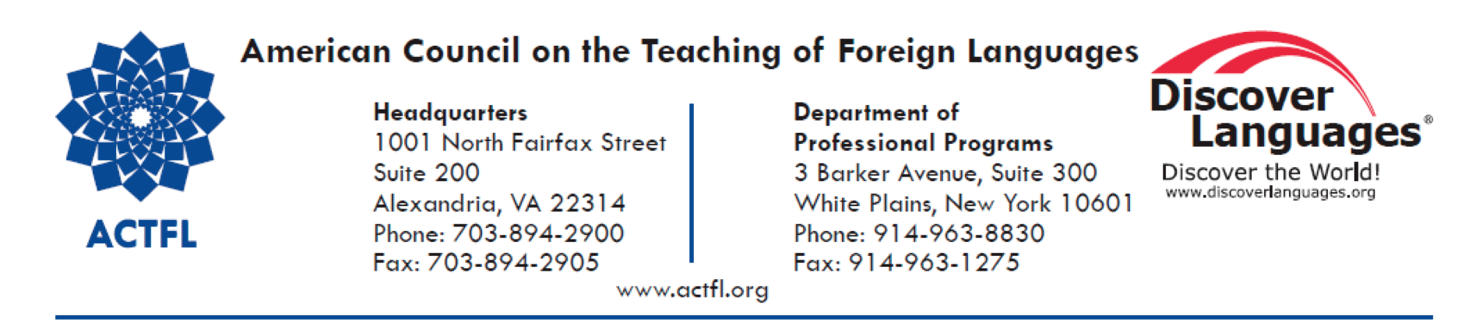
The American Council on the Teaching of Foreign Languages (ACTFL) is the national association for language education professionals from all levels of instruction and representing all languages. With more than 12,300 active members, ACTFL provides innovative professional development opportunities, acclaimed training and certification programs, and widely cited books, publications, scholarly journals, research studies and language education resources, including Foreign Language Annals and The Language Educator magazine. As part of its mission and vision, the organization provides guidance to the profession and to the general public regarding issues, policies, and best practices related to the teaching and learning of languages and cultures. ACTFL is a leading national voice among language educators and administrators and is guided by a responsibility to set standards and expectations that will result in high quality language programs. For more information, visit the website at www.actfl.org.

Slide 2
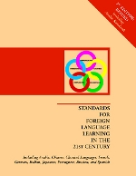
ACTFL and The World Languages Profession
1986—ACTFL Proficiency Guidelines—Speaking (rev. 1999)
2001—ACTFL Proficiency Guidelines—Writing
2011—ACTFL Proficiency Guidelines—Speaking, Writing, Listening, Reading
1996—Standards for Foreign Language Learning: Preparing for the 21st Century (K-16 Student Standards)
2002--ACTFL/NCATE Program Standards for the Preparation of Foreign Language Teachers

Slide 3
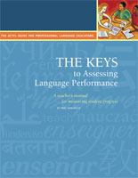
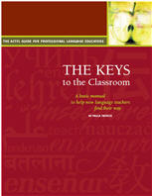
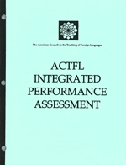
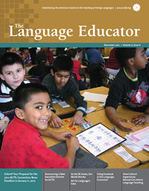
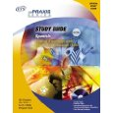
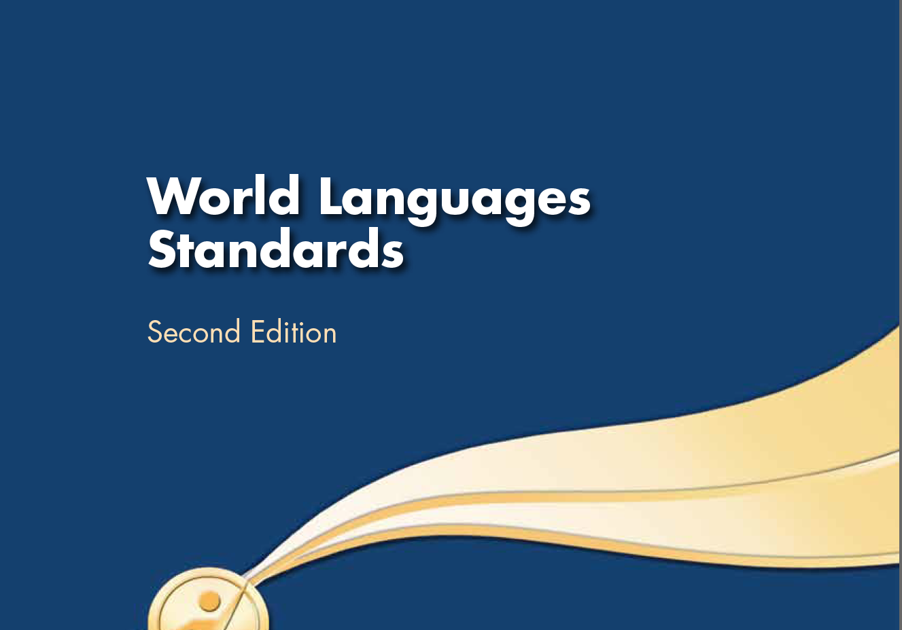
ACTFL and The World Languages Profession
2008—ACTFL Integrated Performance Assessment (IPA) Manual
2010—Partnership for 2lst Century Skills (P21) World Languages Map
2011—Alignment of the National Standards for Learning Languages with the Common Core State Standards (Draft)

Slide 4
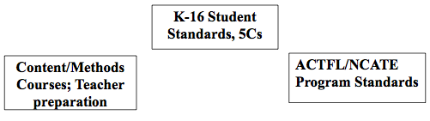
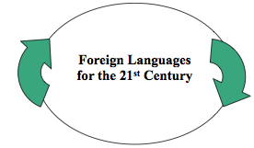

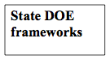

SEAMLESS ARTICULATION
A seamless connection of K-16 student standards, initial and accomplished teacher standards, State Departments of Education frameworks, the Praxis II exams, foreign language content and methodology classes on campuses will provide us with well-educated students and well-trained teachers for the 21st century.

