Slide 1
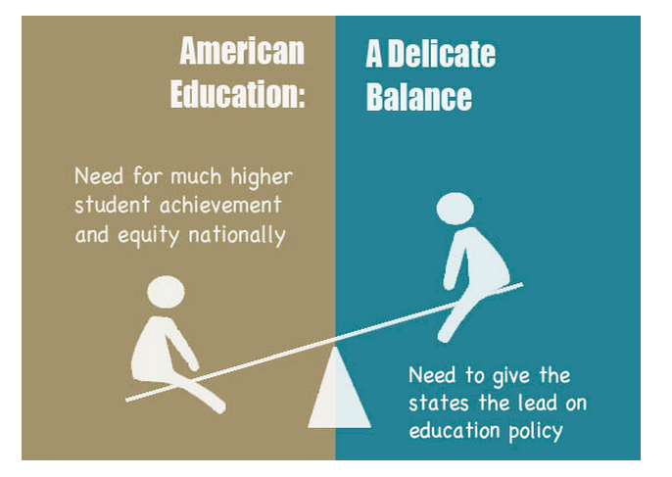
Need for highly effective educators
Standards to ensure quality

Slide 2
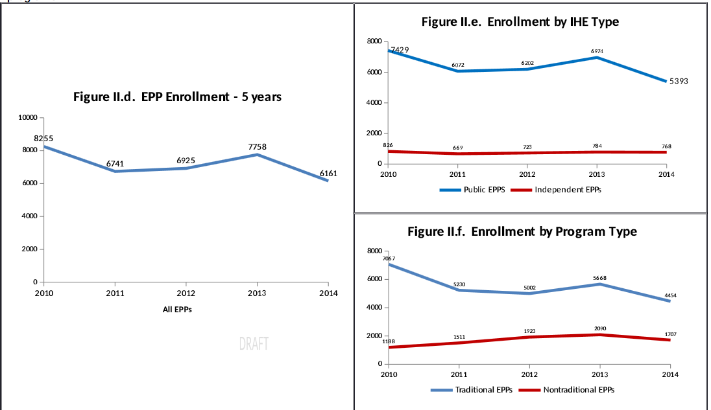
Where Have All the Teachers Gone?

Slide 3
Arkansas Teacher Attrition
 | Average % 1 yr loss (2001-2014) | Average % 3 yr loss (2001-2012) | Average % 5 yr loss (2001-2010)
% new teachers lost after one year | 14.15%
% new teachers lost after three years |  | 27.39%
% new teachers lost after five years |  |  | 34.56%

Slide 4
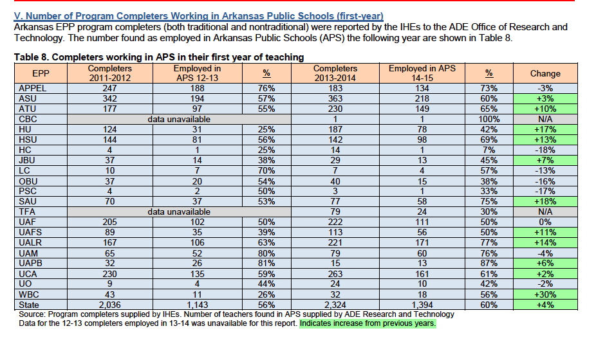
Educator Preparation Program Completers

Slide 5
All Too Often…
Inexperienced Teacher | A teacher with less than one year of full-time professional teaching experience; a teacher in his or her first year of teaching. Source: SIS
Out-of-field Teacher | A teacher who is teaching out of license area while on an Additional Licensure Plan (ALP). Source: AELS
Unqualified Teacher | A long-term sub waiver. An individual, licensed or unlicensed, using a long-term sub waiver to substitute teach in an out-of-area position for more than 30 consecutive days during one semester Source: AELS

Slide 6
Waivers
ALP: Additional Licensure Plan
Long-term sub: More than 30 days
2013-14
  17% of Special Education Teachers in Arkansas
2014-15
  18% of Special Education Teachers in Arkansas

Slide 7
Licensure Rules
78 Public Comments related to the special education portion of the rules
  60 in support of the rules
  18 against the rules
Other comments related to other portions of rules
  Of most concern are rules related to middle-level licensure
  Revisit in December; will need to update and educate committees

Slide 8
Current pathways of licensure
Arkansas Licensure
Traditional (U, G, B, M, D)
Nontraditional (post-bacc)
Other Routes
In-state IHEs (21)
Out-of-State IHEs (3)
In-State IHEs (MAT, MEd, MTLL)
APPEL
Accelerated
ATC
TFA
ABCTE
PPTL
(post-bacc)
Reciprocity
Test out for Adding Areas
Program of Study Endorsement
Notes:
462 Programs
Visual and Hearing Specialists (3 Out-of-State IHEs)

Slide 9
Former pathways of licensure for Special Education
Arkansas Licensure
Traditional
(G, M )
Nontraditional (post-bacc)
Other Routes
In-state IHEs (21)
Out-of-State IHEs (3)
In-State IHEs (MAT, MEd, MTLL)
APPEL
Accelerated
ATC
TFA
ABCTE
PPTL
(post-bacc)
Reciprocity
Test out for Adding Areas
Program of Study Endorsement

Slide 10
Current pathways of licensure for Special Education
Arkansas Licensure
Traditional (U, G, B, M)
Nontraditional (post-bacc)
Other Routes
In-state IHEs (21)
Out-of-State IHEs (3)
In-State IHEs (MAT, MEd, MTLL)
APPEL
Accelerated
ATC
TFA
ABCTE
PPTL
(post-bacc)
Reciprocity
Test out for Adding Areas
Program of Study Endorsement
K-12 Special Education licensure is now a first-time standard license; candidates may not meet HQT requirements upon completion;
Program of study also available as an endorsement

Slide 11
Proposed Options for increasing the number of teachers for Special Education
Arkansas Licensure
Traditional (U, G, B, M, D)
Nontraditional (post-bacc)
Other Routes
In-state IHEs (21)
Out-of-State IHEs (3)
In-State IHEs (MAT, MEd, MTLL)
APPEL
Accelerated
ATC
TFA
ABCTE
PPTL
(post-bacc)
Reciprocity
Test out for Adding Areas with other requirements + mentoring
*Program of Study Endorsement=12 hours (resource only)
*SPED 101 Academy

Slide 12
MAT
Non-traditional program through higher ed
Successful PRAXIS score
Completion of 101 SPED Academy and other course requirements prior to becoming a “teacher of record”
Completion of master’s degree program while teaching

Slide 13
Program of Study
12 hours of coursework
SPED 101 Academy may meet 3 hours of this requirement
  Competencies
Successful PRAXIS score

Slide 14
Testing Out
SPED 101 Academy
45 Hour Professional Development Course
Mentoring
Successful PRAXIS score

Slide 15
Changing Landscape
New Licensure Level
New Programs
Performance on assessments
Trending decrease of teachers in pipeline
------------------------------------------------------------
How great is the need?
How urgent is the need?
How do we work toward short and long-term solutions?

Slide 16
Need Title II data for 2014-15 enrollment verification in higher ed special education programs
  Unofficial reports verbally
Need current enrollment higher education enrollment data for special education programs
  Previous program data not collected because Special Education was an add-on program of study to a license
Need 2015-16 data on Special Education ALPs
  In 2013-14, 17% of Special Education teachers in the workforce were teaching on an ALP or long-term sub waiver; In 2014-15 the number of ALP or long-term subs teaching special education classes was 18%
  Special Education waivers account for approximately 1/3 of all waivers issued each year

Slide 17
Special Education Programs
 | B-K |  | K-12 First time |  | K-12 Add-On
 | Programs | Start Date | Programs | Start Date | Programs | Start Date
ASU |  |  | B | Fall 15 | M | Fall 15
HU | BG | Fall 15 | B | Fall 15 | UGM | Fall 15
HSU |  |  | B | Fall 14 | GM | Fall 14
SAU |  |  |  |  | GM | Fall 2015
UAF |  |  | B | Fall 14 | GM | Fall 2015
UALR |  |  | B | Spring 2015 | M | Fall 2015
UAM |  |  |  |  | G | Fall 2014
UCA | G | Fall 15 | B | Fall 14 | UGM | Fall 2015
 | 3 |  | 6 |  | 15

