Slide 1
Autism Genetics
Stephen G. Kahler, MD
1/15/2016
Autism Legislative Task Force

Slide 2
Disclaimer and Acknowledgement
These are my own views. I am not representing ACH, ACHRI, or UAMS.
Many of these slides came from Dr. Brad Schaefer, section head of Genetics and Metabolism, Dept of Pediatrics, UAMS

Slide 3
Autism
Defined earlier—mild or profound disorder involving communication, interactions, language, socialization, activities, and age of onset.
Defined by behavior—the only biological part of the definitions is age of onset. Symptoms emerge during infancy/toddlerhood.
Some children have a very abrupt onset to their symptoms after being apparently normal (“regressive autism”); others appear to be affected from birth, and symptoms emerge as the child gets older.

Slide 4
Genetics
The study of inherited characteristics
  Simple examples are easiest—blood type, transplantation/rejection factors
  Gregor Mendel and pea plants/seeds—rough/smooth, etc.
  Sex

Slide 5
What is genetic about autism?
Gender, for starts—roughly 80% of our patients (mild and severe) are boys.

Slide 6
Why else would we think genetics was part of the story?
Family clusters
  Parental features—milder versions of children’s problems?
  Siblings
  Other relatives
  Structural features/physical characteristics—large head, for example.
  Nameable disorders that have a known genetic cause—Down syndrome, for example.

Slide 7
Two ‘types’ of autism
(Miles & Hillman 2000)
Complex
  Abnormalities in early morphogenesis manifested by either significant dysmorphology, a recognizable syndrome, or microcephaly
  20% total autism population
  Poorer outcomes
    Lower IQ
    More seizures / abnormal EEG’s
    More abnormal findings

Slide 8
Evidences to the Genetic Basis of Autism
Multifactorial inheritance
Concordance data
Gene studies
Dysmorphology
Chromosomal abnormalities
Rare Syndromes
Neurocutaneous disorders / Phakomatoses
Metabolic disorders
Teratogens

Slide 9
Concordance
Monozygotic versus Dizygotic twins
Presumption is that monozygotic twins are genetically identical and thus should be concordant for all traits
Experience clearly says otherwise
Reasons for differences:
  Different environments (including in utero)
  Acquired mutations
  Variable expression / reduced penetrance

Slide 10
Genetics and Autism
Twin studies
MZ concordance
  70% concordance in MZ twins
    Range 36 – 95%
  90% concordance of broader phenotype in MZ twins
  Longer lag in dx of MZ twin!
DZ concordance
  3%
    Range 0 – 23%
  30% for broader phenotype

Slide 11
Genetics and Autism
Sibling risk ratio
Sibling risk ratio (λ_{s})
  (increased risk over general population)
  Reported from 45 - 215
  Best estimates 100 – 150
    Compare to 500 for cystic fibrosis

Slide 12
‘Multifactorial Inheritance’ of Autism
Recurrence risk (sibs)
  Ritvo (1989)
    Overall 8.6%
    14.5% if affected child is female
    7% if affected child is male
  Simonoff (1998)
    7% if affected child is female
    4% if affected child is male
    33 – 50% after 2 affected
  Overall 3 – 10%
    Chakabarti 2001, Icasiano 2004, Lauritsen 2005)
  Observed: only 2-3 % recurrent cases
    Presumed due to decreased number of future children

Slide 13
Population Genetics of Autism
Summary
Parameter | Value | Comments
Recurrence risk | 10-20% | Value increased based on newer studies
Relative recurrence ratio
Monozygotic twins | 150
Dizygotic twins | 8
Full siblings | 7 - 10
Heritability | 0.7 – 0.9 | One recent study estimate of 0.5
Occurrence gender | 4-5X higher in males | Few studies have not seen this
Proband gender effect | 2X increase if female | Recent studies differ on this effect
Paternal age | Increased | One recent study saw a higher occurrence in younger fathers
Reproductive curtailment (stoppage) | Appears to be real phenomenon
Birth order | Decreased in later sibs | To be confirmed

Slide 14
Searching for genetic causes
Shared genetic components
  Large structures---chromosomes, esp XX vs XY
  Smaller structures—small regions of chromosomes
    Duplicated or missing?
  Even smaller structures—changes within individual genes
    (Humans have roughly 20,000 genes distributed among the 23 (pairs) of chromosomes
    The total DNA in a set of chromosomes is 3 billion DNA ‘letters’ (ACGT)
    The genes and their regulatory regions occupy a very small fraction—1%?—of the total DNA. The function of the rest is gradually being understood.

Slide 15
Cytogenetic Abnormalities
Most commonly seen are deletions or duplications of proximal 15q
  Also, tetrasomy 15, dicentric 15
Other common aneuploidies
  Deletions of 7q
  Duplications of 22q13
  Deletions of 2q37
  18q
  Xp
  47XYY; 45X/46XY

Slide 16
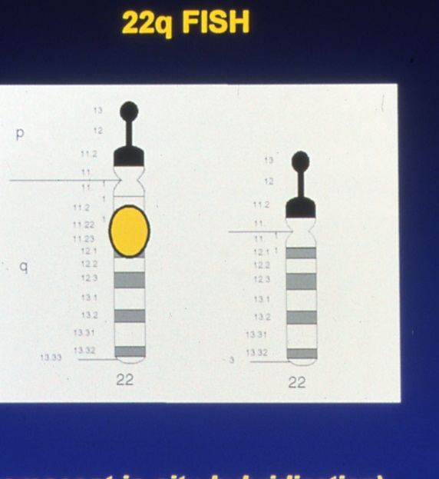
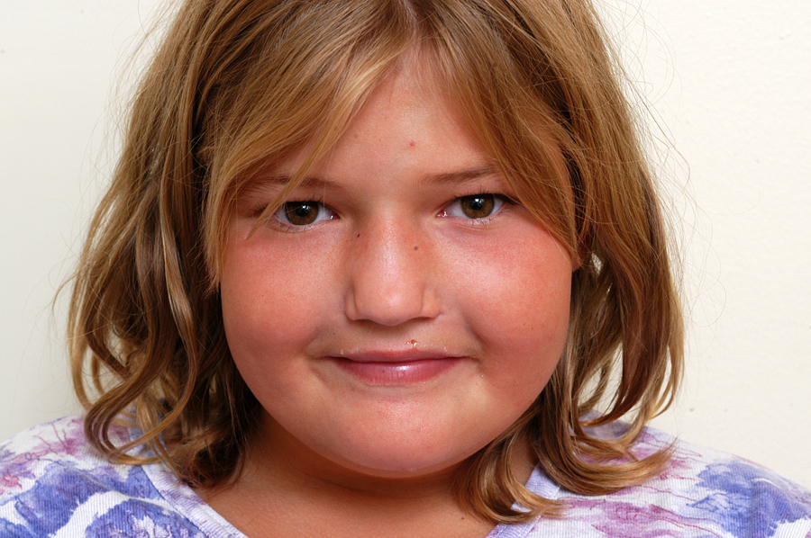
Deletions of 22 q 11.2

Slide 17
Extreme Variability in Expression
22q11.2 deletions
  Associated with multiple syndromes
    DiGeorge
    Shprintzen (VCFS)
    CHARGE
    Opitz
  185 different anomalies reported
  Tremendous intra- and inter-familial variability

Slide 18
CMA and autism
  Six studies over the past 3 – 4 years
    274/2805 (10%)
  Diagnostic yield is increased to about 30% if selection criteria for ‘complex autism’ are used:
    Microcephaly
    Congenital anomalies
    Seizures
    Dysmorphic features

Slide 19
Autism Syndromes
CNVs on CMA
Copy number variant | Incidence in cohorts with ASDs | Eponym | Other Key features (besides autism)
1q21.1 del | 1% | None | Congenital heart disease (30%)
2q22.3 del dup |  | Mowat-Wilson | Hirschprung disease, epilepsy, facial dysmorphisms
16p11.2 del/dup | 1% | None
17p11.2 dup |  | Potocki-Lupski | Hypotonia, slow growth, epilepsy
22q11.2 del |  | DiGeorge/Shprintzen | Multiple congenital anomalies
22q13.3 del | 1% | Phelan-McDermid | Hypotonia, accelerated growth

Slide 20
What sort of genes are involved?
Most have to do with how brain nerve cells (neurons) grow, sprout their connecting regions, and communicate with each other.
Neurons act like integrated circuits, taking information from various places, integrating it, and signaling to the next step in the circuit.
Communication is by chemical messengers between neurons.
Transmitting regions are at the tips (terminals) of axons, receiving regions are called dendrites.
Human brains have xx billion neurons; a neuron may connect with many thousands of others.

Slide 21
Known X linked Genes Causing Syndromic and Non-Syndromic MR
Fragile X
MECP2 (Rett)
ARX (West)

Slide 22
More about neurons
Neurons can change their connections—this is part of learning.
Neurotransmitters can also change.
Many medications influence neurotransmission—these are used in neurology and psychiatry. Many foods and recreational drugs also influence neurotransmission.

Slide 23
Candidate Genes
(Over 200 thus studied)
5 – OH tryptamine / receptors
Dopamine hydroxylase
FOXP2 (Forkhead box P₂)
Ionotropic kainate 2 (glutamate receptor 6)
Glyoxalse 1
Monoamine oxidase A
SLC25A12 (Mitochondrial aspartate/glutamate carrier)
Neuroligin 3 and 4
Seratonin transporter
WNT2
A2BA1 / FOX1
SHANK3
MET
NRXN1
HOXA1

Slide 24
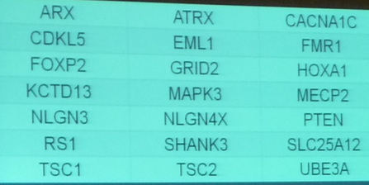
Screening for Candidate Genes
Sequencing syndromic autism genes in patients with non-syndromic autism
  21 genes in 339 patients
  Seven de novo mutations in FOXP2, HOXA1, PTEN, tsc2

Slide 25
THE BRAIN IS COMPLICATED!
There are MANY ways for a brain to function poorly, and lead to
  Mental retardation
  Seizures
  Autism
  Schizophrenia
  Depression
  Etc.

Slide 26
Nothing is simple
Think of the great range of variation in a condition where we have an “explanation”—Down syndrome
Some have a heart malformation
The type of malformation varies
Some have intestinal obstruction
Some have much more severe learning difficulties than others
Some have autism
Nearly all are very friendly and loving
Some acquire hypothyroidism; many age quickly, and have Alzheimer disease at an early age
MANY HAVE INCREASED OXIDATIVE STRESS—VERY SIMILAR TO WHAT WE HAVE FOUND IN CHILDREN WITH AUTISM.

Slide 27
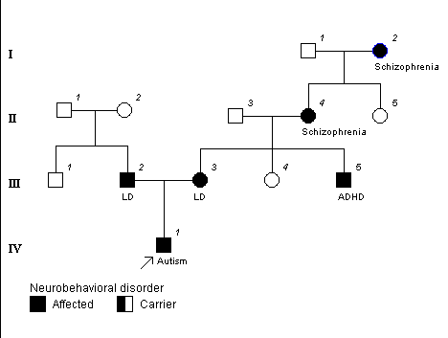

Slide 28
Genetics and Metabolism of Autism
NOTHING is purely genetic or purely environmental.
Brains can be vulnerable/susceptible to environmental events, or resistant.
Genes are much easier to study than environmental influences, so they get a lot of attention.
COMBINATIONS of genes (more than one) and environmental factors (more than one) makes the most sense as an explanation for what is going on in complex disorders, such as autism ,diabetes, cancers, etc.
We know much more about how to influence body chemistry (metabolism) than we do about regulating genes, hence our interest in studying metabolic abnormalities in children with autism, while learning as much as we can about the underlying/contributing genetic factors.

