Slide 1

Arkansas Works’ Career Coach Program: an effective college and career planning model

Slide 2
What is Arkansas Works ?
Governor Mike Beebe’s Initiative adopted by his Workforce Cabinet
Administered by the Arkansas Department of Career Education
Designed to complement and enhance assisting college and career planning efforts of School Districts, Postsecondary Institutions, and Adult Education Centers
Three component system comprised of Career Coaches, On-line College and Career Planning Tool, and ACT Academies

Slide 3
How Did the Career Coach
Program Start?
Began January 2010 with 43 Career Coaches based in 59 school districts through 12 Two-year Colleges
Currently, there are 49 Career Coaches based in 57* school districts through 13 Two-year Colleges and 1 Cooperative Education Service Center
Two positions for specialized populations – Hispanic/ English as a Second Language (ESL) Students and Adults
Three positions to address high schools classified as Dropout Factories – LR Hall, JA Fair and McClellan
*Decline in school districts served due to closing of Turrell and Twin Rivers School districts

Slide 4
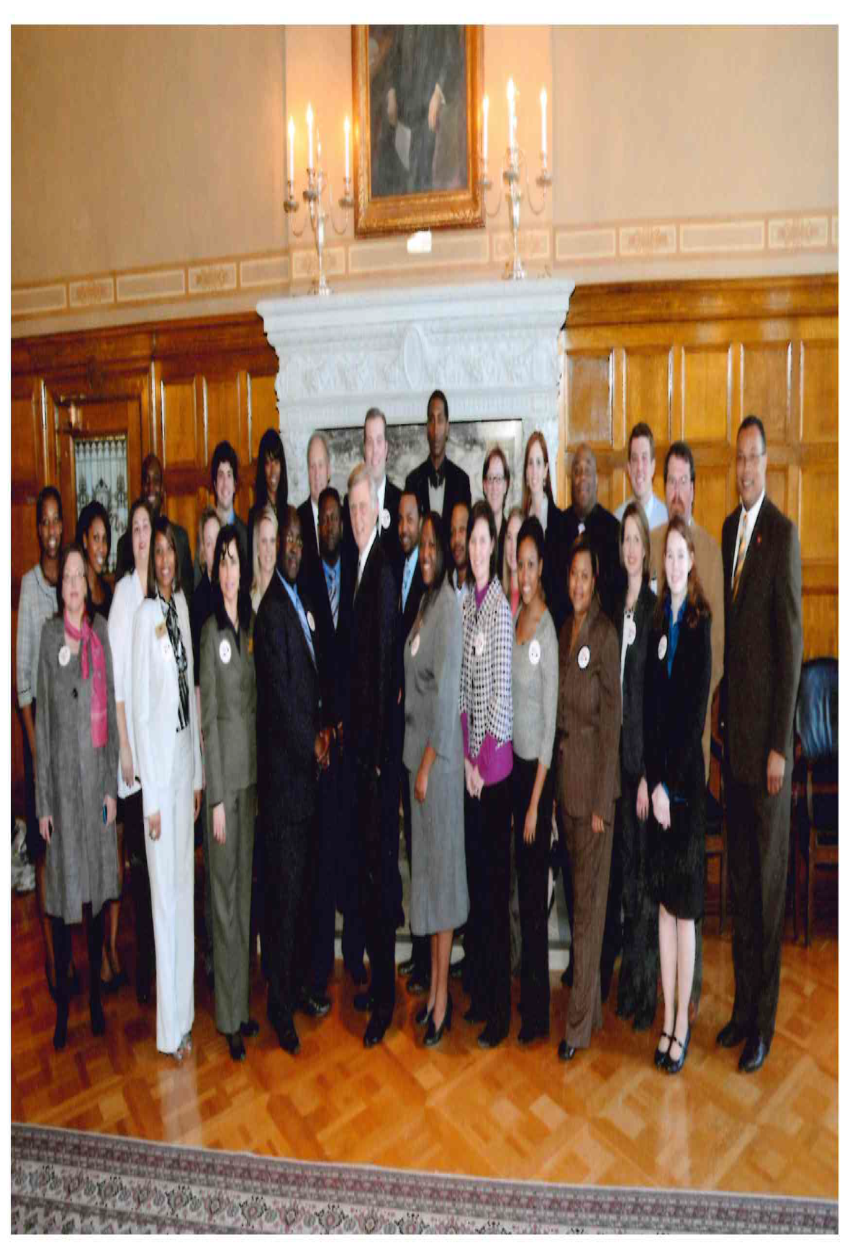
Who Are Career Coaches?

Slide 5
How Are Career Coaches
Funded?
The Career Coach Program is funded by two sources:
Arkansas Department of Workforce Services through Temporary Assistance for Needy Families (TANF) Funds
Winthrop Rockefeller Foundation

Slide 6
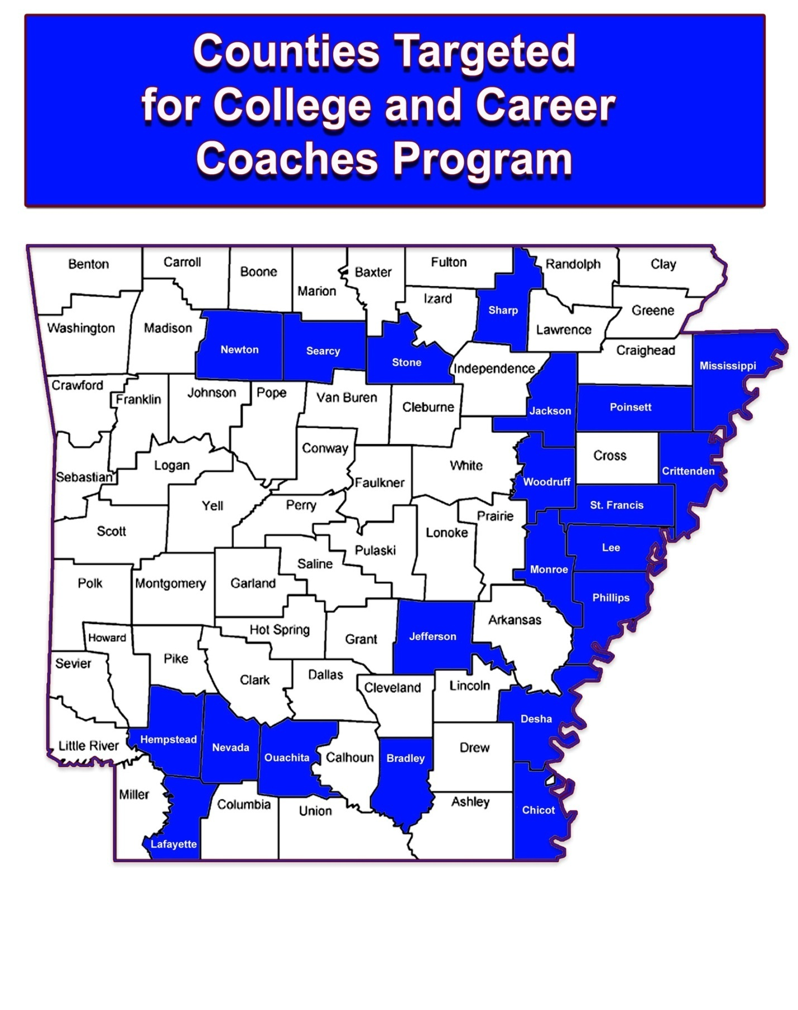
Where Are Career Coaches?
21 Counties
69 High Schools
29 Middle/Junior
High Schools
19 Adult Education
Centers

Slide 7

What Career Coaches Do?
Career Coaches offer programs and services to 27,147 students in the areas of:
Development and revision of college and career plans
Preparation for postsecondary education
Financial aid information and applications
Connecting secondary education with postsecondary education and careers
Transition from secondary to postsecondary education
Career Coach from Mid-South Community College, Robin Allen, assisting students learn more about careers in Manufacturing

Slide 8
What Have Career Coaches
Accomplished?
College Going Rate
(First-Time College Freshmen Fall 2010):
Increased from 33.10% to 51.73% (18.63%)
  State average increased from 46.9 to 51.7% (4.8%)
  Data was provided by ADHE and reflects students, who graduated high school in May 2010 and entered a public postsecondary institution in the Fall of 2010. Data for May 2011 graduates will not be available until July 2012.

Slide 9
What Have Career Coaches
Accomplished?
2011 ACT Academy:
Increasing ACT Score
74% of Participants increased their ACT Score by at least one point
When comparing the average ACT Score data from ADHE prior to Arkansas Works and up to Fall 2011, the average score has increased from 19.6 to 20.28 (.68 points).
State average increased by .43 points

Slide 10
What Have Career Coaches
Accomplished?
2011 ACT Academy: Reducing Need for Remediation
52% of Participants increased at least one subject score to 19 or higher and tested out of Remediation
  When comparing the average Remediation Rate data from ADHE prior to Arkansas Works and up to Fall 2011, the average rate has decreased for all 21 counties from 68.49% to 63.46%
  (-5.03%).
  State average decreased by -4.77

Slide 11
Additional Resources and Recognition
Outside of AR Works Initiative
Over 100 Secondary/Postsecondary Educators and 300 DWS employees received Career Development Facilitator (CDF) training
College Access Challenge Grant – College 101
Act 1222 of 2011
Arkansas Legislative Task Force on Reducing Poverty and Promoting Economic Opportunity – Final Report 2010

Slide 12
Career Coach Program Expanding Outside of Arkansas Works
Prescott School District hired a Career Coach with NSLA funds
Winthrop Rockefeller Foundation has funded two additional Career Coaches to serve Central Arkansas (Boys and Girls Club of Central Arkansas and Pfeifer Camp)
Walton Foundation has provided a $1.5 Million grant to place 15 Career Coaches in Benton and Washington Counties

Slide 13
Future Goals for
Arkansas Works
Secure a Bridge Grant to allow continuation of Career Coach program in the 21 counties until June 30, 2013.
Secure State Funding to allow continuation of Career Coach program in the 21 counties beyond June 30, 2013.
Expand Career Coach Program to include all 75 counties

