Slide 1
Northwest Technical Institute
Secondary Center
Presented by Stephanie Trolinger, Secondary Center Director

Slide 2
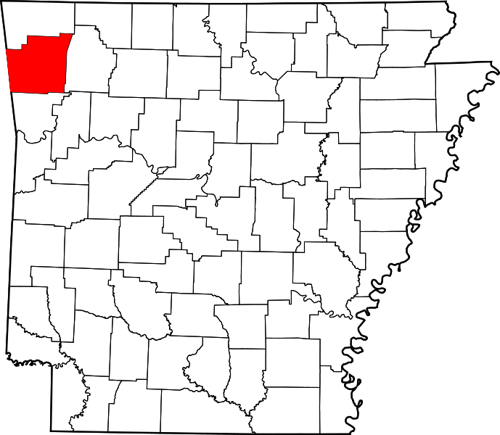
Who We Serve:
High School Students in Washington County

Slide 3
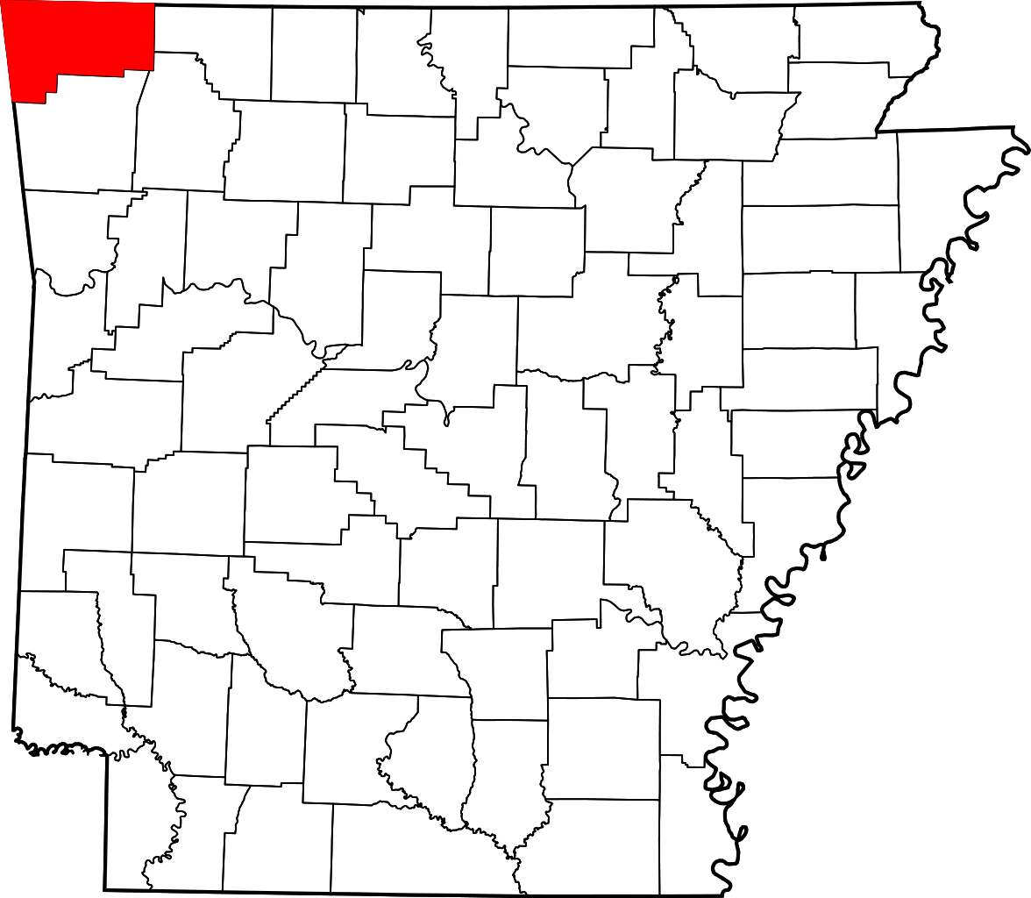
Who We Serve:
High School Students in Benton County

Slide 4
Secondary Programs
Springdale
Automotive Service
Springdale
Automotive Collision
Fayetteville, Rogers, Springdale, Siloam Springs
Cosmetology

Slide 5
Secondary Programs
Springdale and Rogers
Criminal Justice
Rogers
Medical Professions: CNA/PCA+
Fayetteville and Rogers
Medical Professions: Dental

Slide 6
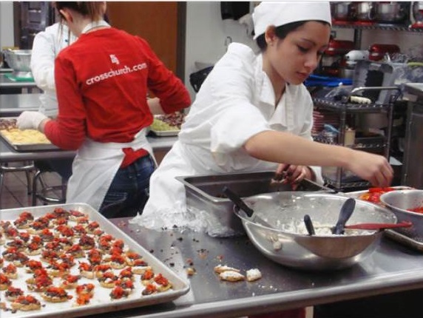
Secondary Programs
Food Production, Mgmt., and Services
Farmington High School
Medical Professions Education
Welding
Rogers
Springdale

Slide 7
Enrollment has steadily increased

Slide 8

Creating Value for CTE
NWA Regional Student Career and Technical Education Honors Program
  Raise awareness and improve the perception of CTE programs by providing honors cords to high school students.
NTI will recognize our secondary students upon graduation from high school.
NTI will provide graduation charms for secondary students.
Secondary Center Diesel Technology proposal
  Proposal will be sent to ACE October 1, 2014 for the 2015 school year.

Slide 9
Thank you!
Questions or Comments….
Stephanie Trolinger
strolinger@nwti.edu

