Slide 1
ISP 2011-119
To Require Foreign Language as a Requirement for Eligibility for an Arkansas Academic Challenge Scholarship
Representative Randy Stewart

Slide 2
Background
Since the Academic Challenge Scholarship a decline was noted in the number of students taking Foreign Language courses. Although we can not be certain that the decline was attributed to the removal of the requirement in the Arkansas Lottery Scholarship a study of the importance of Foreign Language courses in our educational system should be reviewed.

Slide 3
Students Enrolled in
Foreign Language Courses
 | 2008 | 2009 | 2010 | 2011
Students | 43,224 | 43,583 | 44,338 | 38,801
Teachers |  |  | 460 | 425
359
755
-5,537
12.49% Decline
Data for grades 9-12
Notes:
-12.49% decline from 2010-2011 in students note the increases in each year

Slide 4
Arkansas Teachers Licensed in Foreign Language
Grades 7-12 | 2009 | 2010 | 2011
Spanish | 879 | 850 | 827
French | 334 | 313 | 289
German | 79 | 75 | 71
-29
-23
-21
-24
-4
-4
Data for grades 7-12

Slide 5
Critical Academic Licensure Shortage Areas
2010 – 2011 and 2011-2012
School Years
Mathematics (Secondary)
Special Education
Science (Secondary)
Foreign Language – All Areas
Arkansas Department of Education
Notes:
In 2009-2010, the State produced 31 math/science education (BSE) degrees and only 3 foreign language education degrees.

Slide 6
Distance Learning Centers
ASMSA-Office of Distance Education in Hot Springs - focus is 38 Required Units
ADE Distance Learning Center in Maumelle - focus is 38 Required Units
Arkansas Virtual High School in Plumerville - focus is 38 Required Units
Arkansas Early College High School in Monticello - focus is concurrent credit enrichment
Dawson Center for Distance Learning in Arkadelphia - focus is career and technical education enrichment
Offering Spanish, German, French and Chinese

Slide 7
What are the options?
Introduce Foreign Language at a Younger Age
Require Foreign Language for High School Graduation
Require Foreign Language for Arkansas Scholarships
Suggestions ?

Slide 8
1. Foreign Language at a Younger Age
    Case studies find that language is acquired most easily during the first ten years of life.
    This is because the part of the brain that learns language is still developing and that it is easy for that child to pick up and copy sounds.
University of Maine: Children and Brain Development http://umaine.edu/publications/4356e/

Slide 9
K-12 Student Demographic
2009-2010
2010-2011
 | MALE | FEMALE | TOTAL
Asian | 3,226 | 3,230 | 6,456
Black | 51,127 | 50,170 | 101,297
Hispanic | 20,669 | 19,441 | 40,110
Native American | 1,662 | 1,664 | 3,326
Native Hawaiian | 1,108 | 993 | 2,101
Other | 3,763 | 3,757 | 7,520
White | 157,563 | 148,688 | 306,251
 | 239,118 | 227,943 | 467,601
 | MALE | FEMALE | TOTAL
Asian | 3,360 | 3,316 | 6,676
Black | 50,441 | 49,451 | 99,892
Hispanic | 21,658 | 20,181 | 41,839
Native American | 1,646 | 1,660 | 3,306
Native Hawaiian | 1,086 | 1,015 | 2,101
Other | 4,986 | 4,893 | 9,879
White | 156,573 | 147,800 | 304,373
 | 239,750 | 228,316 | 468,066
change
220
-1,405
1,729
-20
-
2,359
-1,878
1,005
Arkansas Department of Education – ADE Data Center

Slide 10
2. Requirement for High School Graduation
Delaware- 2 credits of Foreign Language
Florida- 2 credits of sequential Foreign Language at the secondary level as a prerequisite for admission to all Florida state colleges and universities.
Hawaii – 2 credits of the same Foreign Language
Kentucky- demonstrate ‘basic’ proficiency
Louisiana- 2 years of language are required of all students beginning in the 2012 school year.
Texas- has alternative graduation plans, two of the three plans require at least 2 years of the same foreign language to meet graduation requirements.
In 29 States the requirement of a Foreign Language course is outlined for graduation.
Notes:
29 states have the requirements in

Slide 11
Michigan Graduation Requirements
beginning with the 2016 graduating class students must complete 2 credits of a world language other than English prior to graduation, or demonstrate a two-year equivalent proficiency.
Each local school district is responsible for designing opportunities for students to meet the new world language requirement:
  offering a K-8 program for all children that results in proficiency equivalent to two credits at the high school level;
  encouraging students to complete the first credit of language study in Grades 6 and 7 and the second credit of language study in Grade 8;
  encouraging students to complete the first credit of language study in Grade 8 and the second credit of language study in Grades 9-12; or
  spreading two credits of language study over four calendar years, completing the first credit in two academic years and the second credit in two additional years.
NCSSFL- National Council of State Supervisors for Languages
Notes:
Students are required (1) to demonstrate holistic proficiency at the Novice High level on the ACTFL Proficiency Scale; (2) demonstrate basic knowledge of cultural practices, products, and perspectives of the culture(s) in which the language is used; (3) gain cultural knowledge as well as knowledge in other curricular areas using the world language; (4) demonstrate an understanding of the nature of the language and culture through comparisons of the language and culture studied and their own; and (5) use the language both within and beyond the school setting.

Slide 12
Studies compiled by the American Council on the Teaching of Foreign Languages (ACTFL) have reported
Language learning is beneficial in the development of students’ reading abilities.
There is a correlation between language study and higher scores on the SAT and ACT Tests.
There is a correlation between high school foreign language study and higher academic performance at the college level.
Language learners develop a more positive attitude toward the target language and/or the speakers of that language.
ACTFL- American Council on the Teaching of Foreign Languages

Slide 13
3. Back in the Scholarship
Academic Challenge
Fall School Year | Applicants | Had 2 year Language requirement | % with requirement | Awarded Scholarship
2006 | 5,973 | 4,580 | 76.76% | 3,104
2007 | 6,181 | 4,507 | 72.98% | 3,074
2008 | 7,080 | 5,269 | 74.42% | 3,589
2009 | 7,649 | 5,735 | 75.02% | 3,733
Data provided by ADHE
Notes:
Each year there was an increase in the number of students applying for the scholarship as well as an increase in the number of students with the 2 year language requirement. This is important to note that the number of students taking courses had also increased each year.

Slide 14
Scholarships
Lottery Scholarship
Year | Applicants | Awarded Scholarship
2010 | 11,898 | 11,206
2011 | 18,319 | 12,337
2012 | *cannot be determined | 15,000
Data provided by ADHE (traditional students only)
Notes:
This slide outlines the number of students that are receiving– Traditional only

Slide 15
Foreign Language Requirements at Arkansas Public Colleges and Universities
Of the 503 Bachelor’s degrees offered in Arkansas public institutions 161(32 %) Bachelor’s degrees have foreign language requirements.
In Arkansas of the (954) undergraduate degrees 163
(17 %) have foreign language requirements at public institutions.
Notes:
ADD ATTACHMENT- and see the ADHE DATA

Slide 16
In 2007- 2008 the state produced 5 foreign language education degrees
In 2009-2010 the state produced 3 foreign language educational degrees
  Based on the reports of the Arkansas Academic Cost Accounting – Uniform Reporting of Educational and General Revenues, Expenditures, and Academic Productivity
Arkansas Department of Higher Education
Notes:
Attribute this to the fact that teachers are minors in FL studies

Slide 17
Partnership for the 21st Century
  Mission: to serve as a catalyst to position 21st century readiness at the center of US K-12 education by building collaborative partnerships among education, business, and community and government leaders
  Core Subjects: The No Child Left Behind Act of 2001, which reauthorized the Elementary and Secondary Education Act of 1965, identifies the core subjects as English, reading or language arts; mathematics; science; foreign languages; civics; government; economics; arts; history; and geography.
  The initiative is to create a ‘global citizen’
Notes:
The Partnership for 21st Century Skills is a national organization that advocates for 21st century readiness for every student. As the United States continues to compete in a global economy that demands innovation, P21 and its members provide tools and resources to help the U.S. education system keep up by fusing the three Rs and four Cs (critical thinking and problem solving, communication, collaboration, and creativity and innovation).
Every child in America needs to be ready for today’s and tomorrow’s world. A profound gap exists between the knowledge and skills most students learn in school and the knowledge and skills they need for success in their communities and workplaces.
16 states have already implemented this program (skill set)
Global Awareness Using 21st century skills to understand and address global issues
Learning from and working collaboratively with individuals representing diverse cultures, religions and lifestyles in a spirit of mutual respect and open dialogue in personal, work and community contexts
Understanding other nations and cultures, including the use of non-English languages

Slide 18
Arkansas Economy
2010 Arkansas International Business Report
30 German-owned companies in Arkansas that employ over 2,000 people. The report goes on to note:
“European-owned businesses accounted for approximately 65% of all foreign investment in the state […] The most recent leads came from Germany, France, and the UK. They were predominantly in the renewable energy sector.”
published by the Arkansas Economic Development Commission

Slide 19
Arkansas Economy
Mexico is our second largest partner, with more than one‐half billion dollars in goods exported from Arkansas last year. Mexico is the top destination for Arkansas cereal exports ($120 million, primarily rice and wheat).
Following Canada, Mexico is Arkansas's second top destination for machinery ($43 million), paper and paperboard ($27 million), plastic ($30 million), and vehicles and parts ($19 million).
published by the Arkansas Economic Development Commission
Notes:
This data is from 2010 report

Slide 20
published by the Arkansas Research Center

Slide 21
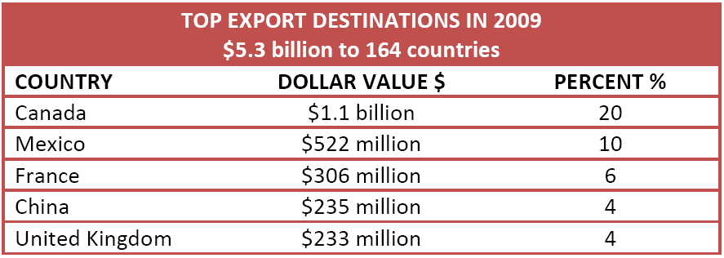
Arkansas Economy
published by the Arkansas Economic Development Commission

Slide 22
According to data collected by the Modern Language Association (MLA), 18% of the United States population, 50 million people, speak a different language other than English.
An article published in the New York Times, January 2010 states that approximately 27,500 middle and high schools in the United States offer at least one foreign language. Many teachers believe that the learning of another language is important for both students and the world.
Information provided by Modern Language Association and New York Times

Slide 23
“In this globalized world, a foreign language provides students an important skill for their future career. It can increase students' opportunity in job-hunting. More importantly, it opens a cultural window to the world,”
  Yan Wang, Ph.D, the Assistant Professor of Japanese at Carthage College
Notes:
Being fluent or nearly fluent in a world language makes a job candidate more appealing to a company and can be the difference between getting and not getting a job.

Slide 24
The Bureau of Labor Statistics (BLT), part of the United States Department of Labor, expects employment of translators and interpreters to grow faster than average.

Slide 25
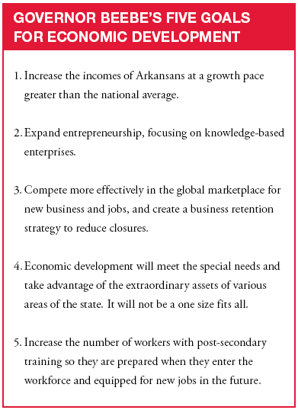


Slide 26
Existing Legislation
1) A.C.A. 6-16-127 Arkansas Foreign Language Teacher Training Program.
2) A.C.A. 6-16-128 Arkansas Early Grades Foreign Language Pilot Program.

Slide 27
Discussion of Next Steps and Timeline

