Slide 1
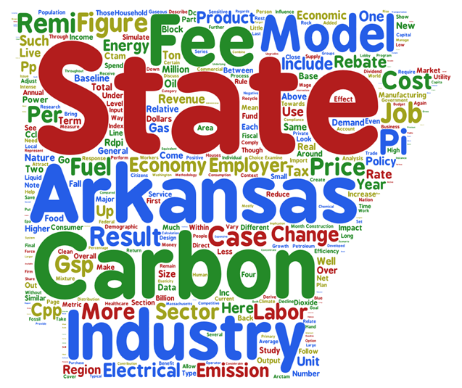

The Impact of a Fee on CO₂ in Arkansas
Regional Economic Models, Inc. (REMI)

Slide 3
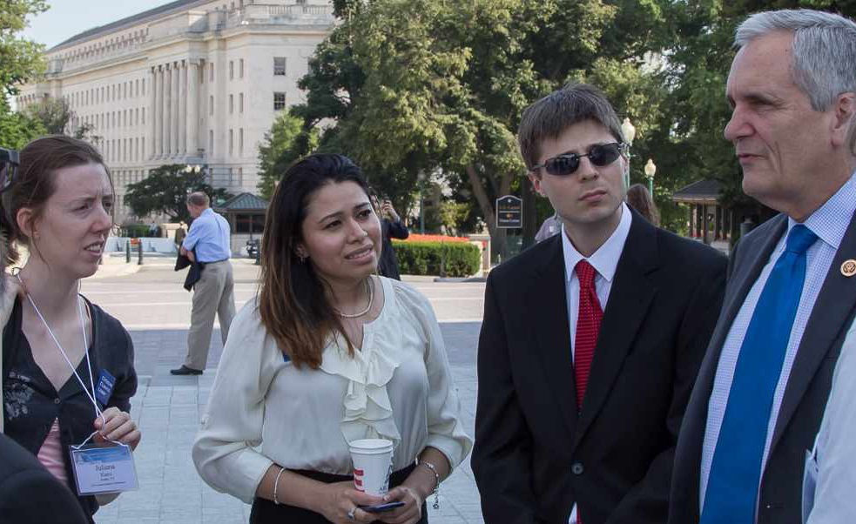
Meet with Congress
1388
1231
1086
711
534
255
106
2010
2011
2012
2013
2014
2015
2016
2016
40,046 personal letters to members of Congress
Notes:
The most effective thing you can do is meet with your member of Congress, and do so regularly. So we do that, and we also write them handwritten letters and call them often. In 2016 we had over 1,388 meetings with Congress or their staff and sent them over 40,000 personal letters.

Slide 4

Regional Economic Models, Inc.
Notes:
Services related to regional modeling, forecasting, and economic impacts
Began as an offshoot from the University of Massachusetts-Amherst in the 1970s and 1980s, and it is still an ongoing research project

Slide 5
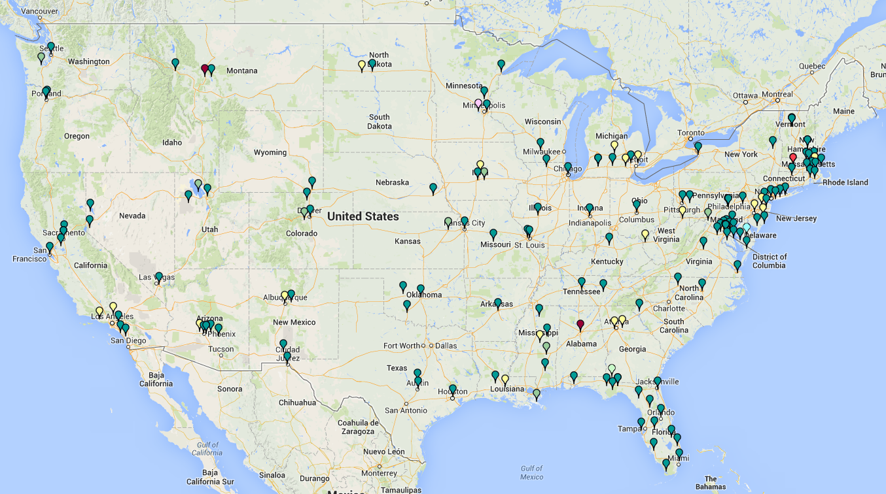
Client Map
Notes:
Economic Impacts of the Arkansas Private Option - Arkansas Hospital ...
www.arkhospitals.org/Misc.%20Files/August2015APOEconomicImpacts.pdf
Economic Impacts of the Arkansas Private Option. Chris Brown, John Bennett. Regional Economic Models, Inc. August 2015 ...
THE PROJECTED ECONOMIC AND FISCAL IMPACT OF THE BIG RIVER STEEL PROJECT IN ARKANSAS - 2013

Slide 6
CTAM
Carbon Tax (or Price) Analysis Model
  Keibun Mori
    Open-sourced
  Public data only from the U.S. DOE
  Previous applications:
    Massachusetts
    Washington
      King County, WA
    California
    Federal (9-regions)
    Vermont
    Rhode Island
Tax revenues = price*emissions
Price on carbon emissions
Changes end-use energy prices
Reduces demand for energy
Change from AEO reference case
Notes:
Congressional Budget Office
https://www.cbo.gov/sites/default/files/111th-congress-2009-2010/workingpaper/2010-04-io_model_paper_0.pdf
Department of Treasury
https://www.treasury.gov/resource-center/tax-policy/tax-analysis/Documents/WP-115.pdf

Slide 7
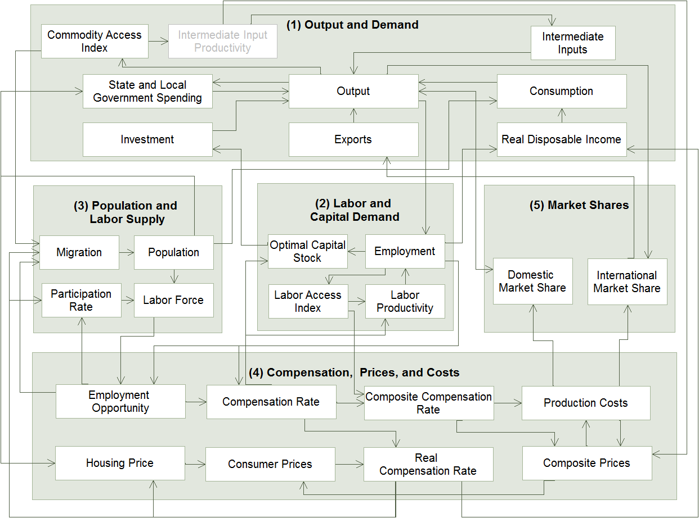
REMI PI⁺

Slide 8
Integrating Models
CTAM Model
PI⁺ Model
Residential, commercial, and industrial sectors
Revenue recycling measures
Variables for energy-related costs of living and doing business
Energy costs for petroleum-derived products, natural gas, and electricity
GDP and population growth

Slide 9
Policy Design
What is a carbon fee?
What are the goals of the fee?
What are the policy considerations?

Slide 10
Carbon Fee
A “carbon fee” is a charge for emitting new carbon dioxide into the atmosphere in a region
  Disincentive to the use of fossil energy products
    The modeling here includes no “climate feedbacks” about the effects of changing emissions on the environment
  Generates revenues to compensate for changing energy costs and other public policy purposes
    The focus here—a carbon fee is a matter of “mundane” budget policy such as changing the sales or income tax
Comparable systems throughout North America
  British Columbia (general carbon price), California (AB32), New England and the Northeast (RGGI)

Slide 11
Carbon Fee and Dividend
The best first step
1
Place a fee on fossil fuels at the source (mine, well or port).
2
Return all of the revenue to households equally.
3
A border adjustment on goods imported
from or exported to countries without
an equivalent price on carbon.
Notes:
Our solution is called Carbon Fee and Dividend.
We believe Carbon Fee and Dividend makes fossil fuels accountable for their costs in the clearest, fairest and most transparent way. It’s what economists and climate scientists alike have argued is the best first step we can take.
It’s has three parts; we call it the three-legged stool.
A fee’s placed on fossil fuels at the source (well, mine, port of entry). This fee starts low and increases steadily each year.
All of the money collected is held in a trust fund and returned to American households monthly, on an equal basis. Under this plan about 2/3 of all households would break even or receive more in their dividend checks than they would pay in higher prices due to the fee, thereby protecting the poor and middle class from higher prices.
The final leg of the stool is a border tariff adjustment on goods imported from or exported to countries without an equivalent price on carbon. This adjustment would both discourage businesses from relocating to where they can emit more CO₂ and encourage other nations to adopt an equivalent price on carbon.
This approach rewards producers, consumers, and other nations if they emit fewer greenhouse gasses, which, if we remember from earlier in the presentation, is the goal.

Slide 12
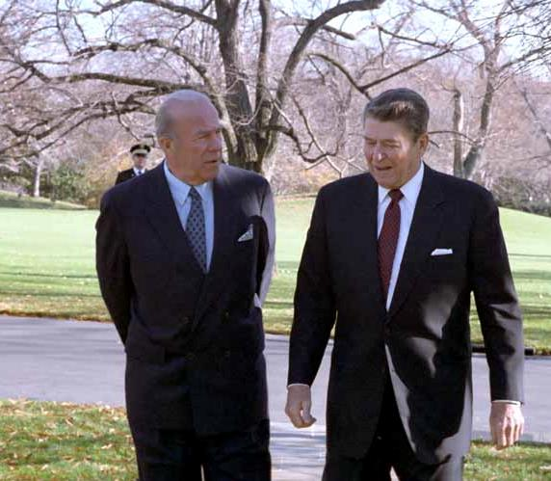
George Shultz
Treasury Secretary, Secretary of State
‘‘
We argue for revenue neutrality on the grounds that this tax should be exclusively for the purpose of leveling the playing field, not for financing some other government programs or for expanding the government sector.
CCL Advisory Board
’’
Notes:
From the right, we have another CCL Advisory Board member former Reagan Secretary of State George Shultz.
Secretary Shultz says, “We argue for revenue neutrality on the grounds that this tax should be exclusively for the purpose of leveling the playing field, not for financing some other government programs or for expanding the government sector.”
We know that we have responded to similar threats in the past. When faced with increasing evidence of a hole in the ozone layer in the 1980s, President Reagan and Secretary of State George Shultz decided the prudent decision was not to argue with doubters but to take out an insurance policy on ozone depleting substances. The insurance policy worked. Du Pont developed replacements for the substances that were destroying the ozone hole, and we avoided serious risk to humans.
Research tells that most humans are not “blank slates.” How we humans process information and settle on a position is largely due to our worldview, not data, facts or science. Most people, on the right, left or in the middle, take their cues from those whom they feel are trusted messengers; or those folks who are “in their tribe.”
Recognizing this fact, we train our CCL volunteers to focus on others’ values, not our own. It takes some practice, but we are finding it’s worth the effort.
Carbon Fee and Dividend has bi-partisan support.

Slide 13
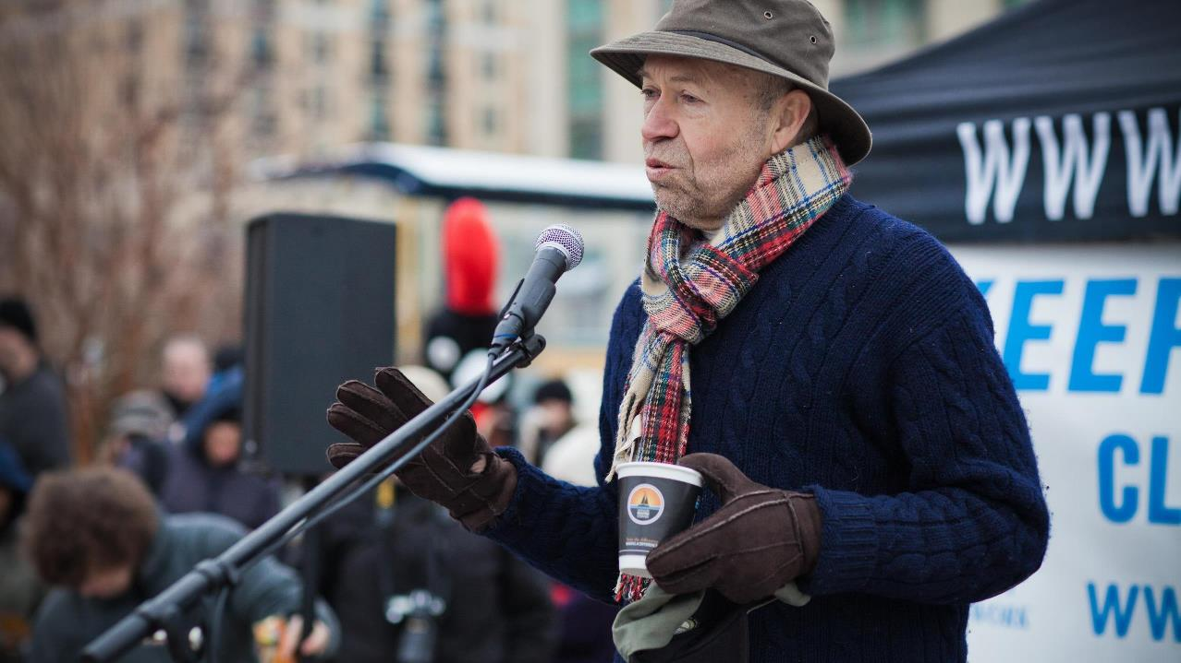
James Hansen
Climate Scientist
‘‘
…the backbone of a solution to the climate problem is a flat carbon emissions price... This carbon price must rise continually at a rate that is economically sound. The funds must be distributed back to the citizens
CCL Advisory Board
’’
Notes:
On the left the most vocal and ardent supporter of Carbon Fee and Dividend has to be Dr. James Hansen, who also happens to serve on our Advisory Board.
Dr. Hansen says, “…the backbone of a solution to the climate problem is a flat carbon emissions price... This carbon price must rise continually at a rate that is economically sound. The funds must be distributed back to the citizens, not to special interests.”

Slide 14
Carbon Fee and Dividend
National and regional study from REMI
Under Carbon Fee and Dividend
Emissions
Economy (jobs and GDP)
Health
Incomes
Notes:
In 2014, Regional Economic Models, Inc. (REMI) released a national and regional study of Carbon Fee and Dividend. The report detailed the projected impacts of a steadily rising fee and dividend (versus no fee and dividend) on:
Emissions
Jobs and GDP
Health
Household income
The report concluded that there is no economic argument against Carbon Fee and Dividend. It reduces emissions quickly, grows GDP, increases jobs, and saves lives.

Slide 15
Emissions reductions
Under Carbon Fee and Dividend
31%
Within 10 years*
50%
Within 20 years*
*Below 1990 levels
Notes:
Emissions peak and turn downward!
In 10 years, CO2 emissions are reduced 31% below 1990 levels.
In 20 years, they are reduced 50%.

Slide 16
Notes:
While the emissions drop

Slide 17
GDP Growth
Under Carbon Fee and Dividend
$70 - $85B/year
Average
$1.375 T
20 years
Notes:
Again, the dividend acts like a stimulus, so it also grows GDP.
Average GDP growth over 20 years is $70 – $85B dollars over 20 years
That’s a 1.375 trillion-dollar boost in economic output than we would have without Carbon Fee and Dividend.

Slide 18
Jobs created
Under Carbon Fee and Dividend
2.1M New Jobs
10 years
2.8M New Jobs
20 years
Notes:
The dividend acts like a stimulus. People spend it, so it goes back into the economy and creates jobs:
2.1M jobs created over ten years and
Over 2.8M jobs created over 20 years.
That’s greater than a 1% increase in employment that we get without carbon fee and dividend.

Slide 19
Lives Saved
Under Carbon Fee and Dividend
227,000 lives
Over 20 years
Notes:
We know that when you burn fossil fuels you also release other toxic substances that contribute to more air pollution, which shortens peoples’ lives. So, reducing emissions saves lives by preventing premature deaths associated with asthma and respiratory disease.
13,000 premature deaths are prevented per year after ten years of carbon fee and dividend.
227,000 premature deaths prevented in 20 years.

Slide 20
Household Dividend
Under Carbon Fee and Dividend
$288/month*
10 years
$396/month*
20 years
*For a family of four
Notes:
Since the carbon fee increases steadily, the dividend also increases.
A family of four would receive $288 per month, or $3,456 per year, after 10 years, and $396 per month after 20 years.
Products made with clean energy become relatively less expensive, and consumers have more money to spend.

Slide 21

Monthly Dividend
$450
$400
$350
$300
$250
$200
$150
$100
$50
$0
Monthly dividend for a family of four (two adults and two dependent children) in 2012 dollars
2015
2016
2017
2018
2019
2020
2021
2022
2023
2024
2025
2026
2027
2028
2029
2030
2031
2032
2033
2034
2035
National level results
Notes:
So the monthly dividend increases annually.

Slide 22
The Impact of a Fee on CO₂ in Arkansas
Regional Economic Models, Inc. (REMI)

Slide 23

Questions
How would such a fee affect Arkansas?
  “It’s the economy”
    Households
    Businesses
    State budget
What would a carbon fee mean under the EPA’s Clean Power Plan (CPP) requirements?

Slide 24
Fee Rate
Two rate scenarios
  “CCL” starts at $15 per ton and rises at $10 per year
  “CPP” starts at $30 and rises at $30 per year to $150 at the maximum
  Slow increase over time allows for the economy to anticipate and react
One set of simulations covers only electricity, the other includes a fee on electricity as well as on liquids and gaseous fuels

Slide 25
Revenue Recycling
Case (1)
Case (3)
Case (2)
Case (4)

Slide 26
Carbon Fee on Electricity
This does not include liquids or gaseous fuels
What is the impact on the economy?
How does this go with the CPP?

Slide 27
CO₂ Emissions

Slide 28
Electricity Demand

Slide 29
The Arkansas Economy
The Natural State

Slide 30
Arkansas Employment

Slide 31
Arkansas Industries

Slide 32
MFG Employment

Slide 33
MFG Production

Slide 34
Location Quotients

Slide 35
Gross State Product

Slide 36
Macro Context

Slide 37
Total Employment

Slide 38
GSP by Industry

Slide 39
GSP by MFG Industry

Slide 40
Jobs by Industry

Slide 41
“Uppers and downers…”

Slide 42
Cost of Living

Slide 43
Fee Revenues

Slide 44
Dividends/Rebates
Household Rebate
Employer Rebate

Slide 45
Real Income

Slide 46
Population

Slide 47
Final Conclusions
A strong economy and environmental quality are not mutually exclusive functions
  In fact, when understood as “mundane” fiscal policy, environmental measures might have some positive effects across the economy
    Reduced fossil fuel imports
    Encouragement of localized, labor-intensive industries
These results do not depend on a motivation for “why” to put a fee on carbon dioxide
  Climate “feedbacks” are not an effect in the modeling performed here

