Slide 1
Act 222 Update 2017
Leadership Coordinating Council
School Support Program

Slide 2
Lcc purpose – act 222
6-1-403. Purpose.
The purpose of the School Leadership Coordinating Council is to:
Serve as a central body to coordinate the leadership development system efforts across the state including:
    Encouraging school districts to work with the Department of Education, the Department of Higher Education, the Department of Workforce Education, the Arkansas Leadership Academy, and other leadership groups;
    Recommending a state leadership development system to coordinate all aspects of leadership development based on educational leadership standards adopted by the Department of Education; and
    Devise a system of gathering data which includes input from practitioners, educational and community leaders, university leadership and faculty, and other interested parties;
Assist the Department of Education, the Department of Higher Education, the Department of Workforce Education, the Arkansas Leadership Academy, school districts, and other leadership groups in enhancing school leadership and school support efforts; and
Aid in the development of model evaluation tools for use in the evaluation of school administrators.

Slide 3
Leadership Coordinating council
David Cook, Chair

Slide 4
Meetings of the Leadership Coordinating Council held on
  January 26, 2017
  April 24, 2017 (Sub-committee meeting)
  September 21, 2017

Slide 5
2017-2018 Leadership Coordinating Council Members
  Donny Lee, Chair of the Arkansas Association of Colleges for Teacher Education Council of Deans
  Johnny Key, Commissioner of Education
  David Cook (Chair), Director of the Arkansas Leadership Academy
  Maria Markham, Director of the Department of Higher Education
  Charisse Childers, Director of the Department of Career Education
  Richard Abernathy, Executive Director of the Arkansas Association of Educational Administrators
  Tracey-Ann Nelson, Executive Director of the Arkansas Education Association
  Tony Prothro, Executive Director of the Arkansas School Boards Association
  Mary Gunter, Executive Director of the Arkansas Association for Supervision and Curriculum Development
  Dale Query, Executive Director of the Arkansas Rural Education Association
  Shelly Albritton, Arkansas Professors of Educational Administration
  Roy Hester, Arkansas Center for Executive Leadership
  Jeff Williams, representative from the Educational Service Cooperatives
  Scott Smith, Arkansas Public School Resource Center
  Michele Linch, Arkansas State Teachers Association
  Jane English, Chair of the Senate Committee on Education
  Bruce Cozart, Chair of the House Committee on Education

Slide 6
Act 344 (91st General Assembly, 2017)
  -An Act to amend the membership of the School Leadership Coordinating Council (4 members added)
  A representative from the Arkansas Public School Resource Center
  A representative from the Arkansas State Teachers Association
  The Chair of the Senate Committee on Education
  The Chair of the House Committee on Education

Slide 7
Objectives of the Leadership Coordinating Council reset through June 2019
  PSEL
    Help in creation of rubric for LEADS
  Ad Hoc
    Create strategies for bringing leadership programs to the Delta
  IMPACT
    Legislation which allows flexibility in use of NSLA funds for recruitment and retention of leaders
    Expand services of ALA in order to serve a broader base of leaders

Slide 8
Arkansas Leadership Academy
School Support/Organizational
Development Program

Slide 9
School Support Program
Provides weekly on-site coaching and facilitation.
Creates sustainable systems for the purpose of improving student achievement.
Builds leadership capacity within schools and districts.
Provides expertise and support to all stakeholders- educators, students, and community.
“The Arkansas Leadership Academy had the best record for getting schools back on track.”
Review of School Improvement Consultation Expenditures and Results
Presented by the Bureau of Legislative Research to the Joint Education Committee (Feb. 7, 2012)
Notes:
In 2001, The Arkansas Leadership Academy was selected by the Southern Regional Educational Board to design a program for low-performing schools. A state-wide team created the Intensive School Support for Low-Performing Schools which is what eventually became the School Support Program in 2005 with ACT 129 during the Arkansas 85th General Assembly. Then ACT 222 of 2009 provided the continued authorization of the School Support Program. The Arkansas Leadership Academy has record of helping low-performing schools get back on track and improving student achievement.

Slide 10
Organizational Development
Expanded the work of School Support Program to the School District Level to support wide-scale improvement efforts
Organizational Development was first implemented during the 2015-16 school year in 6 school districts across the state
4 districts were added in 2016-2017 school year
3 new districts and one community college were added in 2017-2018
Provides leadership development at the district and individual school level
  Hypothesis: sustainable change happens faster when all levels focus on aligning organizational energy toward identified needs areas that are based on student and adult learning data

Slide 11
Research Models
Theory of Change
  link outcomes and activities to explain HOW and WHY the desired change is expected to come about
Logic Model
  graphically illustrate program components, and creating one helps stakeholders clearly identify outcomes, inputs and activities

Slide 12
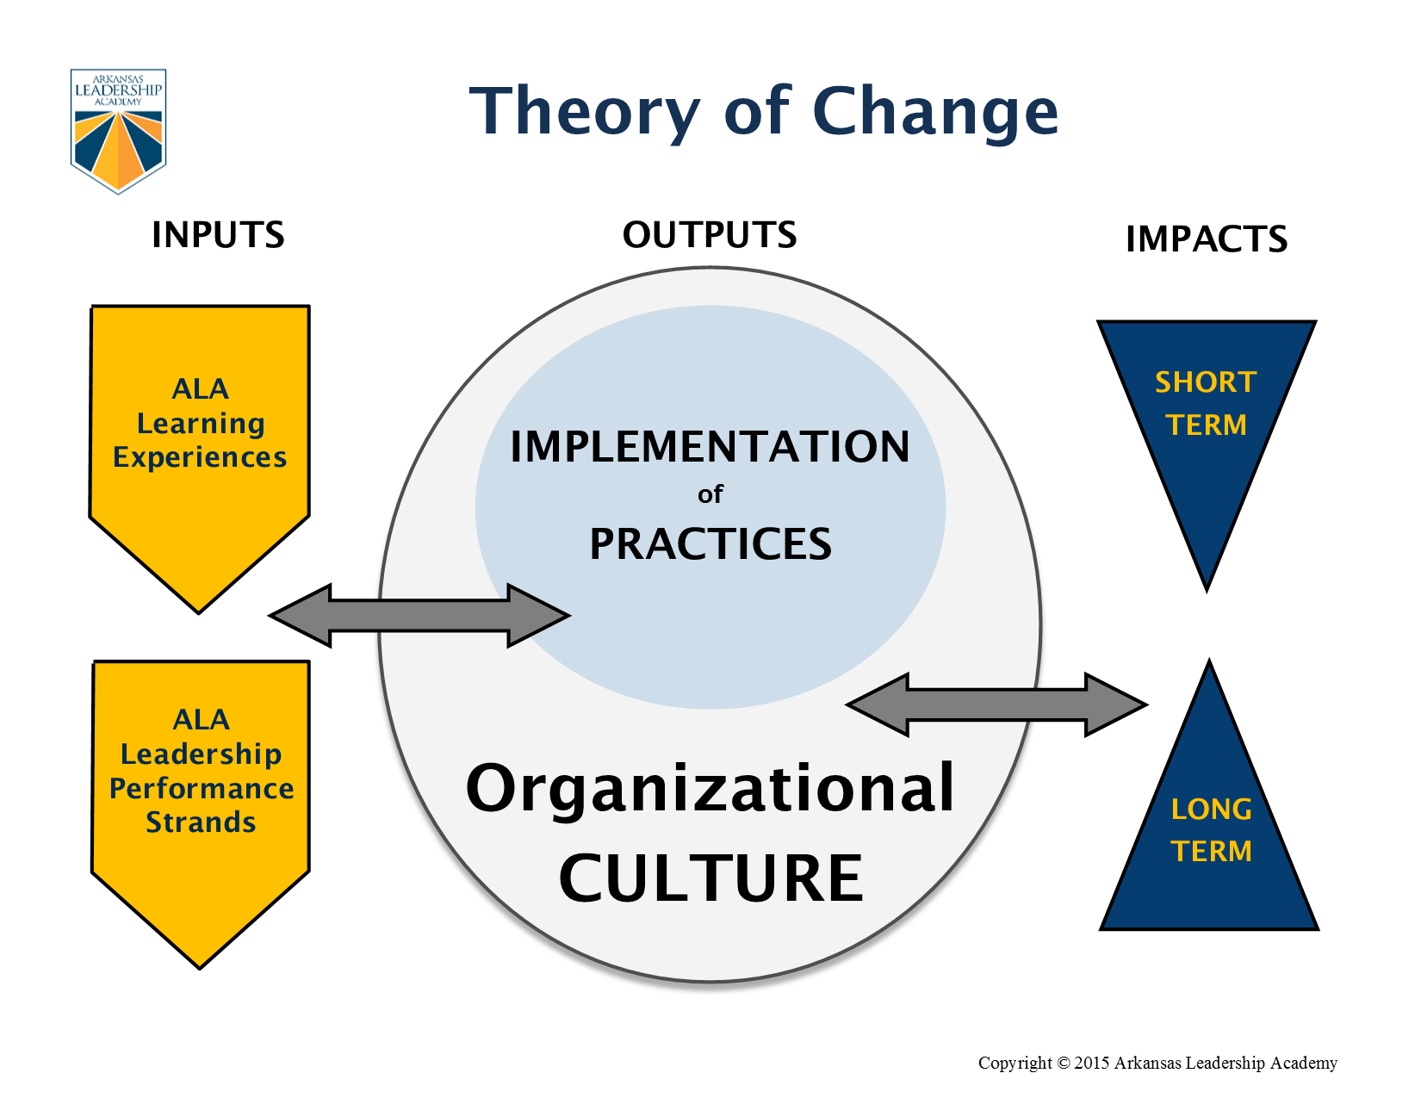

Slide 13
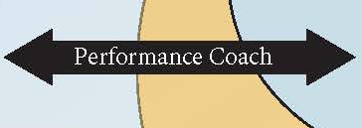
Performance coach
The Performance coach supports the transfer of learning from the “On-Site” learning experiences (THEORY) to the school/district setting (PRACTICE)
The Performance coach provides ongoing support and accountability for the implementation of the “next steps” for the leadership team.

Slide 14
The Performance Coach and the Principal develop a Personal Learning Plan based on the skills in the PSSR.
The Performance Coach supports the Leadership Team in establishing a set of shared core beliefs for a school.
The Performance Coach and Principal conduct classroom walkthroughs and analyze the data to plan professional development opportunities for the staff.
The Performance Coach supports the leadership team in establishing collaborative groups to analyze student learning data and make decisions regarding allocation of resources to increase the teaching and learning process in the school/district.
The Performance Coach supports a school staff in the integration of new technology to meet the learning needs of both students and adults.

Slide 16
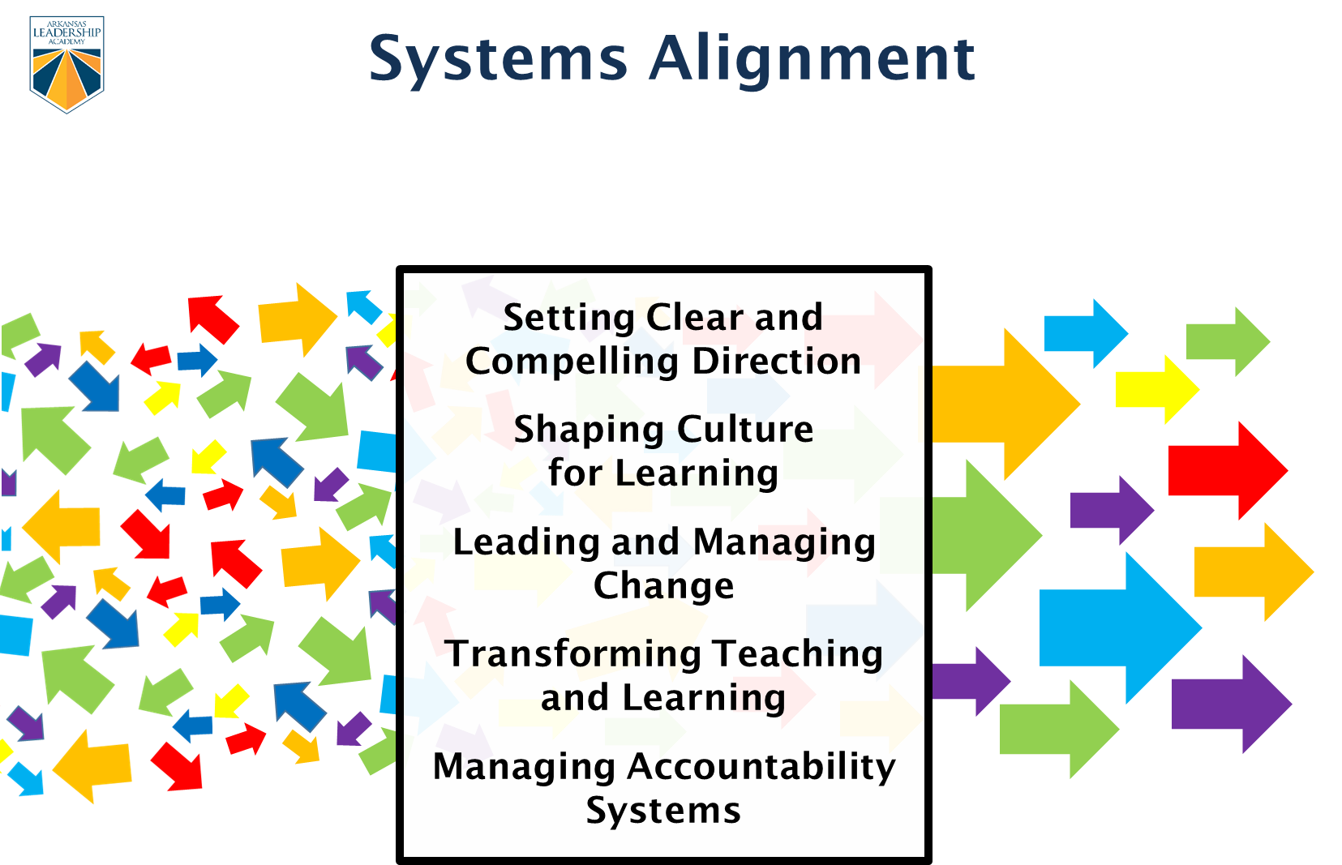

Slide 17
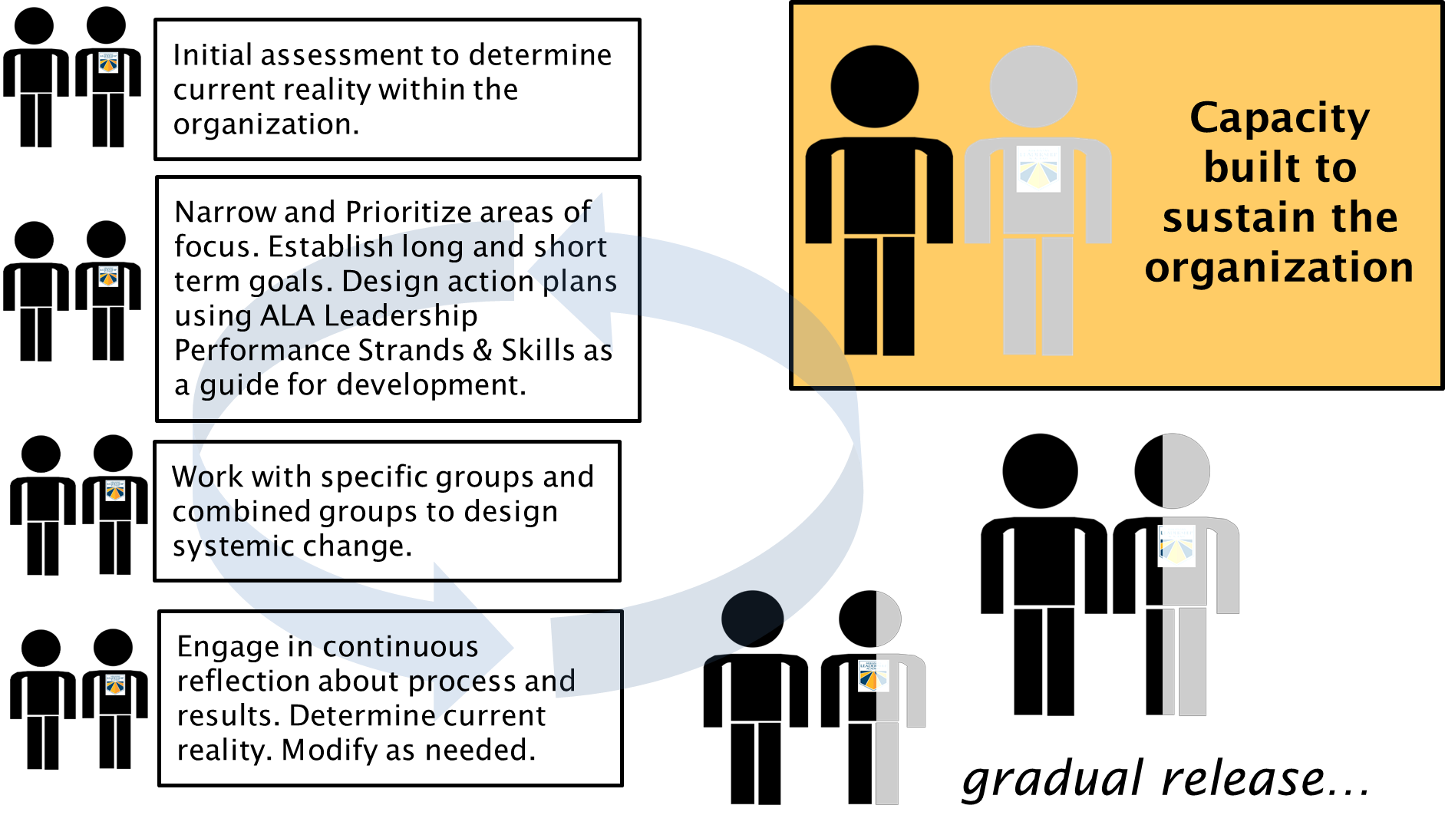

Slide 18
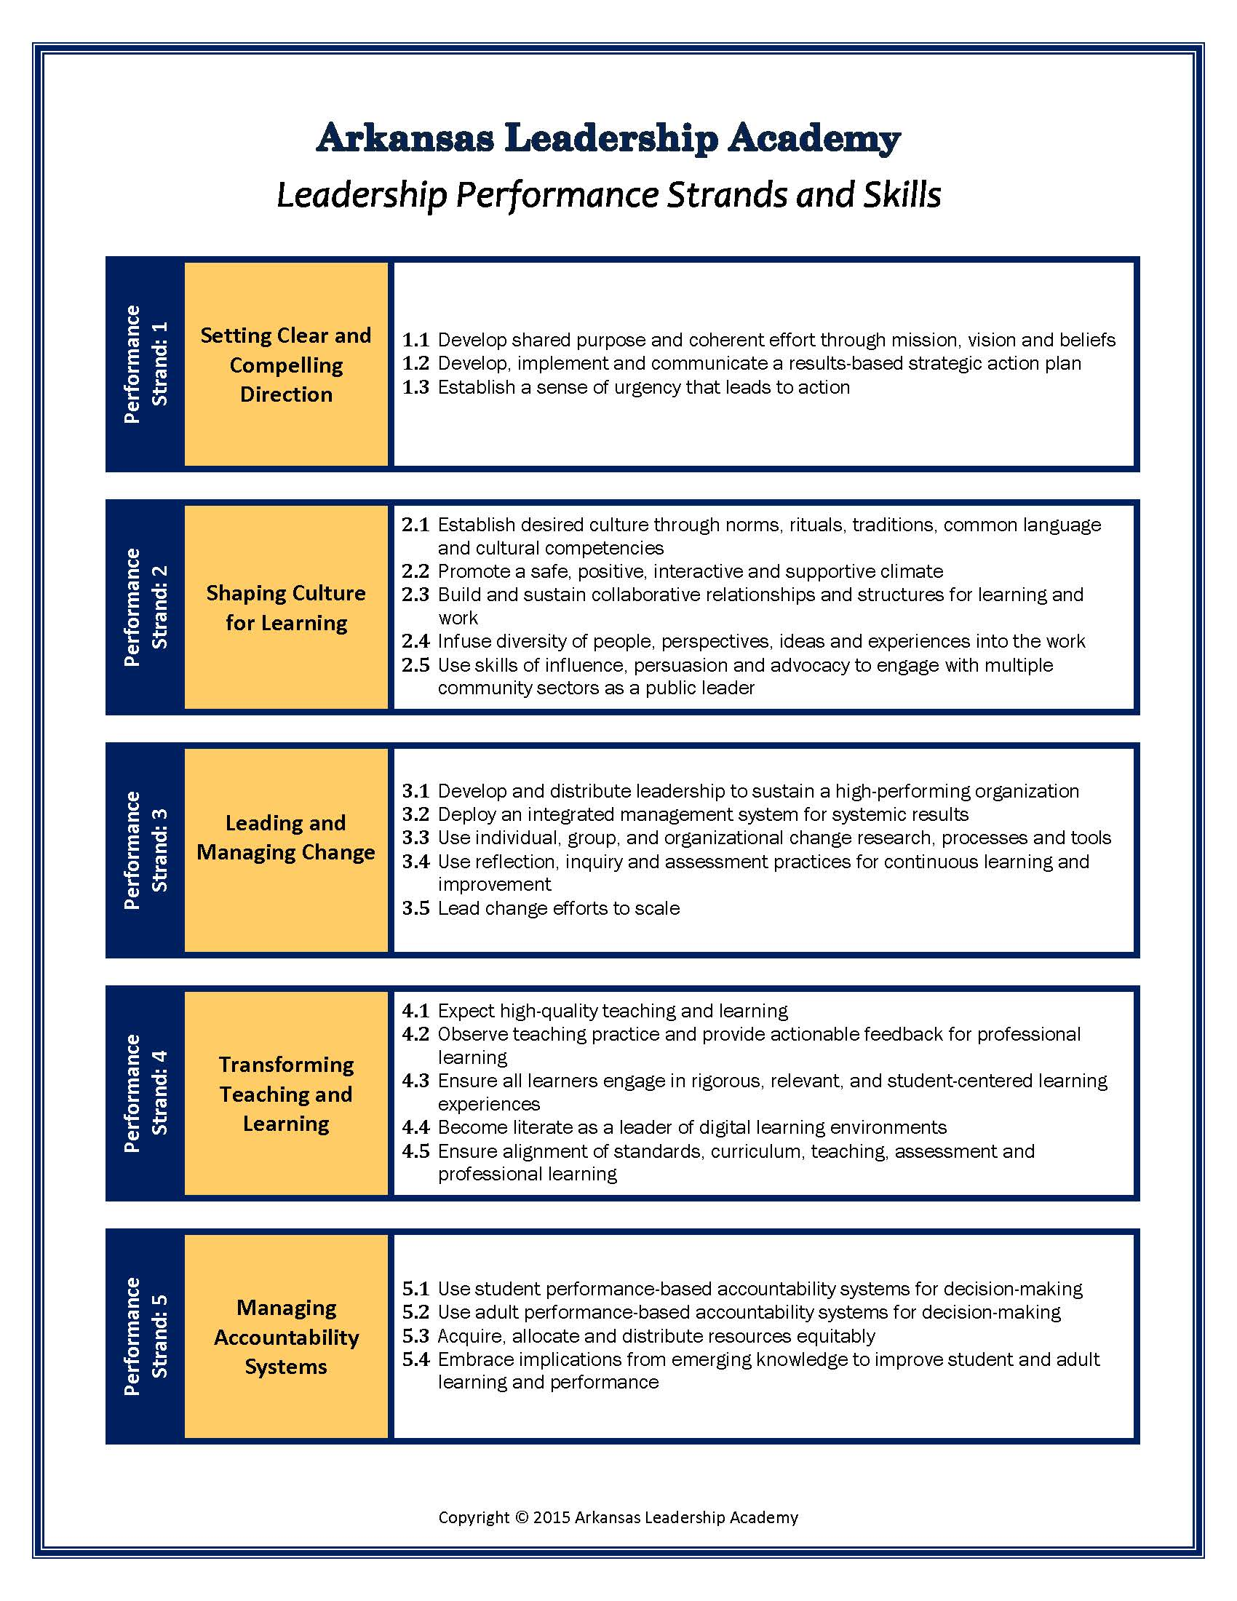

Slide 19
Learning Experiences
Master Principal Program
Assistant Principal Institute
Teacher Leadership Institute
Leadership Team Institute
Facilitation of Adult Learning Institute
Student Voice Institute
Executive Collaborative Institute
Notes:
The Academy offers programs and institutes designed to reach districts and schools at all levels with the goal of building sustainable systems. The Arkansas Leadership Academy is dedicated to supporting district and school leaders who are committed to building their capacity through team-building and shared decision making in order to be responsive to change and to take their incentives to scale.

Slide 20
Leadership Development System
Needs Assessment
There are three stages in the assessment process:
1. Preparation: Gain a clear understanding of the performance expectations included in each rubric to conduct an accurate assessment. If particular expectations are not clear, seek clarification.
2. Assessment: Check the boxes next to those expectations in each rubric that best describes your school/district performance.
3. Reflection and Rating: reflect on the expectations you have checked and rate your school/district performance on each rubric using the five point rating scale:
1-Beginning 2-Emerging 3-Applying 4-Integrating 5-Innovating

Slide 21
Strategic Plan
The Performance Coach and the Leadership team engage in a process to establish priority areas from the Needs Assessment and develop a strategic plan that will guide the work of the PC and Leadership Team throughout the current school year.
Strategic Plan focus areas are determined collaboratively and are based on the data provided by the leadership team during the needs assessment.
The Strategic Plan is updated continuously and evidence toward those goals are collected and is used to monitor the work in the district.

Slide 22
Progress monitoring
LEADS Optional Staff Survey
Principal Self-Efficacy Survey
Teacher Self-Efficacy Survey
Teacher Collective Efficacy Survey
Organizational Health Inventory (E,M,S)
Stages of Concern Questionnaire
Leadership Development System Self Assessment
*All surveys are delivered electronically in the fall of a school/district’s first contract year and in the spring of each year to measure longitudinal changes in efficacy, performance, school culture, and concern profiles
*Reports are delivered to principals and data is used to plan services and learning experiences of school

Slide 24
Progress Monitoring
Baseline – Year 1:
OHI-S, OHI-M, OHI-E, TSES, TCES, & PSES

Slide 25
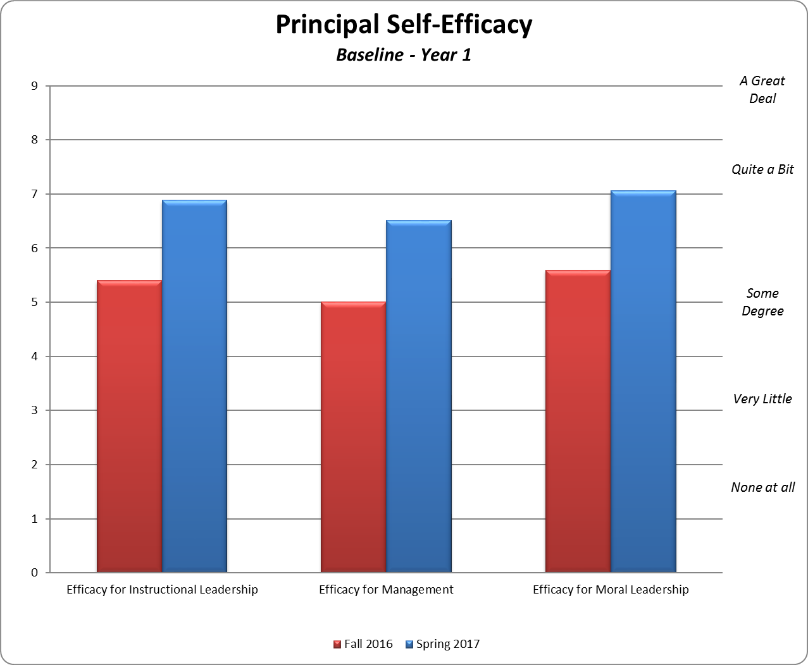

Slide 26
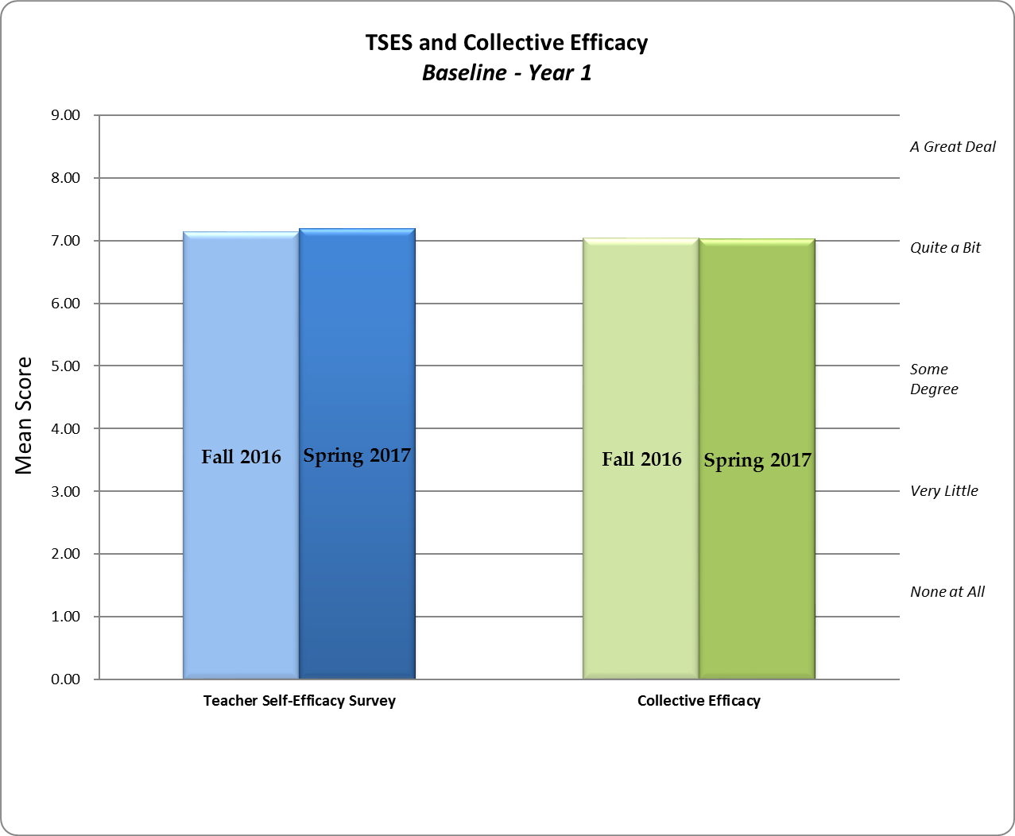

Slide 27
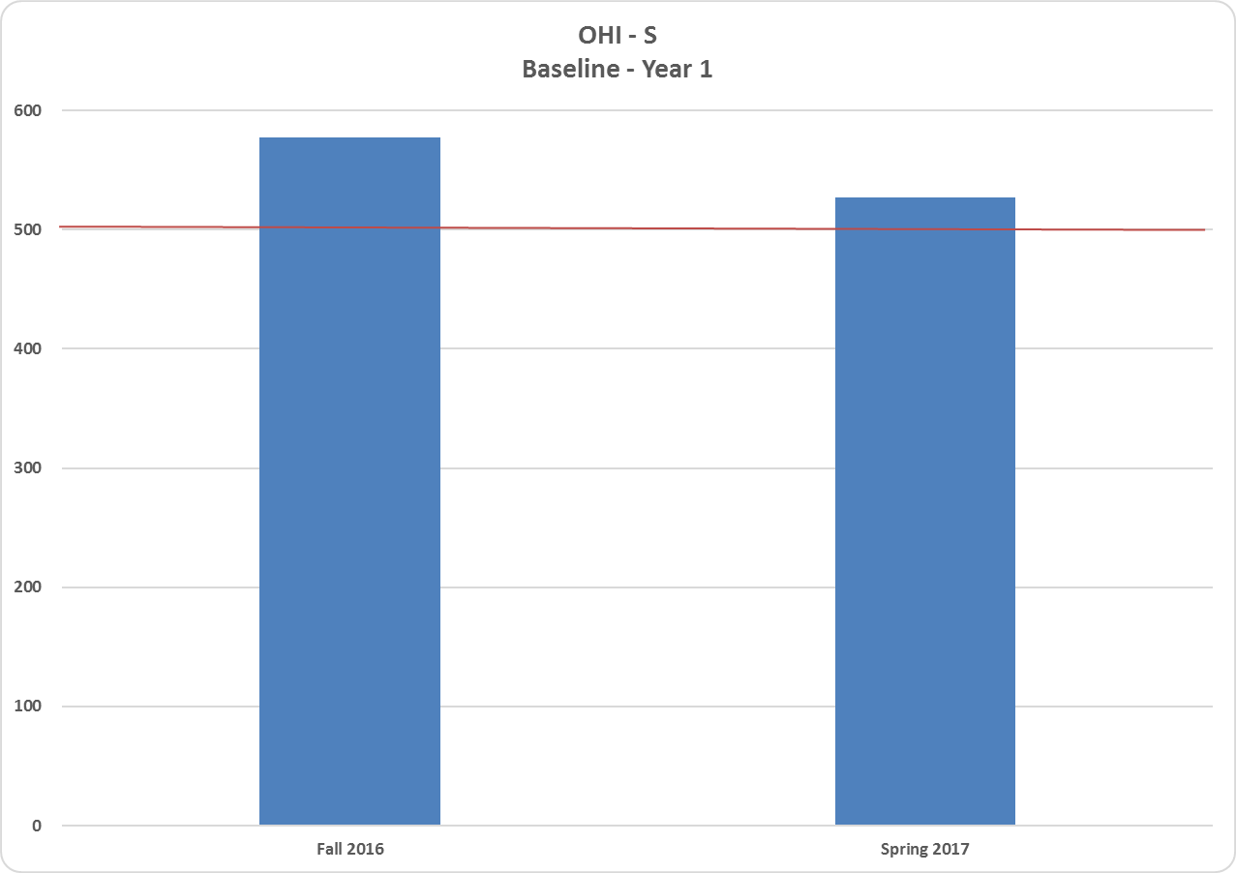

Slide 28
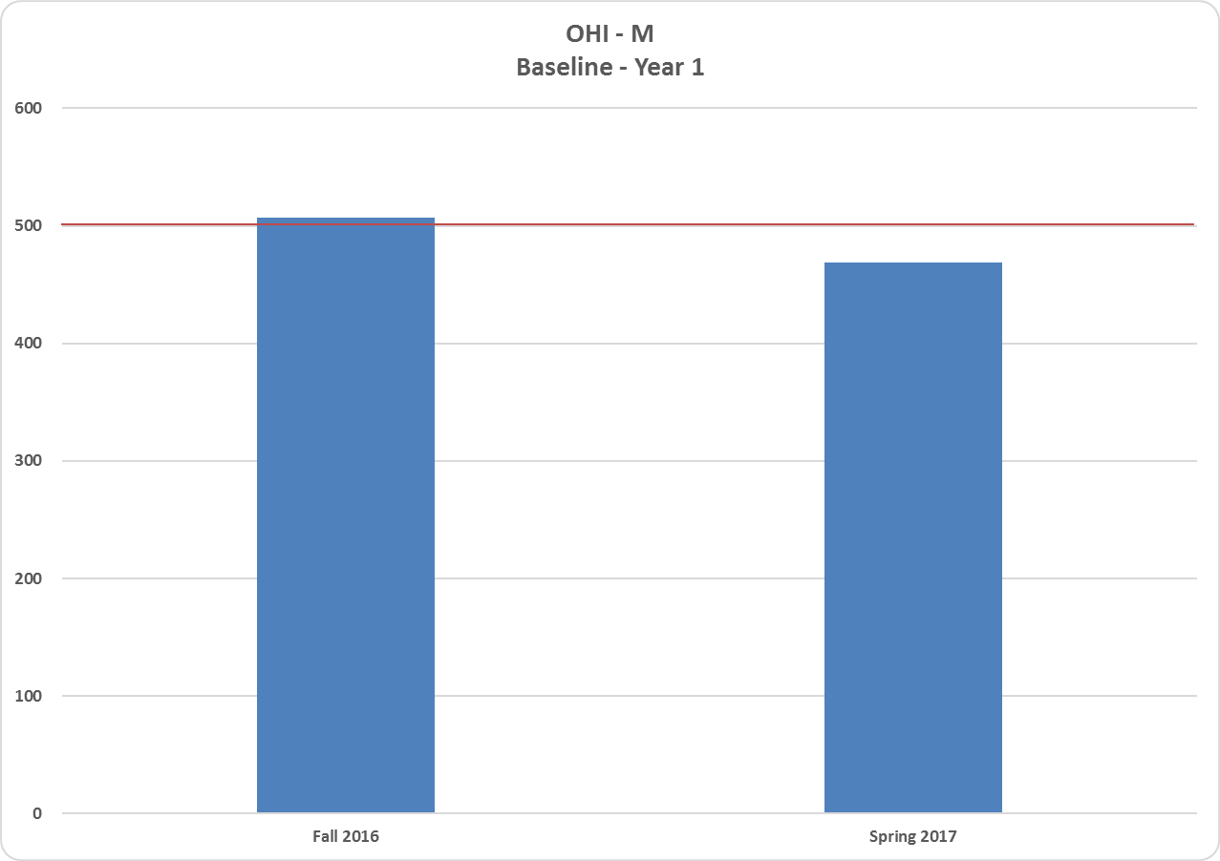

Slide 29
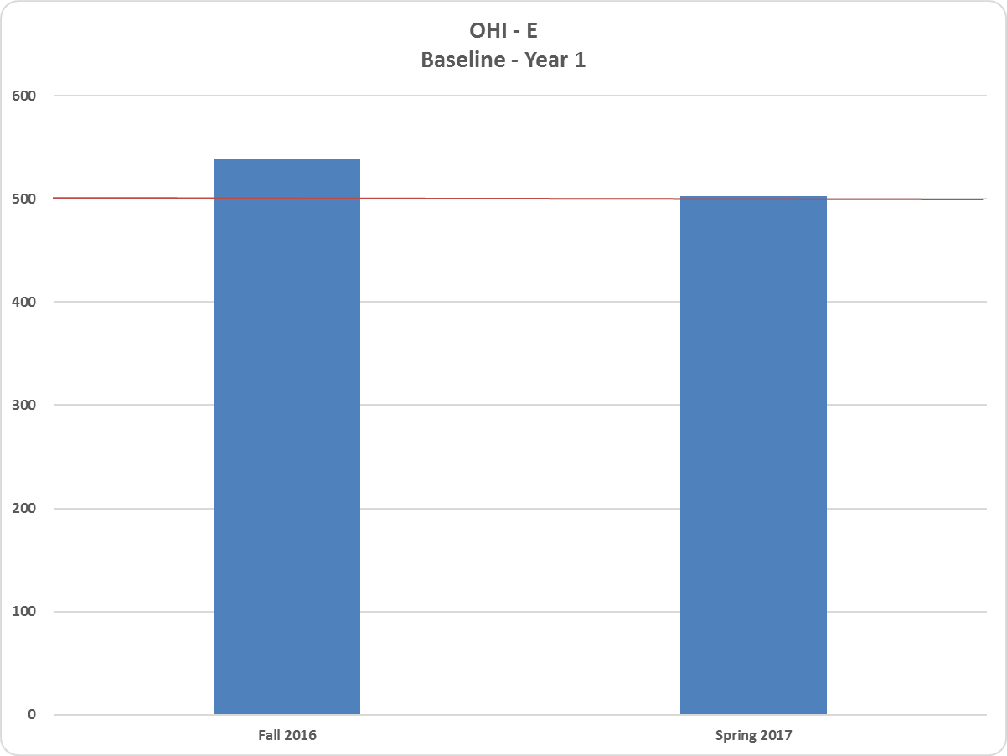

Slide 30
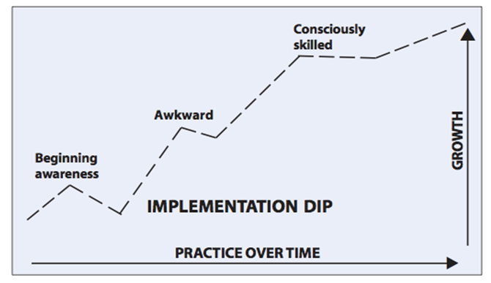
Implementation Dip

Slide 31



Like us on Facebook
@ARleadacademy
@ARleadacademy
www.arkansasleadershipacademy.org

