Slide 1
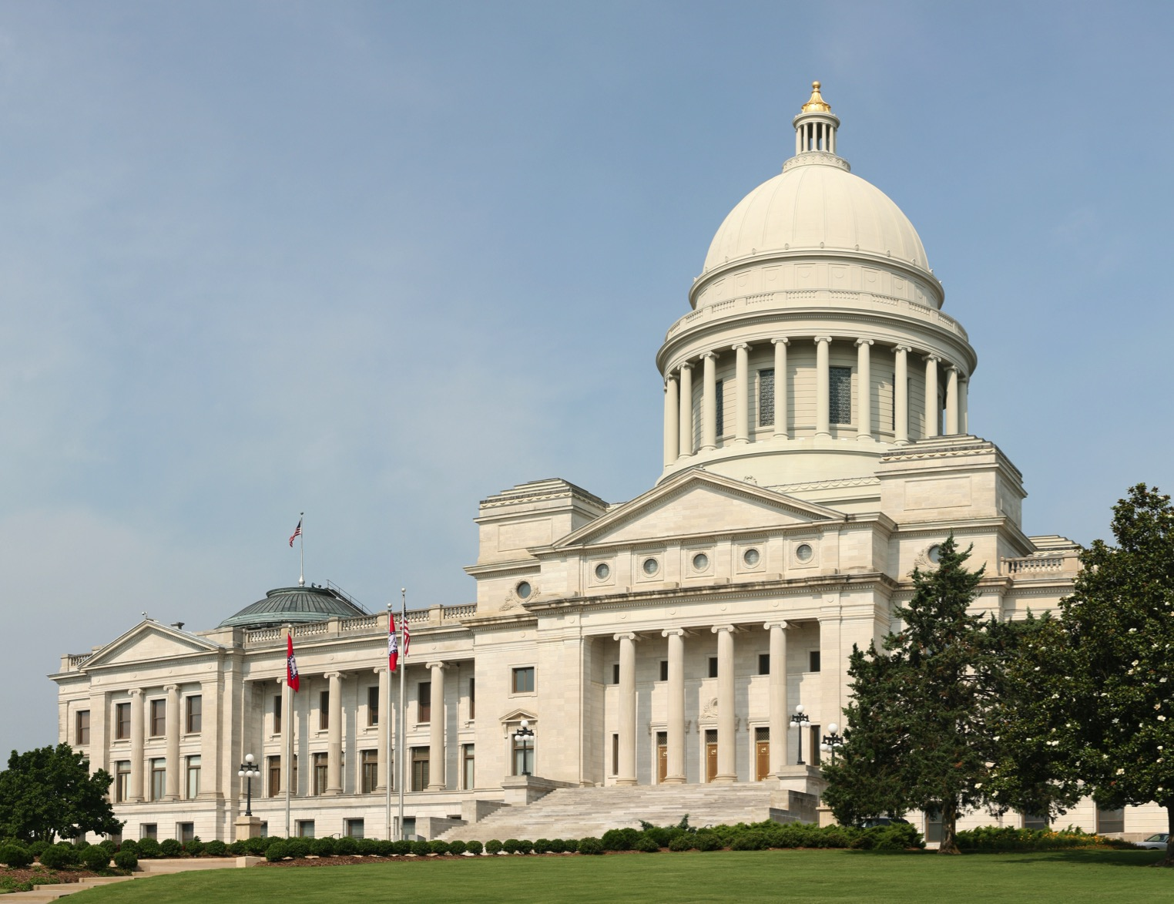
Justice Reinvestment in Arkansas
HANDOUT 1
Fifth Presentation to the Legislative Criminal Justice Oversight Task Force
June 22, 2016
Andy Barbee, Research Manager
Jessica Gonzales, Senior Research Associate
Mack Jenkins, Senior Policy Advisor
Ben Shelor, Policy Analyst

Slide 2
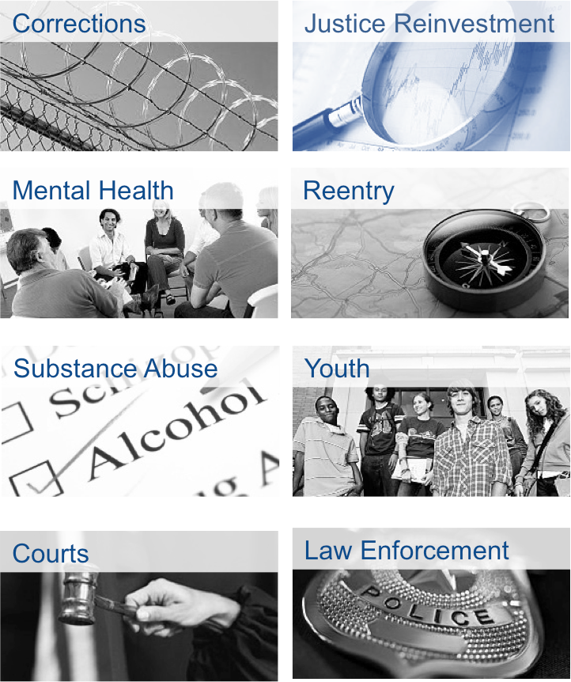

Council of State Governments Justice Center
National non-profit, non-partisan membership association of state government officials that engage members of all three branches of state government.
Justice Center provides practical, nonpartisan advice informed by the best available evidence.

Slide 3

What is Justice Reinvestment?
A data-driven approach to reduce corrections spending and reinvest savings in strategies that can decrease recidivism and increase public safety
The Justice Reinvestment Initiative is supported by funding from the U.S. Department of Justice’s Bureau of Justice Assistance (BJA) and The Pew Charitable Trusts.

Slide 4
Overview
01
Project Update
02
Comparing Probation and Prison
03
Sanctioning of Violators – Cost and Public Safety
04
Recidivism Reduction through Strengthening Supervision
05
Next Steps
Council of State Governments Justice Center | 4

Slide 5







Stakeholder input informs the data analysis presented today
Legislative Criminal Justice Oversight Task Force
Individual meetings/calls with task force members and their staff
Corrections
Meetings with leadership and staff from the Board of Corrections, ADC, ACC, and the Arkansas Parole Board; observation and interviews with staff and offenders at three ACC Field Offices and three Community Corrections Centers; visit to Cummins and Varner Units
Arkansas General Assembly
Meetings with Senators and House Representatives, including legislative leadership and the Bureau of Legislative Research
Behavioral Health
DHS Division of Behavioral Health Services (DBHS), Mental Health Council of Arkansas, Decision Point Inc., Ozark Guidance, Western Arkansas Guidance, and leadership of the Behavioral Health Treatment Access Task Force
Courts
Meetings, calls, and presentations with individual judges, Judicial Council leadership; Administrative Office of the Courts; and court observations
Law Enforcement and Prosecuting Attorneys
Arkansas Prosecuting Attorneys Association, Arkansas Attorney General’s Office, Arkansas Sheriffs Association, representatives of the Washington County Sheriff’s Office, Pulaski County Sheriff’s Office, Union County Sheriff’s Office, and Sebastian County Sheriff’s Office.
State Associations and Foundations
Association of Arkansas Counties, Arkansas Policy Foundation, Restore Hope

Slide 6
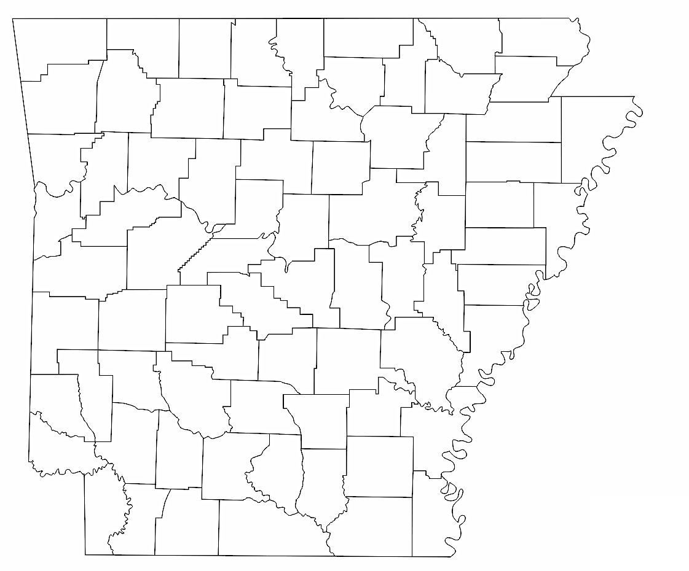
CSG Justice Center staff are pursuing regional perspectives in stakeholder engagement, reflecting the state’s size and diversity
80+
CALLS & MEETINGS
12
ON-SITE VISITS
1,500+
MILES DRIVEN
SINCE FALL 2015
County Meetings
With the assistance of the Association of Arkansas Counties and the Arkansas Sheriffs Association, CSG Justice Center staff met with leaders and stakeholders from Washington, Union, Pulaski, and Sebastian Counties to learn about the criminal justice challenges at the local level.

Slide 7
Update on criminal justice system stakeholder engagement since February 2016 Task Force presentation
On-site Meetings with Stakeholders
Calls with Stakeholders
& Review of Policy/Practice
Probation/Parole & Community Corrections
Site visits to Northwest and Central Arkansas including observation and meetings with staff and offenders at ACC Probation/Parole field offices and Community Corrections Centers.
Judges & Prosecutors
Calls and meetings in Little Rock, Fort Smith, and Fayetteville
County Officials
Meeting with 18 county-level representatives, including County Judges, Prosecuting Attorneys, Sheriffs, jail administrators, behavioral health treatment staff, and community corrections staff
Sebastian County Mental Health Summit
CSG staff participated in May 2016 summit in Fort Smith
40+ hours spent on calls with stakeholders
100+ hours reviewing sentencing & corrections law, probation & parole policies, and other relevant information
Statewide Surveys
County jail populations
Data Analysis
Over 2.7 million data records analyzed across felony sentencing, ADC, ACC, and ACIC
ADC population tracked on daily basis to include tracking of trends in the county jail backlog

Slide 8
Arkansas’s criminal justice agencies have been excellent in providing data
Today’s focus on:
Justice Reinvestment Data Request Update
Data Requested | Source | Status
Criminal History Information | Arkansas Crime Information Center | Received; Analyzed
Filing, Disposition, & Sentencing | Arkansas Sentencing Commission, Arkansas Administrative Office of the Courts | Received; Analyzed
Probation and Parole Supervision, Risk Assessment Data | Arkansas Community Correction | Received; Analyzed
Prison Population Snapshot, Admissions, & Releases | Arkansas Department of Correction | Received; Analyzed, more analyses pending
Parole Board decision data | Arkansas Parole Board | Received; Analyses pending
County Jail Population, Admissions, & Releases | Pulaski, Sebastian, Union, and Washington Counties | Received; Analyses pending

Slide 9
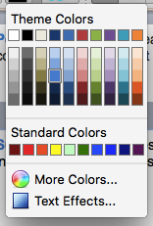
Recap of Key Findings to Date
DIRECTIONS:
Please adjust the title, subtitle, presenter names, and transparent white rectangle, as needed.
REVISION INDICATORS:
Please copy and paste the shape below to call out any items on the slide to revise or make comments. You can adjust the triangle point by clicking on the yellow diamond.
PowerPoint Toolkit: Please find below the elements mostly used in JR PPT that is pre-formatted with suggested specifications of line thickness, color combinations, etc. To cut formatting time, simply copy, paste adjust the text or shape below to the slide deck to the left.
Suggested Colors: These suggested colors and their tones/hues are complimentary to the Justice Center colors of blue and gold that are also good contrast to cater to an individual’s ability to process different colors.
Shapes
Lines
Square/Rectangle
Circles/Ovals
 | Black
 | Charcoal
 | Gold
 | Azul
 | Slate
 | Rose
Type text here
Overcrowded prisons and jails
Costly status quo
Text (Font Arial)
Slide Header/Title with Key Word Highlight (22pt)
Subheaders/Text Callouts are flexible by size and color.
Subheader Gold
Subheader Azul
Subheader Slate
Subheader Rose
Body Text is a flexible by size but should be smaller than the subheader.
Body Text Black
Body Text Charcoal
Source Text’s size is 8pt with a Light Charcoal color and italicized.
Sentencing of low-level felons to prison
Arrows

Slide 10
Overview
01
Project Update
02
Comparing Probation and Prison
03
Sanctioning of Violators – Cost and Public Safety
04
Recidivism Reduction through Strengthening Supervision
05
Next Steps
Council of State Governments Justice Center | 10

Slide 11
Section Preview
DIRECTIONS:
Please adjust the title, subtitle, presenter names, and transparent white rectangle, as needed.
REVISION INDICATORS:
Please copy and paste the shape below to call out any items on the slide to revise or make comments. You can adjust the triangle point by clicking on the yellow diamond.
PowerPoint Toolkit: Please find below the elements mostly used in JR PPT that is pre-formatted with suggested specifications of line thickness, color combinations, etc. To cut formatting time, simply copy, paste adjust the text or shape below to the slide deck to the left.
Suggested Colors: These suggested colors and their tones/hues are complimentary to the Justice Center colors of blue and gold that are also good contrast to cater to an individual’s ability to process different colors.
Shapes
Lines
Square/Rectangle
Circles/Ovals
 | Black
 | Charcoal
 | Gold
 | Azul
 | Slate
 | Rose
Type text here
Importance of examining outcomes
Understanding recidivism
Text (Font Arial)
Slide Header/Title with Key Word Highlight (22pt)
Subheaders/Text Callouts are flexible by size and color.
Subheader Gold
Subheader Azul
Subheader Slate
Subheader Rose
Body Text is a flexible by size but should be smaller than the subheader.
Body Text Black
Body Text Charcoal
Source Text’s size is 8pt with a Light Charcoal color and italicized.
Probation more cost-effective than prison
Arrows

Slide 12
Prior discussions highlighted issue of prison vs. probation for lower-level offenses
DIRECTIONS:
Please adjust the title, subtitle, presenter names, and transparent white rectangle, as needed.
REVISION INDICATORS:
Please copy and paste the shape below to call out any items on the slide to revise or make comments. You can adjust the triangle point by clicking on the yellow diamond.
PowerPoint Toolkit: Please find below the elements mostly used in JR PPT that is pre-formatted with suggested specifications of line thickness, color combinations, etc. To cut formatting time, simply copy, paste adjust the text or shape below to the slide deck to the left.
Suggested Colors: These suggested colors and their tones/hues are complimentary to the Justice Center colors of blue and gold that are also good contrast to cater to an individual’s ability to process different colors.
Shapes
Lines
Less
history
More
history
Criminal History Score
Square/Rectangle
Circles/Ovals
 | 0 | 1 | 2 | 3 | 4 | 5+
10
9
8
7
6
5
4
3
2
1
 | Black
 | Charcoal
 | Gold
 | Azul
 | Slate
 | Rose
Type text here
Offense
Seriousness
Prison
More serious offenses
Text (Font Arial)
Slide Header/Title with Key Word Highlight (22pt)
Subheaders/Text Callouts are flexible by size and color.
Subheader Gold
Subheader Azul
Subheader Slate
Subheader Rose
Body Text is a flexible by size but should be smaller than the subheader.
Body Text Black
Body Text Charcoal
Source Text’s size is 8pt with a Light Charcoal color and italicized.
Arrows
All Sentencing Options Available
Less serious offenses
Non- Prison
Source: Arkansas Sentencing Commission, Sentencing Standards Grid, Offense Seriousness Rankings and Related Material, 2015

Slide 13
Sentences to both prison and probation are driven primarily by property and drug offenses
DIRECTIONS:
Please adjust the title, subtitle, presenter names, and transparent white rectangle, as needed.
REVISION INDICATORS:
Please copy and paste the shape below to call out any items on the slide to revise or make comments. You can adjust the triangle point by clicking on the yellow diamond.
PowerPoint Toolkit: Please find below the elements mostly used in JR PPT that is pre-formatted with suggested specifications of line thickness, color combinations, etc. To cut formatting time, simply copy, paste adjust the text or shape below to the slide deck to the left.
Suggested Colors: These suggested colors and their tones/hues are complimentary to the Justice Center colors of blue and gold that are also good contrast to cater to an individual’s ability to process different colors.
Shapes
Lines
Felony Sentences by Disposition Type, 2014
Circles/Ovals
 | Black
 | Charcoal
 | Gold
 | Azul
 | Slate
 | Rose
Square/Rectangle
Total Sentences: 14,760
Type text here
SIS/Other
Underlying Most Serious Offense Type
Person
Sex
Property
Drug
Other
Probation
(49.5% of all sentences)
87% Drug / Property / Other
Text (Font Arial)
Slide Header/Title with Key Word Highlight (22pt)
Subheaders/Text Callouts are flexible by size and color.
Subheader Gold
Subheader Azul
Subheader Slate
Subheader Rose
Body Text is a flexible by size but should be smaller than the subheader.
Body Text Black
Body Text Charcoal
Source Text’s size is 8pt with a Light Charcoal color and italicized.
CCC
Arrows
Prison
(37.2% of all sentences)
78% Drug / Property / Other
Other consists of offenses such as possession of firearm by certain persons, failure to appear (FTA on a felony) furnishing prohibited articles, fleeing , and non support.
Source: Arkansas Sentencing Commission Data, 2014

Slide 14
Understanding what a recidivism rate means…
DIRECTIONS:
Please adjust the title, subtitle, presenter names, and transparent white rectangle, as needed.
REVISION INDICATORS:
Please copy and paste the shape below to call out any items on the slide to revise or make comments. You can adjust the triangle point by clicking on the yellow diamond.
PowerPoint Toolkit: Please find below the elements mostly used in JR PPT that is pre-formatted with suggested specifications of line thickness, color combinations, etc. To cut formatting time, simply copy, paste adjust the text or shape below to the slide deck to the left.
Suggested Colors: These suggested colors and their tones/hues are complimentary to the Justice Center colors of blue and gold that are also good contrast to cater to an individual’s ability to process different colors.
Shapes
Lines
36-Month Rearrest Rates for Individuals Released from ADC in FY2012
Overall 3-year re-arrest rate is 57% (cumulative across the 36 months in graph at left).
Once “at risk” of being arrested (i.e. recidivating), 2-3% of the cohort are getting arrested each month early on, but that falls to less than 1% per month before month 24.
Square/Rectangle
Circles/Ovals
32%
 | Black
 | Charcoal
 | Gold
 | Azul
 | Slate
 | Rose
Type text here
16%
9%
Text (Font Arial)
Slide Header/Title with Key Word Highlight (22pt)
Subheaders/Text Callouts are flexible by size and color.
Subheader Gold
Subheader Azul
Subheader Slate
Subheader Rose
Body Text is a flexible by size but should be smaller than the subheader.
Body Text Black
Body Text Charcoal
Source Text’s size is 8pt with a Light Charcoal color and italicized.
Arrows
Months Out
Source: ADC Release Data, ACIC Arrest Data

Slide 15
Overall, people placed on probation instead of released from prison are re-arrested at roughly 18-21 percent lower rates within three years
DIRECTIONS:
Please adjust the title, subtitle, presenter names, and transparent white rectangle, as needed.
REVISION INDICATORS:
Please copy and paste the shape below to call out any items on the slide to revise or make comments. You can adjust the triangle point by clicking on the yellow diamond.
PowerPoint Toolkit: Please find below the elements mostly used in JR PPT that is pre-formatted with suggested specifications of line thickness, color combinations, etc. To cut formatting time, simply copy, paste adjust the text or shape below to the slide deck to the left.
Suggested Colors: These suggested colors and their tones/hues are complimentary to the Justice Center colors of blue and gold that are also good contrast to cater to an individual’s ability to process different colors.
Shapes
Lines
36-Month Rearrest Rates for Individuals Released from Prison Compared to Individuals Beginning Felony Probation in FY2012
Square/Rectangle
Circles/Ovals
 | Black
 | Charcoal
 | Gold
 | Azul
 | Slate
 | Rose
Type text here
Arrest Rate | Prison | Prob. | Prob. % Diff.
1 Yr | 32% | 26% | - 19%
2 Yr | 48% | 38% | - 21%
3 Yr | 57% | 47% | - 18%
Text (Font Arial)
Slide Header/Title with Key Word Highlight (22pt)
Subheaders/Text Callouts are flexible by size and color.
Subheader Gold
Subheader Azul
Subheader Slate
Subheader Rose
Body Text is a flexible by size but should be smaller than the subheader.
Body Text Black
Body Text Charcoal
Source Text’s size is 8pt with a Light Charcoal color and italicized.
Arrows
Months Out
Source: ADC Release Data, ACC Intake Data, ACIC Arrest Data

Slide 16

Comparing apples to apples, probation yields as good or better recidivism rates as prison
DIRECTIONS:
Please adjust the title, subtitle, presenter names, and transparent white rectangle, as needed.
REVISION INDICATORS:
Please copy and paste the shape below to call out any items on the slide to revise or make comments. You can adjust the triangle point by clicking on the yellow diamond.
PowerPoint Toolkit: Please find below the elements mostly used in JR PPT that is pre-formatted with suggested specifications of line thickness, color combinations, etc. To cut formatting time, simply copy, paste adjust the text or shape below to the slide deck to the left.
Suggested Colors: These suggested colors and their tones/hues are complimentary to the Justice Center colors of blue and gold that are also good contrast to cater to an individual’s ability to process different colors.
Shapes
Lines
Two Year Rearrest Rates for Drug/Property Offenses,
FY2013 Cohorts
Circles/Ovals
 | Black
 | Charcoal
 | Gold
 | Azul
 | Slate
 | Rose
Square/Rectangle
Type text here
Prior Felony Arrests | Prison Releases | Probation Starts
0 to 1 | 37% | 37%
2-3 | 51% | 49%
4 or more | 60% | 55%
Overall | 50% | 40%
Text (Font Arial)
Slide Header/Title with Key Word Highlight (22pt)
Subheaders/Text Callouts are flexible by size and color.
Subheader Gold
Subheader Azul
Subheader Slate
Subheader Rose
Body Text is a flexible by size but should be smaller than the subheader.
Body Text Black
Body Text Charcoal
Source Text’s size is 8pt with a Light Charcoal color and italicized.
4 years supervision at $2.25/day
Arrows
Probation
$3,285
cost to state
Return on Investment
2 years in prison at $62/day
$45,260 cost to state
Prison
Source: ADC Release Data, ACC Intake Data, ACIC Arrest Data

Slide 17
Overview
01
Project Update
02
Comparing Probation and Prison
03
Sanctioning of Violators – Cost and Public Safety
04
Recidivism Reduction through Strengthening Supervision
05
Next Steps
Council of State Governments Justice Center | 17

Slide 18
Section Preview
DIRECTIONS:
Please adjust the title, subtitle, presenter names, and transparent white rectangle, as needed.
REVISION INDICATORS:
Please copy and paste the shape below to call out any items on the slide to revise or make comments. You can adjust the triangle point by clicking on the yellow diamond.
PowerPoint Toolkit: Please find below the elements mostly used in JR PPT that is pre-formatted with suggested specifications of line thickness, color combinations, etc. To cut formatting time, simply copy, paste adjust the text or shape below to the slide deck to the left.
Suggested Colors: These suggested colors and their tones/hues are complimentary to the Justice Center colors of blue and gold that are also good contrast to cater to an individual’s ability to process different colors.
Shapes
Lines
Square/Rectangle
Circles/Ovals
 | Black
 | Charcoal
 | Gold
 | Azul
 | Slate
 | Rose
Type text here
Violators of supervision driving prison growth
Almost a third of those violators are purely technical
Text (Font Arial)
Slide Header/Title with Key Word Highlight (22pt)
Subheaders/Text Callouts are flexible by size and color.
Subheader Gold
Subheader Azul
Subheader Slate
Subheader Rose
Body Text is a flexible by size but should be smaller than the subheader.
Body Text Black
Body Text Charcoal
Source Text’s size is 8pt with a Light Charcoal color and italicized.
Questionable cost-effectiveness of status quo
Arrows

Slide 19
Admissions to prison increased 41 percent from FY2009 to FY2015
DIRECTIONS:
Please adjust the title, subtitle, presenter names, and transparent white rectangle, as needed.
REVISION INDICATORS:
Please copy and paste the shape below to call out any items on the slide to revise or make comments. You can adjust the triangle point by clicking on the yellow diamond.
PowerPoint Toolkit: Please find below the elements mostly used in JR PPT that is pre-formatted with suggested specifications of line thickness, color combinations, etc. To cut formatting time, simply copy, paste adjust the text or shape below to the slide deck to the left.
Suggested Colors: These suggested colors and their tones/hues are complimentary to the Justice Center colors of blue and gold that are also good contrast to cater to an individual’s ability to process different colors.
Shapes
Lines
Annual Admissions to Prison, FY2009–2015
Square/Rectangle
Circles/Ovals
From FY2012 to FY2015, admissions increased 70%
 | Black
 | Charcoal
 | Gold
 | Azul
 | Slate
 | Rose
Type text here
Most current update:
Comparing Jul-Apr FY2012 and FY2016 shows admissions up 61%
Text (Font Arial)
Slide Header/Title with Key Word Highlight (22pt)
Subheaders/Text Callouts are flexible by size and color.
Subheader Gold
Subheader Azul
Subheader Slate
Subheader Rose
Body Text is a flexible by size but should be smaller than the subheader.
Body Text Black
Body Text Charcoal
Source Text’s size is 8pt with a Light Charcoal color and italicized.
Arrows
Source: ADC Admission Data

Slide 20
Parole violators went from being a third of all prion admissions to over half
DIRECTIONS:
Please adjust the title, subtitle, presenter names, and transparent white rectangle, as needed.
REVISION INDICATORS:
Please copy and paste the shape below to call out any items on the slide to revise or make comments. You can adjust the triangle point by clicking on the yellow diamond.
PowerPoint Toolkit: Please find below the elements mostly used in JR PPT that is pre-formatted with suggested specifications of line thickness, color combinations, etc. To cut formatting time, simply copy, paste adjust the text or shape below to the slide deck to the left.
Suggested Colors: These suggested colors and their tones/hues are complimentary to the Justice Center colors of blue and gold that are also good contrast to cater to an individual’s ability to process different colors.
Shapes
Lines
Admissions to Prison by Type of Admission,
FY2009 and 2015
Circles/Ovals
 | Black
 | Charcoal
 | Gold
 | Azul
 | Slate
 | Rose
Square/Rectangle
Type text here
Total = 7,448
Total = 10,467
Parole violators accounted for 54% of all admissions to prison in FY2015
Up from 32% in FY09
+ 137%
Parole
Violators
Probation Violators
Text (Font Arial)
Slide Header/Title with Key Word Highlight (22pt)
Subheaders/Text Callouts are flexible by size and color.
Subheader Gold
Subheader Azul
Subheader Slate
Subheader Rose
Body Text is a flexible by size but should be smaller than the subheader.
Body Text Black
Body Text Charcoal
Source Text’s size is 8pt with a Light Charcoal color and italicized.
+ 4%
Arrows
Most current update:
New Commits
- 10%
July-April FY2016 shows admissions for parole violators accounted for 51% of all ADC admissions.
Other
- 14%
Source: ADC Admission Data, ACC Termination Data

Slide 21
Virtually all of the growth in Arkansas’s prison population stems from sanctioning of supervision violators
DIRECTIONS:
Please adjust the title, subtitle, presenter names, and transparent white rectangle, as needed.
REVISION INDICATORS:
Please copy and paste the shape below to call out any items on the slide to revise or make comments. You can adjust the triangle point by clicking on the yellow diamond.
PowerPoint Toolkit: Please find below the elements mostly used in JR PPT that is pre-formatted with suggested specifications of line thickness, color combinations, etc. To cut formatting time, simply copy, paste adjust the text or shape below to the slide deck to the left.
Suggested Colors: These suggested colors and their tones/hues are complimentary to the Justice Center colors of blue and gold that are also good contrast to cater to an individual’s ability to process different colors.
Shapes
Lines
Year-End Prison Population by Type of Admission,
FY2009 and 2015
ADC Population Growth FY2009-2015
Circles/Ovals
 | Black
 | Charcoal
 | Gold
 | Azul
 | Slate
 | Rose
Square/Rectangle
Type text here
Population | Raw Growth
Total Prison | + 4,243
Parole Violators | + 3,786
Probation Violators | + 372
Probation + Parole Violators Combined | + 4,158
Total = 14,722
Total = 18,965
Parole
Violators
Probation Violators
Text (Font Arial)
Slide Header/Title with Key Word Highlight (22pt)
Subheaders/Text Callouts are flexible by size and color.
Subheader Gold
Subheader Azul
Subheader Slate
Subheader Rose
Body Text is a flexible by size but should be smaller than the subheader.
Body Text Black
Body Text Charcoal
Source Text’s size is 8pt with a Light Charcoal color and italicized.
Arrows
New Commits
51% of prison population consists of supervision violators
48% as of 4/30/16
Other
ADC Snapshot Data, 2009 – April 2016

Slide 22
Almost a third of revoked probationers and parolees did not have an arrest while on supervision prior to revocation
DIRECTIONS:
Please adjust the title, subtitle, presenter names, and transparent white rectangle, as needed.
REVISION INDICATORS:
Please copy and paste the shape below to call out any items on the slide to revise or make comments. You can adjust the triangle point by clicking on the yellow diamond.
PowerPoint Toolkit: Please find below the elements mostly used in JR PPT that is pre-formatted with suggested specifications of line thickness, color combinations, etc. To cut formatting time, simply copy, paste adjust the text or shape below to the slide deck to the left.
Suggested Colors: These suggested colors and their tones/hues are complimentary to the Justice Center colors of blue and gold that are also good contrast to cater to an individual’s ability to process different colors.
Shapes
Lines
Square/Rectangle
Circles/Ovals
FY2015 Prison Admissions
by Type of Admission
Violators with Arrest During Supervision?
 | Black
 | Charcoal
 | Gold
 | Azul
 | Slate
 | Rose
Type text here
Felony
Arrest
Misdemeanor
Arrest
No
Arrest
49%
22%
30%
Parole
Violators
48%
21%
31%
2,237 probationers and parolees revoked to prison despite not having an arrest while on supervision
Text (Font Arial)
Slide Header/Title with Key Word Highlight (22pt)
Subheaders/Text Callouts are flexible by size and color.
Subheader Gold
Subheader Azul
Subheader Slate
Subheader Rose
Body Text is a flexible by size but should be smaller than the subheader.
Body Text Black
Body Text Charcoal
Source Text’s size is 8pt with a Light Charcoal color and italicized.
AVG # of
Violations
Fewer than three
Arrows
Probation Violators
Almost 75% comprised of:
Failure to comply w/ conditions
Failed drug test
Failure to report
Failure to pay
New Commits
Other
Source: ADC Admission Data, ACC Termination Data

Slide 23
Probation violators released from prison in FY2015 spent more than twice as long in prison compared to FY2009
DIRECTIONS:
Please adjust the title, subtitle, presenter names, and transparent white rectangle, as needed.
REVISION INDICATORS:
Please copy and paste the shape below to call out any items on the slide to revise or make comments. You can adjust the triangle point by clicking on the yellow diamond.
PowerPoint Toolkit: Please find below the elements mostly used in JR PPT that is pre-formatted with suggested specifications of line thickness, color combinations, etc. To cut formatting time, simply copy, paste adjust the text or shape below to the slide deck to the left.
Suggested Colors: These suggested colors and their tones/hues are complimentary to the Justice Center colors of blue and gold that are also good contrast to cater to an individual’s ability to process different colors.
Shapes
Lines
Length of Stay (Months) in Prison,
FY2015 Releases
Square/Rectangle
Circles/Ovals
Of those released in FY2015:
Technical probation revocations spent 12 months in prison
Technical parole violators spent 15 months in prison
 | Black
 | Charcoal
 | Gold
 | Azul
 | Slate
 | Rose
Type text here
FY09
FY15
FY15
Text (Font Arial)
Slide Header/Title with Key Word Highlight (22pt)
Subheaders/Text Callouts are flexible by size and color.
Subheader Gold
Subheader Azul
Subheader Slate
Subheader Rose
Body Text is a flexible by size but should be smaller than the subheader.
Body Text Black
Body Text Charcoal
Source Text’s size is 8pt with a Light Charcoal color and italicized.
FY09
Arrows
Note: The lengths of stay in prison do not account for time spent in local jails awaiting violation hearing.
Source: ADC Release Data, ACC Termination Data

Slide 24
Current cost to Arkansas for imprisoning technical probation and parole violators represents almost $20 million annually
DIRECTIONS:
Please adjust the title, subtitle, presenter names, and transparent white rectangle, as needed.
REVISION INDICATORS:
Please copy and paste the shape below to call out any items on the slide to revise or make comments. You can adjust the triangle point by clicking on the yellow diamond.
PowerPoint Toolkit: Please find below the elements mostly used in JR PPT that is pre-formatted with suggested specifications of line thickness, color combinations, etc. To cut formatting time, simply copy, paste adjust the text or shape below to the slide deck to the left.
Suggested Colors: These suggested colors and their tones/hues are complimentary to the Justice Center colors of blue and gold that are also good contrast to cater to an individual’s ability to process different colors.
Shapes
Lines
Square/Rectangle
Circles/Ovals
Technical Violators Revoked to Prison in FY2015
1,678
 | Black
 | Charcoal
 | Gold
 | Azul
 | Slate
 | Rose
Type text here
Excludes absconders
Contract Bed Cost per Day of $30
Average length of stay in prison of 12 months
Requires 1,678 prison beds on a daily basis
Text (Font Arial)
Slide Header/Title with Key Word Highlight (22pt)
Subheaders/Text Callouts are flexible by size and color.
Subheader Gold
Subheader Azul
Subheader Slate
Subheader Rose
Body Text is a flexible by size but should be smaller than the subheader.
Body Text Black
Body Text Charcoal
Source Text’s size is 8pt with a Light Charcoal color and italicized.
Arrows
$18.4 Million
Annually
Source: ADC Release Data, ACC Termination Data, ADC County Jail Backlog Cost Per Day
Notes:
Preface by making point that essentially half of ADC’s budget has become about incarcerating supervision violators.

Slide 25
Use of TVP sanctioning declined by more than 40 percent from FY2013 to FY2015
TVP Admissions, FY2009-2015
TVP centers are intermediate sanctioning facilities for parole violators.
In addition to being an option for the Parole Board, parole officers can also directly petition to have their parole client placed into a TVP center when sanctioning a parole violator.
43% decline
Decline in use of TVPs occurred at same time as increase in parole violators sent to prison.
Policy change in 2013 excluded parole violators with a new felony charge and also limited to no more than two opportunities.
Source: TVP Admission Data
Notes:
Change in TVP admit criteria beginning 2013 regarding felony charges (to be excluded) and prior TVP admits (capped at two).
TVP length of stay 90-120 days.
Cost per day similar to ADC prisons (low $60s).
Similar recid rates.

Slide 26
Arkansas’s TVPs perform similarly to prison in terms of recidivism, but they’re less costly and present better opportunity to reduce recidivism
DIRECTIONS:
Please adjust the title, subtitle, presenter names, and transparent white rectangle, as needed.
REVISION INDICATORS:
Please copy and paste the shape below to call out any items on the slide to revise or make comments. You can adjust the triangle point by clicking on the yellow diamond.
PowerPoint Toolkit: Please find below the elements mostly used in JR PPT that is pre-formatted with suggested specifications of line thickness, color combinations, etc. To cut formatting time, simply copy, paste adjust the text or shape below to the slide deck to the left.
Suggested Colors: These suggested colors and their tones/hues are complimentary to the Justice Center colors of blue and gold that are also good contrast to cater to an individual’s ability to process different colors.
Shapes
Lines
One-Year Rearrest Rates for Parole Violators Released from Prison Compared to Parole Violators Released from TVP Centers, FY2009 and FY2014
Square/Rectangle
Circles/Ovals
 | Black
 | Charcoal
 | Gold
 | Azul
 | Slate
 | Rose
Type text here
Similar costs per day:
TVP ~ $60
ADC ~ $62
Different lengths of stay:
TVP ~ 3-4 months
ADC ~ 12 months
Different costs to state:
TVP ~ $7,200/person
ADC ~ $22,630/person
Text (Font Arial)
Slide Header/Title with Key Word Highlight (22pt)
Subheaders/Text Callouts are flexible by size and color.
Subheader Gold
Subheader Azul
Subheader Slate
Subheader Rose
Body Text is a flexible by size but should be smaller than the subheader.
Body Text Black
Body Text Charcoal
Source Text’s size is 8pt with a Light Charcoal color and italicized.
Arrows
Source: TVP Release Data, ADC Release Data, ACIC Arrest Data, ACC Cost Per Day Estimate
Notes:
TPVs currently limited to two stays, first one is 90 days and second is 120 days.

Slide 27
In recent years, many states have implemented short, swift and certain sanctioning policies for technical violators
Suggested Colors: These suggested colors and their tones/hues are complimentary to the Justice Center colors of blue and gold that are also good contrast to cater to an individual’s ability to process different colors.
Louisiana
Washington
North Carolina
Circles/Ovals
 | Black
 | Charcoal
 | Gold
 | Azul
 | Slate
 | Rose
Square/Rectangle
In 2007, Louisiana unanimously approved legislation that set a 90-day limit on the incarceration of those whose probation or parole has been revoked for the first time for violating the rules of their community supervision.
In 2012, Washington implemented a swift and certain (SAC) policy that uses short periods of incarceration for sanctioning violations of conditions. The policy calls for “high level” supervision violations to be sanctioned with up to 30 days of confinement.
North Carolina’s 2011 justice reinvestment legislation included policies permitting swift and certain “quick dips” of 2-3 day jail sanctions and “dunks” of 90-day prison sanctions in response to violations of supervision conditions.
Text (Font Arial)
Slide Header/Title with Key Word Highlight (22pt)
Subheaders/Text Callouts are flexible by size and color.
Subheader Gold
Subheader Azul
Subheader Slate
Subheader Rose
Body Text is a flexible by size but should be smaller than the subheader.
Body Text Black
Body Text Charcoal
Source Text’s size is 8pt with a Light Charcoal color and italicized.
Arrows
Sources: “Evaluation of Washington State Department of Corrections (WADOC) Swift and Certain (SAC) Policy Process, Outcome and Cost-Benefit Evaluation”, Washington State University, “Reducing Incarceration for Technical Violations in Louisiana: Evaluation of Revocation Cap Shows Cost Savings, Less Crime”, Pew Charitable Trusts; “Justice Reinvestment in North Carolina: Three Years Later”, Council of State Governments Justice Center.

Slide 28
Those states are showing positive outcomes in terms of reductions in recidivism
Suggested Colors: These suggested colors and their tones/hues are complimentary to the Justice Center colors of blue and gold that are also good contrast to cater to an individual’s ability to process different colors.
Louisiana
Washington
North Carolina
Circles/Ovals
 | Black
 | Charcoal
 | Gold
 | Azul
 | Slate
 | Rose
Square/Rectangle
Reduced length of stay for 1st time technical revocations by 281 days, or 9.2 months.
Maintained public safety, with returns to custody for new crimes declining from 8% to 6%, a 22 percent decrease.
Resulted in a net savings of approximately 2,034 jail and prison beds a year.
SAC reduced the length of stay and encouraged more appropriate and proportionate responses to violations.
SAC participants were less likely to recidivate – 20% less likely to receive any felony conviction, and 30% less likely to receive a violent felony conviction.
Probation revocations to prison fell by half
Prison population declined 8%.
Recent analysis indicates violators with a “quick dip” were less likely to abscond or be revoked to prison and more likely to be successful on supervision than those that did not receive a quick dip in response to supervision violations.
Text (Font Arial)
Slide Header/Title with Key Word Highlight (22pt)
Subheaders/Text Callouts are flexible by size and color.
Subheader Gold
Subheader Azul
Subheader Slate
Subheader Rose
Body Text is a flexible by size but should be smaller than the subheader.
Body Text Black
Body Text Charcoal
Source Text’s size is 8pt with a Light Charcoal color and italicized.
Arrows
Sources: “Evaluation of Washington State Department of Corrections (WADOC) Swift and Certain (SAC) Policy Process, Outcome and Cost-Benefit Evaluation”, Washington State University, “Reducing Incarceration for Technical Violations in Louisiana: Evaluation of Revocation Cap Shows Cost Savings, Less Crime”, Pew Charitable Trusts; “Justice Reinvestment in North Carolina: Three Years Later”, Council of State Governments Justice Center.

Slide 29
Overview
01
Project Update
02
Comparing Probation and Prison
03
Sanctioning of Violators – Cost and Public Safety
04
Recidivism Reduction through Strengthening Supervision
05
Next Steps
Council of State Governments Justice Center | 29

Slide 30
Section Preview
DIRECTIONS:
Please adjust the title, subtitle, presenter names, and transparent white rectangle, as needed.
REVISION INDICATORS:
Please copy and paste the shape below to call out any items on the slide to revise or make comments. You can adjust the triangle point by clicking on the yellow diamond.
PowerPoint Toolkit: Please find below the elements mostly used in JR PPT that is pre-formatted with suggested specifications of line thickness, color combinations, etc. To cut formatting time, simply copy, paste adjust the text or shape below to the slide deck to the left.
Suggested Colors: These suggested colors and their tones/hues are complimentary to the Justice Center colors of blue and gold that are also good contrast to cater to an individual’s ability to process different colors.
Shapes
Lines
Square/Rectangle
Circles/Ovals
 | Black
 | Charcoal
 | Gold
 | Azul
 | Slate
 | Rose
Type text here
High caseloads and lengthy supervision terms
Field observations
Text (Font Arial)
Slide Header/Title with Key Word Highlight (22pt)
Subheaders/Text Callouts are flexible by size and color.
Subheader Gold
Subheader Azul
Subheader Slate
Subheader Rose
Body Text is a flexible by size but should be smaller than the subheader.
Body Text Black
Body Text Charcoal
Source Text’s size is 8pt with a Light Charcoal color and italicized.
Turning the corner
Arrows

Slide 31
Between 2009 and 2015, the combined felony probation and parole supervision populations decreased 4 percent
DIRECTIONS:
Please adjust the title, subtitle, presenter names, and transparent white rectangle, as needed.
REVISION INDICATORS:
Please copy and paste the shape below to call out any items on the slide to revise or make comments. You can adjust the triangle point by clicking on the yellow diamond.
Year-End Felony Probation and Parole Populations, FY2009–2015
FY09 Total
= 53,669
FY15 Total
= 51,369
Type text here
Parole population increased 4%
Probation population decreased 10%
Source: ACC Snapshot Data

Slide 32
Arkansas’s probation and parole officers have in excess of 120 cases per officer requiring some level of supervision
DIRECTIONS:
Please adjust the title, subtitle, presenter names, and transparent white rectangle, as needed.
REVISION INDICATORS:
Please copy and paste the shape below to call out any items on the slide to revise or make comments. You can adjust the triangle point by clicking on the yellow diamond.
PowerPoint Toolkit: Please find below the elements mostly used in JR PPT that is pre-formatted with suggested specifications of line thickness, color combinations, etc. To cut formatting time, simply copy, paste adjust the text or shape below to the slide deck to the left.
Suggested Colors: These suggested colors and their tones/hues are complimentary to the Justice Center colors of blue and gold that are also good contrast to cater to an individual’s ability to process different colors.
Shapes
Lines
Arkansas
North Carolina
Square/Rectangle
Circles/Ovals
 | Black
 | Charcoal
 | Gold
 | Azul
 | Slate
 | Rose
Type text here
Text (Font Arial)
Slide Header/Title with Key Word Highlight (22pt)
Subheaders/Text Callouts are flexible by size and color.
Subheader Gold
Subheader Azul
Subheader Slate
Subheader Rose
Body Text is a flexible by size but should be smaller than the subheader.
Body Text Black
Body Text Charcoal
Source Text’s size is 8pt with a Light Charcoal color and italicized.
Arrows
129 cases per caseworker
60 cases per caseworker
Source: ACC Annual Report FY2015; North Carolina DPS, Legislative Report on Probation and Parole Caseloads, March 2015
Notes:
Above accounts for additional officers hired as result of funding provided in FY2015 (X additional FTEs)

Slide 33
Two-thirds or more of supervision failures occur within the first two years of supervision
Months on Supervision for
Probation Revocations, FY2015
Months on Supervision for
Parole Revocations, FY2015
67% within first 24 months
76% within first 24 months
Source: ACC Termination Data

Slide 34
Probationers and parolees are staying on supervision longer and longer
DIRECTIONS:
Please adjust the title, subtitle, presenter names, and transparent white rectangle, as needed.
REVISION INDICATORS:
Please copy and paste the shape below to call out any items on the slide to revise or make comments. You can adjust the triangle point by clicking on the yellow diamond.
Average Length of Supervision (Months) for Successful Probation Terminations
Average Length of Supervision (Months) for Successful Parole Terminations
Type text here
Average months on supervision for felony probationers terminating successfully increased 22% from FY2009 to FY2015
Average months on supervision for felony probationers terminating successfully increased 34% from FY2009 to FY2015
Source: ACC Termination Data

Slide 35
Arkansas’s history of incorporating risk assessment
Act 570 (2011) required creation and implementation of risk assessment and other evidence-based practices. Risk of recidivism should be used to guide allocation of programming and supervision resources
Risk Assessment in ACC
January 2011
ACC implements the Ohio Risk Assessment System (ORAS) on paper
August 2011
ORAS automated into eOMIS case management system
2013
ACC begins development of Arkansas specific risk tool
November 2014
Arkansas Offender Risk Assessment (ARORA) implemented by ACC
Source: Act 1190 Final Report, ACC Annual Reports, email correspondence

Slide 36
System Checklist:
Reducing recidivism and promoting recovery
DIRECTIONS:
Please adjust the title, subtitle, presenter names, and transparent white rectangle, as needed.
REVISION INDICATORS:
Please copy and paste the shape below to call out any items on the slide to revise or make comments. You can adjust the triangle point by clicking on the yellow diamond.
PowerPoint Toolkit: Please find below the elements mostly used in JR PPT that is pre-formatted with suggested specifications of line thickness, color combinations, etc. To cut formatting time, simply copy, paste adjust the text or shape below to the slide deck to the left.
Suggested Colors: These suggested colors and their tones/hues are complimentary to the Justice Center colors of blue and gold that are also good contrast to cater to an individual’s ability to process different colors.
Shapes
Lines
1
Assess risk and need
Circles/Ovals
 | Black
 | Charcoal
 | Gold
 | Azul
 | Slate
 | Rose
Square/Rectangle
Type text here
2
Target the right people
3
Frontload supervision and treatment
4
Implement proven programs
Text (Font Arial)
Slide Header/Title with Key Word Highlight (22pt)
Subheaders/Text Callouts are flexible by size and color.
Subheader Gold
Subheader Azul
Subheader Slate
Subheader Rose
Body Text is a flexible by size but should be smaller than the subheader.
Body Text Black
Body Text Charcoal
Source Text’s size is 8pt with a Light Charcoal color and italicized.
5
Address criminal thinking
Arrows
6
Hold individuals accountable
7
Measure and incentivize outcomes

Slide 37
Arkansas has adopted some best practices, but more work will be needed to reduce recidivism further
PowerPoint Toolkit: Please find below the elements mostly used in JR PPT that is pre-formatted with suggested specifications of line thickness, color combinations, etc. To cut formatting time, simply copy, paste adjust the text or shape below to the slide deck to the left.
Suggested Colors: These suggested colors and their tones/hues are complimentary to the Justice Center colors of blue and gold that are also good contrast to cater to an individual’s ability to process different colors.
Shapes
Lines
 | States without Best Practices: | States with Best Practices
Assessment | No risk/needs assessment Supervision not directed at highest risk | Risk/needs tool used Validation confirms accuracy of tool in practice Supervision resources directed at highest risk
Programming | No funded treatment for offenders in the community Available programs are not evidence based and not high quality Long waitlists to access treatment | Offenders connected to high quality programs to address criminal thinking, SUD and MH Services are frontloaded
Supervision Quality | High caseloads; time spent per high risk case is insufficient. Reactive, compliance monitoring model of probation Lack of engagement of offender | Officers work proactively to change offender behavior Low enough caseloads to ensure sufficient time is spent on each high risk case Each interaction is a “teaching moment”
Arkansas is Roughly Half-Way There
Risk & Needs assessment in place (ARORA) Full validation in progress Risk-based supervision policies
SUD treatment in field offices and centers in community Inconsistent incorporation of programs that address criminal thinking Community-based providers require self-pay
Motivated workforce High caseloads and time pressures make case planning difficult
Square/Rectangle
Circles/Ovals
 | Black
 | Charcoal
 | Gold
 | Azul
 | Slate
 | Rose
Text (Font Arial)
Slide Header/Title with Key Word Highlight (22pt)
Subheaders/Text Callouts are flexible by size and color.
Subheader Gold
Subheader Azul
Subheader Slate
Subheader Rose
Body Text is a flexible by size but should be smaller than the subheader.
Body Text Black
Body Text Charcoal
Source Text’s size is 8pt with a Light Charcoal color and italicized.
Arrows

Slide 38
Observations from the field
PowerPoint Toolkit: Please find below the elements mostly used in JR PPT that is pre-formatted with suggested specifications of line thickness, color combinations, etc. To cut formatting time, simply copy, paste adjust the text or shape below to the slide deck to the left.
Suggested Colors: These suggested colors and their tones/hues are complimentary to the Justice Center colors of blue and gold that are also good contrast to cater to an individual’s ability to process different colors.
Shapes
Lines
Observation: Substance use treatment groups were as large as 35 participants to 1 facilitator. Ideal is about 10:1.
Square/Rectangle
Circles/Ovals
 | Black
 | Charcoal
 | Gold
 | Azul
 | Slate
 | Rose
“I’ve been a PO less than 6 months and I now supervise 150 sex offenders.”
“I spend about 75% of my time doing paperwork. That means I have less than a week each month to actually supervise my cases.”
Text (Font Arial)
Slide Header/Title with Key Word Highlight (22pt)
Subheaders/Text Callouts are flexible by size and color.
Subheader Gold
Subheader Azul
Subheader Slate
Subheader Rose
Body Text is a flexible by size but should be smaller than the subheader.
Body Text Black
Body Text Charcoal
Source Text’s size is 8pt with a Light Charcoal color and italicized.
Observation:
Missed opportunities to engage with offenders around behavior change.
Arrows
Notes:
Avg working days per month ~25. If 75% is paperwork that’s 18.75 days, leaving 6.25. They do court coverage, transports, phone coverage, parole violation hearing coverage, etc.

Slide 39
Maximizing supervision outcomes
DIRECTIONS:
Please adjust the title, subtitle, presenter names, and transparent white rectangle, as needed.
REVISION INDICATORS:
Please copy and paste the shape below to call out any items on the slide to revise or make comments. You can adjust the triangle point by clicking on the yellow diamond.
PowerPoint Toolkit: Please find below the elements mostly used in JR PPT that is pre-formatted with suggested specifications of line thickness, color combinations, etc. To cut formatting time, simply copy, paste adjust the text or shape below to the slide deck to the left.
Suggested Colors: These suggested colors and their tones/hues are complimentary to the Justice Center colors of blue and gold that are also good contrast to cater to an individual’s ability to process different colors.
Shapes
Lines
Reducing recidivism for individuals under community supervision involves a shift from focusing mostly on compliance monitoring to a focus on behavior change.
Supervision as a “Behavioral Intervention” for a justice involved population
Square/Rectangle
Circles/Ovals
 | Black
 | Charcoal
 | Gold
 | Azul
 | Slate
 | Rose
Type text here
Achieving the full potential of supervision involves:
Properly resourcing the supervision entity so that caseloads are at manageable and productive levels
Training officers to task and incorporating an effective quality assurance component
Providing effective treatment that is based on the needs of population
Text (Font Arial)
Slide Header/Title with Key Word Highlight (22pt)
Subheaders/Text Callouts are flexible by size and color.
Subheader Gold
Subheader Azul
Subheader Slate
Subheader Rose
Body Text is a flexible by size but should be smaller than the subheader.
Body Text Black
Body Text Charcoal
Source Text’s size is 8pt with a Light Charcoal color and italicized.
Arrows

Slide 40
Potential areas for the Task Force to specifically address
PowerPoint Toolkit: Please find below the elements mostly used in JR PPT that is pre-formatted with suggested specifications of line thickness, color combinations, etc. To cut formatting time, simply copy, paste adjust the text or shape below to the slide deck to the left.
Suggested Colors: These suggested colors and their tones/hues are complimentary to the Justice Center colors of blue and gold that are also good contrast to cater to an individual’s ability to process different colors.
Shapes
Lines
1.
  Caseload sizes of ACC caseworkers too high for achieving greatest recidivism reduction potential.
Square/Rectangle
Circles/Ovals
 | Black
 | Charcoal
 | Gold
 | Azul
 | Slate
 | Rose
2.
  Approach to sanctioning technical violators is expensive and is not getting better results. Are there better investments that Arkansas can make to both hold violators accountable and reduce recidivism?
Text (Font Arial)
Slide Header/Title with Key Word Highlight (22pt)
Subheaders/Text Callouts are flexible by size and color.
Subheader Gold
Subheader Azul
Subheader Slate
Subheader Rose
Body Text is a flexible by size but should be smaller than the subheader.
Body Text Black
Body Text Charcoal
Source Text’s size is 8pt with a Light Charcoal color and italicized.
Arrows
3.
  Access to treatment and intervention, training of staff, day-to-day work practices and performance measurement.

Slide 41
Overview
01
Project Update
02
Comparing Probation and Prison
03
Sanctioning of Violators – Cost and Public Safety
04
Recidivism Reduction through Strengthening Supervision
05
Next Steps
Council of State Governments Justice Center | 41

Slide 42
Moving forward
PowerPoint Toolkit: Please find below the elements mostly used in JR PPT that is pre-formatted with suggested specifications of line thickness, color combinations, etc. To cut formatting time, simply copy, paste adjust the text or shape below to the slide deck to the left.
Suggested Colors: These suggested colors and their tones/hues are complimentary to the Justice Center colors of blue and gold that are also good contrast to cater to an individual’s ability to process different colors.
Shapes
Lines
Parole decision-making practices
  Use of risk assessment, programming requirements, reentry preparation resources
Jail pressures
  Pressures from ADC holds and challenges of handling individuals with mental illness
Connections to behavioral health services
  Availability and access to programming and treatment for criminal justice involved populations
Square/Rectangle
Circles/Ovals
 | Black
 | Charcoal
 | Gold
 | Azul
 | Slate
 | Rose
Text (Font Arial)
Slide Header/Title with Key Word Highlight (22pt)
Subheaders/Text Callouts are flexible by size and color.
Subheader Gold
Subheader Azul
Subheader Slate
Subheader Rose
Body Text is a flexible by size but should be smaller than the subheader.
Body Text Black
Body Text Charcoal
Source Text’s size is 8pt with a Light Charcoal color and italicized.
Arrows

Slide 43
Project timeline
PowerPoint Toolkit: Please find below the elements mostly used in JR PPT that is pre-formatted with suggested specifications of line thickness, color combinations, etc. To cut formatting time, simply copy, paste adjust the text or shape below to the slide deck to the left.
Suggested Colors: These suggested colors and their tones/hues are complimentary to the Justice Center colors of blue and gold that are also good contrast to cater to an individual’s ability to process different colors.
Shapes
Lines
Task Force Meeting 3
Task Force Meeting 4
Task Force Meeting 5
Task Force Meeting 7
Square/Rectangle
Circles/Ovals
Task Force
Meeting 1
Task Force Meeting 2
Task Force Meeting 6
Task Force Meeting 8
 | Black
 | Charcoal
 | Gold
 | Azul
 | Slate
 | Rose
Nov
Dec
Jan
Feb
Mar
Apr
May
Jun
Jul
Aug
Sep
Oct
Data Analysis
Initial Analysis
Detailed Data Analysis
Impact Analysis
Text (Font Arial)
Slide Header/Title with Key Word Highlight (22pt)
Subheaders/Text Callouts are flexible by size and color.
Subheader Gold
Subheader Azul
Subheader Slate
Subheader Rose
Body Text is a flexible by size but should be smaller than the subheader.
Body Text Black
Body Text Charcoal
Source Text’s size is 8pt with a Light Charcoal color and italicized.
Arrows
Policymaker and Stakeholder Engagement
Stakeholder Engagement and Policymaker Briefings
Policy Option Development

Slide 44
Thank You
DIRECTIONS:
Please adjust the title, subtitle, presenter names, and transparent white rectangle, as needed.
REVISION INDICATORS:
Please copy and paste the shape below to call out any items on the slide to revise or make comments. You can adjust the triangle point by clicking on the yellow diamond.
Type text here
Ben Shelor, Policy Analyst
bshelor@csg.org
Receive monthly updates about justice reinvestment states across the country as well as other CSG Justice Center Programs.
Sign up at:
CSGJUSTICECENTER.ORG/SUBSCRIBE
This material was prepared for the State of Arkansas. The presentation was developed by members of the Council of State Governments Justice Center staff. Because presentations are not subject to the same rigorous review process as other printed materials, the statements made reflect the views of the authors, and should not be considered the official position of the Justice Center, the members of the Council of State Governments, or the funding agency supporting the work.

