Slide 1
Preserving Public Safety
HANDOUT 1
Written By: Ken Casady, Prosecuting Attorney
(citing statistics compiled by BLR, ADC, DCC, CSG, the Arkansas Sentencing Commission and various media sources)
Presented By: Chuck Graham, Prosecuting Attorney
Tom Tatum, Prosecuting Attorney
Dan Shue, Prosecuting Attorney
Cody Hiland, Prosecuting Attorney
Nathan Smith, Prosecuting Attorney

Slide 2
Introduction- APAA President Chuck Graham
The Arkansas Prosecuting Attorneys Association appreciates this opportunity.
The APAA is committed to helping this task force find solutions to the problems of recidivism, mental heath problems in the inmate population, positive reentry into the community, and the numerous other issues before this task force.
Because we value public safety foremost, we believe that renewed efforts aimed at enhancing reentry and curbing recidivism do not mean that we must water down our sentencing laws, our sentencing grid, or further erode the concept of truth-in-sentencing.
Governor Hutchinson opened new space early in his administration that, coupled with other measures, has brought the county jail backup from almost 2,500 to around 900 in April. ADC inmate population is currently trending down, not up.
An overcrowding crisis does not currently exist. We would caution the task force and the legislature against weakening current sentencing practices, and endangering the public safety gains that have recently been made, in the name of addressing an overcrowding issue that has been exaggerated.
Arkansas can be progressive on the issues of recidivism and reentry, uphold our criminal sentencing practices, and still have the resources and the prison space needed to hold inmates that our communities believe should be taken off the streets.

Slide 3
Prosecuting Attorney Tom Tatum: A Review of Growth Rate and Act 570 of 2011

Slide 9
The previous graphs show more context than focusing on a small window of population growth in Arkansas from 2012-2014. When one looks at the larger picture the statistic that is the anomaly is the abnormal drop in Arkansas prison population from 2011 to 2012.
CSG continuously cites the growth rate from 2012-2014. They have failed to emphasize the abnormal drop in population from 2011 to 2012 and the causes for that drop.
One reason for that abnormal drop in inmate population is that the 2012 total is artificially lower than the surrounding years because of the effects of Act 570 of 2011, an often-tweaked reform package from Governor Beebe passed by the legislature in 2011 that has been corrected in every legislative session since.
Act 570 of 2011 reduced drug sentences across the board for drug crimes including dealing and manufacturing, reduced felony thresholds for property crime, released felons before their full time was served, and called for parole to discharge parolees more quickly, much of which later proved unpopular with legislators and their constituents.

Slide 10
Summary: Prosecuting Attorney Tom Tatum
The rate of growth started falling in 2013.
Inmate Population was down in 2015.
Population is down in 2016, as of April 11, 2016 it was 17,581 –
ADC called this total “manageable.”
The Arkansas Sheriffs Association and the Association of Counties have proposed before that a county jail backup of 1,600 inmates is manageable.
The backup as of April 11, 2016 was 920 inmates.
Act 570 of 2011 caused an abnormal drop in prison population.

Slide 11
Prosecuting Attorney Dan Shue
Growth for Good Public Safety Reasons
The ADC population is larger today than it was in 2011. The legislative corrective action to Act 570 of 2011 is one reason.
Another driver of the rate of increase from 2012 to 2014 is the changes in law and policy that resulted in parole violators who committed new felonies while on parole actually being held accountable for their new crimes by DCC.
During the early implementation of Act 570 of 2011 the Parole Board and DCC emphasized discharging and not revoking as many parolees as they could so they could point to low recidivism numbers as a sign their policy and Act 570 of 2011 was working. Starting to hold parolees responsible in 2013 was a positive change for public safety, but it also meant the numbers looked worse.

Slide 12
Why these changes were demanded by the public is well documented, and recent enough that we should not have trouble recalling it.
For years dangerous parole violators and parole violators with multiple new arrests went unrevoked and were free to walk around and commit more crimes while the Department maintained an absolutely toothless policy of ignoring new crimes that parole violators committed in order for the Department’s recidivism numbers to look good.
As often happens in criminal justice policy, a tragedy occurs making these practices all seem like a bad idea. The Darrell Dennis case, where a drug dealer on parole murdered a young man, led to Governor Beebe calling for a State Police Investigation into the State’s parole practices. After his investigation, Governor Beebe made positive public safety changes at DCC and Board policy changed..

Slide 14
Sen. Eddie Joe Williams
Sen. David Sanders
“There’s a perception out there in the general public we’ve somewhat become soft on crime,” said Sen. Eddie Joe Williams, R-Cabot. “I think we’ve got some work to do to amend that.” *
* Mortiz, R (2013, July 23). Lawmaker: Parole System Needs More Than Tighter Restrictions. Arkansas News.
Sen. David Sanders, R - Little Rock, said the parole system needs to be one with “teeth.”
“It can’t be a system of second, third, fourth and fifth chances,” he said. “And that’s what we have today.” *
* Mortiz, R. (2013, July 24) Lawmaker: Parole System Needs More Than Tighter Restrictions. Arkansas News.

Slide 15
Sen. Jeremy Hutchinson
Sen. Jeremy Hutchinson, R – Little Rock, told Sharp he was concerned the agency is not following its mission “to protect the safety, but to run the organization and make the books look good.” *
* Mortiz, R. (2013, July 24) Lawmaker: Parole System Needs More Than Tighter Restrictions. Arkansas News
Gov. Mike Beebe
“Public safety comes first,” Beebe said during a news conference. “Bad guys have to go to jail and we all know we’ve got to pay for it. It’s not free.” *
* Mortiz, R. (2013, November 4) Investigation Finds ‘Systemic Problems’ in Parole System, Beebe says. Arkansas News.

Slide 16
Act 1029 of 2013
Senator David Sanders sponsored a law that increased public safety and mandated that parole violators who committed a new dangerous offense be held pending their parole revocation hearing.
*Act 1239 passed last session eased this provision by adding the language that a sheriff “may” permit a parolee to be held pending the parole revocation hearing.
DCC Policy
Also in 2013, after Darrell Dennis’s arrest for murder and the public outcry that followed, the Board of Corrections adopted a more stringent policy of referring parolees for revocation hearings.

Slide 17
Parole Board Policy Changes

Slide 18
Summary: Prosecuting Attorney Dan Shue
CSG’s research shows that incarceration is up and crime is down.
“Crime in Little Rock decreased a 2nd straight year in 2015, as police recorded the fewest number of criminal incidents since 1979.” * Carroll, S. (2016, April 11) Little Rock Crime Down 2nd Year in a Row. Arkansas Online
The crackdown on felons on parole who have committed new, sometimes violent and dangerous, crimes while still on parole was a reason for the one time spike in rate of growth CSG points to.
It was a common sense change in the way parole is handled and rolling those changes back is a detriment to public safety.

Slide 19
Prosecuting Attorney Bryan Chesshir
SO, WHO ARE WE LOCKING UP?
Even though there are indications crime is down, there remains a constant interest in determining the type of inmate that is taking up space in the Arkansas Department of Corrections.
Following are two different snapshots of what kind of felons make up the ADC population, one from a day in September 2015 and one from a day in April 2016.

Slide 20
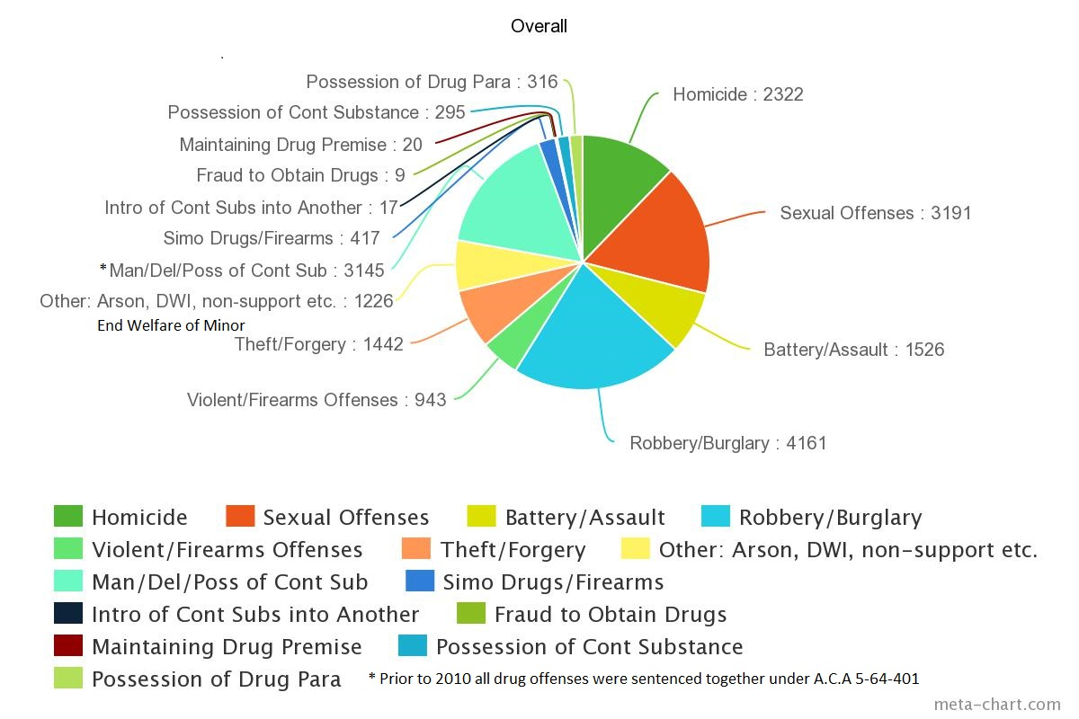
Overall Comparison
As of September 2015

Slide 21
Snapshot of Inmates by Offense: September 2015

Slide 23
Overall Comparison
As of April 2016

Slide 24
Snapshot of Inmates by Offense: April 2016

Slide 26
Prosecuting Attorney Cody Hiland
Prosecuting Attorney Nathan Smith
SENTENCING PRACTICES
In a recent task force meeting CSG insinuated a link between the rise in incarceration rate in 2013 and possible disregarding of the State’s sentencing grid.
It should be noted that the Arkansas sentencing grid is not mandatory. It is meant to provide for uniformity in sentencing.
It is statutorily not applicable to jury trials and jury sentencing.
The grid is utilized by judges, prosecutors, and defense attorneys to arrive at fair sentences after considering the seriousness of the crime and the defendant’s criminal history.

Slide 27
“Excluding non-applicable cases, the statewide departure rate in 2014 was 35%. This is on par with the rate in 2012 of 36% and 37% in 2013.”
This “significant statistic” provided by the Sentencing Commission clearly indicates that sentencing practices have remained consistent through 2012, 2013 and 2014, making it even more likely that the driver of the spike in incarceration is the fact that parole began to actually revoke parolees that committed new felony offenses.

Slide 28
As we can see with this data, upward and downward departures have remained consistent during the years in question.

Slide 29
In short, any argument that any spike in the incarceration rate is tied to prosecuting attorneys or judges ignoring the grid seems to be inaccurate, as departure rates have remained consistent throughout.

Slide 30
Discussion of Sentencing Grid
CSG expressed concern over too many inmates rated as a 4 or 5 being in prison.
The following are some crimes that are rated 4 or 5 on the sentencing grid.
Negligent Homicide – 4
Terroristic Act - 5
Sexual Indecency with a Child – 4
Incest - 5
Sexually Grooming a Child – 4
Possession of Firearm by Felon – 5
Criminal Possession of Explosives – 5
Registered Sex Offender working with Children – 4
False Imprisonment 1st Degree – 4
2nd Degree Battery – 4
Computer Exploitation of a Child – 5
Forgery 1st Degree (Counterfeiting Currency) – 5
Sex Offender Failing to Register – 3
Many 4 and 5 rated crimes per the sentencing grid are crimes that the public thinks should land someone in prison. One should also note that many 4 and 5 levels that appear on the final judgment have been pleaded down from a more serious charge.

Slide 31
DCC 2015 Annual Report
Less than 38% of crimes filed as felonies end in ADC sentences.

Slide 32
Summary: Prosecuting Attorney Cody Hiland
Prosecuting Attorney Nathan Smith
The report from the Arkansas Sentencing Commission indicates that sentencing practices have remained fairly consistent during the period that CSG evaluated.
Other Concepts Discussed by the Task Force:
*Appealing Bench Trial Sentences
*Jury Sentencing
*Trial of Your Peers/Differing Community Standards

Slide 33

CONCLUSIONS:
The APAA is for: Better reentry services for inmates, better mental health services for inmates and defendants, and for having the necessary space to safely accommodate the prison population.
The APAA is against: Making a hasty reaction and passing bad sentencing legislation or any legislation based on the erroneous belief that there is a population crisis when the jail backup is manageable and the ADC population is dropping not rising.
The APAA has polled the public on these relevant issues and we believe they think like we do on these matters.

