Slide 1
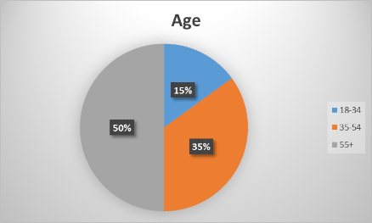
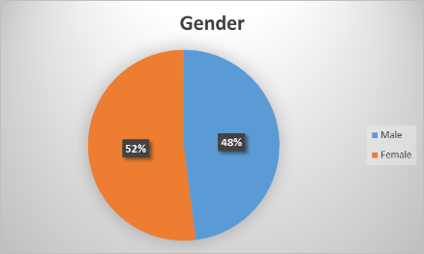
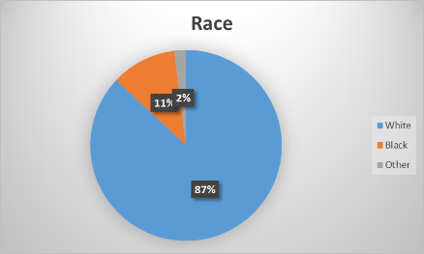
Criminal Justice Poll
Diamond State Consulting
HANDOUT 2
600 hundred person sample
52% Female & 48% Male
50% over 50, 35% 35-54 & 15% 18-24
87% White, 11% Black & 2% Other

Slide 2
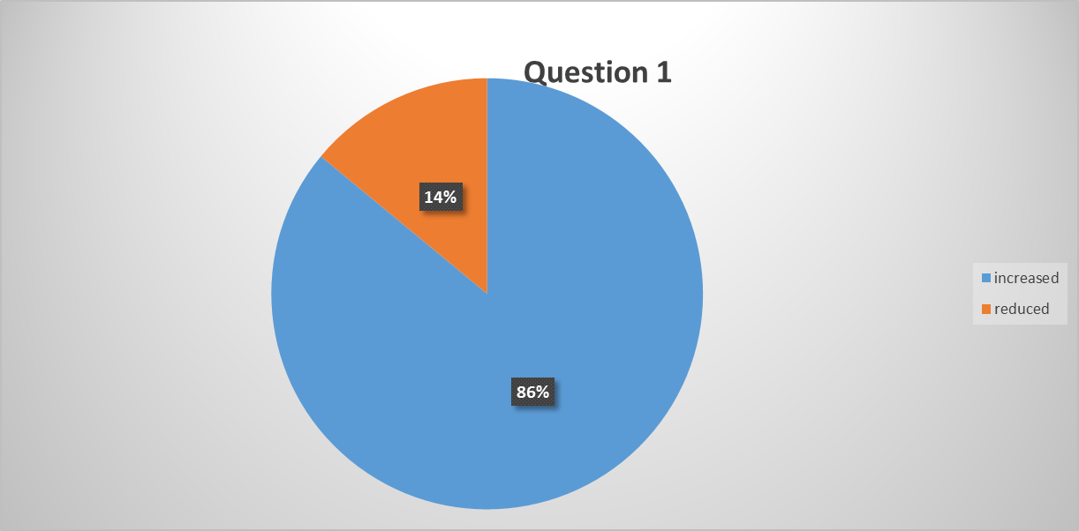
Question 1
Do you believe state prison sentences for those convicted of sex offenses should be reduced or increased? For "reduced sentences" press 1. For "increased sentences" press 2.

Slide 3
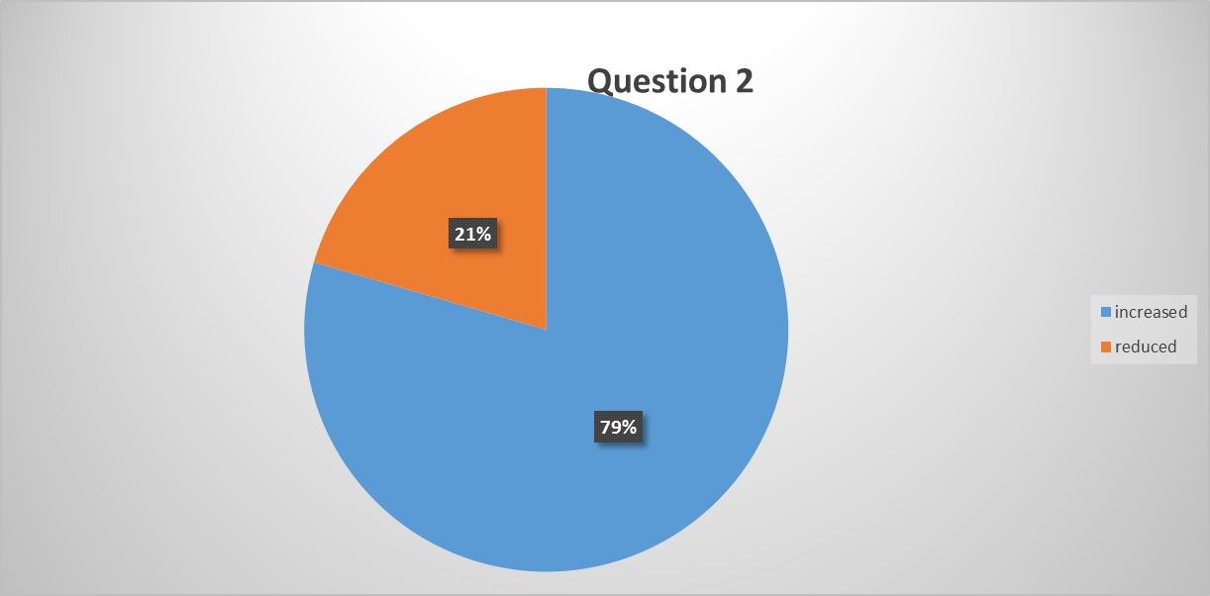
Question 2
Do you believe state prison sentences for those convicted of breaking into homes and businesses should be reduced or increased? For "reduced sentences" press 1. For "increased sentences" press 2.

Slide 4
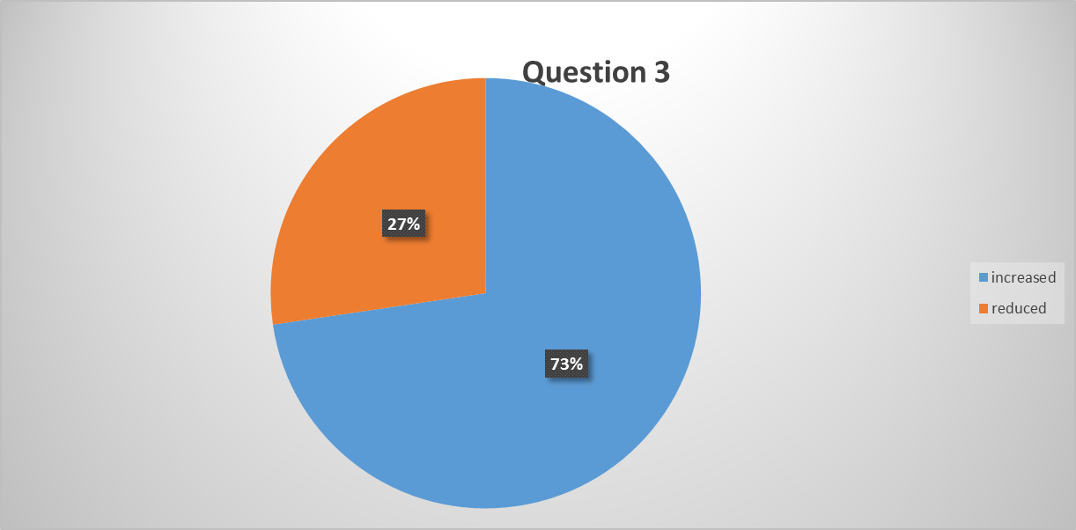
Question 3
Do you believe state prison sentences for those convicted of theft should be reduced or increased? For "reduced sentences" press 1. For "increased sentences" press 2

Slide 5
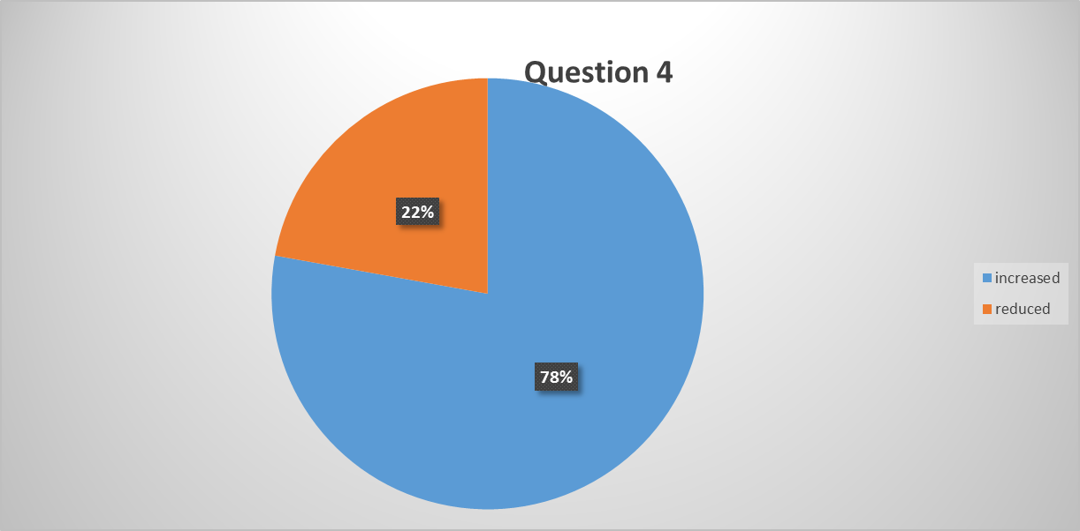
Question 4
Do you believe state prison sentences for drug dealers should be reduced or increased? For "reduced sentences" press 1. For "increased sentences" press 2

Slide 6
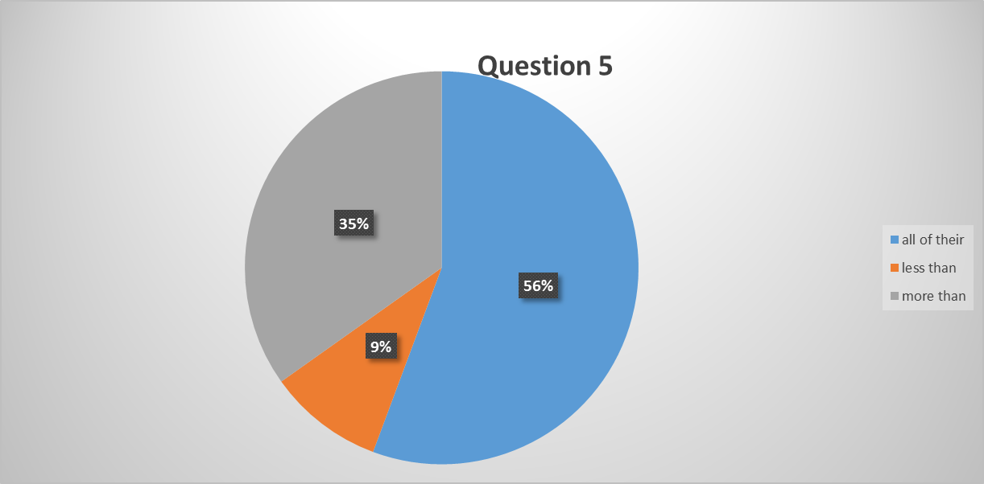
Question 5
Currently, the majority of inmates - including those convicted of violent crimes and sex crimes - serve only 1/4th or 1/6th of their sentences before being paroled back out into the community. Should convicted felons serve less than the current percentage, more than the current percentage or all of their prison sentence? For "convicted felons should serve less than 1/4th or 1/6th of their sentence" press 1. For "convicted felons should serve more than 1/4th or 1/6th of their sentence" press 2.For "convicted felons should serve all of their prison sentence" press 3.

Slide 7
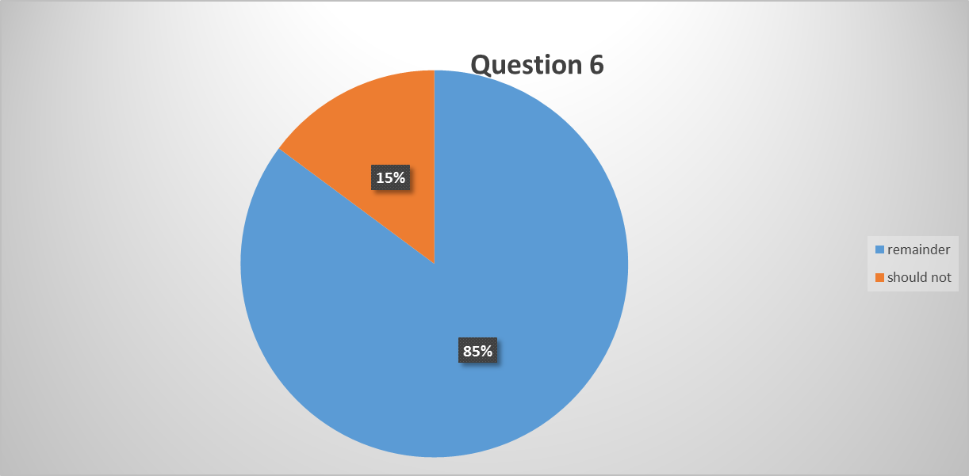
Question 6
Currently, if a person convicted of a crime receives a 20 year sentence, they will serve approximately 5 years before becoming eligible for parole. If the inmate is released on parole and commits another felony after being released back to the community, should they be required to serve the remaining 15 years left on the original 20 year sentence? Press 1 if you believe an inmate who commits a crime while out on parole "should serve" the remainder of his sentence. Press 2 if you believe an inmate who commits a crime while out on parole "should not" serve the remainder of his sentence

Slide 8
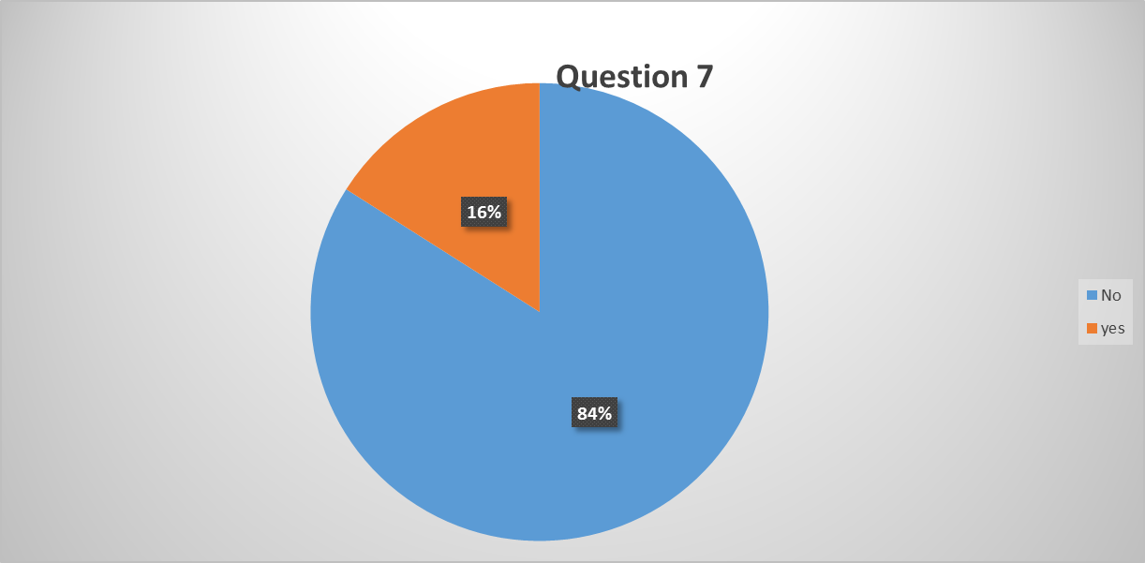
Question 7
Do you believe the state legislature should authorize early release of prison inmates who have committed violent or theft related crimes to save money in the state budget? Press 1 for "yes." Press 2 for No."

Slide 9
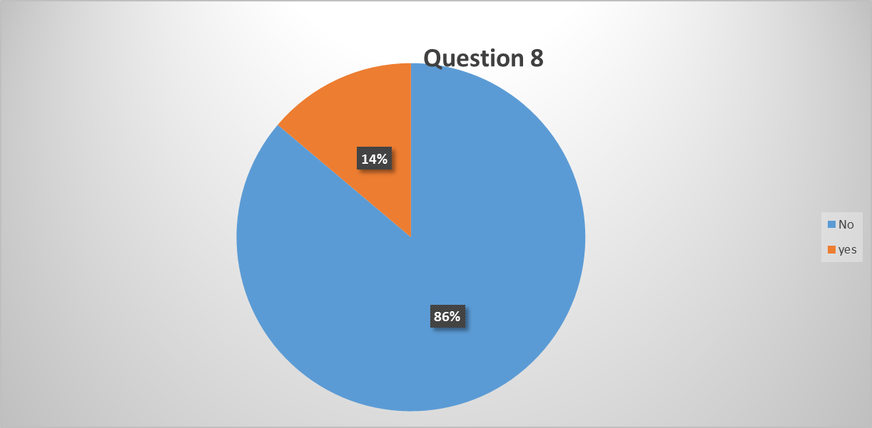
Question 8
Do you believe Congress and the President should authorize early release of federal prison inmates who have committed violent or theft related crimes to save money in the national budget? Press 1 for "yes." Press 2 for No."

Slide 10
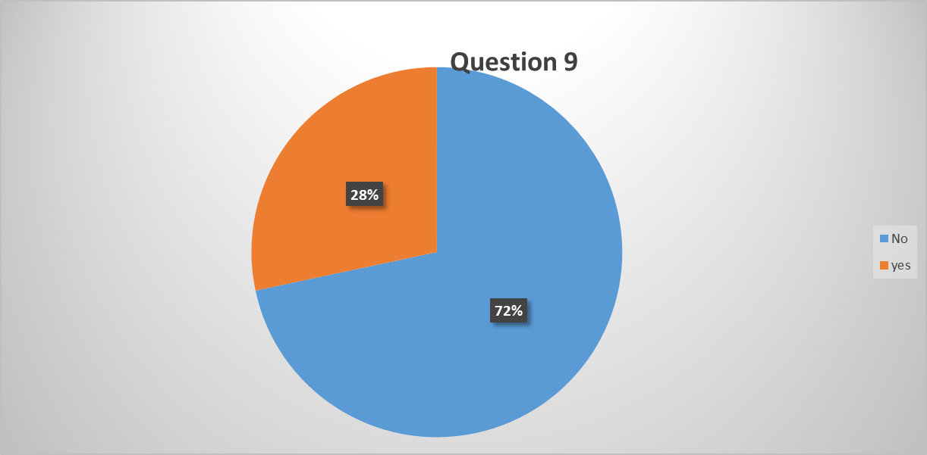
Question 9
Do you believe felons should be given the right to vote?

Slide 11
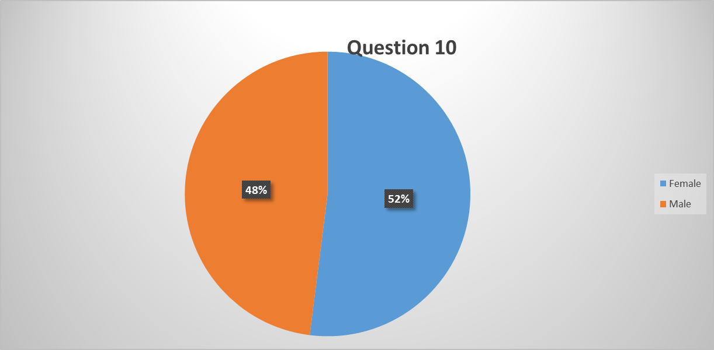
Question 10
For statistical purposes only: are you male or female? Press 1 for male, press 2 for female

Slide 12
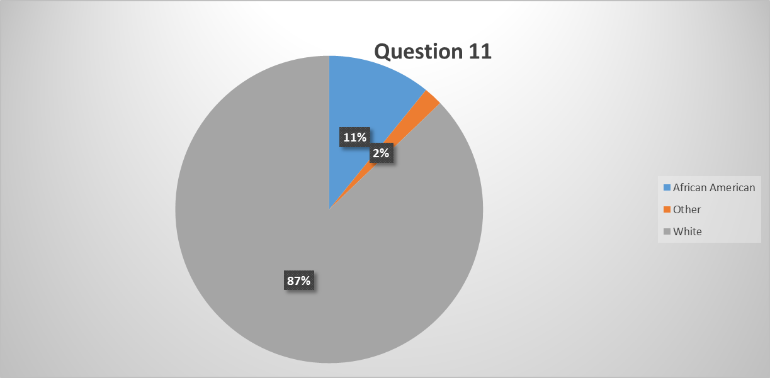
Question 11
For statistical purposes only: if you are white press 1, if you are African American press 2, if you are Hispanic or another group press 3.

Slide 13
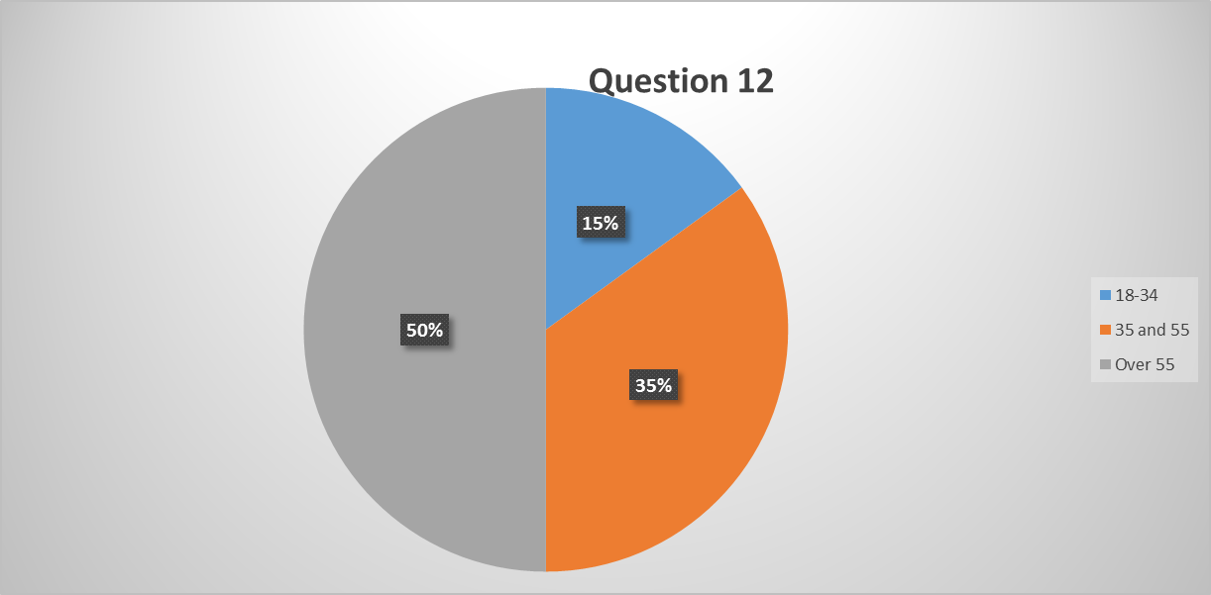
Question 12
For statistical purposes only: if you are between the ages of 18-34 press 1, if you are between 35 and 55 press 2, if you are over 55 press 3.

