Slide 1



Ted Abernathy
ted@econleadership.com

Slide 2



Slide 3

I Have Nothing Profound the Say
Think
…except, many of the things we used to all know we knew, have changed

Slide 4

“No one born after the turn of the century has ever known anything but a world uprooting its foundations, overturning its values and toppling its idols.”
Peter Drucker 1957
“Is the dizzying disorientation brought on by the premature arrival of the future, a product of the greatly accelerated rate of change in society.”
Alvin Toffler 1971

Slide 5

Today’s New “Place” Reality
The economy changed
The competition changed
Locational factors changed
The U.S. workforce has changed
The talent demands changed
Customer (talent & companies) demands/expectations changed
The pace of change and everything else changed

Slide 6

Urbanization

Slide 7
U.S. Population Concentration
Metro-Non-Metro
Almost 60% of US population lives in Cities of 1 million or more
80%
In 2012 over 90% of GDP and 86% of all jobs are in metropolitan areas
Source: Census

Slide 8
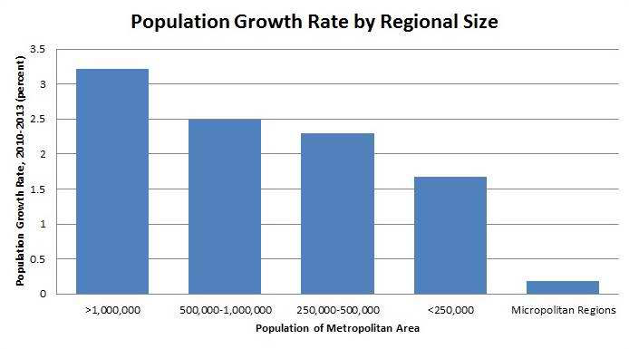
Source: Atlantic Cities, March 28, 2014

Slide 9
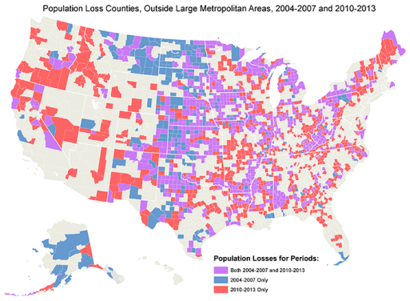
Source: Atlantic Cities, March, 2014

Slide 10
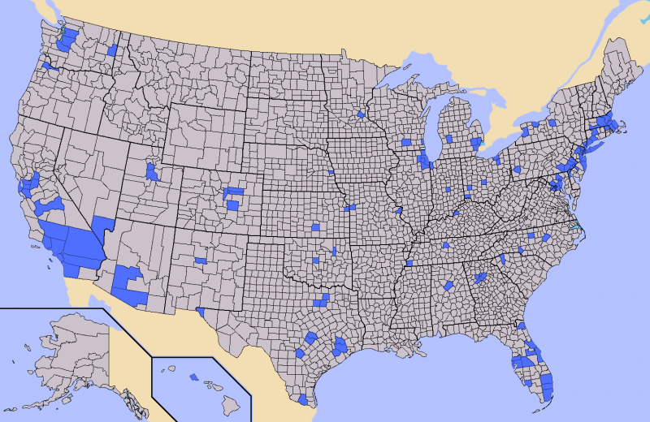
Half of the US Population Lives in these 146 Counties
Source: Business Insider 2013 WALTER HICKEY AND JOE WEISENTHAL

Slide 11
Southern States % of Population Rural & Small Cities 2010
Source: U.S. Census 2010, Daily Yonder 2012

Slide 12
The Individual Focus
Workforce Conundrum for Places
Place Trains Talent
Talent Seeks Job
Talent Leaves Place

Slide 13


The Technology Conundrum

Slide 14


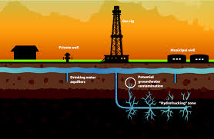







McKinsey & Company
Disruptive Technologies: May 2013
Energy
Mobile Internet
Advanced Materials
Next Generation Genomics
Robotics, Cloud, Digital-intel, 3D Printing

Slide 15
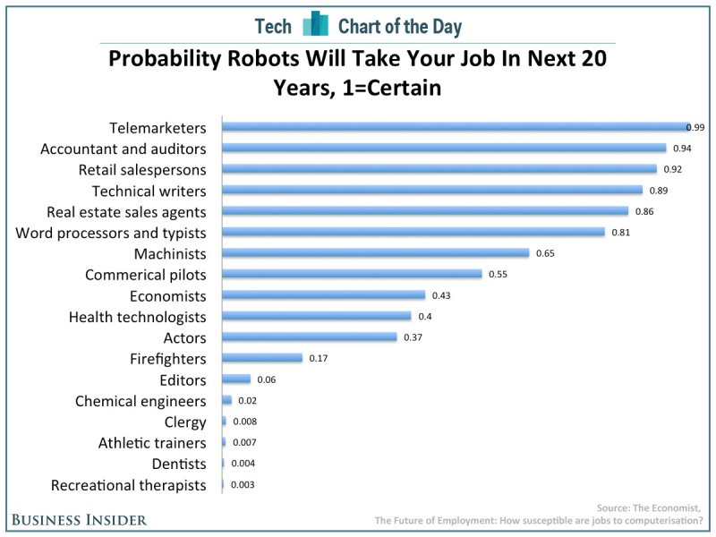

Source: Business Insider, The Economist, 2014

Slide 16
Most frightening to parents:
“Only the best-educated humans will compete with machines. And education systems in the U.S. and much of the rest of the world are still sitting students in rows and columns, teaching them to keep quiet and memorize what is told to them, preparing them for life in a 20th century factory.”
— Howard Rheingold, tech writer and analyst

Slide 17


Slide 18

Re-imagine Readiness
Strengthen the connections between education and job skills
Re-think credentials and their value in the workplace
Give students more exposure to the world of work
Scale technology so that every student can benefit from a high quality, personalized learning experience

Slide 19
Re-imagine Readiness
Strengthen the connections between education and job skills
Re-think credentials and their value in the workplace
Give students more exposure to the world of work
Scale technology so that every student can benefit from a high quality, personalized learning experience

Slide 20
Re-imagine Readiness
Where do people get skills?

Slide 21

http://www.youtube.com/watch?v=uBSQXwt09iU&feature=player_embedded

Slide 22
% of College Freshman “to be able to get a better job” as an important reason for college
Source: The American Freshman, 2012, 2013

Slide 23
Top Skills Employers Say They Want (2014)
Ability to work in a team
Ability to make decisions and solve problems
Ability to plan, organize and prioritize work
Ability to communicate verbally
Ability to obtain and process information
Ability to analyze quantitative data
Technical knowledge related to the job
Proficiency with computer software programs
Ability to create and/or edit written reports
Ability to sell and influence people
Source: National Association of Colleges and Employers

Slide 24

Rankings of Employee Skills from Most Important to Least Important
Under $12 per hour $12-20 per Hour Over $20 per hour
Honesty/Integrity Honesty/Integrity Honesty/Integrity
Dependability/Responsibility Dependability/Responsibility Dependability/Responsibility
Positive Attitude/Energy Positive Attitude/Energy Positive Attitude/Energy
Work Ethic Work Ethic Work Ethic
Customer Service Teamwork Teamwork
Teamwork Customer Service Problem Solving
Professionalism Professionalism Verbal Communication
Verbal Communication Verbal Communication Professionalism
Durham Demand-Driven Workforce Development
Source: Economic Leadership Survey of 122 business for Durham NC, 2014

Slide 25
Job Specific Skills
(Such as construction trades, coding, or customer service)
Work Skills
(Such as communication problem solving, and critical thinking)
Life Skills
(Such as honesty, dependability, teamwork and, positive attitude)

Slide 26
Can the Skills of the Talent Pool Keep Up With the Demand for Skills?
Are the demands of businesses rising faster than the abilities of the average worker with average intelligence, average skills and average motivation?
Source: No source, I made this up

Slide 27
Re-imagine Readiness
Strengthen the connections between education and job skills
Re-think credentials and their value in the workplace
Give students more exposure to the world of work
Scale technology so that every student can benefit from a high quality, personalized learning experience

Slide 28
US Adults Years School Completed
In 1980, 32% had some college & 17% BA
In 2010, 56% some college & 30% BA

Slide 29
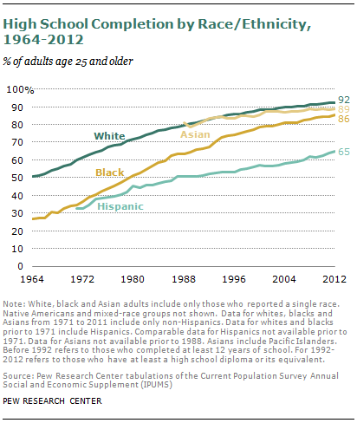

Slide 30
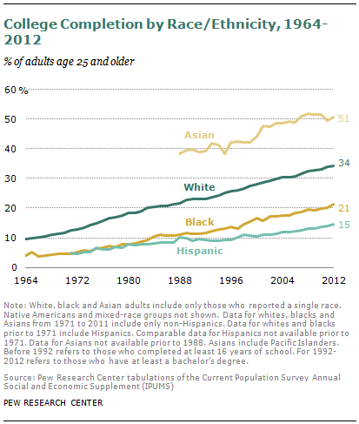

Slide 31
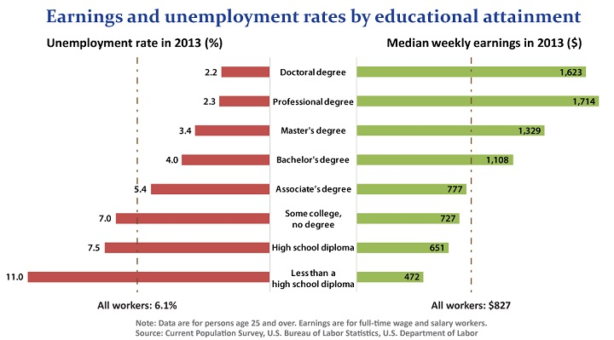
Source: U.S. Bureau of Labor Statistics.

Slide 32

What % of Jobs, in America, in 2022 will require a Bachelor’s Degree or more?

Slide 33
Source: BLS, June 2014

Slide 34
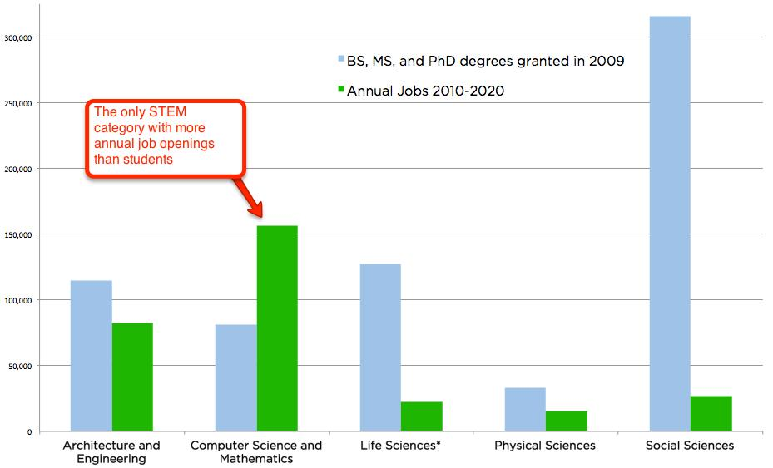
Not all STEM Degrees Are Equal
Sources: Bureau of Labor Statistics, National Science Foundation

Slide 35
U.S. Projected Job Growth 2013-2017
Source: emsi, CareerBuilder Occupational Projection

Slide 36
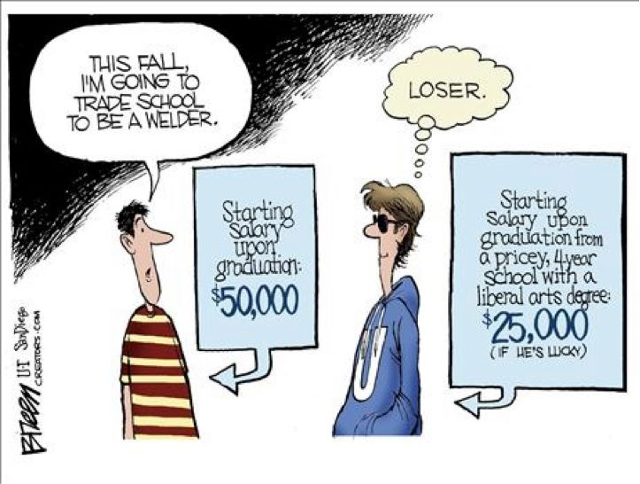

Slide 37
Re-imagine Readiness
Strengthen the connections between education and job skills
Re-think credentials and their value in the workplace
Give students more exposure to the world of work
Scale technology so that every student can benefit from a high quality, personalized learning experience

Slide 38
Work Shifts
Creative
Work
Routine
Work
Outsourced
Routine
Work
Machines
Routine Work
Source: National Center on Education and the Economy, Tough Choices or Tough Times, 2007

Slide 39
Work Shifts
Creative
Work
Routine
Work
Outsourced
Routine
Work
Machines
Routine Work
Source: National Center on Education and the Economy, Tough Choices or Tough Times, 2007

Slide 40
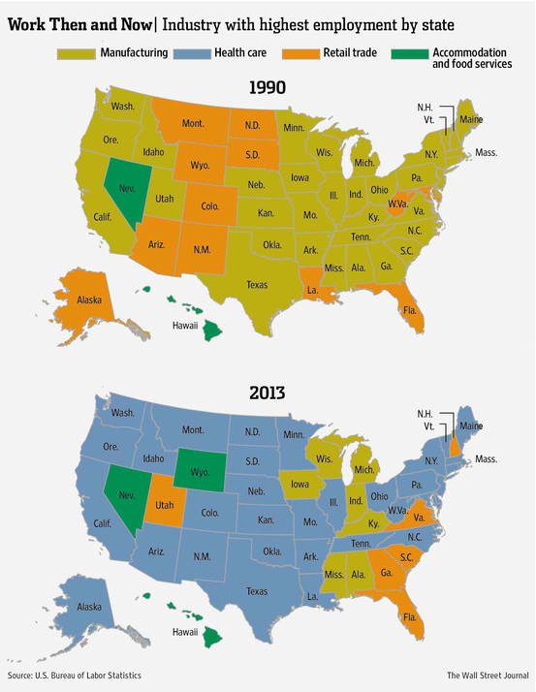
The shift in the types of jobs has been swift and profound!

Slide 41
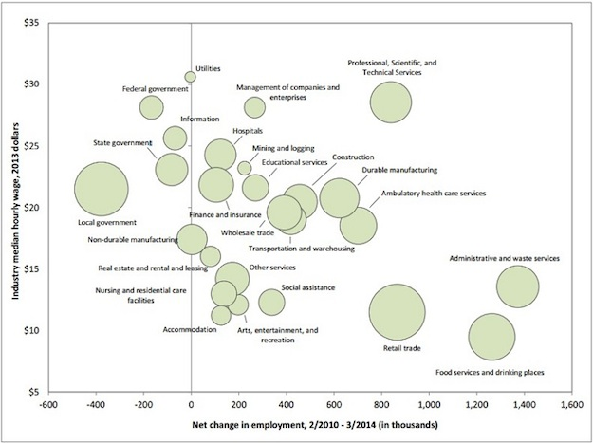
Source: National Employment Law Project, 2014

Slide 42
Re-imagine Readiness
Strengthen the connections between education and job skills
Re-think credentials and their value in the workplace
Give students more exposure to the world of work
Scale technology so that every student can benefit from a high quality, personalized learning experience

Slide 43

MOOCs
Khan Academy
Virtual High School
E-textbooks
Digital gaming content (competency based)
Ubiquitous learning content

Slide 44
Re-engage Adult Learners and Disconnected Youth
Target workers with some credits, but no degree or credential
Help dislocated workers rejoin the workforce
Recover disconnected youth

Slide 45
2013 Unemployment Rate By Age
Sources: Bureau of Labor Statistics

Slide 46
Re-align Relationships and Resources
Create a continuity in education and workforce development from early childhood through career
Align and track data across the education and workforce pipeline
Engage business in a meaningful way

Slide 47
Re-align Relationships and Resources
Create a continuity in education and workforce development from early childhood through career
Align and track data across the education and workforce pipeline
Engage business in a meaningful way

Slide 48

Top Factors for Companies Considering New Investment
Availability of skilled labor
Highway accessibility
Labor costs
Occupancy or construction costs
Availability of advanced ICT services
Availability of buildings
Corporate tax rate
State & Local Incentives
Low union profile
Energy availability and costs

Slide 49


Workforce Development
ted@econleadership.com

Slide 50
Workforce Development
“A top priority of the nation’s governors is developing the skilled and knowledgeable workforce required for states to be economically competitive in a global economy.”
National Governors Association 2013
“In business today, no competition is tougher than the global race for talent. In every industry, every job sector, and every part of the world, employers are asking the same question: How are we going to find, train, and retain the best workers?”
U.S. Chamber of Commerce 2013

Slide 51

What Are The Components of a Perfect System?
Supply-Side
Citizens looking for good jobs
Demand-Side
Employers looking for good labor
Workforce System
Organizations that improve skills, provide information or connect
Move people out of poverty
Help unemployed find jobs
Educate for increased skills
Train for increased skills
Find just in time talent
Reduce costs
Minimize risk
Maximize profits

Slide 52
Potential employees with non-competitive work skills and competitive work histories (and no obvious barriers to work)
Potential employees with competitive work skills and non-competitive work histories (and no obvious barriers to work)
Potential employees with non-competitive work skills and non-competitive work histories (and either no or obvious barriers to work)
Potential Employees with specific “insurmountable” barriers to employment

Slide 53
Let’s Talk Barriers To Employment
Drug Tests
Criminal Background Checks
Credit Checks
Reading, Math and Comprehension
Social Media Checks
References
Interviews

Slide 54
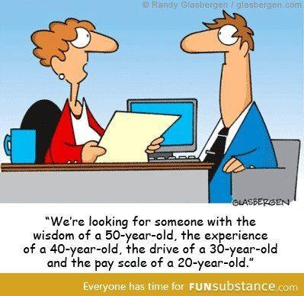

Slide 55


Slide 56


Slide 57
Changing Workforce Development
Old Way
New Way
Responsive to rules and systems
Programmatic silos with special populations
Education and workforce are different systems
Geography matters
Technology to track people and results
Responsive to employer needs
Flexible, simplified and customized
All efforts are seamless and matriculation is simple
Industry needs matter
Technology to customize, analyze needs, and empower customers
Source: Based in part on work by the Rutgers's State of the U.S. Workforce System 2012

Slide 58
What Springdale Supply and Demand Say
Businesses have trouble finding employees with specific skills
Skills are different, but fall into job skills, work skills and life skills with varying problems with each.
Trainers have trouble identifying the future skill needs
Everyone is 4-year focused and that is mostly not the issue
Parents and students have no idea of future job markets
Training is not flexible enough (nights, weekends)
Groups don’t align or cooperate

Slide 59
What Springdale Supply and Demand Say
Rising frustration that will impact economic competitiveness
Want “just-in-time” qualified “temporary” talent
Want all credentials quantified
Kids need more work experience
Older workers need new skills
Reasons this is hard (funding formulas, turf, rapid change and the speed to do anything, resource limitations)
We can’t exchange info as we should
We have to tell a better story, better

Slide 60
Specific Directions for Springdale
Increase available information to both supply and demand (Employer surveys annually)
Disseminate as widely as possible (Web and cable…)
Identify & eliminate regulatory and legislative barriers to improvement
Codify collaboration
Dramatically increase business engagement in the development of supply (curriculum design)
Dramatically expand work exposure and work experience

Slide 61


Slide 62
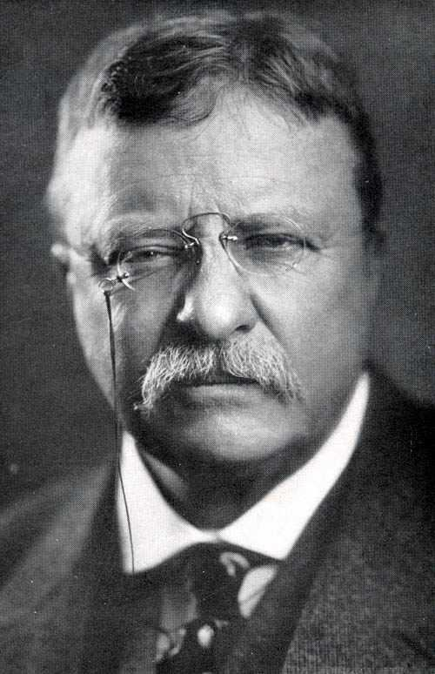
“Do what you can, with what you have, where you are.”

Slide 63

Follow on twitter @tedabernathy
or
LinkedIn Ted Abernathy
“ Leadership and learning are indispensable to each other.”
John F. Kennedy
ted@econleadership.com

