Slide 1

Education Committee – House
Education Committee – Senate
ARKANSAS DIVISION OF PUBLIC SCHOOL ACADEMIC
FACILITIES AND TRANSPORTATION
December 6, 2011
Notes:
* The following slides have some colorful graphics since the slides are used in training sessions.

Slide 2


Master Plan/Partnership Program
Two-Year Cycle
DATE | MILESTONE | DISTRICT | DIVISION
ODD YEAR
February 1 | Preliminary Master Plan
May 1 | Partnership Program Project List
EVEN YEAR
February 1 | Final Master Plan
March 1 | Partnership Program Project Applications
September 1 | Final Master Plan Approval / Non-Approval
Notes:
Discuss the two year cycle that address the Master Plan and the Partnership Program
Dates are established by statute and rule
In 2011
Districts submitted a preliminary master plan
Division issued the Partnership Program project list for the 2011-2013 biennium
In 2012
Districts will submit their final master plan
Districts will submit Partnership Program project applications for the 2013-2015 biennium
Division will review and approve master plans

Slide 3
Master Plan Tabs
Master Plan
Update Preliminary Master Plan
Feb 1
Odd Year
Master Plan
Feb 1
Even Year
TAB 1 District Information X X
TAB 2 School Board Resolution X
TAB 3 Public Hearing X
TAB 4 District Enrollment Projections X X
TAB 5 Community & District Profile (Optional) X
TAB 6 Narrative Analysis X X
TAB 7 Insurance X X
TAB 8 Identification of Access Issues X
TAB 9 Custodial Plan X X
TAB 10 Maintenance Plan X X
TAB 11 Preventative Maintenance Plan X X
TAB 12 Projected Replacement Schedule for
Life Cycle Systems X X
TAB 13 Committed Projects X X
TAB 14 Planned New Construction Projects X X
TAB 15 Annual Expenditures for Maintenance/Repair
& Capital Outlay X
Notes:
The Master Plan requirements are established by statute
The division has designated the various requirements as tabs
All tabs are required for Master Plan
Not all tabs are required for Preliminary Master Plan

Slide 4
Partnership Program
  “New” construction
    Not repair or maintenance
  Minimum project cost - $150,000 or $300/student
    Waived for life/safety such as fire alarms
  Projects must be on district’s Master Plan
Notes:
The Partnership Program is the main school facility program
Projects are “new construction”, including renovations, but can not be maintenance or repair
Projects must be on the district’s Master Plan

Slide 5
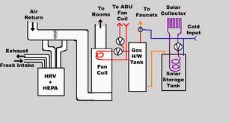
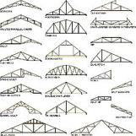

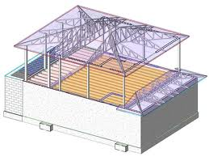

Warm, Safe, and Dry Projects
Qualified systems
  Roofs
  HVAC
  Fire/Safety
  Plumbing
  Electrical
  Structural
Complete system replacement
  Partial system replacement considered repair (not eligible for Partnership Program funding)
Notes:
* By rule, Partnership Program projects are designated as warm, safe, and dry or space.
Warm, safe, and dry projects by rule address specific primary building systems
Complete systems must be replaced so that projects are not maintenance or repair
Warm, safe, and dry needs are dynamic
Current needs get repaired or replaced
New Needs arise as systems reach end of life

Slide 6

Space Projects
  New schools
  Additions (including new buildings)
  Conversions of existing space (to different use)
Notes:
The second type of Partnership Program projects involve additional spaces
Projects are for
New Schools
Additions
Conversion of existing space to new use
Space needs can change as districts’ enrollments increase or decline.

Slide 7
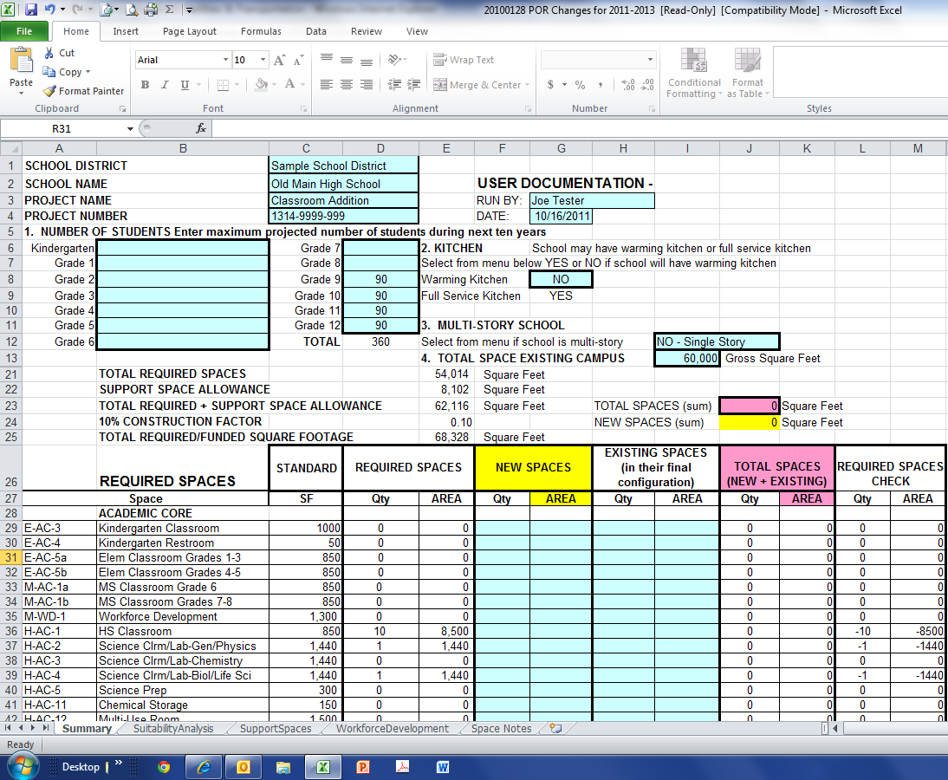
Program of Requirements (POR)
Notes:
The primary tool for Partnership Program space projects is the Program of Requirements or POR
Based on the number of students, the POR provides the overall gross size for a new school and the specific required spaces in the overall size.
The required spaces are based on adequacy.
School districts may build larger schools but must meet the requirements of the POR, using district funds

Slide 8
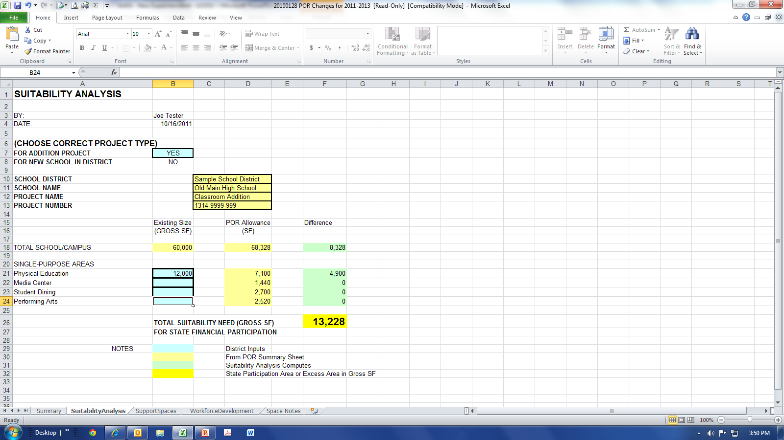
Suitability Analysis
Notes:
Another component of the POR is the suitability analysis, or space determination of an existing school.
Using both the existing spaces in a school and the number of students, the suitability is the amount of space that the state can participate in with the Partnership Program to meet space needs of students.

Slide 9

Partnership Program – State Financial Participation Determination
  Qualified project scope in square feet (e.g. 10,000 SF)
  Project cost factor (e.g. $130/SF)
  Qualifying Project Cost (QPC)
    Scope x cost factor
    10,000 SF x $130/SF = $1,300,000
  State Financial Participation = QPC x (1 minus Wealth Index)
    If Wealth Index = 0.350
    State Financial Participation = $1,300,000 x 0.65 = $845,000
Notes:
* This slide demonstrates the process developed in rule to compute the qualifying project cost and the amount of state financial participation.

Slide 10
Ranking of Approved Projects
  Projects ranked by three factors
    Academic Facilities Wealth Index
    Facility Condition Index (FCI)
      Cost to renovate facility divided by replacement cost
      General Rule – facility should be replaced if FCI > 65%
    Ten-Year Growth Percentage
Notes:
The Partnership Program rules provide a three-factor ranking process to rank all qualified projects.
Since there are annual legislative fiscal sessions, projects are ranked by Year One and Year Two.
Warm, safe, and dry projects are ranked ahead of space projects.
In general projects rank higher for –
Less wealthy districts
Facilities in poorer condition
Districts with higher growth
Although there is a ranking process, to date every qualified project that met the program parameters has been funded. NO PROJECTS HAVE NOT BEEN FUNDED DUE TO A LACK OF AVAILABLE FUNDING.

Slide 11
Educational Facilities Partnership Fund
Committed Projects (In Dollars)
Intermediate Repair | 28,079,953.32
Transitional | 86,000,000.36
Catastrophic | 2,448,856.00
Partnership
2006 - 2007 | 207,002,324.77
2007 - 2009 | 268,502,373.34
2009 - 2011 | 110,267,851.47
*2011 – 2013 | 190,260,807.00
SUBTOTAL PARTNERSHIP | 776,033,356.58
TOTAL COMMITTED PROJECTS | 892,562,166.26
* Includes $31.8M Anticipated Year-Two Projects (2012-2013)
As of July 12, 2011
Notes:
This slide shows the State Financial Participation committed to date for all funding programs.
The 2011-2013 totals include the anticipated committed costs for Year Two of the biennium.

Slide 12
Educational Facilities Partnership Fund
Ending Fund Balances (In Dollars)
PROGRAM |  | TOTAL REVENUE |  | TOTAL EXPENDITURES |  | ENDING FUND BALANCE
FY2005 |  | 20,000,000.00 |  | 0.00 |  | 20,000,000.00
FY2006 |  | 52,442,523.95 |  | 30,614,911.76 |  | 41,827,612.19
FY2007 |  | 89,171,750.00 |  | 83,056,280.58 |  | 47,943,081.61
FY2008 |  | 501,131,925.00 |  | 104,995,660.99 |  | 444,079,345.62
FY2009 |  | 49,140,709.00 |  | 122,546,114.07 |  | 370,673,940.55
FY2010 |  | 34,495,435.60 |  | 113,361,185.47 |  | 291,808,190.68
FY2011 |  | 55,220,716.00 |  | 120,811,853.17 |  | 226,217,053.51
FY2012 EST |  | 57,449,199.00 |  | 100,166,642.00 |  | 183,499,610.51
FY2013 EST |  | 59,677,682.00 |  | 95,000,000.00 |  | 148,177,292.28
FY2014 EST |  |  |  | 80,000,000.00 |  | 68,177,292.62
FY2015 EST |  |  |  | 35,000,000.00 |  | 33,177,293.09
FY2016 EST |  |  |  | 7,009,518.00 |  | 26,167,775.09
TOTAL |  | 918,729,940.55 |  | 892,562,166.04 |  | 26,167,774.51
As of July 12, 2011
Notes:
This slide shows the ending fund balances by year when you compare the expenditures and revenues.
The projected ending fund balance for all current projects is about $26M.
The $26 M includes the anticipated 2011-2013 Year Two projects of about $31.8 M and revenues of about $60M.

Slide 13



Notes:
* This concludes the overview of the state’s master plan and Partnership Program.

Slide 14
Facilities - Questions
Have all warm, safe, and dry facilities needs been met in the state?
Have all facilities needs in the state been met?
What’s being done for stalled projects that were intended to address warm, safe, and dry conditions? Which districts are these?
Process for sunset of incomplete projects? Which districts are these? Were any of the sunset projects warm, safe and dry projects?
What are the barriers to meeting the remaining needs for all districts?
Equity of facilities between districts and within districts
Where was the line drawn for awarded projects? Why was that cutoff selected?

Slide 15
Transportation - Questions
Address whether the current system for distributing transportation funding to districts provides a suitable level of equity to districts given that the variance in transportation costs per ADM is 9 to 1? As a point of reference the variance in teacher salaries is approximately 2 to 1.
State your position on the best method for addressing transportation expenditures given the demand for transportation varies significantly from district to district in the percentage of students transported. Should transportation expenditures be handled differently from other categorical funding for subsets of students with additional needs?

Slide 16
Partnership Program Summary
As of November 9, 2011
Program | Committed Funds | Expended Funds | Remaining Funds | Number of Projects | Number of Completed Projects | Number of Rescinded Projects | Number of Projects in Progress
Partnership 0607 | $206,935,942.23 | $201,703,485.60 | $5,232,456.63 | 1158 | 637 | 476 | 45
Partnership 0709 | $266,783,739.81 | $213,727,472.37 | $53,056,267.44 | 378 | 162 | 143 | 73
Partnership 0911 | $109,360,857.71 | $63,012,127.28 | $46,348,730.43 | 244 | 99 | 29 | 116
Partnership 1113 | $149,077,624.26 | $2,505,096.94 | $146,572,527.32 | 169 | 2 | 15 | 152
(Year One)
TOTALS | $732,158,164.01 | $480,948,182.19 | $251,209,981.82 | 1949 | 900 | 663 | 386
Partnership 1113 | $0.00 | $0.00 | $0.00 | 51
(Year Two)
Notes:
* Hip- pocket slide. Used only if there are questions.

Slide 17
Academic Facilities Partnership Program
Project Types
 |  | COSTS IN MILLIONS (In Dollars)
PARTNERSHIP PROGRAM |  | TOTAL STATE COMMITMENT | SPACE | WARM, SAFE & DRY
2006 - 2007 |  | 207.00 | 192.50 | 14.50
2007 - 2009 |  | 268.10 | 250.80 | 17.30
2009 - 2011 |  | 110.30 | 76.90 | 33.40
2011 - 2013 YEAR ONE |  | 149.10 | 117.20 | 31.90
2011 - 2013 YEAR TWO |  | 31.70 | 19.50 | 12.20
As of September 19, 2011
Notes:
* Hip- pocket slide. Used only if there are questions.

Slide 18
Academic Facility Projects
Warm, Safe, and Dry Projects
    Roofing 258
    HVAC 154
    Plumbing 26
    Electrical 148
    Fire & Safety 253
    Combination 131
Space
    New School 78
    Addition 410
    Conversion 27
    Addition & Conversion 6
Notes:
* Hip- pocket slide. Used only if there are questions.

Slide 19



Partnership Program Project Timelines
After Commission Approval and Funding
60 Days
18 Months
4 Years
Timeline
  Sign project agreement
  Start construction
  (signed construction contract)
Complete construction
Notes:
* Hip- pocket slide. Used only if there are questions.

Slide 20
Equity of Facilities
  Master Plan / Partnership Program Process
  Standards
    Arkansas School Facility Manual
    Program of Requirements (POR)
  Financial
    Project Cost Factors
    State Financial Participation
    Facilities Wealth Index
  Maintenance
Notes:
* Hip- pocket slide. Used only if there are questions.

Slide 21
Cost Factors
Division of Public School Academic Facilities & Transportation |  |  |  |  |  |  |  |  |  |  |  | NEW FACILITIES
Biennium FY2013/FY2015 Master Plan Budget Estimates
 |  |  |  |  |  |  | Date of current version: |  | October 31, 2011
NOTE: DISTRICTS MAY USE THE FOLLOWING COST INFORMATION FOR MASTER PLANNING PURPOSES. THE DIVISION WILL USE THIS
COST DATA IN CONJUNCTION WITH THE ACADEMIC FACILITIES WEALTH INDEX TO DETERMINE STATE FINANCIAL PARTICIPATION
FOR PARTNERSHIP PROJECTS FOR BIENNIUM 2013 - 2015 PROJECTS. ACTUAL PROJECT COSTS MAY VARY.
New Facilities Cost Estimates, including Sitework, per Project Square Footage.
Escalation estimates are subject to future validation and/or adjustment by the Division.
Additions, Space Conversions and System Renovations - see other tabs
 |  | DIRECT AND INDIRECT COST OF NEW FACILITY
School | Enrollment | Batesville | Camden | Fayetteville |  | Fort Smith | Harrison | Hot Springs | Jonesboro | Little Rock | Pine Bluff | Russellville | Texarkana | West Memphis
K-5 | 200 | $161.79 | $153.31 | $160.89 |  | $175.00 | $163.76 | $156.19 | $175.00 | $175.00 | $175.00 | $163.16 | $166.78 | $168.64
K-5 | 350 | $156.50 | $148.29 | $155.57 |  | $169.78 | $158.41 | $151.08 | $169.77 | $172.31 | $171.73 | $157.84 | $161.17 | $163.04
K-5 | 550 | $151.68 | $143.72 | $150.72 |  | $164.51 | $153.54 | $146.44 | $164.34 | $167.02 | $166.43 | $153.00 | $156.04 | $157.92
K-5 | 750 | $149.03 | $141.19 | $147.98 |  | $161.59 | $150.86 | $143.88 | $161.18 | $164.10 | $163.51 | $150.35 | $153.10 | $155.01
K-5 | 950 | $147.16 | $139.40 | $146.02 |  | $159.51 | $148.97 | $142.08 | $158.88 | $162.05 | $161.44 | $148.48 | $150.97 | $152.91
6-8 | 200 | $173.89 | $164.76 | $172.81 |  | $175.00 | $175.00 | $167.87 | $175.00 | $175.00 | $175.00 | $175.00 | $175.00 | $175.00
6-8 | 350 | $168.02 | $159.18 | $166.91 |  | $175.00 | $170.08 | $162.21 | $175.00 | $175.00 | $175.00 | $169.49 | $171.16 | $174.86
6-8 | 550 | $162.86 | $154.28 | $161.71 |  | $175.00 | $164.86 | $157.23 | $175.00 | $175.00 | $175.00 | $164.30 | $165.73 | $169.37
6-8 | 750 | $157.42 | $149.12 | $156.23 |  | $170.59 | $159.36 | $151.99 | $169.42 | $173.36 | $172.12 | $158.83 | $160.02 | $163.60
6-8 | 950 | $154.00 | $145.87 | $152.74 |  | $166.84 | $155.90 | $148.70 | $165.47 | $169.60 | $168.37 | $155.41 | $156.35 | $159.91
9-12 | 250 | $175.00 | $167.59 | $175.00 |  | $175.00 | $175.00 | $170.85 | $175.00 | $175.00 | $175.00 | $175.00 | $175.00 | $175.00
9-12 | 500 | $166.78 | $157.99 | $165.58 |  | $175.00 | $168.82 | $161.01 | $175.00 | $175.00 | $175.00 | $168.26 | $169.86 | $173.42
9-12 | 1000 | $163.35 | $154.80 | $162.49 |  | $175.00 | $165.34 | $157.69 | $175.00 | $175.00 | $175.00 | $164.73 | $166.94 | $170.33
9-12 | 1500 | $158.57 | $150.26 | $157.67 |  | $172.63 | $160.51 | $153.08 | $171.53 | $174.59 | $173.46 | $159.92 | $161.91 | $165.26
9-12 | 2000 | $155.79 | $147.61 | $154.82 |  | $169.56 | $157.70 | $150.40 | $168.27 | $171.54 | $170.41 | $157.14 | $158.89 | $162.22
9-12 | 2500 | $153.24 | $145.18 | $152.19 |  | $166.74 | $155.12 | $147.95 | $165.25 | $168.74 | $167.61 | $154.59 | $156.09 | $159.43
PK-12 | 650 | $154.69 | $146.55 | $153.61 |  | $168.32 | $156.59 | $149.35 | $166.76 | $170.34 | $169.20 | $156.06 | $157.53 | $160.90
K-8 | 690 | $152.38 | $144.35 | $151.27 |  | $165.12 | $154.25 | $147.12 | $164.10 | $167.79 | $166.59 | $153.73 | $154.96 | $158.44
6-12 | 700 | $160.34 | $151.91 | $159.31 |  | $174.53 | $162.30 | $154.79 | $173.13 | $175.00 | $175.00 | $161.73 | $163.50 | $166.92
Notes:
* Hip- pocket slide. Used only if there are questions.

Slide 22
Operations & Maintenance
662 Total number of buildings inspected from
7/1/10 to 6/30/11.
23 Special investigations (complaints, district
special requests, demolition analysis,
simultaneous inspections held jointly with
other state agencies, etc.)

Slide 23
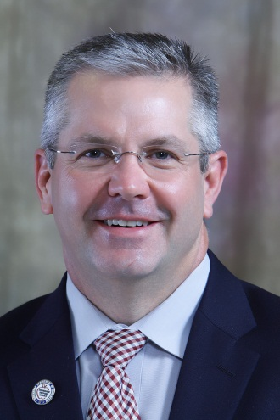
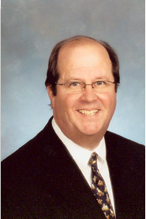

Commission for Arkansas Public School Academic
Facilities and Transportation
Commissioner of Education
Dr. Tom Kimbrell, Chairman
President, Arkansas Development Finance Authority
Mac Dodson
Director, Department of Finance & Administration
Richard Weiss

Slide 24
Division of Public School Academic Facilities and Transportation
November 2011
Dr. Charles C. Stein
Director
Carol Bowman
Administrative Analyst
Terry Granderson
Assistant Director
Mike Simmons
Senior Transportation Manager
Cheryl Houston
Administrative Specialist II
Ed Eason
Fiscal Support Supervisor
Murray Britton
Senior Project Manager
Planning
Lynn Robertson
Senior Project Manager Construction
Ronny Brown
Public School Program Coordinator
Financial Technician
Ashley Burdess
Area Project Manager
Planning
Cal Miller
Area Project Manager Maintenance
Kevin Mullen
Area Project Manager
Construction
Andy Blackwell
School Bus Inspector
Bob Monk
Bus Driver Trainer
Desi Berry
Area Project Manager
Planning
Charles Carter
Area Project Manager Maintenance
Leslie Dyess
Area Project Manager
Construction
Gary Smith
School Bus Inspector
Marvin Parks
Bus Driver Trainer
Emily Hartman
Area Project Manager
Planning
Eddie Poole
Area Project Manager Maintenance
Phillip May
Area Project Manager
Construction
James Camp
School Bus Inspector
Sherry Perry
Bus Driver Trainer
Kenneth Johnson
Area Project Manager Maintenance
Roy Blackmon
Area Project Manager Construction
John Schooley
School Bus Inspector
Carolyn Krone
Administrative Specialist III
Milton Purdy
Area Project Manager
Data Base
Mike Hennessee
School Bus Inspector
Steve Southard
School Bus Inspector
Revised September 12 2011
Notes:
* Hip- pocket slide. Used only if there are questions.

Slide 25
Education Committee – House
Education Committee – Senate
ARKANSAS DIVISION OF PUBLIC SCHOOL ACADEMIC
FACILITIES AND TRANSPORTATION
December 6, 2011
Notes:
* The following slides have some colorful graphics since the slides are used in training session.

Slide 26
Facilities Distress Rule
Section 4.01.1
4.01.1 Any act or violation determined by the Division to jeopardize any academic facility used by a public school or school district, including, but not limited to:
    Material failure to properly maintain academic facilities in accordance with state law and Rules adopted by the Commission;
    Material violation of local, state or federal fire, health, or safety code provisions or laws;
    Material violation of applicable building code provisions or laws;
    Material failure to provide timely and accurate facilities master plans to the Division;
    Material failure to comply with state law governing purchasing or bid requirements or school construction related laws or rules in relation to academic facilities projects;
    Material default on any school district debt obligation; or
    Material failure to plan or progress satisfactorily toward accomplishing the priorities established by the Division and the approved school district master plan.
Notes:
* Hip- pocket slide. Used only if there are questions.

Slide 27
Educational Facilities Partnership Fund
Expenditures (In Dollars)
PROGRAM |  | INTERMEDIATE REPAIR | TRANSITIONAL | ACADEMIC FACILITIES CATASTROPHIC |  | PARTNERSHIP TOTALS |  | TOTAL EXPENDITURES
FY2005 |  |  |  |  |  | - |  | -
FY2006 |  | 14,823,794 | 15,791,117 |  |  | - |  | 30,614,912
FY2007 |  | 11,389,313 | 54,035,149 |  |  | 17,631,819 |  | 83,056,281
FY2008 |  | 1,866,846 | 12,532,629 | 135,326 |  | 90,460,859 |  | 104,995,661
FY2009 |  |  | 3,641,105 | 216,327 |  | 118,688,682 |  | 122,546,114
FY2010 |  |  |  | 1,853,136 |  | 111,508,049 |  | 113,361,185
FY2011 |  |  |  | 77,425 |  | 120,734,428 |  | 120,811,853
FY2012 EST |  |  |  | 166,642 |  | 100,000,000 |  | 100,166,642
FY2013 EST |  |  |  |  |  | 95,000,000 |  | 95,000,000
FY2014 EST |  |  |  |  |  | 80,000,000 |  | 80,000,000
FY2015 EST |  |  |  |  |  | 35,000,000 |  | 35,000,000
FY2016 EST |  |  |  |  |  | 7,009,518 |  | 7,009,518
TOTAL |  | 28,079,953 | 86,000,000 | 2,448,856 |  | 776,033,357 |  | 892,562,166
As of July 12, 2011
Notes:
This slide shows the actual and anticipated expenditures for the committed projects on the previous slide.
Expenditures are only for projects through the 2011-2103 biennium.

Slide 28
Educational Facilities Partnership Fund
Revenue (In Dollars)
 |  |  |  | FUND TRANSFERS
PROGRAM |  | GENERAL REVENUE |  | BONDED DEBT ASSISTANCE (JAA) |  | TOTAL OTHER |  | TOTAL REVENUE
FY2005 |  |  |  |  |  | 20,000,000 |  | 20,000,000
FY2006 |  |  |  |  |  | 52,442,524 |  | 52,442,524
FY2007 |  | 35,000,000 |  | 5,211,326 |  | 48,960,424 |  | 89,171,750
FY2008 |  | 35,000,000 |  | 9,634,873 |  | 456,497,052 |  | 501,131,925
FY2009 |  | 35,000,000 |  | 14,140,709 |  | - |  | 49,140,709
FY2010 |  | 33,633,641 |  | 18,163,282 |  | (17,301,487) |  | 34,495,436
FY2011 |  | 34,828,951 |  | 20,391,765 |  | - |  | 55,220,716
FY2012 EST |  | 34,828,951 |  | 22,620,248 |  | - |  | 57,449,199
FY2013 EST |  | 4,828,951 |  | 24,848,731 |  | - |  | 59,677,682
FY2014 EST
FY2015 EST
FY2016 EST
TOTAL |  | 243,120,494 |  | 115,010,934 |  | 560,598,513 |  | 918,729,941
As of July 12, 2011
Notes:
This slide shows the actual and projected revenues.
Note that the annual general revenue component is about $35 M and the bonded debt assistance component is about $25M.
There was a one time large transfer of funds of $456 M in FY 2008.

