Slide 1
A report to the
Arkansas
Joint Education Committee
September 10, 2012

Slide 2
ACT 222 of 2009: An Act to Strengthen the system of Arkansas Educational Leadership Development
Two Focuses of the ACT
Strengthen Arkansas Educational Leadership Development
Provide School Support

Slide 3
Division of Report
Work of the Leadership Coordination Council
(Act 222; Section 1)
Work of the Arkansas Leadership Academy
(Act 222; Section 2)

Slide 4

The
Arkansas Leadership Academy

Slide 5
Who we are
The Arkansas Leadership Academy School Support Program (SSP) works with schools and districts to build leadership capacity within their educational systems that improve student achievement and sustain high levels of expectation and attainment for all students.
The Academy works in collaboration with 50 partners from around the state, including the Arkansas Department of Education, to provide support with proven methods for empowering educators in their efforts to improve the lives of students.

Slide 6
Purpose
The Academy, through the use of research and best practices, designs creative and innovative approaches to establish learning communities in public schools by developing human resources and by modeling and advocating collaboration, support, shared decision making, team learning, risk taking, and problem solving. Partners commit to changing their organizations to support system improvement.

Slide 7
Academy Mission
“To develop and sustain a cadre of leaders in public education in Arkansas through collaborative governance by Academy partners, resulting in expanded vision, statewide system change initiatives, synergy among stakeholders, and leadership development institutes.”

Slide 8
Noteworthy
“Arkansas Leadership Academy had the best record for getting schools back on track.” (p. 28)
Review of School Improvement Consulting Expenditures and Results Presented by the Bureau of Legislative Research to the Joint Education Committee February 7, 2012

Slide 9
School Support program Purpose and objectives

Slide 10
Purpose of school support
In the School Support Program, Arkansas Leadership Academy, in collaboration with the Arkansas Department of Education, provides support to applicable schools or school districts in School Improvement for three consecutive school years.

Slide 11
Objectives
Build the leadership capacity of the school and district personnel;
Train a diverse school leadership team, including, but not limited to, the superintendent/designee, school principal, and teachers;
Provide a cadre of highly experienced, trained capacity building leaders to work in the school on a regular basis;
Visit the school at least weekly to facilitate leadership activities and provide follow-up on professional development implementation;

Slide 12
Continued…
Work with the school, school district staff, school board members, parents, community members, and other stakeholders as necessary to provide a comprehensive support network;
Work with the school board once every 5-6 weeks to establish goals for the school district and engage in strategic planning to meet district goals; and
Engage the community to gather input concerning strengths, weaknesses, opportunities, and barriers within the school/district

Slide 13
School Support Program
Outcomes

Slide 14
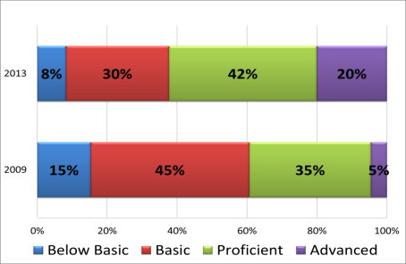
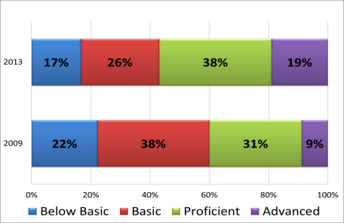
Results for Current Schools With 4 Years SSP
Literacy
Baseline-4 years of SSP
Math
Baseline-4 years of SSP
Descriptive Results:
Consistent movement toward higher achievement for students in all performance levels.
This group includes 12 high schools, 7 middle schools and 3 elementary schools.
Notes:
Although the focus of accountability is on moving all students to proficiency, a primary goal of the SSP is to improve learning for all students across the achievement continuum whether that student is Below Basic or Advanced. The following charts indicate the progress of students at each achievement level: Below Basic, Basic, Proficient and Advanced.

Slide 15
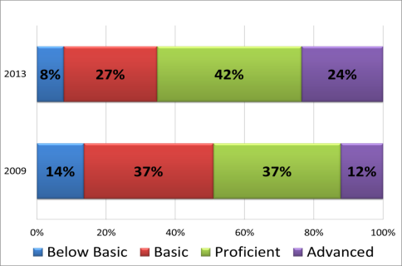
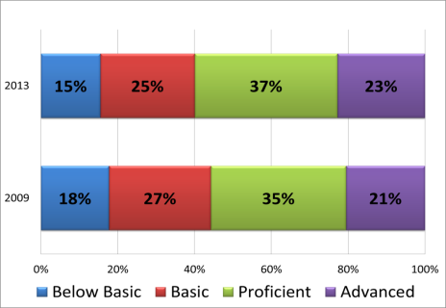
Results for All SSP Schools over 4 years
Literacy
Baseline-4 years of SSP
Math
Baseline-4 years of SSP
Descriptive Results:
Consistent movement toward higher achievement for students in all performance levels even after exiting the SSP after 3 years of service. SSP builds capacity in schools to sustain positive change after the completion of 3 years.
This group includes 14 high schools, 8 middle schools and 9 elementary schools.

Slide 16
Beating the Odds
Union Elementary School in Texarkana (SSP Cohort 4) was recognized by the University of Arkansas’ Office of Education Policy as a “highest-poverty” elementary school (90% or more FRL) that scored above the state elementary GPA average in mathematics and literacy.
http://officeforedpolicy.com/2013/09/19/round-two-of-the-oep-awards-beating-the-odds/

Slide 17
ALA Academic Activity
Presentations and Submissions for presentation or publication
Notes:
Response to the partners and the Research Advisory Team

Slide 18
Master Principal Program:
Reflective Practice & Peer Support Networks
Study presented at the 2011 University Council for Educational Administration Annual Convention
November 19, 2011 Pittsburgh, PA
Bengtson, E., Airola, D. T., Peer, D., & Davis, D.
Bengtson, E., Airola, D. T., Peer, D., & Davis, D. (2012). Using Peer Learning Support Networks and Reflective Practice: The Arkansas Leadership Academy Master Principal Program. International Journal of Educational Leadership Preparation, 7(3), 2-17.

Slide 19
Principals’ Sense of Efficacy: The Influence of the Arkansas Leadership Academy
Paper accepted for presentation at the 2012 University Council of Educational Administration Annual Convention
November, 2012 Denver, Colorado
Airola, D. T., Bengtson, E., & Davis, D.
*Manuscript submitted for publication (2013)

Slide 20
Leadership efficacy
SSP initial focus is on building leadership capacity—hypothesize that as leadership capacity increases, leadership efficacy will increase. Measuring:
Management Efficacy
Instructional Leadership Efficacy
Moral Leadership Efficacy

Slide 21
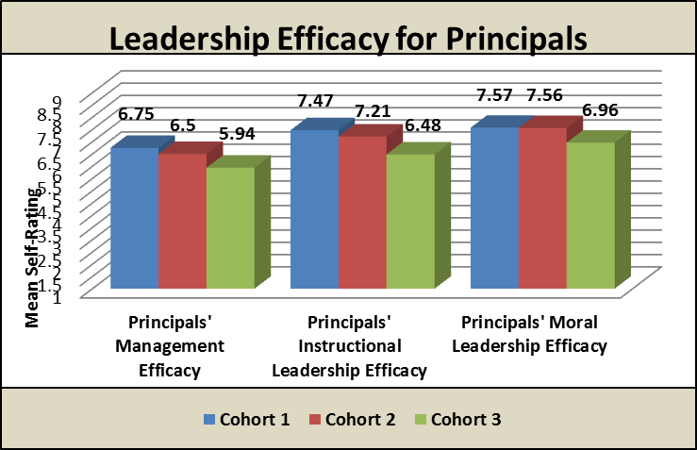
How confident is a leader in their ability to achieve leadership tasks and persist through challenges and obstacles?
Principals starting their Year 3 of SSP had higher leadership efficacy in all areas, with significantly higher efficacy in Instructional Leadership Efficacy as compared to principals starting Year 1 of SSP.
Notes:
Cohort 1 leaders, principals who have been participating in the SSP and other ALA Institute programs, demonstrate the strongest efficacy in all areas: Management Efficacy, Instructional Leadership Efficacy and Moral Leadership Efficacy. The differences between Cohort 1 and the new principals in Cohort 3 in Instructional Leadership are statistically significant exhibiting a meaningfully large effect size (F_{(2, 24)} = 5.56, p = 0.0104; d = 1.29). Cohort 1 principals who have benefitted from several years of SSP and other ALA Institutes demonstrated the strongest efficacy regarding their ability to accomplish the specific tasks of a school leader in terms of managing complex change, particularly in the area of instructional leadership.
These initial findings indicate that principals who lead schools and are part of a school system that participates in the Arkansas Leadership Academy’s School Support Program tend to have a strong sense of efficacy as measured by the survey instrument. Furthermore, the longer principals are involved with the SSP, the higher their sense of efficacy. It could be suggested that the involvement of the SSP’s capacity building teams that originate from outside the system and undertake a systemic approach to school improvement assist in the development of a greater sense of efficacy among school principals.

Slide 22
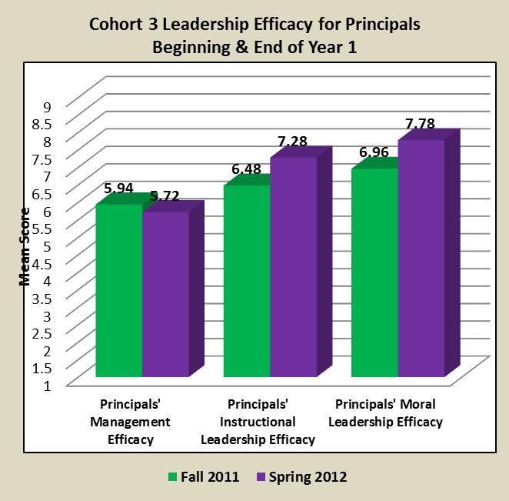
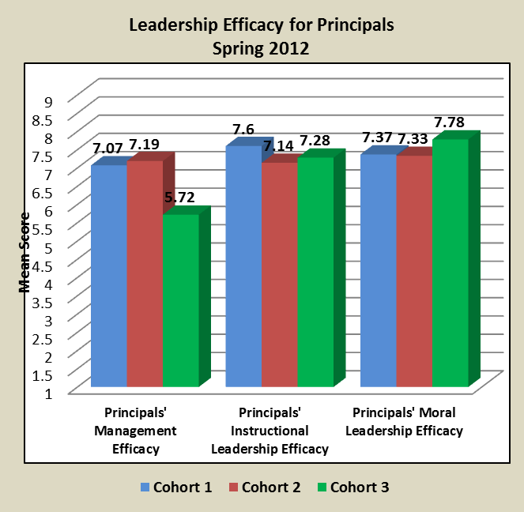
What we are learning about leadership efficacy development?
After 1 Year of SSP: Instructional and moral leadership efficacy increased.
After 1 - 3 Years of SSP: management efficacy increased.
Leaders exhibit higher Instructional Leadership Efficacy after 1 year of SSP and sustain it over the next two years.
Leaders in 2 or 3 years of SSP exhibit higher management efficacy.
Notes:
It appears to take longer to get a handle on the challenges in day to day management. Cohort explained 35% of the difference in PME>

Slide 23
Principals in SSP for their 3rd year had significantly higher instructional & moral leadership efficacy than those just starting with SSP.
Notes:
A primary focus of first year professional development for principals in the SSP is the development of leadership skills. Research has indicated that efficacy is a predictor of leadership behavior. Efficacy is a leader’s confidence in their ability to accomplish specific leadership tasks within their school. Figure 17 exhibits the leadership efficacy for the three groups of leaders involved in SSP efforts. Cohort 1 leaders are in the beginning of their third year of the SSP, Cohort 2 leaders are in the beginning of their second year, and Cohort 3 leaders are in the beginning of their first year of SSP. Note that Cohort 1 leaders, principals who have been participating in the SSP and other ALA Institute programs, demonstrate the strongest efficacy in all areas: Management Efficacy, Instructional Leadership Efficacy and Moral Leadership Efficacy. The differences between Cohort 1 and the new principals in Cohort 3 are statistically significant and very meaningful. Cohort 1 principals who have benefitted from several years of SSP and ALA Institutes have the strongest efficacy regarding their ability to accomplish the specific tasks of a school leader.

Slide 24
A View From the Inside: School Turnaround Enabling Factors and Persistent Obstacles
Presentation accepted for the 2012 University Council of Educational Administration Annual Convention
November, 2012 Denver, Colorado
Airola, D. T., & Davis, D.

Slide 25
Inside School Turnaround: Instructional Leadership Efficacy and Student Achievement
Paper submitted for presentation at American Educational Researchers Annual Conference
April 2013 San Francisco, CA
Airola, D. T., & Bengtson, E.

Slide 26
Models of External Support for School Improvement to Ignite Transformation and Build Capacity for Equity :
The Arkansas Leadership Academy’s School Support Program
Symposium accepted for the 2013 University Council of Educational Administration Annual Convention
November, 2013
Indianapolis, IN
Airola, D. T., & Medeiros, J.
Notes:
The Arkansas Leadership Academy (the Academy), through its School Support Program (SSP), provides a system of capacity-building support to affect rapid change in school culture, leadership and instructional behaviors to meet the goal of ensuring all students have access to and success in achieving college and career readiness. The SSP provides support for schools in “Priority” or “Focus” status under Arkansas’s ESEA flexibility for a minimum of three MODELS OF EXTERNAL SUPPORT FOR SCHOOL IMPROVEMENT UCEA 2013 Annual Convention Symposium Proposal p. 2
consecutive years in a gradual release model. This enables the participating schools to move from explicit support and modeling to self-sustaining structures, processes and strategies within a positive school culture. Grounded in empirical research, the SSP combines role-based professional development (PD) Institutes to develop content knowledge/skills with onsite, customized job-embedded PD to provide coherence and collaborative structures that enhance adult learning and application of new knowledge and skills within the school/district context. Highly trained, experienced capacity-building leaders (CBs) are onsite weekly to develop and sustain a positive support network for leadership. CBs engage in mentoring, modeling and facilitation activities at participating schools with the goal of building the leadership capacity of low performing schools to create and sustain positive effective school cultures. Participation in the Academy’s Institutes provides partner schools/districts with ongoing, content-rich PD in evidence-based effective leadership and instruction regarding teaching and learning to align instructional systems with the academic rigor and relevance required in Common Core State Standards (CCSS) necessary to ensure all students access and maintain a path to college and career readiness. The variations in the success of this model, as well as lessons learned in this work, will contribute to the discussion of tensions and opportunities in external partnerships for school improvement.

Slide 27
Questions or comments
Contact information
Academy Main Office 479-575-3030
David Cook cookdavidd@yahoo.com
Belinda Akin bakin@uark.edu
Jennifer Medeiros jrt004@uark.edu

