Slide 1
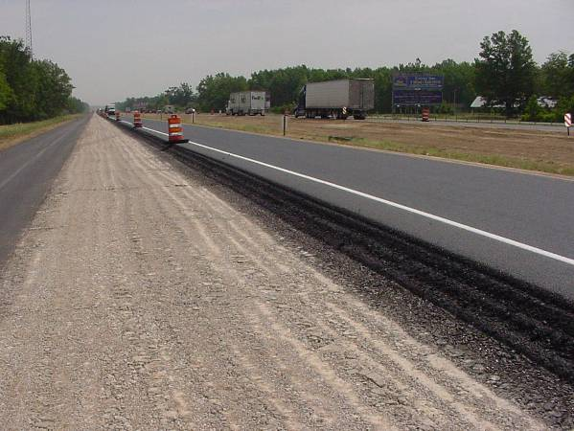
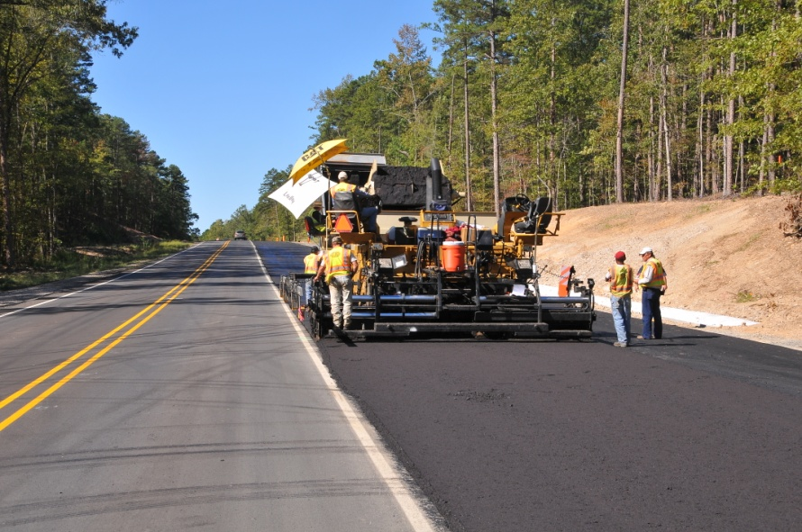
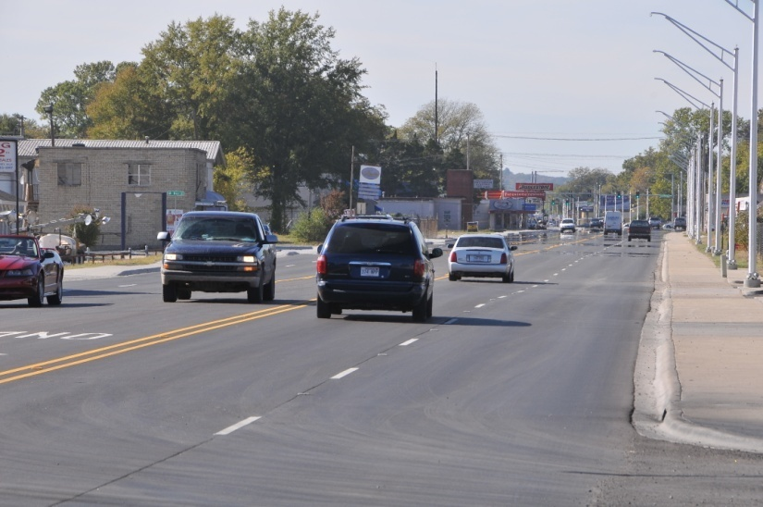
ARKANSAS STATE HIGHWAY AND TRANSPORTATION DEPARTMENT
Transportation Committee
Meeting
January 26, 2012
Notes:
I don’t want to take a lot of your time, but I do want to discuss a couple of topics that I believe are of interest to all of you.
I’d like to share with you the current status of Highway and Transit Funding Issues, touch on the 2011 IRP and then mention the 2012 proposed temporary sales tax.

Slide 2
Appropriations
Consolidated and further Continuing Appropriations Act, 2012 signed by President on November 18, 2011
  Appropriates funding through September 30, 2012 (remainder of Fiscal Year 2012)
  4.6% reduction in funding ($25 million reduction for Arkansas)
  $500 million for TIGER Grants
Notes:
2
Let me just briefly give you the status of the Appropriations Act.

Slide 3
Reauthorization
848 days since SAFETEA-LU expired
8 extensions since September 30, 2009
Current extension expires March 31, 2012
Funds appropriated through September 30, 2012, but may not have spending authorization
Notes:
3
And here is the latest with Reauthorization.

Slide 4
Reauthorization
Moving Ahead for Progress in the 21st Century (MAP-21) approved by Senate EPW Committee
  2-year bill
  Senate Finance Committee must “find” $12 billion to fully fund MAP-21 – reported to reveal plan on Feb. 2
  Slightly below FY2011 funding levels
  Consolidating programs
  Performance measures
  Competitive grants and set-asides for “loans”
Notes:
4

Slide 5
Reauthorization
House T&I Committee should soon release The American Energy and Infrastructure Jobs Act
  5-year bill
  At or near FY2012 funding levels ($2 billion less than FY2011)
  No specifics available, but much talk about consolidating programs and performance measures
Notes:
5

Slide 6
Reauthorization
Steps needed to enact a bill
  Committees must finalize legislation
  House and Senate must debate and pass their bills
  House and Senate must agree on and pass a final bill
Can this happen by March 31, 2012???
Notes:
6

Slide 7
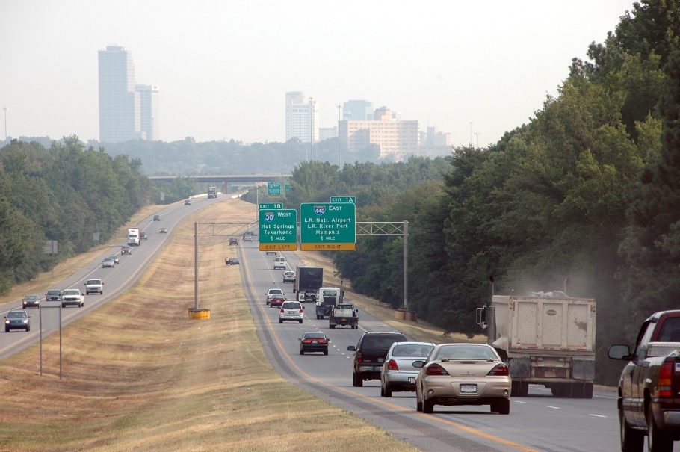
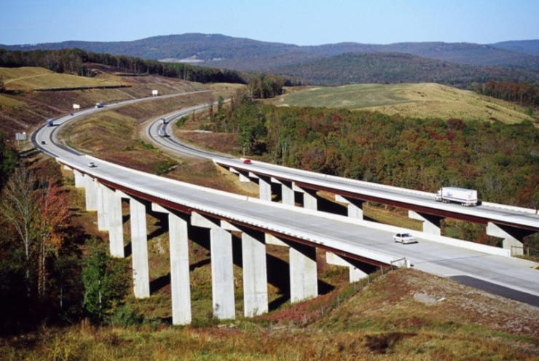

2011 Interstate
Rehabilitation Program
Notes:
Once again the Arkansas voters have overwhelmingly supported the passage of an Interstate Rehabilitation Program.
Here is a brief capsule of the 2011 version.

Slide 8
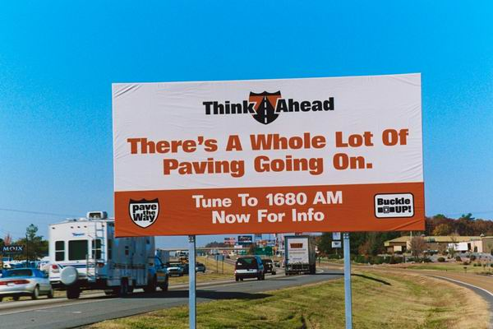
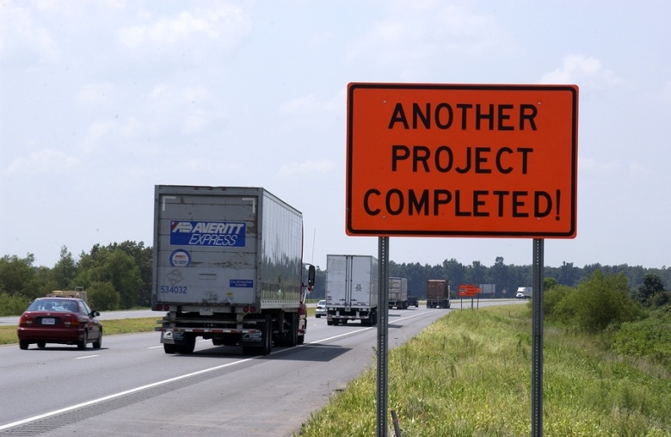
Timeline
April 2011 RFPs for design consultants
November 2011 Contract signed with Financial Advisor
December 2011 Agreements signed with 10 design firms
Currently Assigning projects to design firms
Late 2012 (tentative) Issue bonds and let first contracts
Notes:
We do about $350-$400 Million per year in construction contracts.
But just as we did for the 1999 IRP, we’re going to rely on consultants to assist us with some of the extra design work. Our current staff can handle some of the work, but rather than hire more permanent staff that we won’t need for the long term, we will utilize consultants.
To get ready the Commission authorized us to seek RFPs from possible on-call consultants. In July we began negotiations with 10 consulting firms for project development services and we are already assigning projects.
It is up to the Financial Advisor to ultimately determine the timeframe for the plan, but our goal is to be ready to award contracts in late 2012.

Slide 9
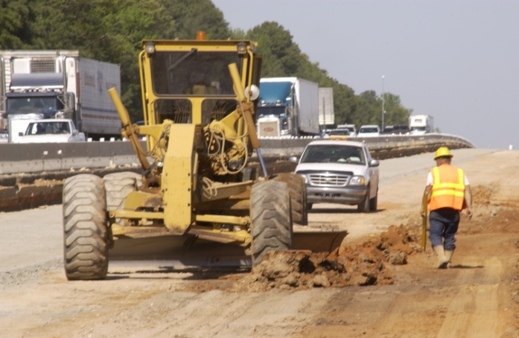
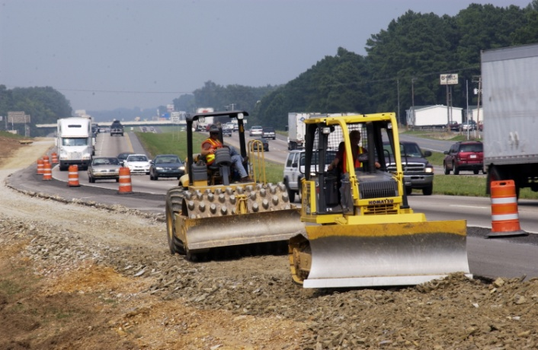
Types of Work
Mill and Inlay
Mill and Overlay
Rubblize and Overlay
Mill, Rubblize and Overlay
Concrete Pavement Rehabilitation
Concrete Reconstruction
Interchanges Modifications
Notes:
This is a list of the types of work to be done.
How to schedule each job is very important:
Obviously, the condition of the roadway is one factor in determining the timing of a project. We have some sections that need work sooner rather than later.
The time it’s going to take to develop the plans is another factor.
And finally, the findings of the Financial Advisor is essential.

Slide 10
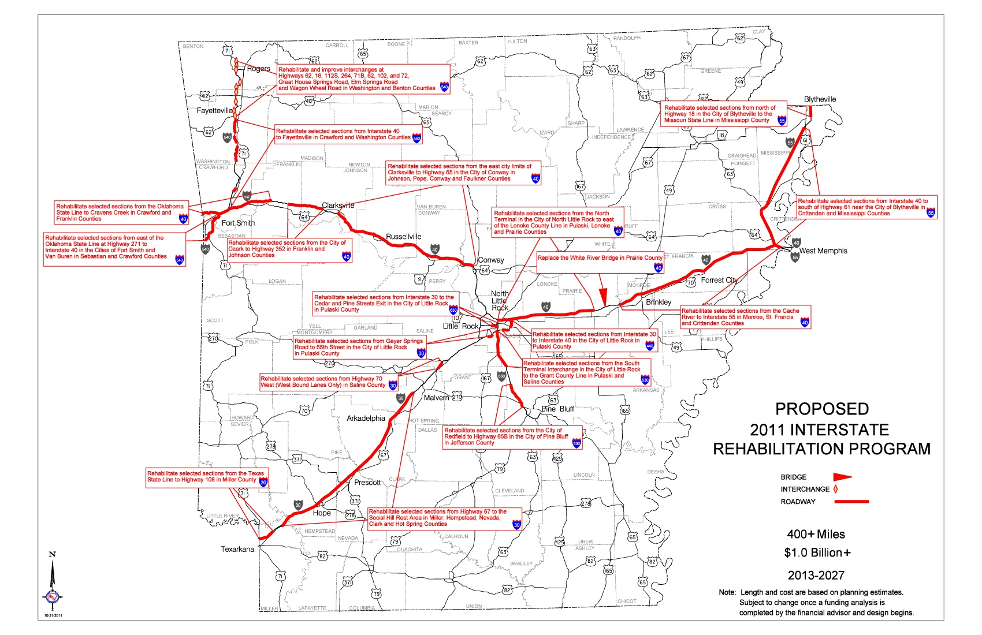
2011 Interstate Rehabilitation
Program Map
Notes:
I’m sure you have already seen this map. It shows the sections of the Interstate system that will be improved as part of the 2011 program.
We think there will be somewhere between 75 and 80 individual projects included.
By comparison, we had around 50 projects in the 1999 program.
Approximately 70% of the work underway in the first three years (2013-2015); remainder spread out over the following 12 years (through 2027).

Slide 11
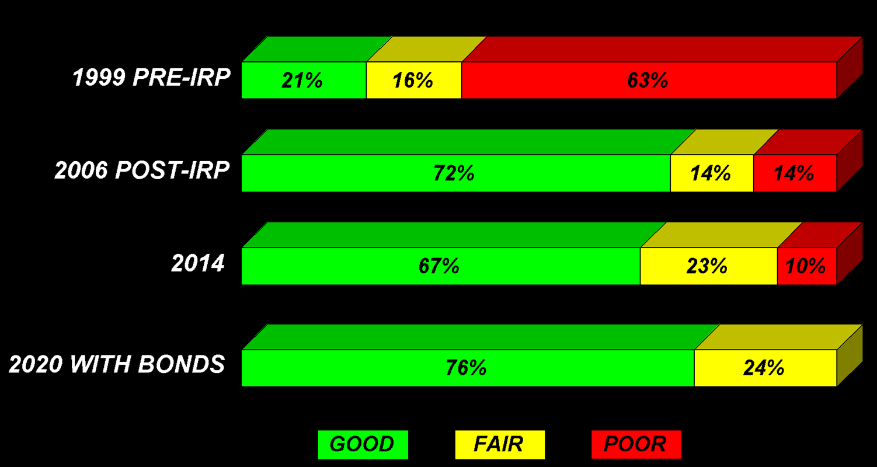
INTERSTATE CONDITION
Notes:
The 1999 IRP resulted in 72% of Arkansas’ Interstates being in good condition in 2006. As you can see, we have made significant progress toward providing an excellent Interstate system.
Since the approval of the IRP, additional routes have been designated as Interstate highways – Interstate 530 from Interstate 30 in Little Rock to Pine Bluff (47 miles) and Interstate 540 from Interstate 40 in Alma to Bentonville (67 miles).
Also, some sections of the Interstate system that were not improved under the 1999 IRP are now deteriorating and in need of improvement.
Based on existing pavement condition, expected deterioration and projected traffic volumes, the Department has projected Interstate needs through 2020.
Without the approval of the 2011 Interstate Rehabilitation Program and using the pay as you go method, Arkansas’ Interstate mileage in good condition will drop to 67% in 2014 and to 56% in 2020.
However, if the proposal passes, Arkansas’ Interstate mileage in good condition will be at 76% in 2020!
So, as you can see, without an adequate mechanism to meet our needs, we will begin to head back to where we were before the 1999 program began. None of us want to see that happen.

Slide 12
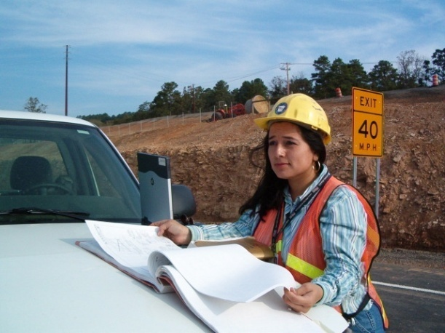
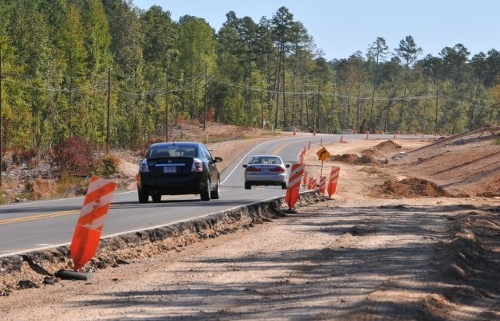
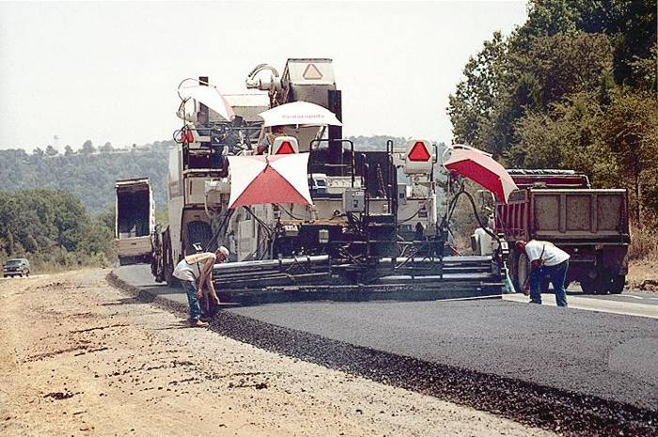
Temporary 0.5% Sales Tax
(Issue #1)
November 6, 2012 election ballot
Temporary Increase
$230m annually ($160m/$35m/$35m)
State Aid Street Fund for City Streets
Notes:
As we look even further ahead, our next challenge will be to educate the voters on the benefits of the proposed Constitutional Amendment to be voted in November 2012.
In the next few months you will be hearing much more about this proposal.
This is the result of House Joint Resolution 1001 by Representative Jonathan Barnett calling for a temporary half-cent sales tax increase.
This increase would not apply to food and food ingredients.
Revenue from the tax is to be divided 70/15/15 among the state, counties and cities. That would equal approximately $160 million for the state, $34 million for the cities and $34 million for the counties in new revenue annually for the life of the bonds.
One penny of the current motor fuels tax will be permanently dedicated to creating a State Aid Street Fund to be used on city streets off of the State highway system; this provision will not expire when the one-half cent tax expires.

Slide 13
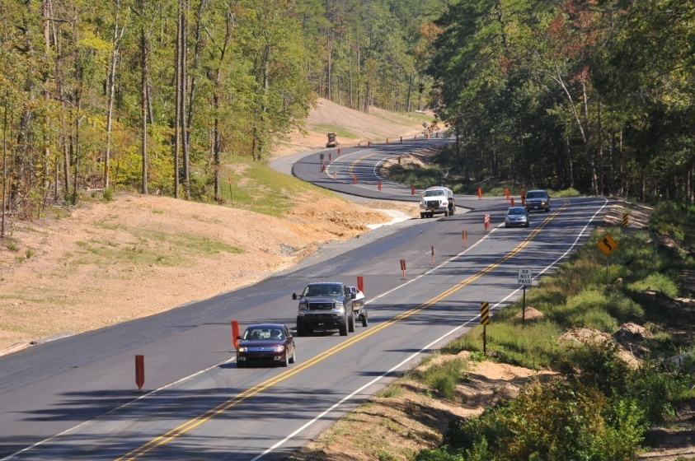
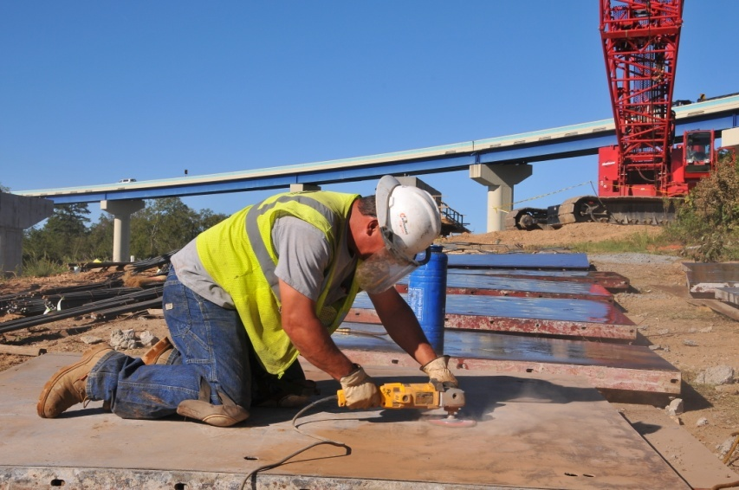
Temporary 0.5% Sales Tax
(Issue #1)
Bond debt retired over 10 years
$1.3 Billion in general obligation bonds
Tax expires when the bonds are retired
Four-lane highways
$1.8 Billion total program
Notes:
Proceeds from the Department’s portion of the tax is dedicated to retiring the bond debt over ten years.
The tax expires when the bonds are retired (10 years)
It would authorize the Commission to issue up to $1.3 billion in general obligation bonds.
The revenue derived from this program would be used for four-lane highway construction or adding capacity to existing four-lane highways.
If all bonds are issued, a construction program totaling approximately $1.8 billion could be undertaken over the 10-year period.

Slide 14
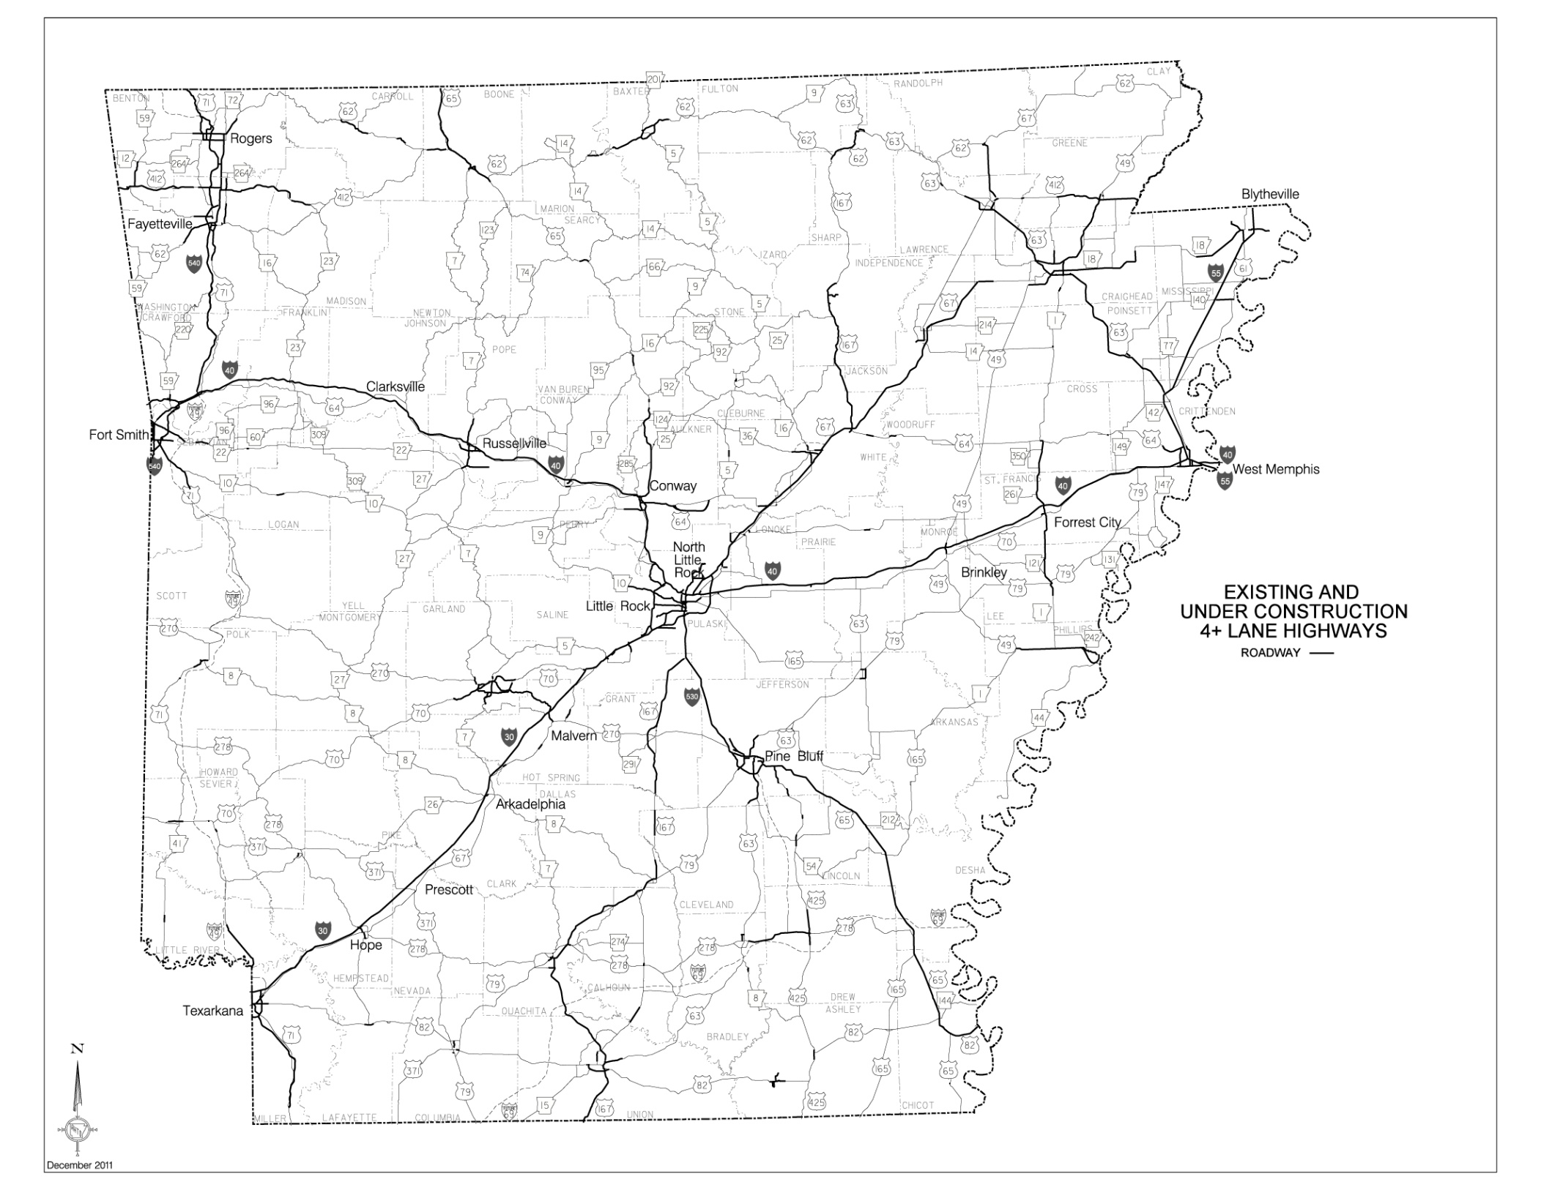

Slide 15
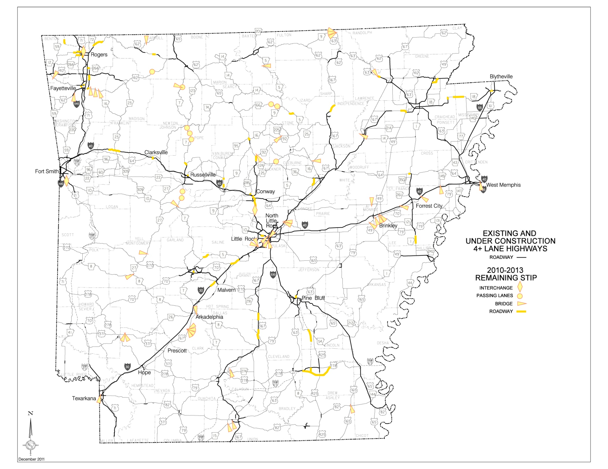

Slide 16
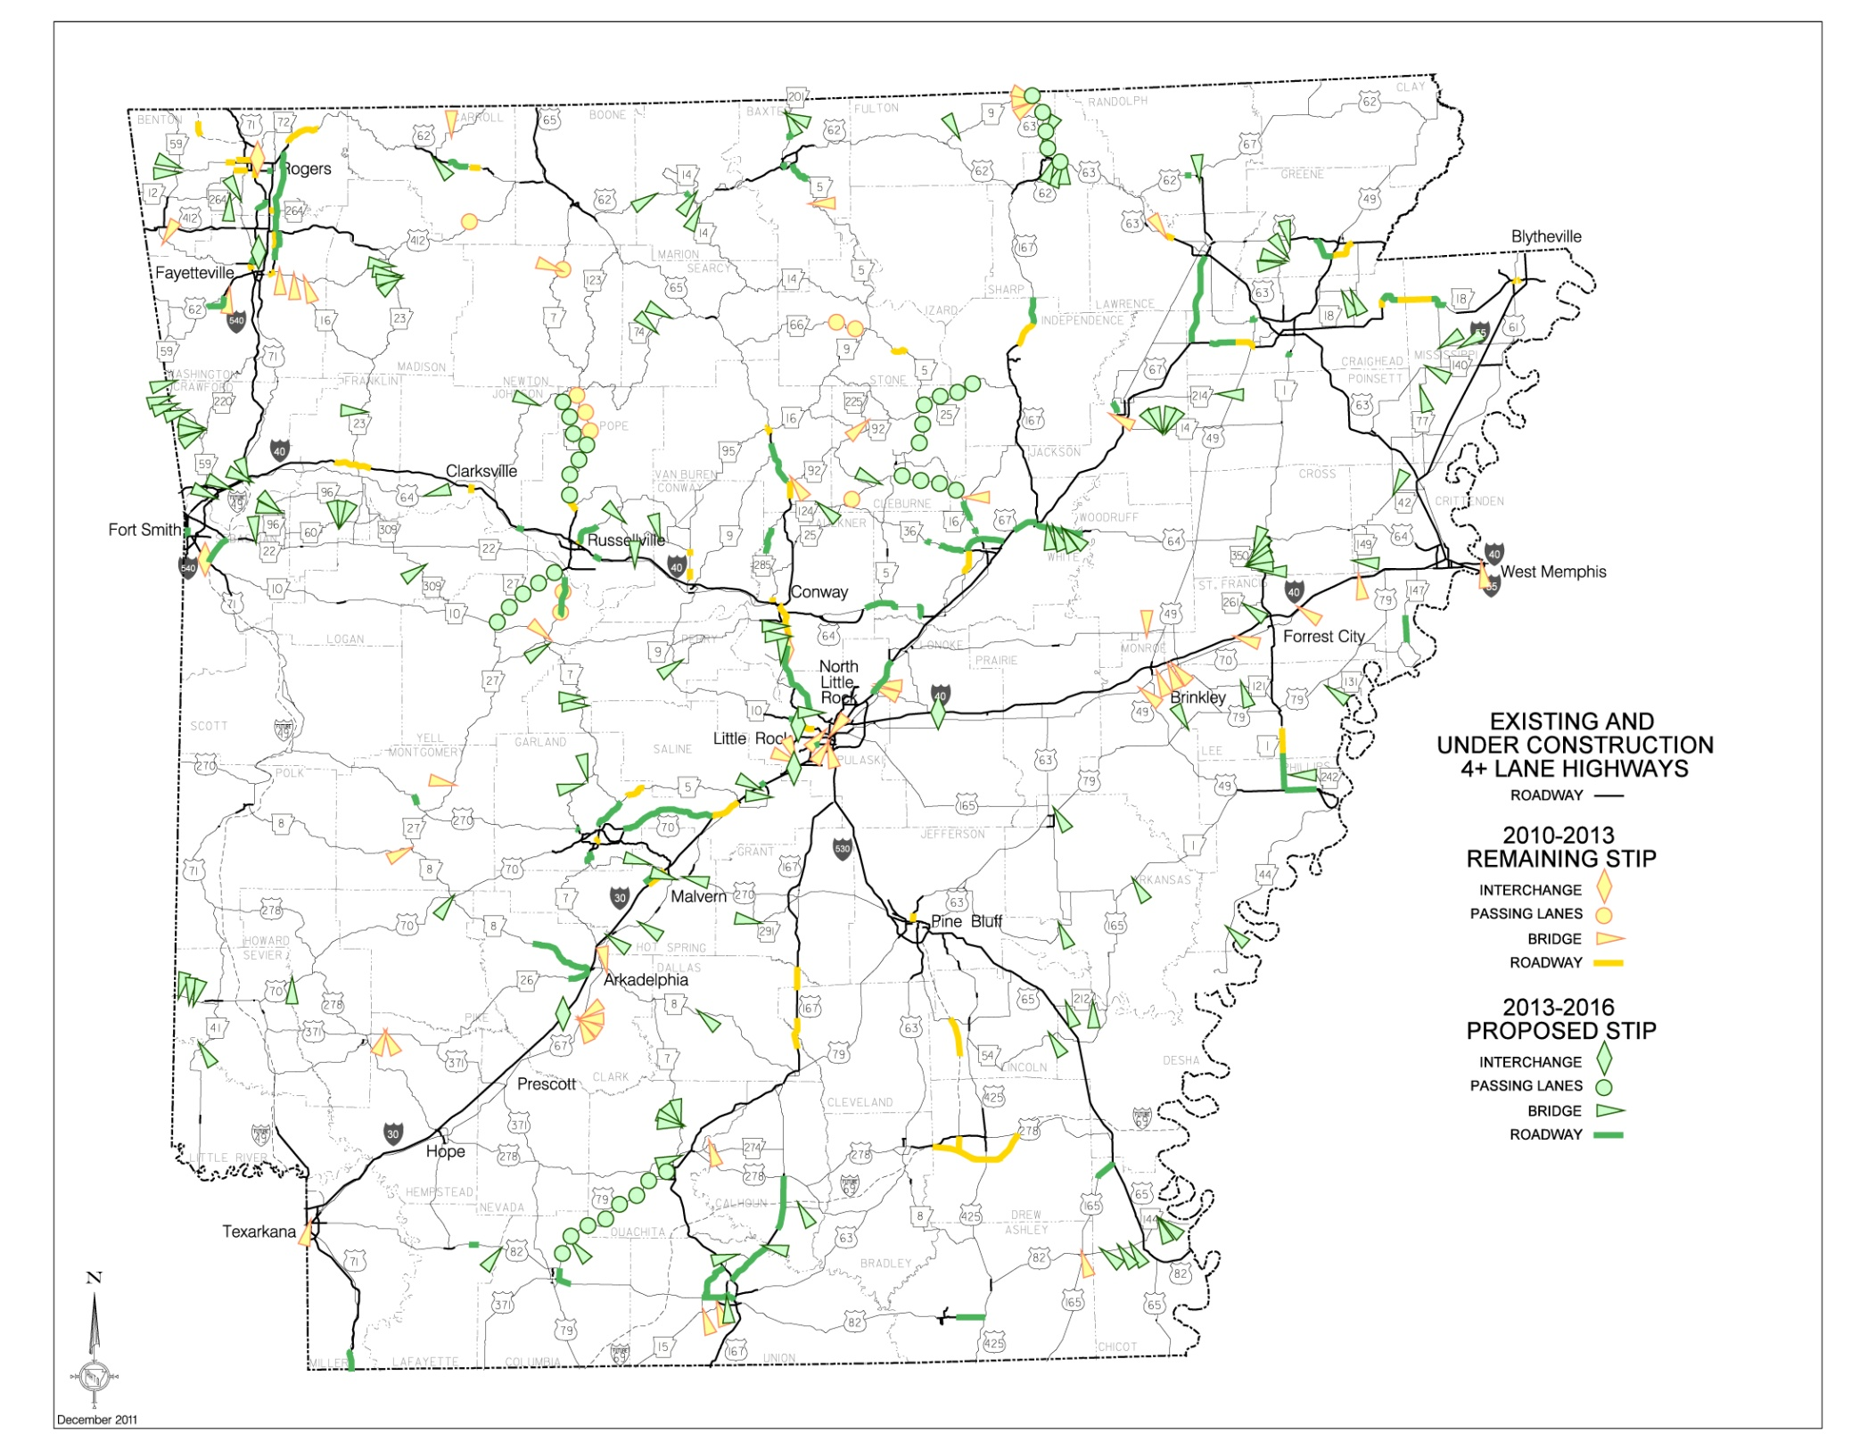

Slide 17
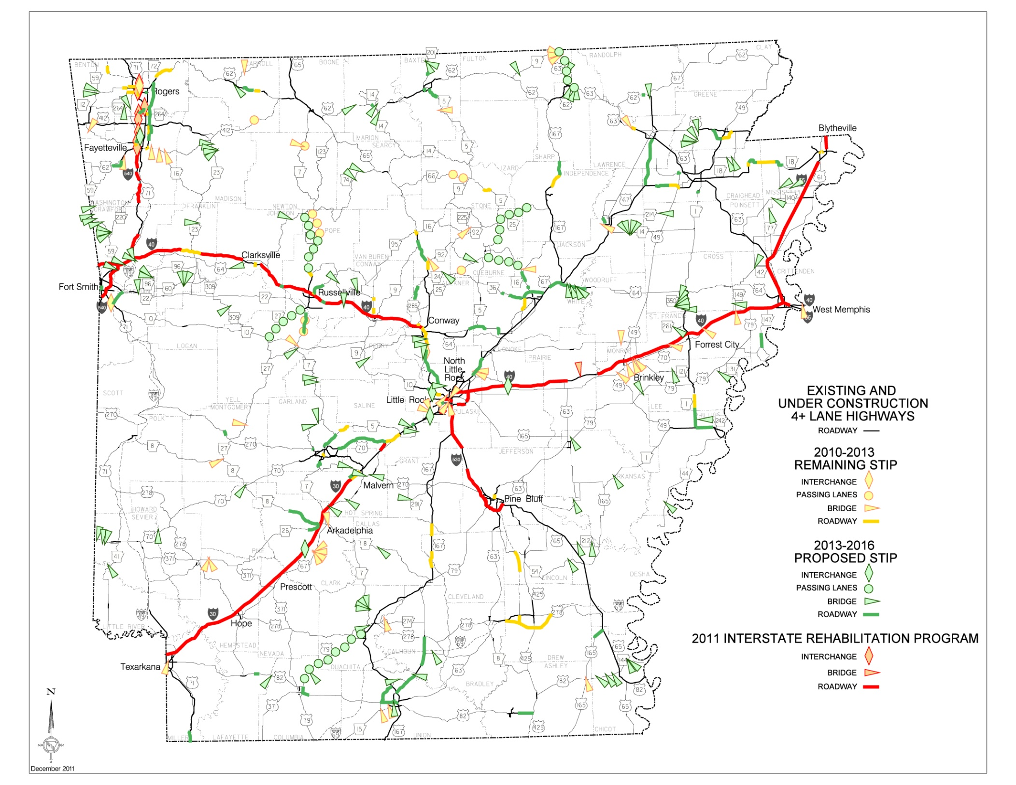

Slide 18
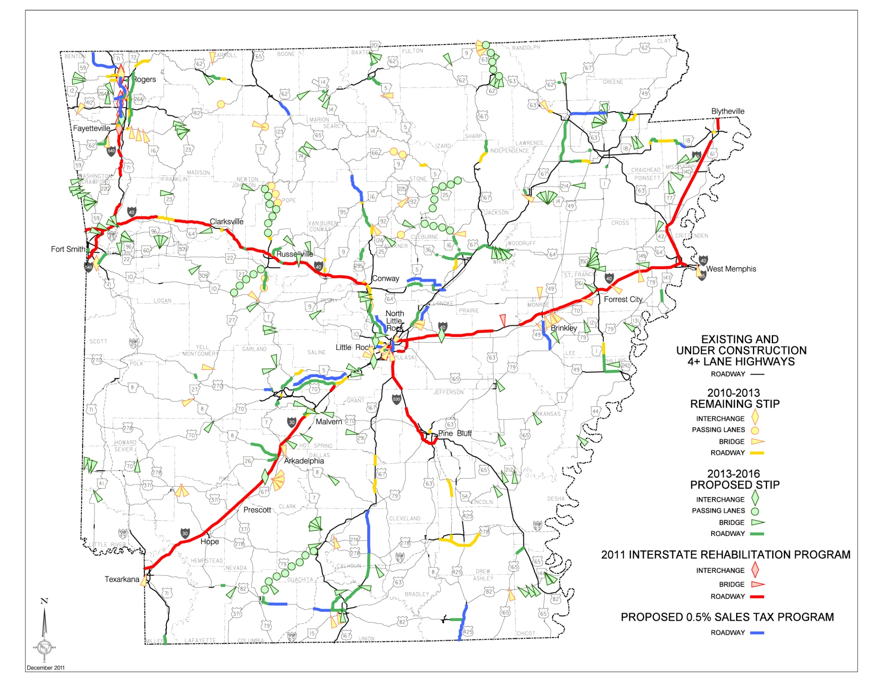

Slide 19
Benefits of Temporary 0.5% Tax
Completion of widening I-540 to six lanes between Fayetteville and Bentonville;
Completion of the initial two lanes of the ultimate four lanes of the Bella Vista Bypass (Future I-49);
Beginning the four-lane construction of the U.S. Highway 412 Bypass (Springdale) from I-540 westward to XNA Connector;
Notes:
The proposed temporary tax would provide much needed capacity improvements in Central and Northwest Arkansas, including….
19

Slide 20
Benefits of Temporary 0.5% Tax
Completion of widening I-40 to six lanes between Conway and North Little Rock;
Completion of widening U.S. Highway 67 to six lanes from Jacksonville to Cabot;
Improvements to I-30 connecting Little Rock and North Little Rock, including widening Arkansas River bridge;
Notes:
20

Slide 21
Benefits of Temporary 0.5% Tax
• Completion of widening U. S. Highway 64 to four lanes between Conway and Beebe;
• Completion of widening U. S. Highway 70 to four lanes between I-30 and Hot Springs;
• Completion of widening U. S. Highway 167 to four lanes between I-530 and El Dorado;
• Completion of widening U. S. Highway 412 to four lanes between Paragould and Walnut Ridge;
Notes:
And here are some other major four-lane corridor needs that can be met if this proposal passes….
21

Slide 22
Benefits of Temporary 0.5% Tax
• Completion of widening U. S. Highway 425 to four lanes from Hamburg to the Louisiana state line;
• Completion of widening Highway 18 to four lanes between Jonesboro and Blytheville;
• Continuation of widening U. S. Highway 65 to four lanes from Clinton northward;
• Continuation of widening U. S. Highway 65 to four lanes from Bellefonte southward;
Notes:
22

Slide 23
Benefits of Temporary 0.5% Tax
• Continuation of widening U. S. Highway 49 to four lanes from Brinkley southward toward Helena-West Helena;
• Continuation of widening U. S. Highway 270 to four lanes from Hot Springs westward;
• Beginning the widening of U. S. Highway 82 to four lanes between Magnolia and El Dorado.
Notes:
23

Slide 24


“Things do not happen. Things are made to happen.”
- John F. Kennedy
“Difficulties mastered are opportunities won.”
- Winston Churchill
Notes:
QUOTES
We are excited about all the things going on – the 2011 IRP is getting underway and another vote by the people is on the horizon giving us some wonderful opportunities.

Slide 25
Visit us at www.arkansashighways.com
Notes:
We are excited about all the things going on – the 2011 IRP is getting underway and another vote by the people is on the horizon.
Are there questions?
25

