Slide 1
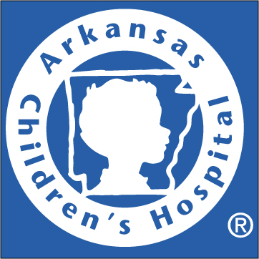
Arkansas Children’s Hospital
Clinical Nutrition Department
Meg Green MS, RD, CSP, LD
Notes:
Good afternoon, my name is Meg Green and I am a Registered Dietitian practicing at Arkansas Childrens Hospital. I am honored to speak on behalf of the Clinical nutrition department, and share with you some exciting and startling statistics.

Slide 2

Natural Wonders Arkansas
Notes:
The Natural Wonders Partnership Council composed of organizations that serve children was originially convened by Arkansas Children’s Hospital to identify the health needs of the states children and develop a plan for improving world class health and quality of life.
The partnership council includes representatives from First lady Ginger Beebe, Arkansas Department of Health, Department of Human Services, Arkansas Blue cross Blue Shield, Arkansas Minority Health Commission, Arkansas Department of Education to name just a few. Through this alliance the programs and initiatives created to accomplish goals such as our investment in education, health, and parent involvement for children ages 0-5, Newborn health screenings that allow for early diagnostic testing, oral health needs and the fluoridation of water statewide, and programs to address childhood obesity. There is still much work that needs to be done. With the recession, 7% of children remain uninsured, 63% of Arkansan children are served under Medicaid, The poverty rate of children is 3rd highest in the nation, and 1 in 3 children in Arkansas School Public Schools are overweight or obese, the medical implications are detrimental.

Slide 3
Affordable Care Act
Increase 250,000 Arkansans eligible for state coverage under Medicaid
Provide programs
  Childhood obesity reduction
  Oral health care education
  Home programs for pregnant women and mothers of school age children
Notes:
The federal Affordable Care act offers many opportunities to improve the health of arkansas. It will increase the opportunity of affordable health care coverage and services. The law will include money for services such as Childhood obesity reduction
Oral health care education
Home programs for pregnant women and mothers of school age children
With the increase of Arkansans covered, this will cause a strain on the health care workforce.
All of the services mentioned today have nutritional implications. The only health care professionals available for medical nutrition therapy are registered dietitians. However, Centers for Medicare and Medicaid Services decided this year Intensive Behavioral Therapy for Obesity can only be provided by primary care physicians. CMS eliminated the most qualified providers who has shown the most evidenced based success. Register Dietitian reimbursment would allow not only aid to the increased provider workload anticipated from ACA, but provide specialist, expert standard health care.

Slide 4

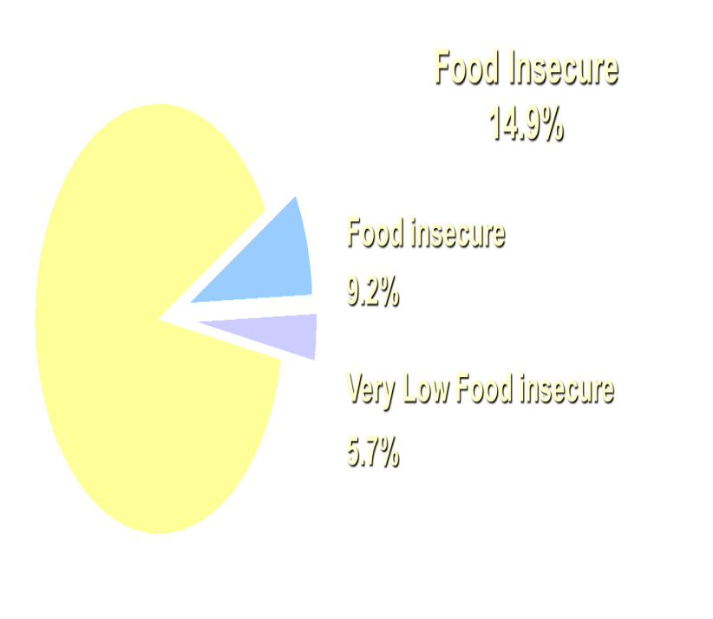
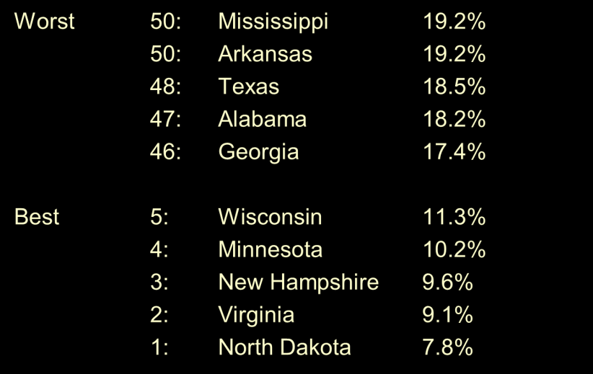
Children’s Health Watch
2011
2011
Notes:
A consortium of academic pediatricians who focus on infant growth (all have growth clinics), which collects data to influence public policy, and for academic publications
Collect data in five urban, safety-net hospitals, Produce scientific research
that is original and timely, Inform policy decisions
with state and national partners
Arkansas Child Hospital ER serves as a 1 of 3 national ER sites. Through CHW, our ER is able to identify families and patients with food insecurities.
Close to real time
Unique focus on under 3 year olds
High risk population
Multiple sites, very large sample
Interaction between program participation, living circumstances, and child status.
We were able to determine 14.9% of households are food insecure and 20.6% include children. From 2007-2009 Arkansas was the leading state in food insecurity with 17.7% , however we are know tied for that position and increased to 19.2%.
The effects of food insecure children can include a 40% chance of developemental delay, academic problems, poor educational achievements, mental health issues, and is correlated to malnutrition, including obesity.

Slide 5
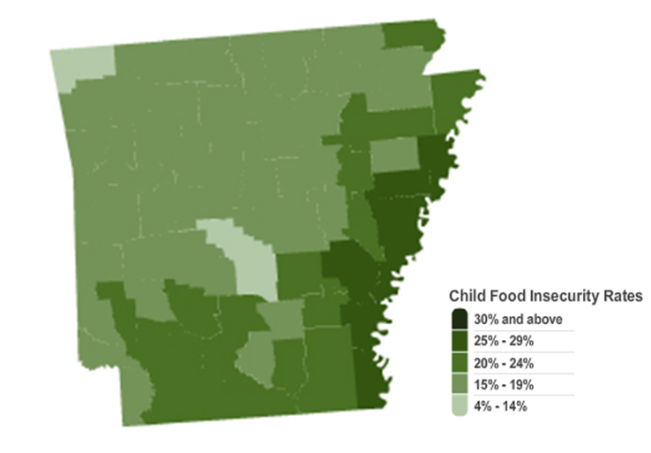
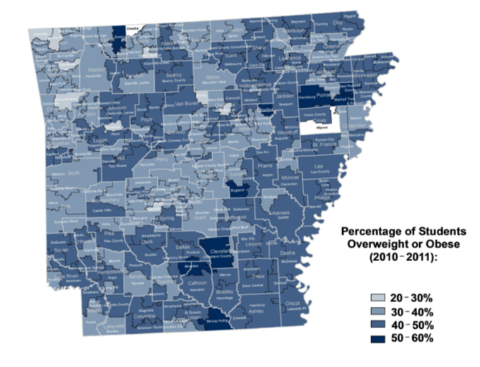
Food Insecure Obesity
Notes:
Here is a look at our current state rate of food insecure children and our overweight and obesity students. It is easy to determine the similarities.
Arkansas Children average with food insecurity is 27.8%. More than the adult population by ~10%. There are 194,460 children in arkansas. 71% of Arkansas childrens are income eligible for federal nutrition programs (below 185% of the federal poverty level. The highest counties in arkansas are Lawerence, Van Buren, Poinsett, Jackson, and Stone.
One in 3 arkansas public school students are overweight or at risk for being overweight. 65% of obese 5-10 year olds have a minimum of 1 cardiovascular health risk and 25% have a minimum of 2. This generation of obese children have a lifespan of 10 years shorter than that of their parents.

Slide 6

Arkansas Children’s Hospital
Clinical Nutrition Department
WHAM
Nutrition Clinic
Weight Management Clinic
Fit 4 Kids
Champions Club
Camp iRock
Notes:
Arkansas Children’s Hospital has programs to help provide for our food insecure and obese patients. We are currently working to qualify food insecure eligible patients for SNAP, (formally known as the food Stamp program) . We on average complete 270 new WIC referrals in our NICU and High Risk Newborn Clinic.
We offer WHAM, Wellness, Health, Action, and Motivation classes monthly as family centered obesity education. Our Weight Management Clinic sees 500 new patients a year and has a 5-6 month delay in scheduling. The recommended turn around for obesity and overweight patients is weekly to monthly.. Our programs are not adequately funded or funded on expired gifts. I hope after today, you too can fight for the experts in nutrition, the Registered Dietitians to provide a healthier future for Arkansas.

