Slide 1
LEGISLATIVE BRIEFING
BENTONVILLE SCHOOLS
Oct. 2011

Slide 2
OVERVIEW OF PRESENTATION
Data on Impacting Achievement
Bentonville Story
  Demographics
  Achievement Results
Bentonville’s Next Steps-Our Focus
  Promising Practices
  New Tools
  9th Grade Center- “Science on a Sphere”
Considerations for Future
  Waivers/Legislation

Slide 3
SCHOOL AND TEACHER EFFECTS ON STUDENT ACHIEVEMENT
School/Teacher Effectiveness | Enter | Leave
Average School/Average Teacher | 50th | 50th
Highly Ineffective School/Highly Ineffective Teacher | 50th | 3rd
Highly Effective School/Highly Ineffective teacher | 50th | 37th
Highly Ineffective School/Highly Effective Teacher | 50th | 63rd
Highly Effective School/Highly Effective Teacher | 50th | 96th
Highly Effective School/Average Teacher | 50th | 78th

Slide 4


The Bentonville Story
Logistics and Demographics of District
Student Achievement Performance and Targets
Commitment to Compete on National Scale
Target Population=Site Driven

Slide 5
Example of Multi Tiered Model of Instruction and Intervention
Intensive-Level
Interventions are provided to students with
intensive/chronic academic and/or behavior
needs based on ongoing progress monitoring
and/or diagnostic assessment.
Strategic Level
Interventions-are provided to students identified
as at risk of -academic and/or social challenges
and/or students identified as underachieving who
require specific support to make sufficient
progress in general education.
Universal Level
ALL students receive research based high
quality, general education that incorporates
ongoing universal screening progress
monitoring and perceptive assessment to
design instruction. Expectations are taught
reinforced and monitored in all settings.

Slide 6
Response to Intervention Model
Process
HIGH
Consideration for SLD/GT
Focused Assessments
Tier 3
Intensive Interventions
(additional 30 min daily))
Intensity of Treatment
Tier 2
Strategic Interventions
(additional 45 min. sessions 4x/wk)
Tier 1
Universal Differentiated Core Instruction
LOW
HIGH
Monitoring Frequency/Degree of Unresponsiveness to Intervention
Notes:
The farther you go along either axis the more effort it takes?

Slide 7
New Deliveries
Fast ForWord
Achieve 3000
Use of iPads
Standards Based Reporting
STEM Initiative

Slide 8
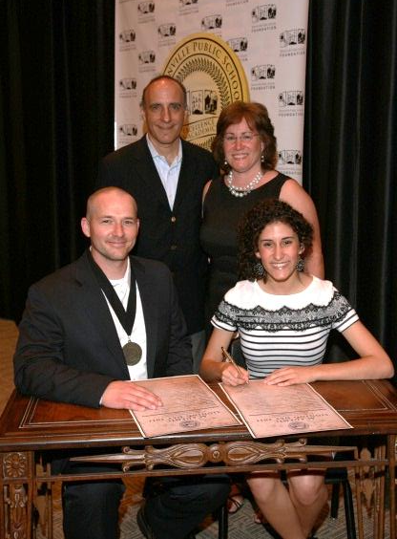

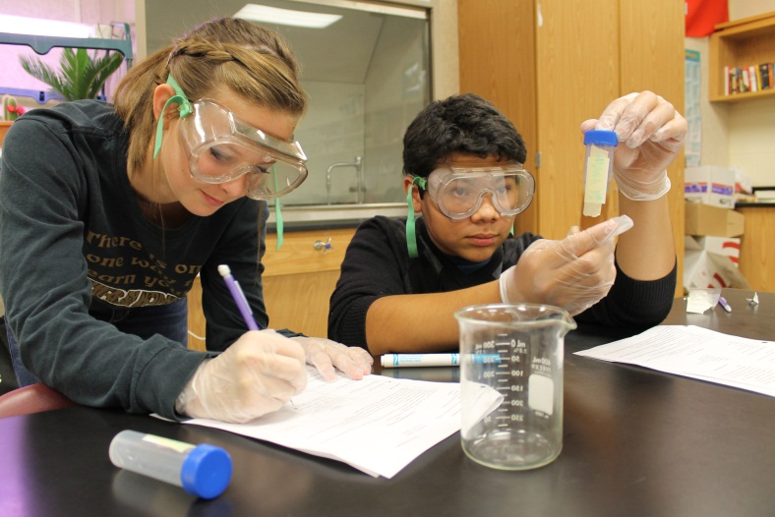

Approved Action
The Administration-Superintendent recommend that we seek voter approval for a 9th Grade Center that will be located at the H.S. with a capacity of 1500.
Notes:
Need Kid Pictures– Prefer Pictures of H.S. Kids

Slide 9

Science on a Sphere

Slide 10


Slide 11

Waivers/New Legislation
Balancing Innovation & Accountability
Teacher Duty Time
Class Size limitation
Instructional Minutes
Concurrent Enrollment

