Slide 1
School Case Studies
Dr. Brent Benda and Ms. Nell Smith
Bureau of Legislative Research

Slide 2
Case Study Objectives
Examine schools that have achieved significant improvement and schools that have been unable to achieve gains. We wanted to see which strategies have worked and what issues have prevented improvement.
Get an on-the-ground view of how the various school improvement initiatives (e.g., scholastic audit, federal school improvement grants, school improvement consultants, school achievement labels, etc.) fit together in a school across time.

Slide 3
Case Study Methodology
Pulled historical data from ADE, NORMES, etc.
Reviewed documentation: scholastic audits, grant applications, accreditation reports, etc.
Read archived news accounts
Visited each school and spoke with superintendent, principal, and teachers

Slide 4
Wonder Elementary, West Memphis
The only school in the state to be in year six or higher of school improvement and get out.

Slide 5
Other Schools Making Big Improvements
Eudora Elementary (Lakeside School District)
99% NSLA
In 2010, 100% of students proficient in math, 97% proficient in literacy
Mildred Jackson Elementary (Hughes SD)
87% NSLA
Increased math scores from 18% proficient in 2005 to 63% in 2011
One to Watch: Trusty Elementary (Fort Smith)
Preliminary data suggest the school increased literacy proficiency from 41% to 60% in one year and math proficiency from 45% to 62%

Slide 6
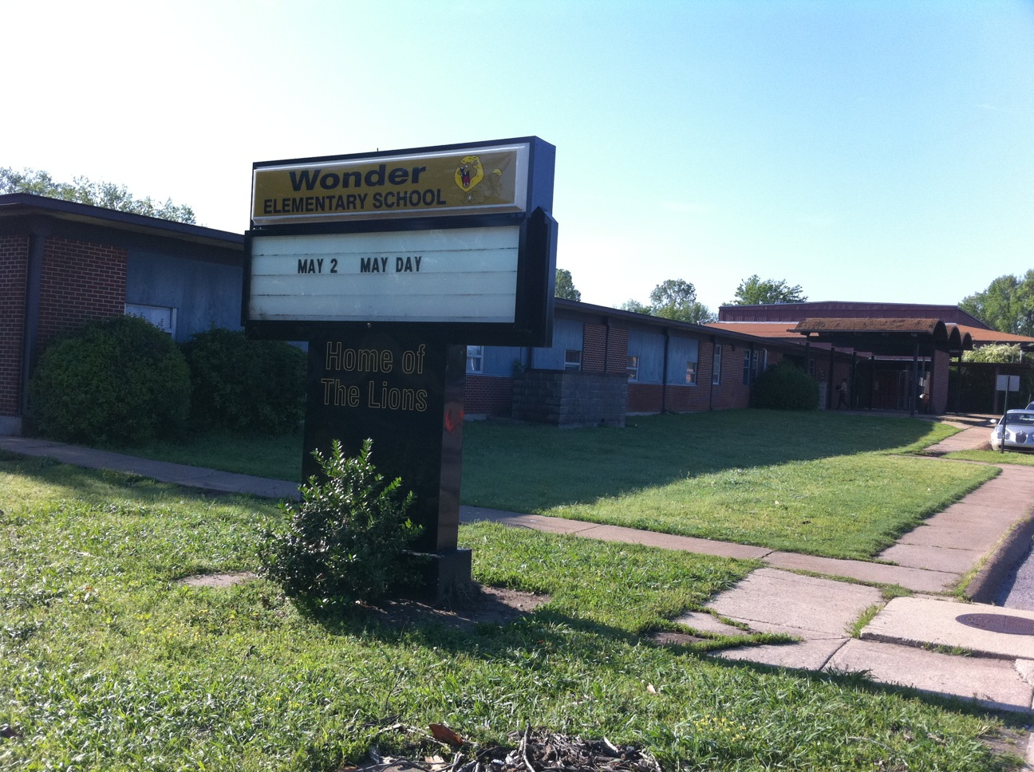
Wonder Elementary, West Memphis
K-6 elementary school
99% African-American
97% eligible for free or reduced price lunch
460 students in 2011
Declining enrollment school in declining enrollment district

Slide 7
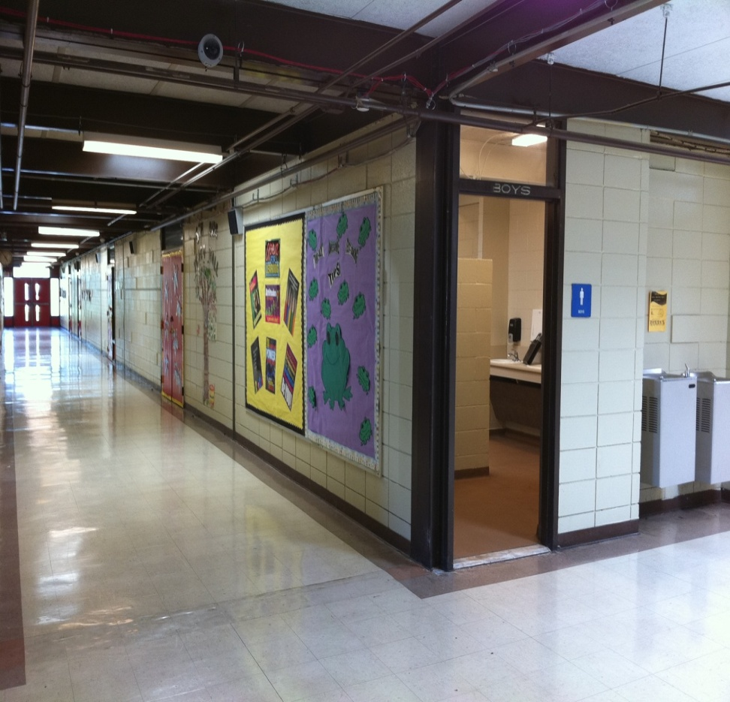
Leadership
Superintendent: Bill Kessinger, has led the district for more than 25 years
Principal: Ora Breckenridge has led Wonder Elementary for 26 years

Slide 8
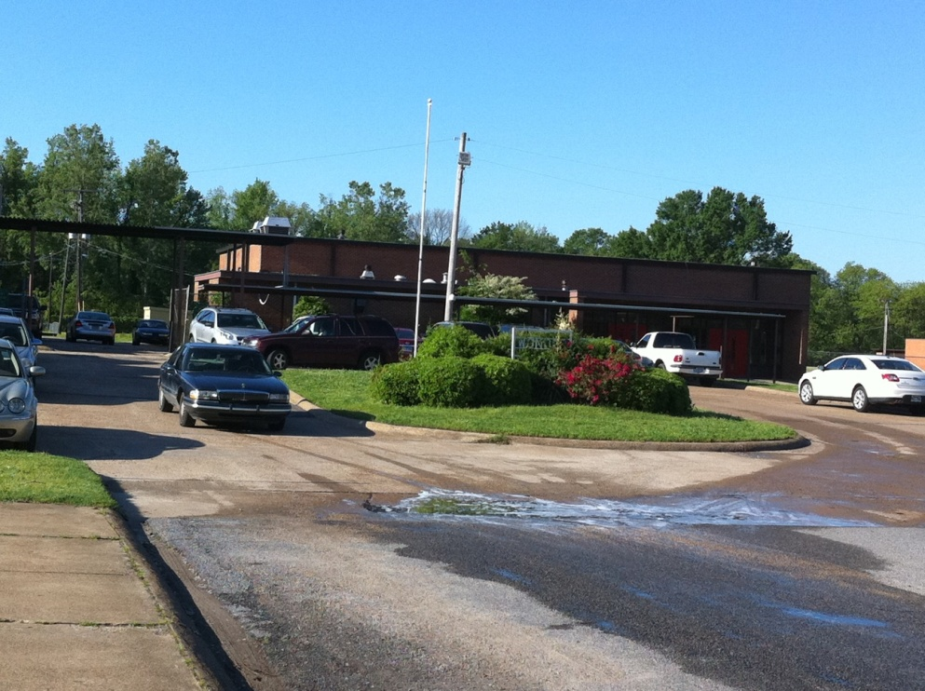
Wonder’s Challenges
Was one of the first schools to be placed in school improvement in 2003
Teachers were teaching
“cover to cover” without
any data about whether
students were learning
Teachers were not teaching
writing at all
Students lacked test-taking skills

Slide 9
School Improvement Consultant
District hired Teachscape and later Elbow 2 Elbow to work with district schools
Between 2006-07 and 2008-09, the district spent about $2.35 million on services from E2E for all of its schools.
With E2E’s guidance teachers began :
  Having students “write with a purpose,” examine passages and analyze content
  Co-teaching to maximize resources and help each other
  Using Marzano’s high yield strategies

Slide 10
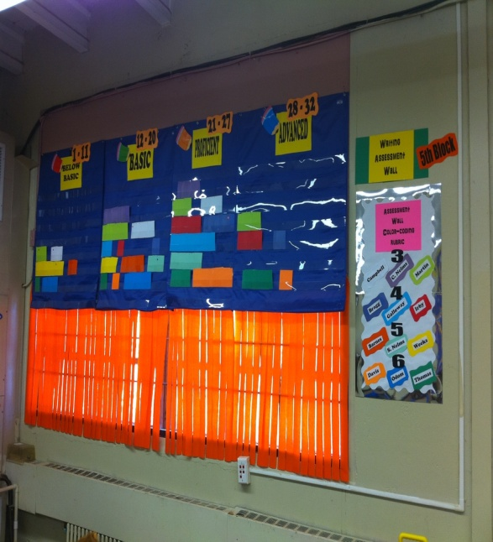
Delta Curriculum Alignment and Assessment Blocks (DCAAB)
District-designed pacing guide organizing curriculum into 4- and 5-week blocks.
Grade-level teachers throughout
the district teach the same
curriculum at the same time.
Students are tested at the end of
each block.
Coaches across the district meet to
review block test scores and
compare schools’ scores.

Slide 11
Osceola Middle School
In 2010, OMS had the lowest percent proficient or advanced in math (18.6%)

Slide 12
Osceola Middle's Student Achievement
and NCLB Targets
In 5th year of school improvement
Designated “persistently lowest achieving”

Slide 13
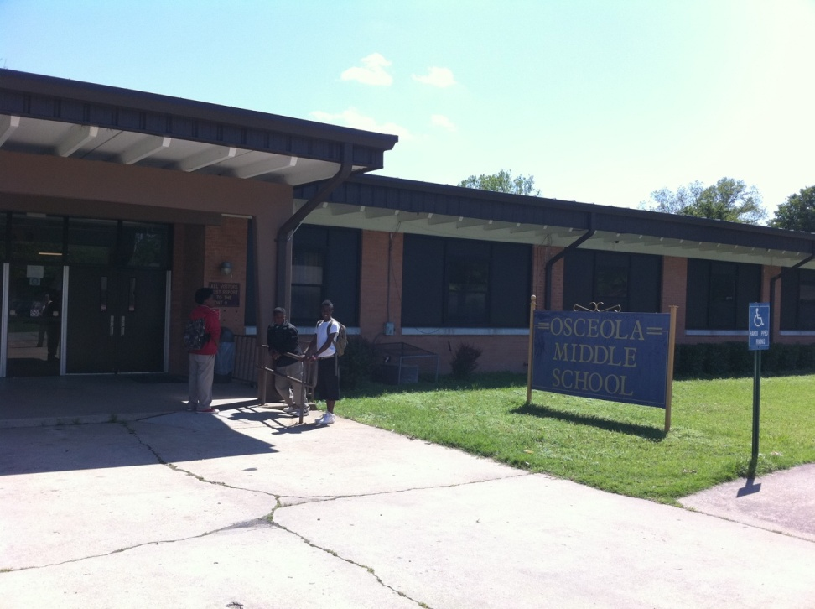
Osceola Middle School, Osceola
Serves grades 6-8
98% eligible for free and reduced price lunch
95.5% African American
156 students in 2011
Declining enrollment school in a declining enrollment district

Slide 14
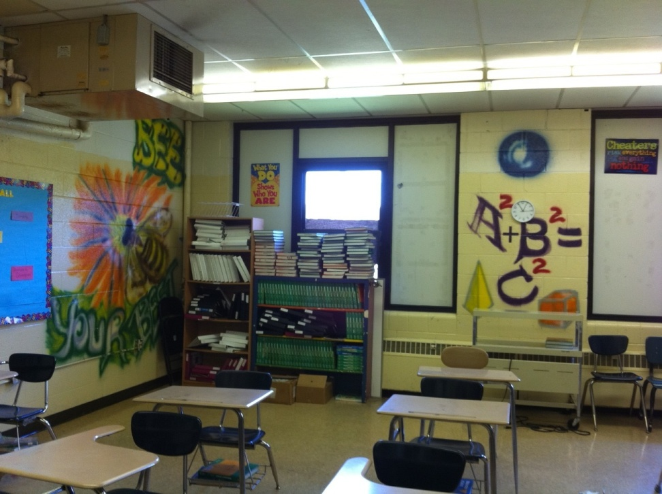
Osceola Middle’s Challenges
Superintendent: teachers not held accountable, high absenteeism rate
District in fiscal distress from 2009-2011
In 2010 all of Osceola’s schools had accreditation violations
Difficulty replacing superintendent because district couldn’t afford to buy out contract

Slide 15
Charter Schools in Osceola
Members of the community have pushed for charter schools for more than a decade.
District opened conversion charter—ACE—in 2002 for 5th-8th grades
Open enrollment charter—OCABS—opened in 2008 for high school students; added 7th and 8th grades in 2009
In 2010, State Board of Education revoked ACE charter
In 2011 the BOE revoked OCABS’s charter
The Osceola School Board is pursuing another charter

Slide 16
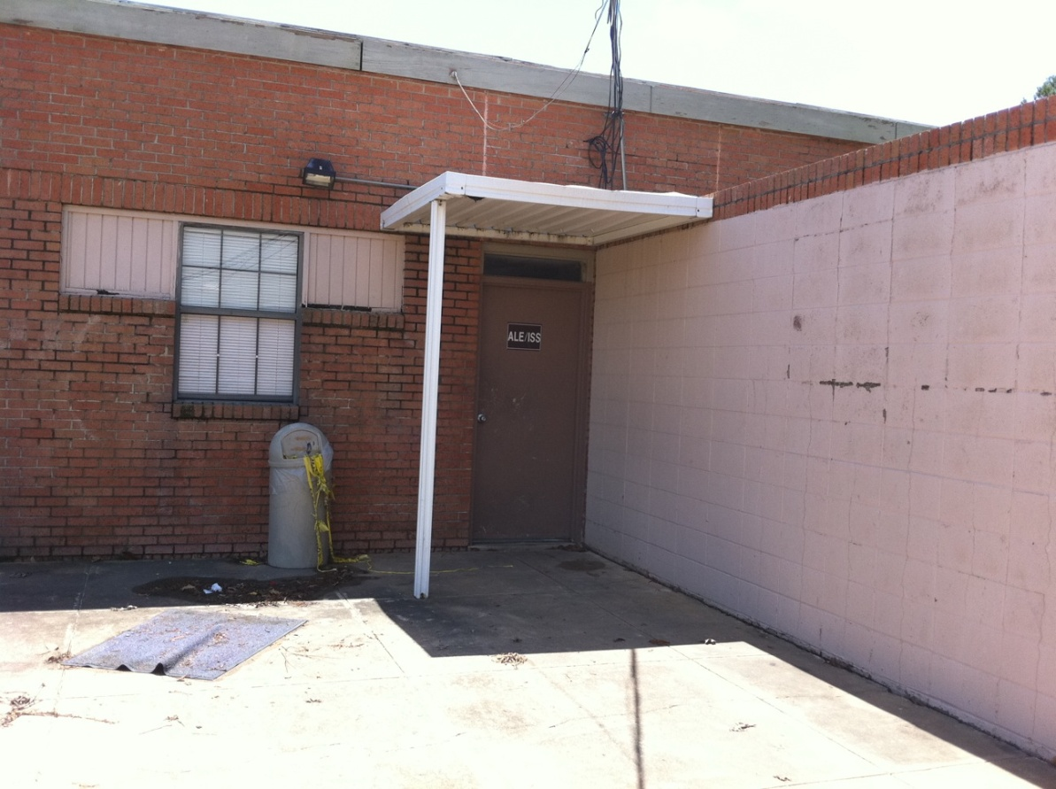
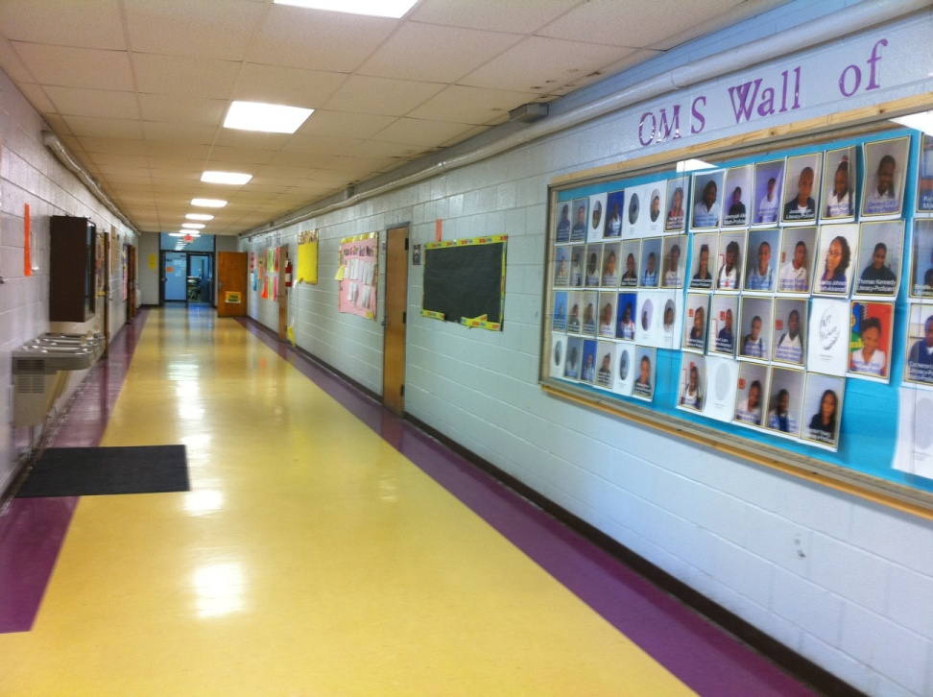
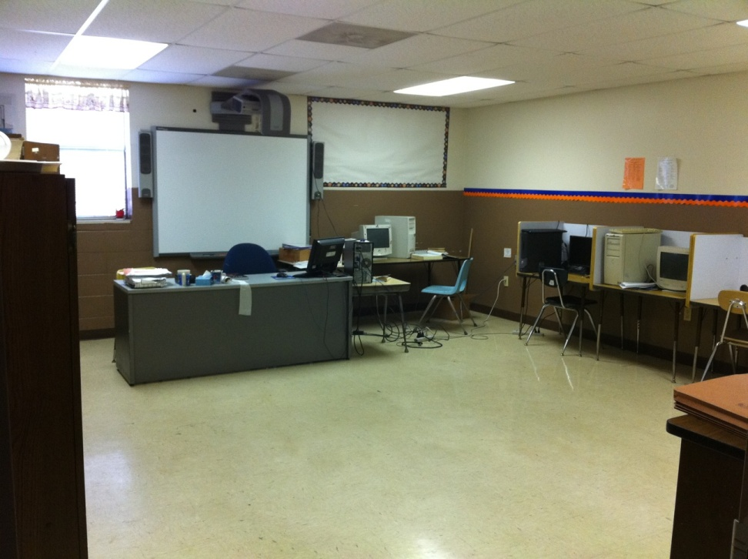

Slide 17
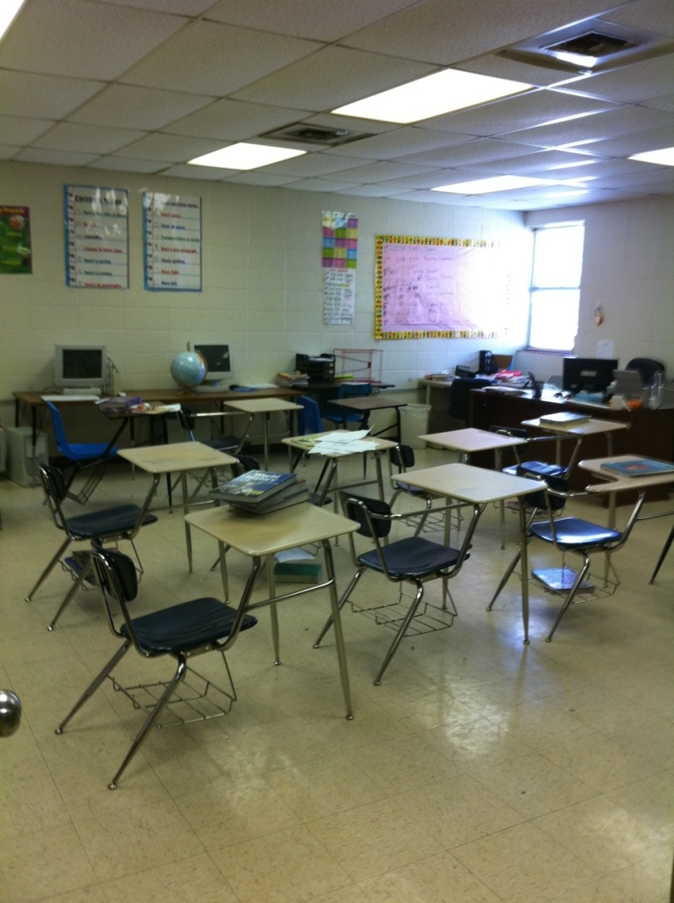
School Improvement Initiatives
Hired JBHM: spent $1.7 million between FY2009 and FY2011
School received a school improvement grant of nearly $1.3 million for FY2011 and FY2012
Doubled JBHM consulting days to 200

Slide 18
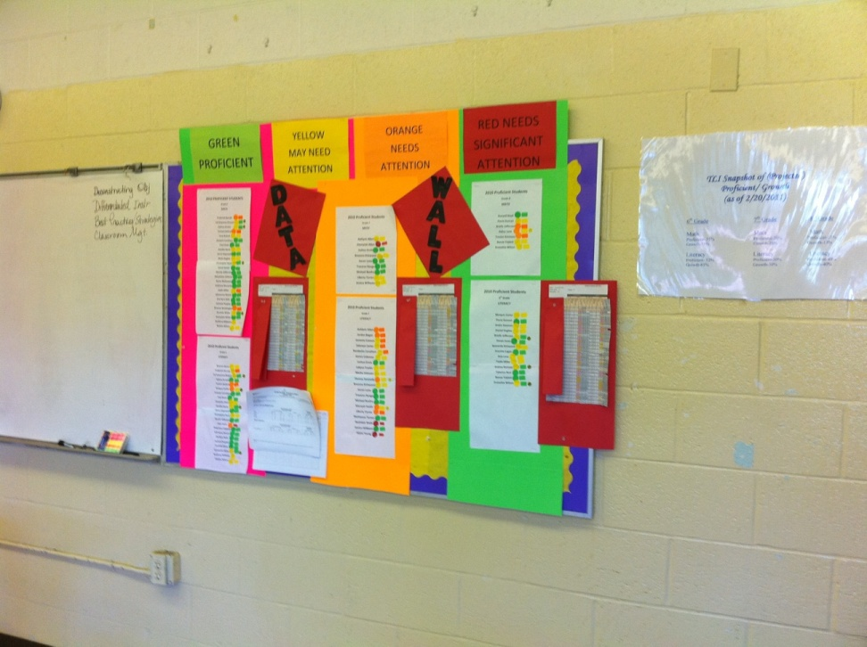
Osceola Middle’s Progress
Two years of gains in literacy scores, from 28.5% proficient in 2009 to 50% in 2011
One year of gains in math scores: 19% proficient in 2010 and 39% in 2011

Slide 19
Dollarway High School
In 5th year of school improvement
Designated “persistently lowest achieving”
In 2010, school with the second lowest percent proficient or advanced in math (20%)

Slide 20
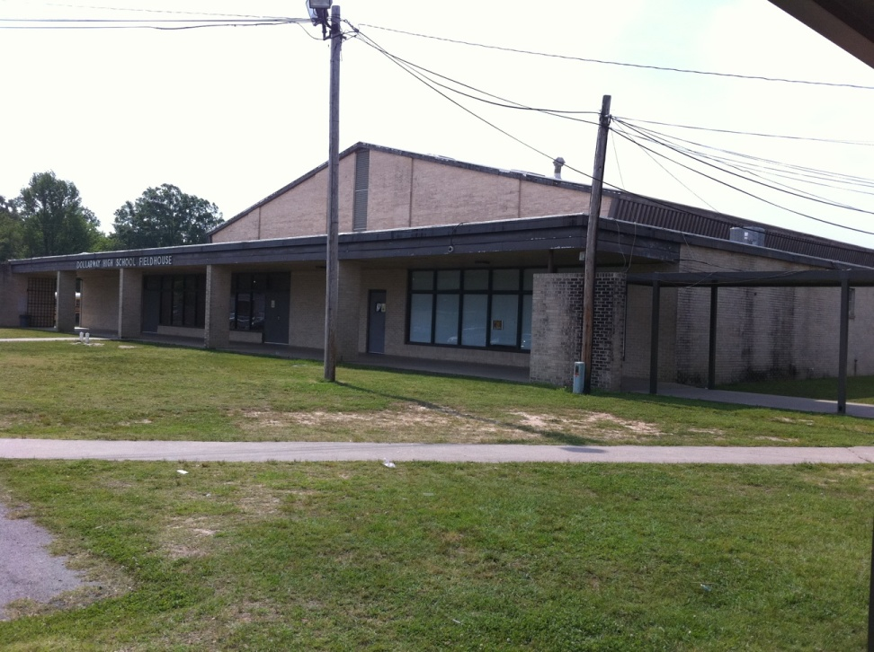
Dollarway High School, Pine Bluff
Serves grades 9-12
90% eligible for free and reduce price lunch
94% African American
474 students in 2011
Declining enrollment school in a declining enrollment district

Slide 21
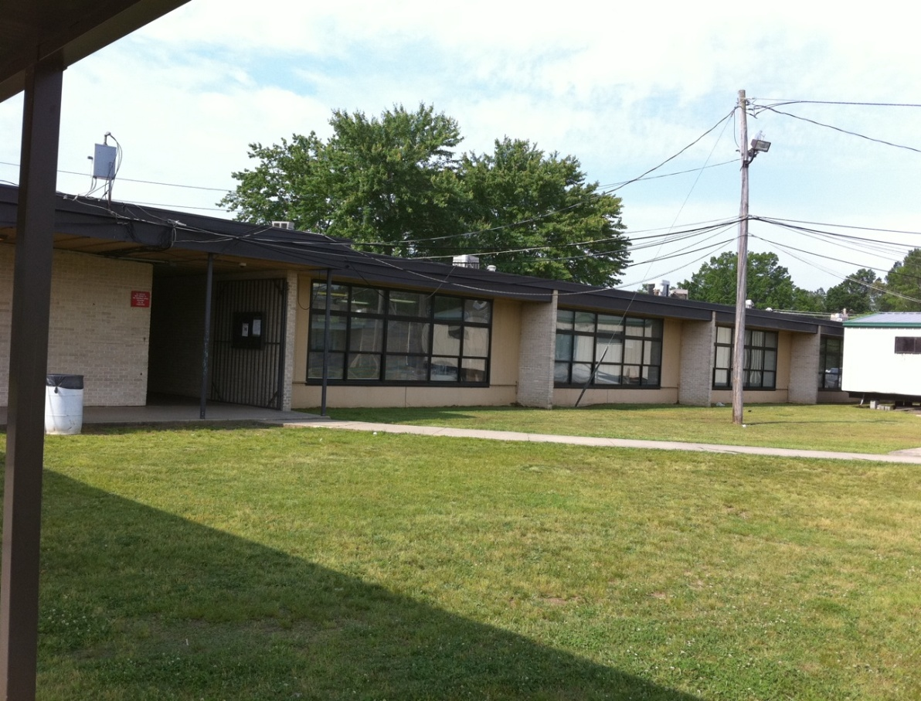
Dollarway High’s Challenges
High superintendent turnover: three superintendents in four years
History of fiscal distress
Dilapidated buildings
Disorderly campus environment

Slide 22
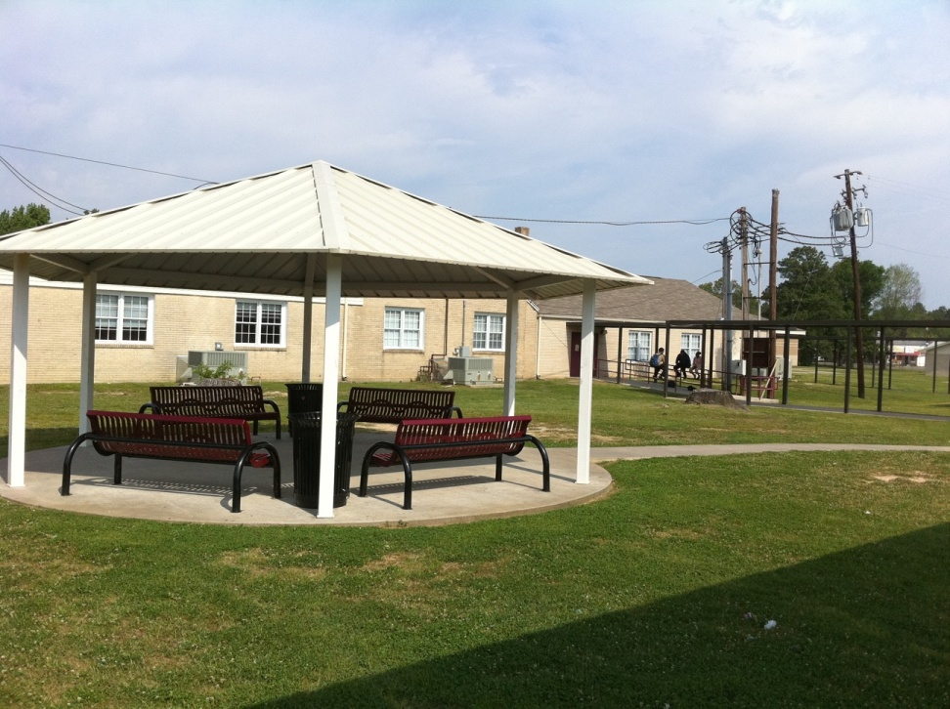
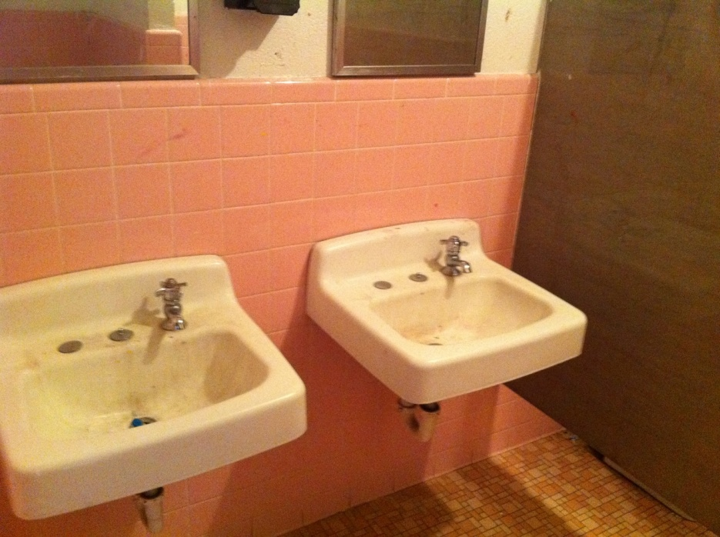
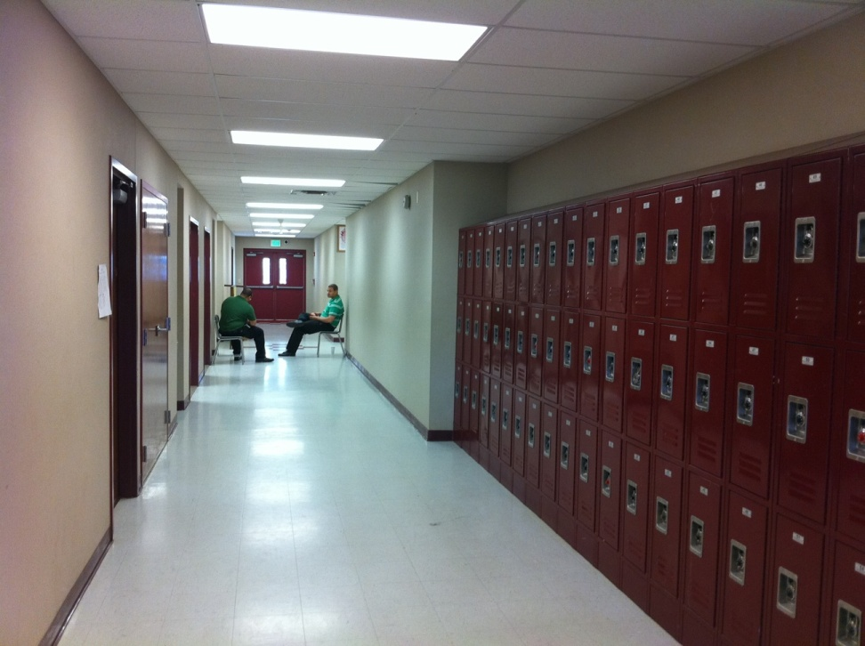
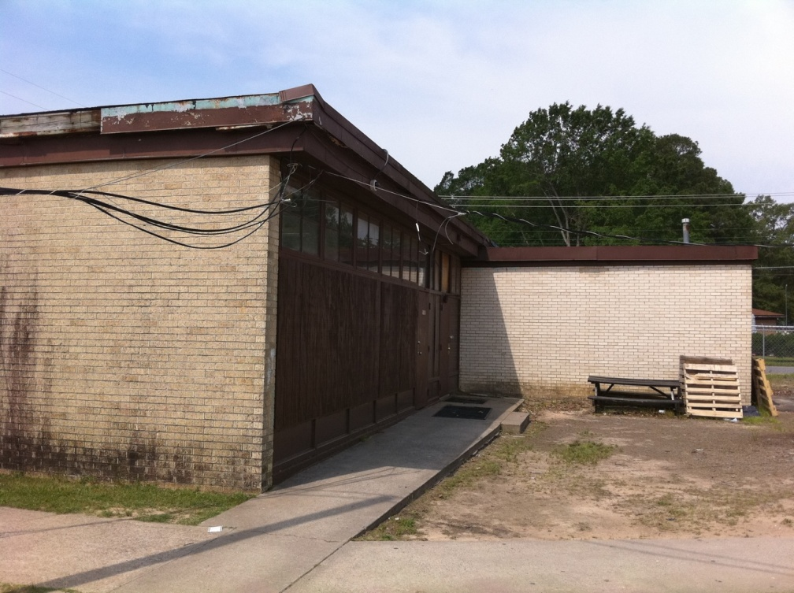

Slide 23
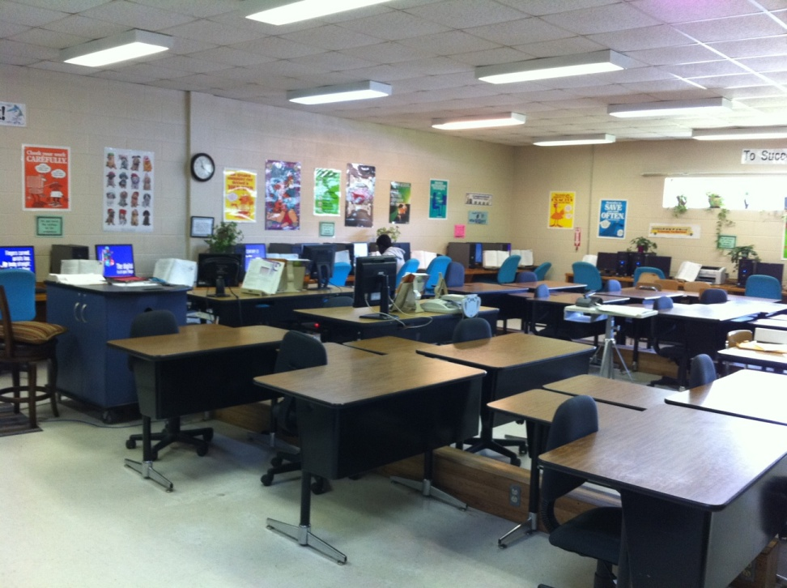
Faculty Challenges
Many teachers are disillusioned and unmotivated
Some teachers are set in their ways and resistant to change
High teacher absenteeism
Many teachers discouraged by testing pressure
Lower salaries than surrounding districts

Slide 24
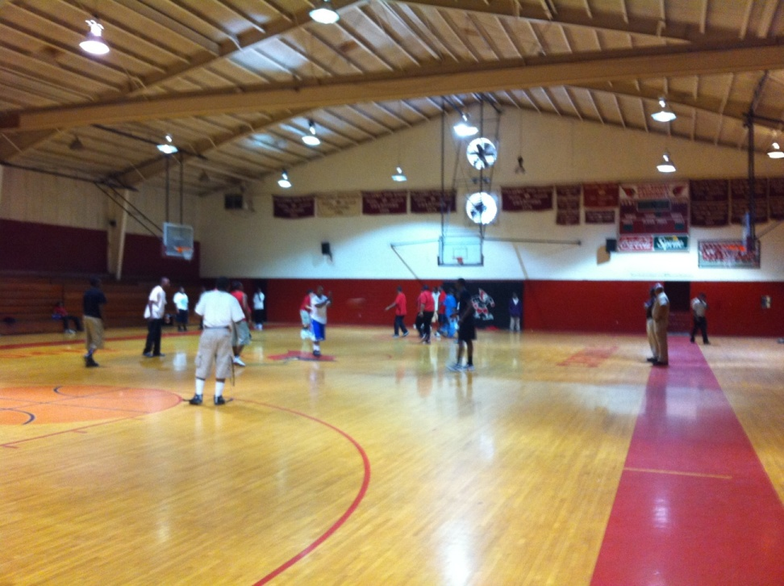
School Improvement Initiatives
Working with JBHM and Academic School Turnaround
Hired literacy and math coaches
Contracted with The Learning Institute for formative testing
Started after-school enrichment program
Received a School Improvement Grant of nearly $2 million for 2011-12

Slide 25
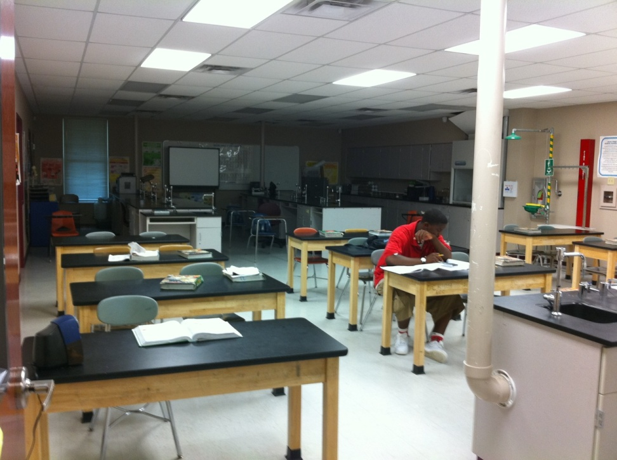
Dollarway’s Progress
Two years of gains in literacy scores: from 14% proficiency in 2009 to 41% in 2011
Two years of gains in math scores from 11% in 2009 to 26% in 2011

