Slide 1
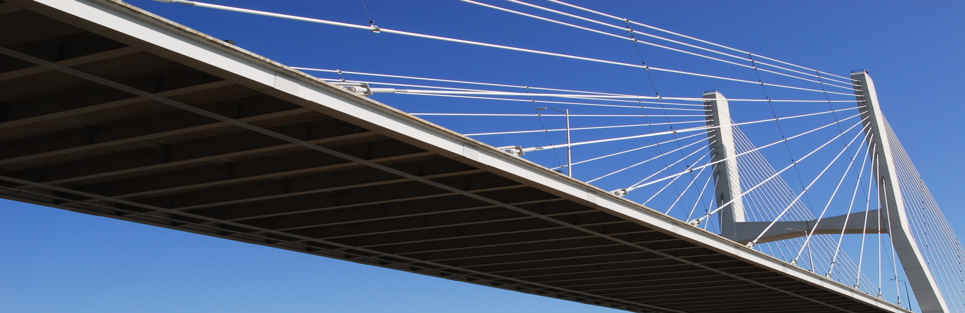
Arkansas State
Highway and Transportation Department
Legislative Joint Transportation Committee Meeting
Arkansas Convention Center
Texarkana
Thursday, November 21, 2013
Notes:
This is an exciting time not only for the Arkansas Highway and Transportation Department, but for everyone in the state. One year ago, Arkansas voters made it quite clear they value quality transportation here in the natural state. We’re going to talk about that as well as where we go from here. I’ll also explain how all of this will work and tell you about some challenges we all face in the future.

Slide 2



Recent Voter Approved Programs
November
2011
November
2012
Notes:
In the last couple of years, we have been the only state where voters have passed two statewide highway programs.
The Interstate Rehabilitation Program in 2011 and the Connecting Arkansas Program in 2012. First, the Interstate Rehabilitation Program passed with 81 percent of the vote.
The CAP was passed in 2012 with 58 percent of the vote.

Slide 3

Connects Arkansas
Increases Capacity
10-Year Revenue Cap
Notes:
First, let’s talk about the CAP.
It’s a perfect name because that’s exactly what to does.. Connect the people of Arkansas.
Cap is also short of “capacity” which is exactly what the program does. It greatly increases
Capacity and improves connectivity. The term CAP also relates to the deadline to have it all complete.
We have a ten year revenue CAP on the entire project.

Slide 4

Turnback Funds
for cities and counties.
Notes:
Remember, The Connecting Arkansas Program not only provides construction for roadways.. It gives back to cities and counties. So more construction on the local level.

Slide 5
Highway Revenue
Distribution
70/15/15 Formula
70% Arkansas Highway & Transportation Dept
15% Arkansas Counties
15% Arkansas Cities
Notes:
In Arkansas, all highway revenues are divided by what’s known as the 70/15/15 formula. 70-percent goes to the Highway Department, 15-percent goes to the counties, and 15-percent goes to the cities.
Projected revenue transferred over 10-year period to AHTD = $1.45 Billion
Projected revenue transferred over 10-year period to cities = $313 Million
Projected revenue transferred over 10-year period to counties = $313 Million

Slide 6
Turnback Funds
Counties & Cities
Location | Est. Standard | CAP Annual | Total Cumulative
Counties | $88.2 million | $33.5 million | $1.22 billion
Cities | $88.2 million | $33.5 million | $1.22 billion
Notes:
Here’s the breakdown.
Est. Standard: $88.2 million
CAP Annual: $33.5 million
Total Cumulative: $1.22 billion

Slide 7
Projected Sales Tax vs. Actual
Month | Projected Net | Actual Receipts | Variance | Monthly Variance | Annual Variance
Jul | $5,950,000.00 | $6,205,659.77 | $255,659.77 | 4.30% | 4.30%
Aug | $13,930.000.00 | $12,923,708.99 | $(1,006,291.01) | -7.22% | -3.78%
Sept | $13,860,000.00 | $13,462,454.84 | $(397,545.16) | -2.87% | -3.40%
Oct | $13,300,000.00 | $12,587,677.76 | $(712,322.24) | -5.36% | -3.96%
Nov | $13,160,000.00
Dec | $13,860,000.00
Jan | $13,860,000.00
Feb | $13,230,000.00
Mar | $13,300,000.00
Apr | $13,650,000.00
May | $13,790,000.00
Jun | $13,930,000.00
Total | $155,820,000.00 | $45,179,501.36 | $(1,860,498.64)
Notes:
Before I show you the highway projects that are coming to the state. I want to show you the money that’s coming in to help fund the improvements. These are DF&A estimates.

Slide 8
October 2013 Revenues and Consumption
July - Oct | FY 2013 | FY 2014 | Variance | % Change
Motor Fuels Tax | $93.6 | $89.1 | ($4.5) | -4.8%
Registration Fees | $27.4 | $26.1 | ($1.3) | -4.7%
Permits & Penalties | $6.4 | $6.2 | ($0.2) | -3.1%
Other | $2.7 | $2.4 | ($0.3) | -11.1%
Total User Revenues | $130.1 | $123.8 | ($6.3) | -4.8%
Natural Gas Severance Tax | $7.9 | $14.5 | $6.6 | 83.5%
RRA Interest | $0.9 | $1.0 | $0.1 | 11.1%
Less: Diesel Tax for Bonds | ($5.7) | ($5.4) | $0.3 | 5.3%
Total Revenues Available | $133.2 | $133.9 | $0.7 | 0.5%
Fiscal 2014 Projected vs. Actual July - Oct | FY 2013 (millions) | FY 2014 (millions) | Difference (millions) | % Change
Gasoline | $475.9 | $467.4 | -8.5 | -1.8%
Diesel | $208.4 | $201.1 | -7.3 | -3.5%
Total | $684.3 | $668.5 | -15.8 | -2.3%
Notes:
Updated for Dec meeting

Slide 9
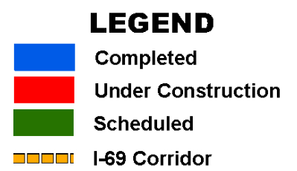
Scheduled
……………………………………
.
Notes:
In blue are the planned construction areas. If you take 1.8 billion dollars and put it on a 16-thousand mile highway system, you don’t get very far. Still, it does increase our capacity on our roads. Again, it has a ten year cap, so it must be complete within ten years. When we combine the CAP and IRP program, we are going to more than double our construction over the next few years.

Slide 10
Notes:
We have about 655 miles of interstates. This 1.2 billion dollar program will reconstruct about 450 of those miles. About 60% of the work will be underway in the first three years (2013-2015); remainder spread out over the following 12 years (through 2027).

Slide 11
Notes:
Here is a map showing our Statewide Transportation Improvement Program. The jobs you seen on the screen are between now and 2016. Again, blue is recently completed, red is under construction and green is scheduled.

Slide 12
Notes:
When you combine all three programs, you can see, we are doing a great deal of work in Arkansas.

Slide 13
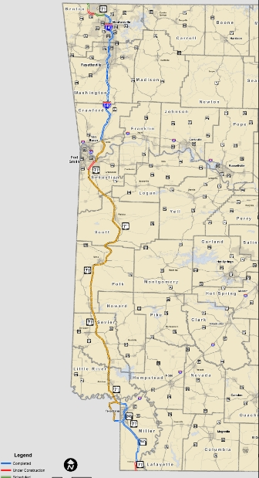



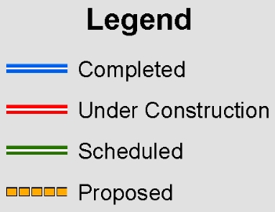
Bentonville
Ft. Smith
In Arkansas
315 miles
$1.2 billion spent
110 miles complete
17 miles under construction
8 miles scheduled
Texarkana
180 miles remaining
$2.8 billion needed
Notes:
Here is a color-coded look at the entire corridor in Arkansas. It totals about 315 miles.
We’ve spent about $1.2 billion to date.
About 110 miles complete
17 miles under construction
8 miles scheduled.
About 180 Remaining.
Cost to complete to Interstate standards - $2.8 billion

Slide 14
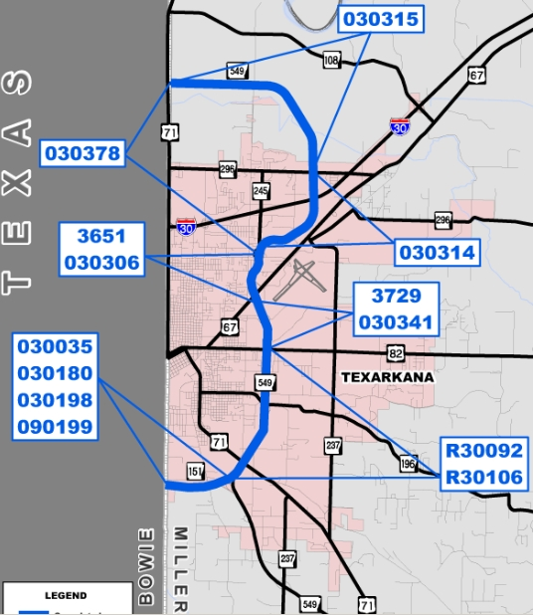












Texarkana
Area
Notes:
Let me start a little more detailed look at the project status down south in the Texarkana area.
As most of you know, we’ve got it completed from Doddridge, which is less than 5 miles from the LA line, to the north side of Texarkana. From Doddridge south to the LA line, all contracts are in place and work is progressing well. We expect that section to be open to traffic in about a year, sometime next Fall.
We dedicated the new and improved Texarkana Loop earlier this year. This new road took off from the existing Loop 245 just south of I-30, headed northeastward to a new interchange at I-30, then turned north and west on new location before intersecting with existing Highway 71 just north of Texarkana.
So to summarize this area, we’ve spent about $250 million on the roadway from Texarkana south to the LA line, and we’ve spent about $150 million on the Texarkana northern loop, bringing the total invested to about $400 million from the north side of Texarkana down to the LA line.

Slide 15
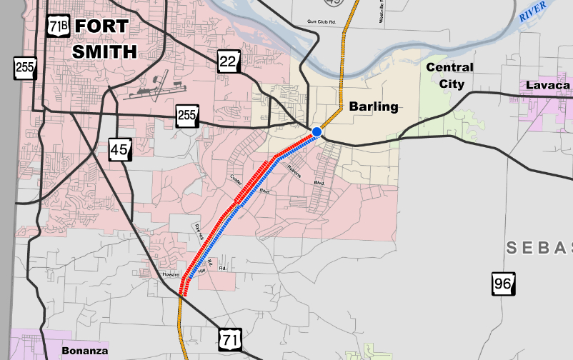
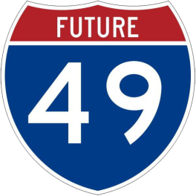
Base & Surface Work
Hwy 71 – Hwy 22
5.5 miles
Complete: Late 2014
Hwy 71 Interchange
Massard Rd – Roberts Blvd.
Complete: Dec 31 , 2013
Notes:
Now the section of future I-49 across Fort Chaffee. I’m happy to say this $125 million investment is only about a year away from completion.
It goes from existing Highway 71 just south of Fort Smith, not far from Jenny Lind, northward to Highway 22 here near Barling. Six contracts were awarded for this 6-mile route. We hope to be cutting a ribbon next fall.
Of course, the next big step in this area will be continuing the route northward across the Arkansas River to tie into the existing I-540/I-40 interchange at Alma. Unfortunately, like so much of the rest of the route, we don’t have a timeline for that segment. But you can see that route depicted on this map.

Slide 16






Bella Vista
Co. Rd. 34. – State Line
Scheduled: TBD
CA0905
Hwy 71 B – Hwy 72 S
Scheduled: Early 2014
CA0904
Hwy 71 Interchange
Scheduled: TBD
CA0903
Hwy 72N – Co. Rd. 34
$13.6 million
Complete: Late 2014
090393
Hwy 72 S – Hwy 72 N
$19.8 million
Complete: Mid 2014
090292
Notes:
The interesting thing about the part from Fayetteville north is that we’re in the process of investing over $600 million to improve and add much needed capacity through there. Now, that total includes construction of the Bella Vista Bypass, which you see on the screen now.
Completion of the initial two lanes of the ultimate four-lane BVB is included in the CAP that was approved by voters last November. That is the one-half cent temporary sales tax increase the garnered the support of 58% of the voters at the polls.

Slide 17
Bentonville
Ft. Smith
Corridor in
Arkansas:
$2.8 Billion
to Complete
Texarkana
Notes:
So the ‘missing link,’ so to speak, is generally the portion of I-49 from the Texarkana area to I-40 in the Fort Smith area.
CAP is about 200 miles statewide and it focused on connectivity and capacity

Slide 18
Notes:
Now let’s look at some other projects underway or planned in southwest Arkansas.

Slide 19
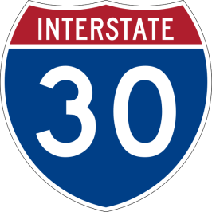
BB0702 – 8 miles
Hwy 26-Caddo River
Scheduled: 2014
BB0701
Gurdon Rest Area – Hwy. 26
Scheduled: TBD
BB1101
Boughton Rd. – Gurdon Rest Area
Scheduled: TBD
BB0308
Hwy 299 – E. of Hwy 371
Scheduled: TBD
BB0309
E. of Hwy. 371 – Boughton Rd.
Scheduled: TBD
BB0306 – 7 miles
Sheppard – Hwy. 278
Scheduled: 2014
BB0303 – 2 miles
Red River – East & West
Scheduled: 2014
BB0307
Hwy. 278 – Hwy. 299
Scheduled: TBD
BB0305 – 4 miles
Hwy. 67 – Sheppard
Scheduled: 2016
BB0302 – 4 miles
Hwy. 67 – W. of Red River
Scheduled: 2016
BB0310 – 4 miles
Hwy. 108 – Hwy. 67
Scheduled: 2015
BB0301 – 7 miles
Texas - Hwy. 108
Scheduled: 2015
Notes:
Let’s begin with Interstate 30.

Slide 20

Hwy 79 Passing Lanes
5 miles
Magnolia – Camden
Scheduled: 2015
70366
Legend
CAP
STIP
Notes:
A closer look at some other areas.. The CAP program is in blue, the Statewide Transportation Improvement Program is in green.
Looking at Highway 79 from Magnolia to Camden we are adding 2 northbound and 2 southbound passing lanes. It’s scheduled for bid in 2015.

Slide 21

Hwy 82 Widening
9 miles
Hwy. 98 – Hwy 79
Scheduled: 2017
CA0705
Hwy 82 Widening
4 miles
Hwy 79 - Co. Rd. 525
Scheduled: 2015
70365
Hwy 82
Railroad Bridge
Scheduled: 2016
70377
Hwy 82 Widening
7 miles
Hwy. 82B – Westward
Scheduled: 2016
CA0706
Hwy 82 Widening
5 miles
Hwy 82B/167B
Scheduled: 2016
70367
Legend
CAP
STIP
Notes:
Looking at Highway 82. We are using both the CAP and the STIP.
Moving from east to west.
Widen to 5 lanes
Highway 98 – Hwy 79 (9 miles)
Scheduled: 2017
Widen to 5 lanes
Highway 79 – County Road 525 (4 miles)
Scheduled: 2015
(THE DESIGN OF THIS PROJECT IS STILL BEING DISCUSSED)
Widening to 4 lanes
Highway 82B – Westward
Scheduled 2016
In El Dorado
Improvements/Widening 5 miles/Hwy 82b/167B
Scheduled: 2016
Also constructing a new railroad overpass. It’s scheduled for 2016.
Highway 82B

Slide 22
Hwy 82 Widening
2 miles
Stamps
Scheduled: 2016
30343
Legend
CAP
STIP
Notes:
Moving a little further west to Stamps. We are also widening there as well. About 2 miles. It’s scheduled for 2016.

Slide 23

Hwy 167 Widening
6 miles
Hwy 79 - Southward
Scheduled: 2018
CA0704
Hwy 167 Widening
5 miles
Hwy 273 – Peters Rd.
Est. Complete: 2015
70289
Hwy 167 Widening
7 miles
Hwy 274 - Northward
Scheduled: 2018
CA0703
Hwy 167 Widening
5 miles
Hampton – Hwy 274
Scheduled: 2016
CA0702
Hwy 167 Widening
1.4 miles
Scheduled: 2016
CA0701
Legend
CAP
STIP
Notes:
Looking at Highway 167. We are also using both the CAP and the STIP. Moving from north to south. Again, CAP is blue, STIP is green…
The spot furthest north is currently under construction. It’s between Hwy. 273 & Peters Road. We are widening at a cost of $33 million. It’s expected to be complete by summer 2015.
Widening will extend 6 miles south of Hwy 79 and 7 miles north of Hwy 274. Both scheduled for 2018.
Widening 5 miles from Hampton to Highway 274 and about a mile south of Hwy 274. Both are scheduled for 2016.
Scheduled: 2017

Slide 24
Hwy 167 Widening
5 miles
Hwy 172 - Hampton
Scheduled: 2016
70284
Hwy 167
Ouachita River Bridge
Scheduled: 2014
70282
Hwy 167 Widening
4 miles
Bangs Slough – Hwy 172
Scheduled: 2016
70283
Hwy 167 Widening
3 miles
Hwy. 335 – Ouachita River
Scheduled: 2014
70281
Hwy 167 Widening
5 miles
El Dorado – Hwy. 335
Scheduled: 2014
70280
Legend
CAP
STIP
Notes:
Staying with Highway 167. But these are the STIP projects in green.
2 projects – Bangs Slough to Hampton. 9 miles. Scheduled for 2016
New Ouachita River Bridge (4 Lanes undivided)
Scheduled for 2014
2 projects- Ouachita River to El Dorado. Also, scheduled for 2014.

Slide 25

Hwy 335 Rehabilitation
3 miles
Hwy. 82 – Hwy. 7
Scheduled: 2016
070368
335
Legend
CAP
STIP
Notes:
While we are near El Dorado, I want to mention that in 2016, we plan to put bids out for a rehabilitation for Highway 335 which connects Highway 72 with Highway 82 on the west side of the city.

Slide 26


Pine Bluff
Hwy 212 – Hwys. 11/425
Est. Complete: Late 2014
020356
Monticello Bypass
Grading & Structures
Hwy 425 – Hwy. 278 East
Est. Complete: Mid 2015
020471
I-69 Connector
New 2 lane Road
Hwy. 11/425 Connector – Hwy. 35
Scheduled: TBD
020357/020358
Warren
Record of Decision
Approved
April 2012
Record of Decision
Approved
May 2006
Record of Decision
Approved
June 2004
Notes:
Additional lanes will come in the future… no date has been set.

Slide 27
We’re being asked to do more with less...
Notes:
27
So, you’ve seen the construction. Everyone likes improvements and new construction, but that may soon change. The fact is that we are being asked to do MORE with less…

Slide 28
We can only do less with less.
Notes:
28
The fact is… We can’t do more with less. We can only do less with less.

Slide 29

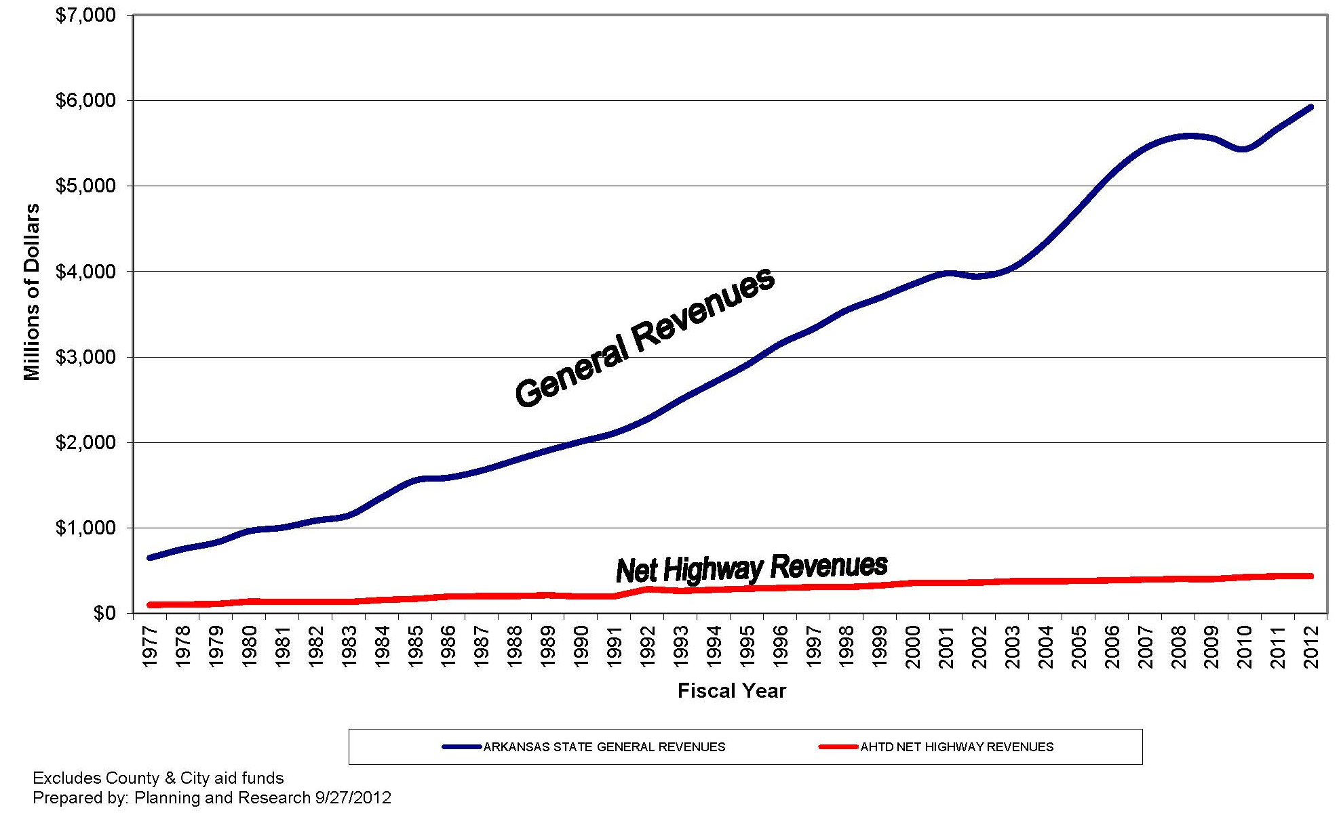
State General Revenues vs.
AHTD Net Highway Revenues
Notes:
This graph truly illustrates the funding issues we face.
Our State General Revenues have continued to grow--at an average of nearly 4% over the past ten years (even with the significant downturn from 2008-2010.)
Gross Highway Revenues (this includes revenues for the AHTD, Cities, and Counties) have remained relatively flat—growing less than 2% on average over the past decade.
Growth in highway revenue over time has generally been the result of motor fuel tax increases (1991 for example), not natural growth.
Flat revenues--combined with increasing costs--have resulted in a tremendous hardship for the state, cities, and counties.
We simply are not able to keep up with our needs.

Slide 30
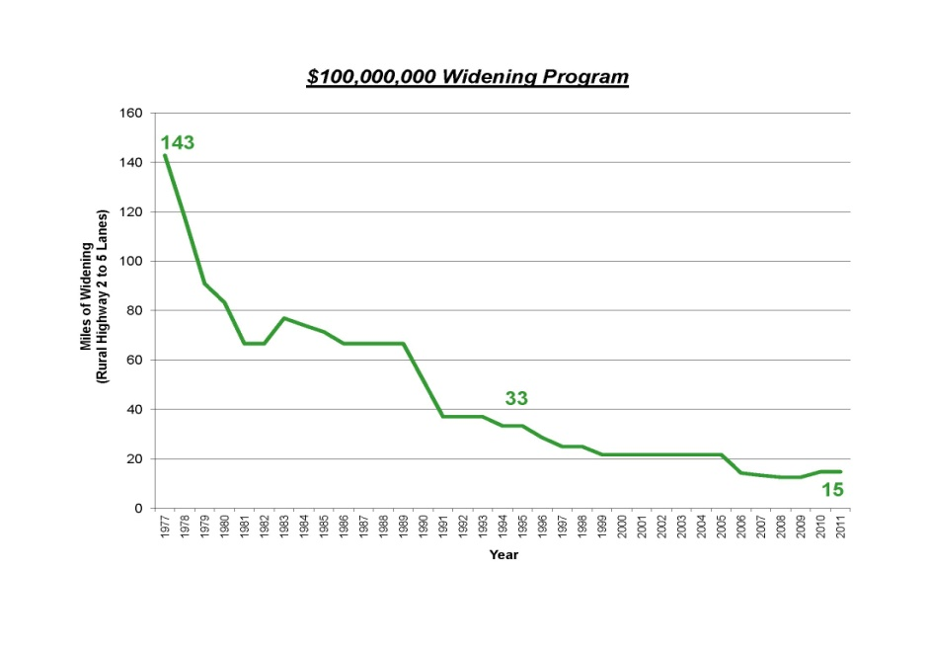
AHTD Challenges
$100,000,000 Widening Program
Miles of Widening
Rural Highway 2 to 5 lanes

Slide 31
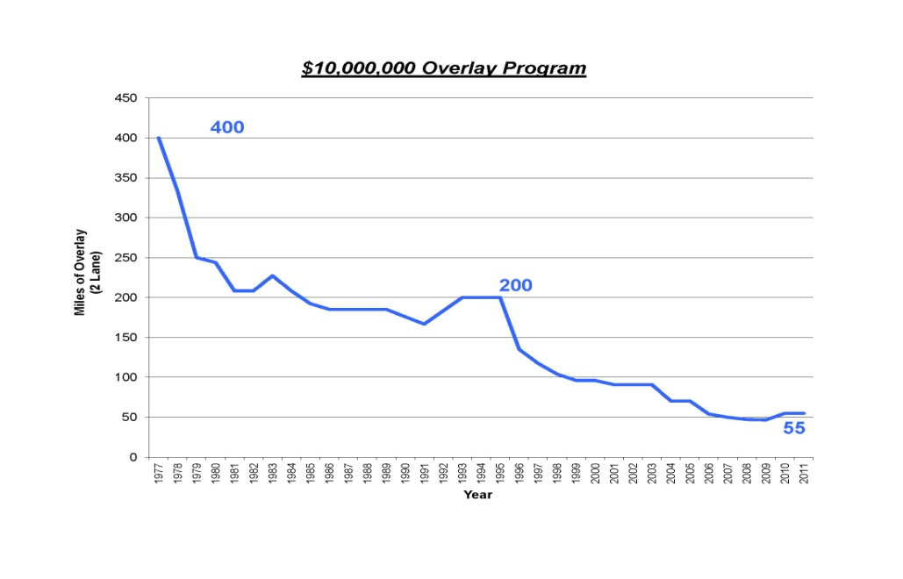
AHTD Challenges
$10,000,000 Overlay Program
Miles of Overlay
2 lanes

Slide 32
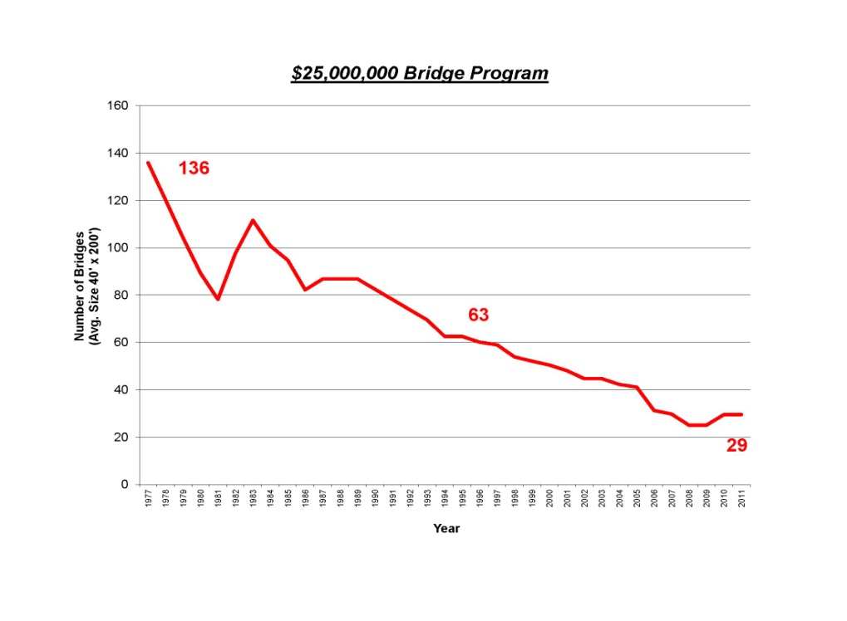
AHTD Challenges
$25,000,000 Bridge Program
Number of Bridges
Average size 40’ X 200’

Slide 33


Needs vs. Revenue
= 200 miles
= 450 miles
Notes:
Let’s chat a little more about the CAP and the IRP.
Cap=about 200 miles of highway
IRP=450 miles of highway
16,400 mile system

Slide 34

Needs vs. Revenue
+
Total = 650 miles
3.9%
Notes:
Those two programs cover just 650 miles of the 16,400 mile system. That translates to just 3.9 percent. More needs to happen to maintain our existing highway system.

Slide 35
Needs vs. Revenue
    An additional $200 million annually is needed over the next 10 years
    for highway congestion, pavement and bridge conditions, maintenance, administration and operations to remain at current levels.
Notes:
We have 23 billion dollars in needs over the next ten years. Even with the half cent general sales tax, we are only going to have 6 billion dollars to meet those needs. We need an additional 200-million dollars annually just to keep everything as it is. If we don’t get that money, our job will be to manage the decline of our highway system.
35

Slide 36
HIGHWAY TRUST FUND
ESTIMATED FEDERAL HIGHWAY AND TRANSIT PROGRAM FUNDING LEVELS
WITH NO NET NEW REVENUES
Highway Safety
Federal Aid Highway
Transit
Notes:
The main points of the testimony were:
1. The current trajectory of the HTF is unsustainable. Starting in fiscal year 2015, the trust fund will have insufficient resources to meet all of its obligations, resulting in steadily accumulating shortfalls.
2. Since 2008, the Congress has avoided such shortfalls by transferring $41 billion from the general funds of the Treasury to the HTF. The Congress has enacted an additional transfer of $12.6 billion that is scheduled to occur in 2014. If lawmakers chose to continue authorizing such transfers, they would have to transfer an additional $15 billion in 2015 and increasing amounts in subsequent years to prevent future shortfalls, if spending was maintained at the 2013 level, as adjusted for inflation.
3. Lawmakers could also address the projected annual shortfalls by substantially reducing spending for surface transportation and transit programs, by boosting revenues, or by adopting some combination of the two approaches. To bring the trust fund into balance in 2015 would require entirely eliminating the authority in that year to obligate funds (projected to be about $51 billion), raising the taxes on motor fuels by about 10 cents per gallon, or undertaking some combination of those approaches.

Slide 37

National Survey:
American Manufacturers
70 %
American infrastructure is in fair or poor shape and needs a great deal or quite a bit of improvement
Notes:
Here’s a recent poll conducted among members of the National Manufacturers Association.
70 percent say American infrastructure is in fair or poor shape and needs a great deal or quite a bit of improvement.

Slide 38
National Survey:
American Manufacturers
70 %
American roadways are getting worse
Notes:
70 percent also say American roadways are getting worse.

Slide 39
National Survey:
American Manufacturers
65 %
Do not believe that infrastructure is positioned to respond to the competitive demands of a growing economy over the next 10 to 15 years
Notes:
65 percent do not believe that infrastructure is positioned to respond to the competitive demands of a growing economy over the next 10 to 15 years.

Slide 40
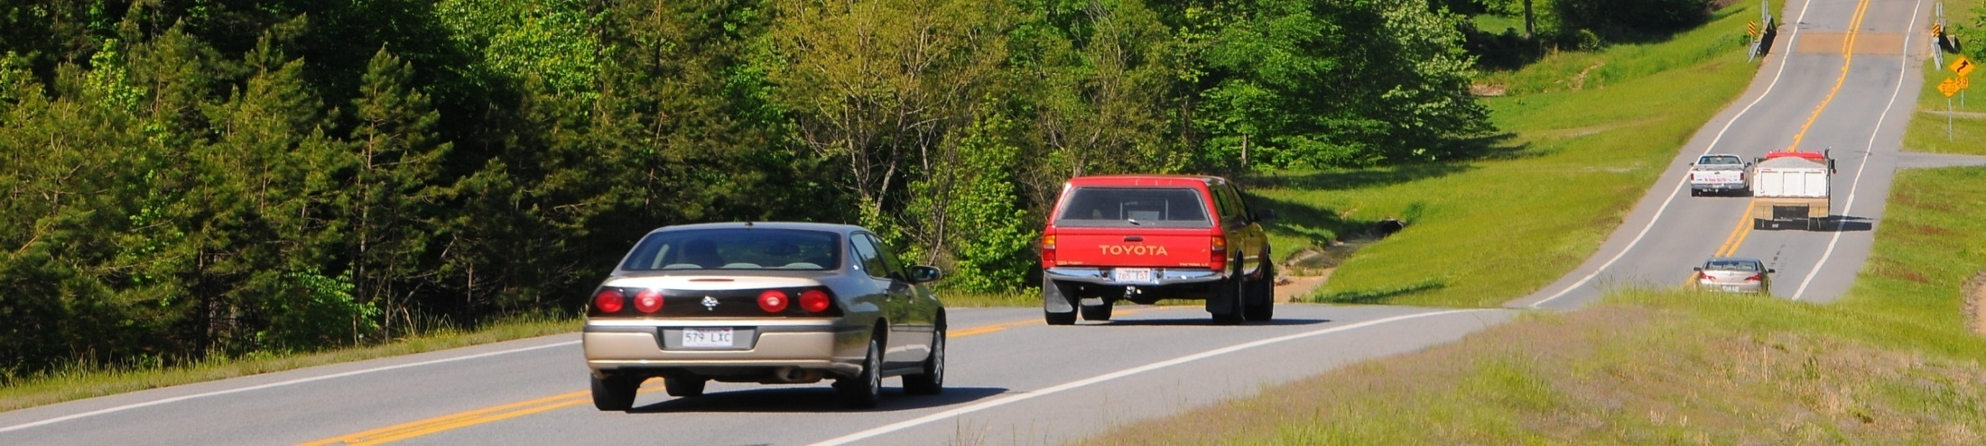
National Survey:
Americans Value Good Roads
78 %
Driving a motor vehicle is “Very” or “Extremely” important to conducting daily lives
Notes:
This despite the fact that Americans value good roads. In a national survey…
78 % Driving a motor vehicle is “Very” or “Extremely” important to conducting daily lives.

Slide 41
National Survey:
Americans Value Good Roads
88 %
Transportation infrastructure is important to maintaining a strong economy
Notes:
88 % Transportation infrastructure is important to maintaining a strong economy.

Slide 42
National Survey:
Americans Value Good Roads
83 %
Transportation network is important to ensuring national defense and emergency response
Notes:
83 % Transportation network is important to ensuring national defense and emergency response.

Slide 43
Average Monthly Household
Expenditures
Notes:
So if we value out highways so much.. And want them to improve.. Why do we spend so little on them?
As a state and a nation, we are under investing in our infrastructure. Even with the half cent sales tax passed back in November.
Most Americans have no idea how much money they pay every month to maintain roads, bridges and public transportation.
Compared to the average monthly American household expenditure on state and federal gas taxes used to fund surface transportation improvements necessary for mobility, data from the U.S. Department of Commerce and the Federal Highway Administration show the average household spends:
Nearly 3.5 times more monthly ($159) for electricity and natural gas
Nearly 3.5 times more ($161) for telephone service; and
More than 2.5 times more ($124) for cable and satellite television, radio and internet service.
19 percent more on internet service than on highways.
This just doesn’t make sense. It must change.

Slide 44

Construction Zone Locations
Live Traffic Conditions
Weather Radar
Live Traffic Cameras (Coming Soon)
Notes:
Before I go, I want to tell you about something we are very excited about. “I Drive Arkansas.” It’s our new website. On it, you will be able to get…
Construction zone locations
Live traffic conditions
Weather radar
Live traffic cameras (Coming Soon)
Eventually, you will also be able to sign up for email alerts for upcoming construction projects in your area.

Slide 45

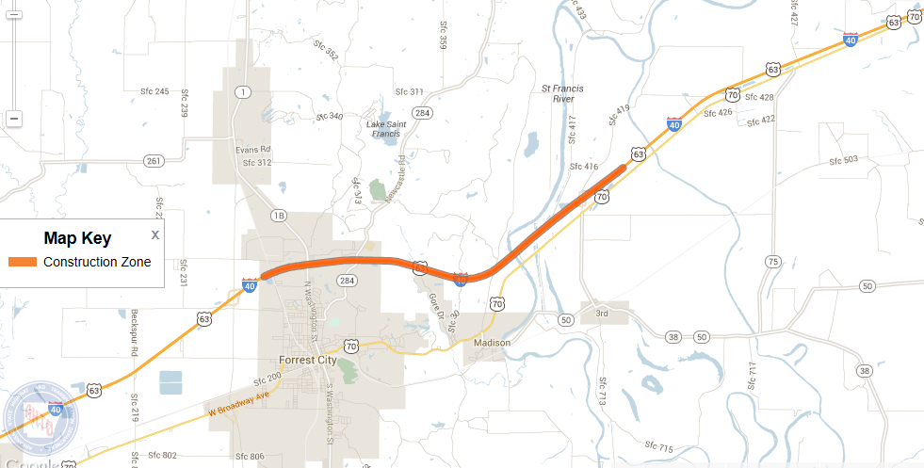
Notes:
It allows you to zoom down on construction zones. This one is located just east of Forrest City on Interstate 40.

Slide 46
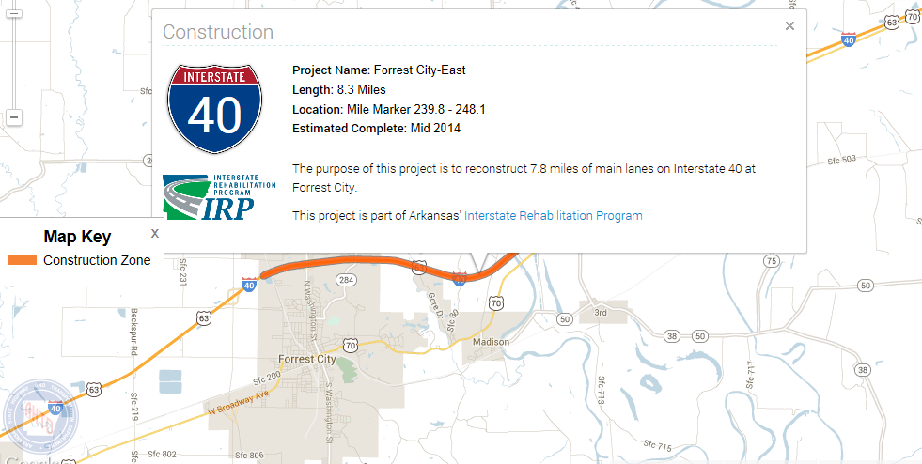
Notes:
When you click on the construction zone, it displays a dialogue box. You can get information on the length of the project, the location and the estimated completion date.

Slide 47
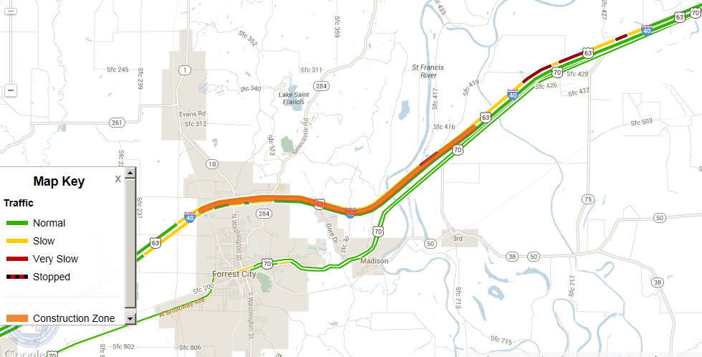
Notes:
It also allows you to see live traffic flow information related to the construction zone.
Green = Traffic running smoothly
Yellow = Slow
Red = Very Slow
Red/Black = Traffic is stopped

Slide 48
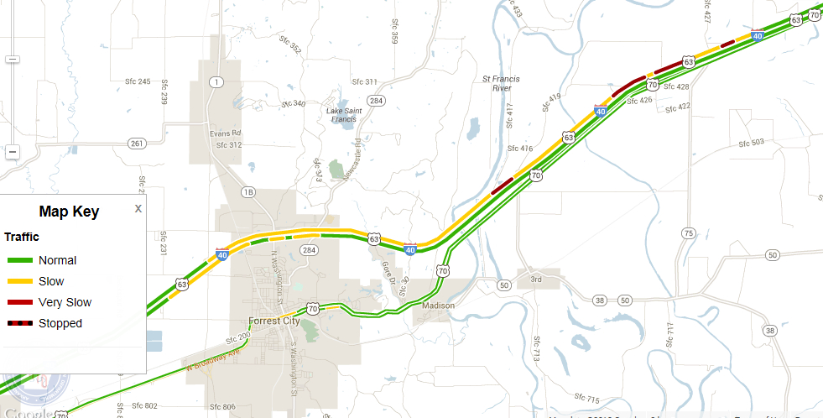
Notes:
You can also delete construction zones to show only live traffic flow.
(Traffic flow is detected using the movement of cell phone signals)

Slide 49
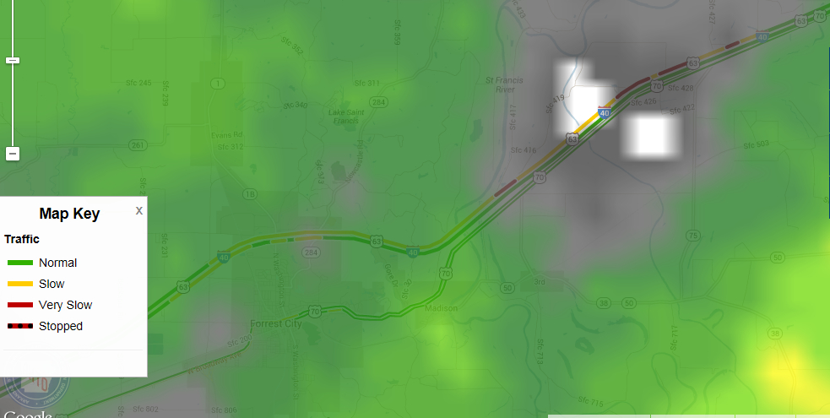
Notes:
It also has a weather radar. And current conditions as well as forecasts for individual cities.

Slide 50
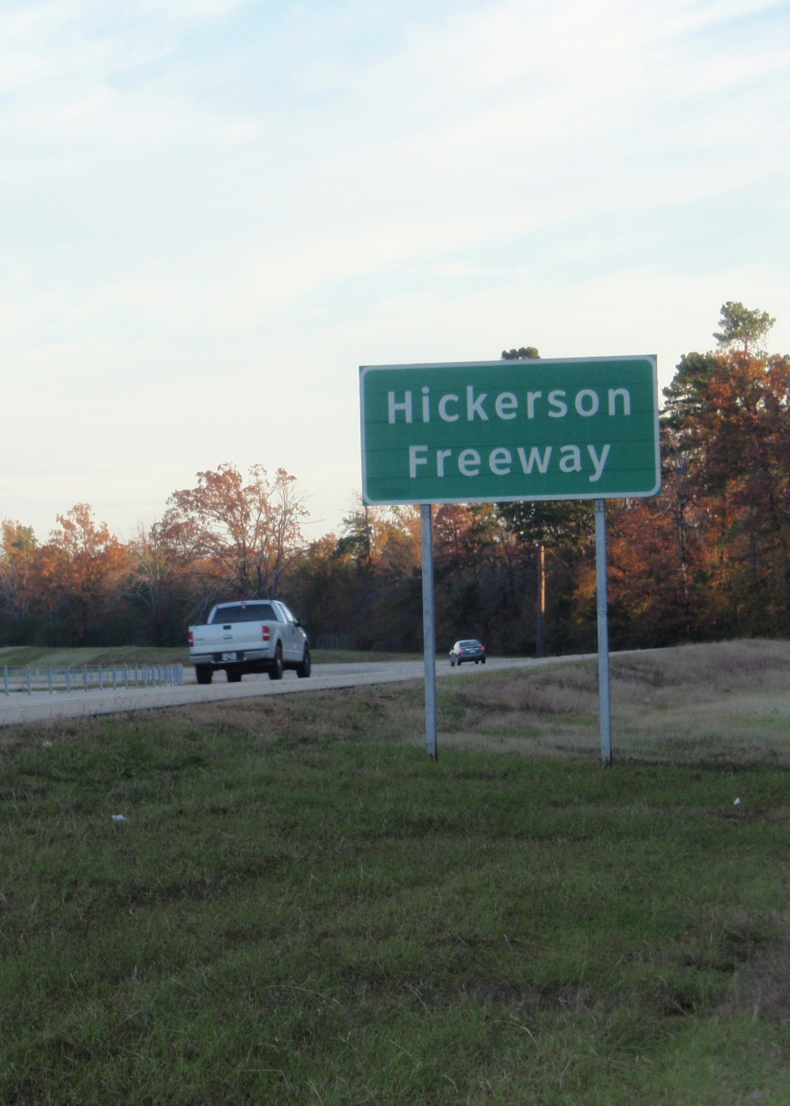
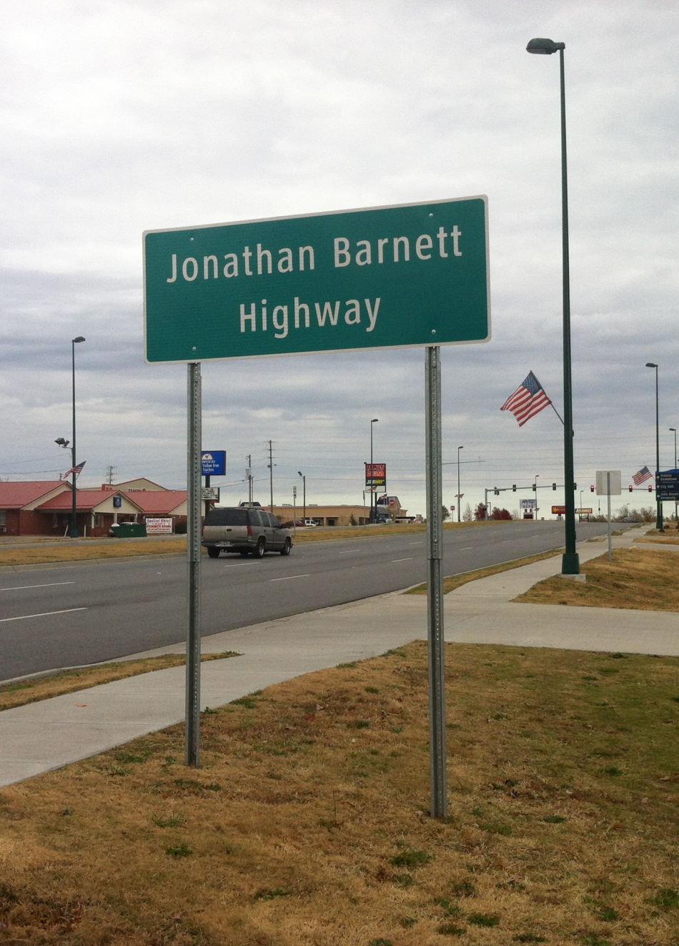
Familiar Names
Notes:
Before I go.. You may have noticed some familiar names on the road.

Slide 51
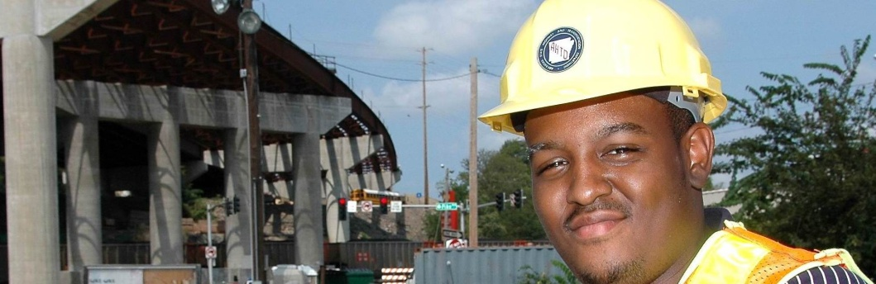


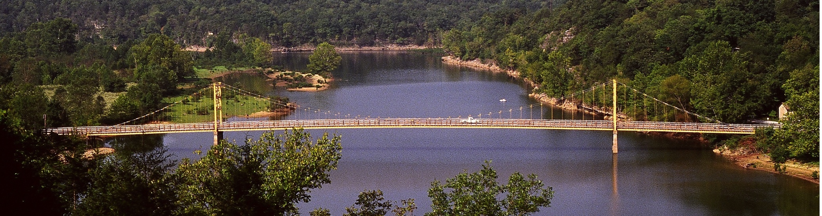
ArkansasHighways.com
Litter Hotline 866-811-1222
@AHTD
Notes:
A REMINDER:
You can get all your Arkansas travel information at ArkansasHighways.com.
Also, follow us on Twitter at AHTD and get information on lane closures, etc.

