Slide 1

Arkansas Health Care Reform
Task Force
TSG Update Report #1
June 2015, revised 6/11 12:30PM

Slide 2
Executive Summary
May 16
June 11
Oct 1
Today’s Report
Strong cooperation from Agency and Private Option carriers
Address many of the Task Force Questions about Arkansas Medicaid program and Health Care Independence Program
Offer TSG analysis and preliminary observations
Working on several potentially substantive issues:
  Need for improved contract & vendor management → from eligibility to program operation
  High Focus on institutional care in both LTC and DD → very high cost options are utilized
  Comparison to other state spending shows opportunity to adopt best practice
  Multiple Medicaid Waivers already exists; some cross similar populations and need to consolidate

Slide 3
Initial Observations
Finance
Traditional Medicaid had been growing rapidly, has moderated since 2014 to approximately 2% annually
A significant amount (over $1 billion) of Medicaid is paid outside the claims process
The Private Option program now accounts for over 20% of total Medicaid expenditures
Most Long Term Care is provided in Nursing homes at a cost more than twice that of Assisted Living and even greater than that for home care
Traditional Medicaid costs are more than Private Option on a PMPM basis, driven by ABD population

Slide 4
Initial Observations (cont.)
Long Term Services and Supports
Arkansas ranked 40th by AARP for recipient choice
All initial assessments for nursing home placements are conducted by Nursing Home professionals
Developmental Disabilities
50/50 split between resources expended for institutional care and home and community based care
Pharmacy
Arkansas does not participate in a multi-state rebate pool
Appears that a low percentage of opiate users locked in to a single dispensing pharmacy

Slide 5
Initial Observations (cont.)
Procurement
The procurement timeline is VERY lengthy. From the start of the procurement to the onboarding of a project team is now an 18 month to 2 year process
Medicaid has experienced a number of challenges related to using staff augmentation (time and materials) contracts affecting several vendors including: EngagePoint, eSystems, Computer Aid Inc (CAI)
Contracts appear to be missing incentives for the contractors to minimize cost
Procurement and contracting process has improved significantly over the last 4 years. However, the State has assumed the majority of risk for many projects

Slide 6
Initial Observations (cont.)
Procurement (cont.)
The State has not invested in many PMO or contract management experienced personnel
Systems Projects
Ongoing information eligibility software systems implementations are clearly still troubled projects committed to steep development curves and delivery dates

Slide 7
Initial Observations (cont.)
Eligibility
Redetermination of Private Option eligibility has no current mechanism to accept real time alerts from the State Wage data base
The MAGI Eligibility and Enrollment system went live October 1, 2013 and still has unresolved issues
Cognosante will have 13 people in a PMO role with a focus on avoiding a worst case scenario
RedMane has been engaged to do the work to support SNAP. This is caught up in confusion between Redmane and IBM
The new CURAM system was purchased with the expectation that 80% of new applicants could then be handled automatically, or “no touch.” The actual no touch rate is closer to 17%

Slide 8
Initial Observations (cont.)
Health Independence Account
The FY 2016 management contract is for $8,060,100.00 (Approximately $66.00 per member per month, which does not take into consideration any risk and opportunity cost for vendor to shift a large portion of their business to meet State’s immediate resource need here).
42,753 cards issued, of which 10,175 are currently activated. Yet, the amount applied to successful transactions from January to May of 2015 was $170,932.26
Similar contract with State Employees has over 20,000 users and costs approximately $4 per member per month

Slide 9
Overall Medicaid Questions
Task Force Queries about costs | 2014 Amounts
Prescription drugs | 372,716,180
Long-term care | 970,898,395
Nursing home care | 696,112,127
Assisted living facility care | 16,175,328
Mental health services | 560,230,744
Hospital care | 1,560,952,845

Slide 10
Federal and State Share of Medicaid
SFY 2014
 | Federal | State | Total
Traditional Medicaid | 3,354,200,000 | 1,389,000,000 | 4,743,200,000
Private Option | 371,700,000 | 2,400,000 | 374,100,000
Total | 3,725,900,000 | 1,391,400,000 | 5,117,300,000
Calculation:
Includes $24 million of overhead in addition to $5.1 billion in claims
70% & 30% of Traditional Medicaid claims
50% & 50% of Admin
Note: CHP is actually 80% & 20%, but TSG has not yet identified the full CHP cost. CHP is less than $100 million so the error is small

Slide 11
Details of Medicaid in SFY2014

Slide 12
Details of Long Term Care, page 1/2
* SFY 2015 through March

Slide 13
Details of Long Term Care, page 2/2
* SFY 2015 through March

Slide 14
Details of Hospital Services, page 1/3
SFY2015 amounts are ytd through March

Slide 15
Details of Hospital Services, page 2/3
SFY2015 amounts are ytd through March

Slide 16
Details of Hospital Services, page 3/3
SFY2015 amounts are ytd through March

Slide 17
Details of Mental Health
* SFY 2015 through March

Slide 18
Medicaid Monthly Costs per Beneficiary, 2007-2014

Slide 19
Medicaid Costs per Beneficiary
2014-2015

Slide 20
Medicaid Program cost?
Per state share? Per federal share?

Slide 21
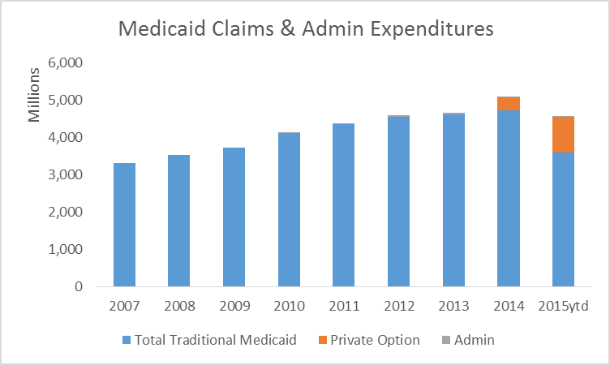
Medicaid Trends
2015 amount is through March 31

Slide 22
Top Growth Areas in Traditional Medicaid: by Cost Category

Slide 23
Top Growth Areas in Traditional Medicaid: by Beneficiary Aid Category

Slide 24
Projection of State Share
Revised 6-11 12:30PM

Slide 25
Enrollment History
Enrollment in Traditional Medicaid grew at 1.0% per year 2006-2013
Then, 30,000 people moved from Medicaid to Private Option

Slide 26
Enrollment Projection
State population has been growing at 0.4% per year
Medicaid enrollment has increased 0.4-0.5% for most of the past decade, except 2010 which seems to be an outlier
While baby boomers will develop into the Aged, the best predictions (US Admin on Aging) is that the Aged population will shift from 22% to 26% of total by 2020, that is 0.35% change per year
Thus, it is likely that traditional Medicaid enrollment will continue to increase at about the rate of the state population
While Private Option continues to grow in 3Q2015, it is likely to plateau in 2015
Thus at this point, it seems prudent to project all categories of beneficiaries at 0.5%

Slide 27
Preliminary Enrollment Estimate

Slide 28
Expenditure Forecast Detail:
High Growth Scenario
Revised 6-11 12:30PM

Slide 29
Expenditure Forecast Detail:
Low Growth Scenario
Revised 6-11 12:30PM

Slide 30
Comparing Nursing Homes to Assisted Living
Based on Data from September 2014 | 58 - Private SNF | 59 - Private SNF Crossover | 63 - Public SNF | Assisted Living Facility
Total September Amount | $48,296,194 | $1,674,318 | $2,908,318 | $1,421,416
# Recipients | 11,534 | 1,512 | 229 | 749
Ave/person/month | $4,187 | $1,107 | $12,700 | $1,898
Per Day* | 140 | 37 | 423 | 63
* To calculate, TSG divided the total September 2014 expense by the number of beneficiaries that were in a facility at any time during the month. Also, TSG divided the monthly amount by 30 days. Both of these approaches will somewhat understate the average cost.

Slide 31
Comparing Arkansas Medicaid Spending to Other States
(Source: CMS/Truven Health Analytics: 4/28/14) Expenditures Per Resident: Total LTSS Costs: FY 2012 Note: As part of this project, TSG will be reaching out independently to states and may obtain more updated data, including financial data within the State of Arkansas Medicaid so the use of Truven’s data analysis is only to provide the Task Force with some snapshot of comparison without knowing exactly the data sets that Truven used for their report.
State | Expenses Per Resident | State Rank
Arkansas | $606.64 | 11
Mississippi | 505.92 | 18
Louisiana | 488.72 | 19
Missouri | 454.56 | 23
Kansas | 415.29 | 27
Tennessee | 360.82 | 32
Oklahoma | 322.92 | 37
Texas | 291.09 | 42
US | $445.92 | NA
* To calculate, TSG divided the total September 2014 expense by the number of beneficiaries that were in a facility at any time during the month. Also, TSG divided the monthly amount by 30 days. Both of these approaches will somewhat understate the average cost.

Slide 32
Comparing Arkansas Medicaid Spending to Other States (cont.)
State | Acute Care | Long Term Care | DSH Payments | Total
US | 68.2% | 28.4% | 3.7% | 100%
Arkansas | 64.2% | 34.3% | 1.5% | 100%
Kansas | 72.2% | 24.8% | 3.7% | 100%
Louisiana | 58.7% | 30.5% | 10.7% | 100%
Mississippi | 65.4% | 30% | 4.6% | 100%
Missouri | 66.6% | 25.5% | 7.9% | 100%
Oklahoma | 72.9% | 26.2% | .9% | 100%
Tennessee | 87.8% | 11.3% | .8% | 100%
Texas | 79.5% | 19.7% | .8% | 100%

Slide 33
State Medicaid Waivers
Arkansas Health Care Independence Program: 1115
Arkansas Elder Choices: 1915 (c)
Arkansas Tax Equity & Fiscal Responsibility: 1115
Alternative Community Services: 1915 (c)
Alternatives for People with Physical Disabilities: 1915 (c)
Non-Emergency Transportation: 1915 (b4)
AR Autism: 1915 (c)
ARKidsB: 1115
AR Living Choices Assisted Living: 1915 (c)
Note: Does not include State Plan Amendments

